Slide 1
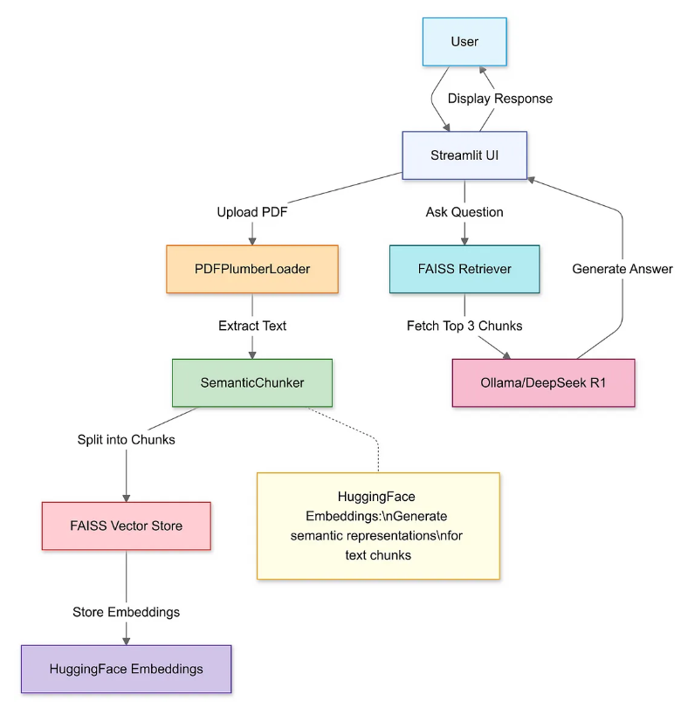

Slide 2
National Office Report

Slide 3
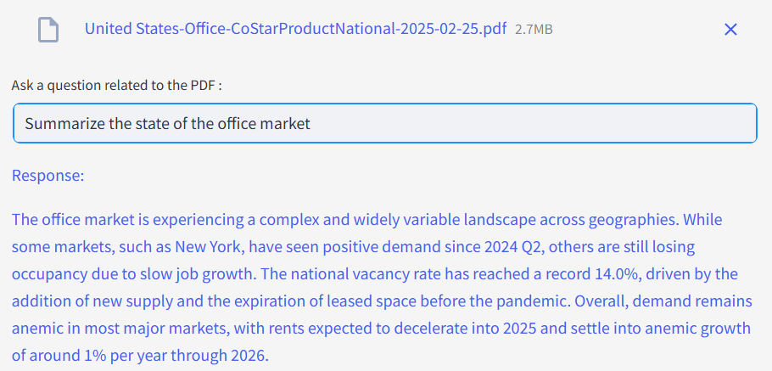

Slide 4
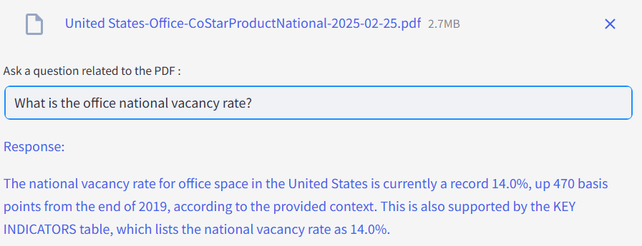

Slide 5
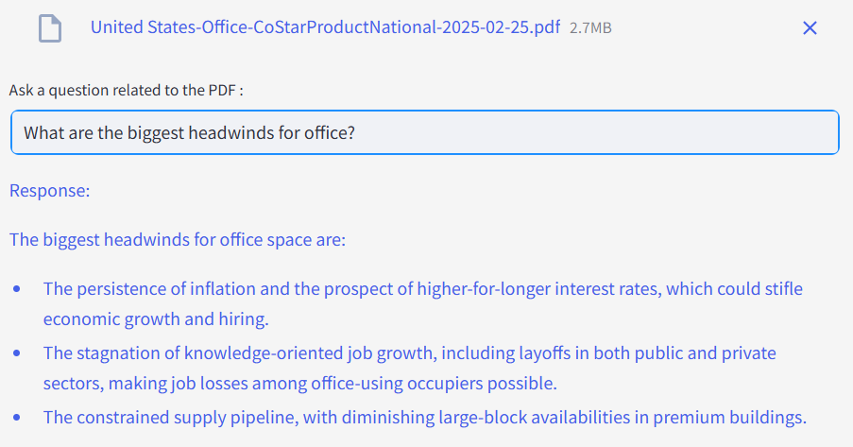

Slide 6
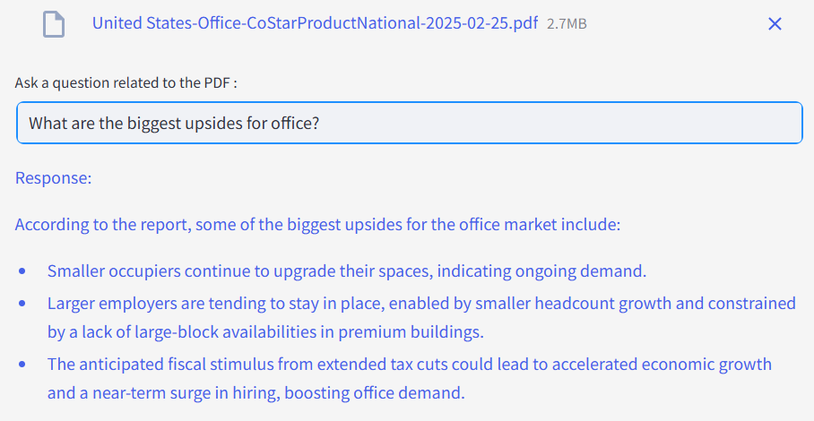

Slide 7
Forecast and Data White Paper

Slide 8
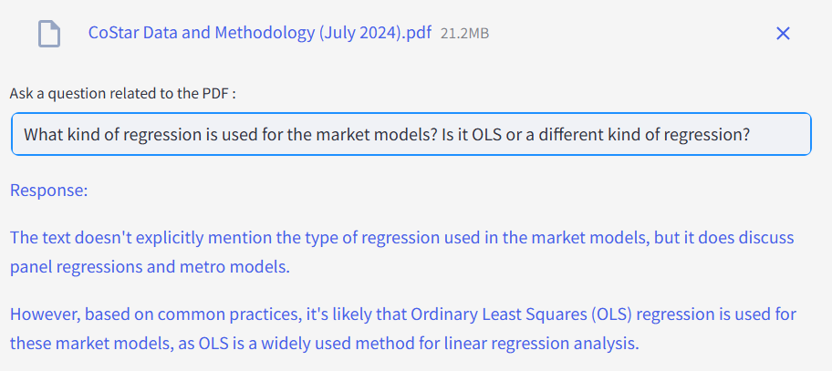
Answer: OLS

Slide 9
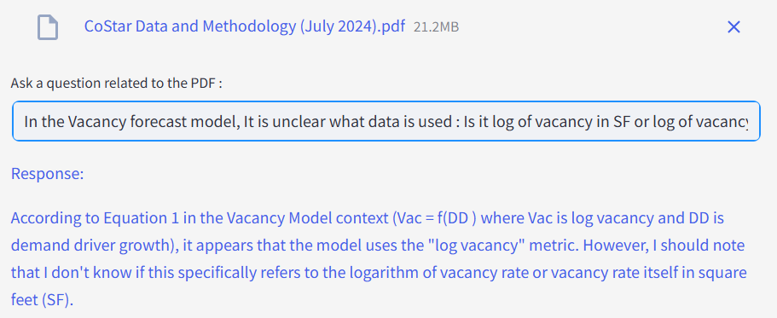
Answer: log of vacancy rate

Slide 10
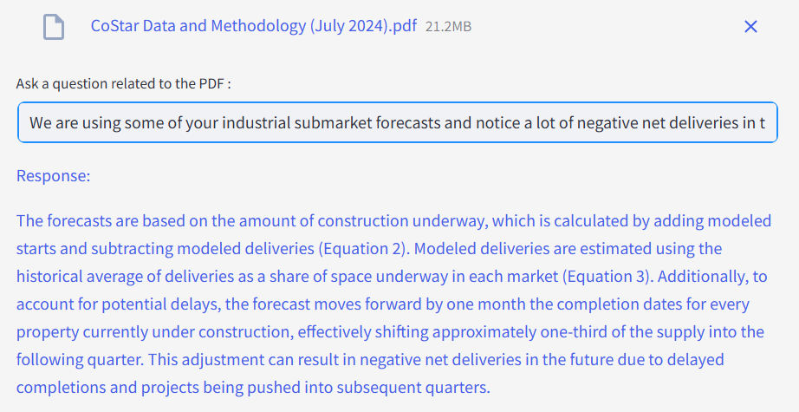
Answer: Every submarket’s forecast includes an estimate for future demolitions/removals based on its historical average (see chart below with negative net deliveries in history). And if a submarket, such as this one, has little or no under construction, then the net deliveries forecast will be slightly negative in each quarter. Note that these do not represent actual properties that will be demolished in the future (CoStar does not track future demolitions), these just represent a chance of a demolition based on the submarket’s historical average demolitions.

Slide 11
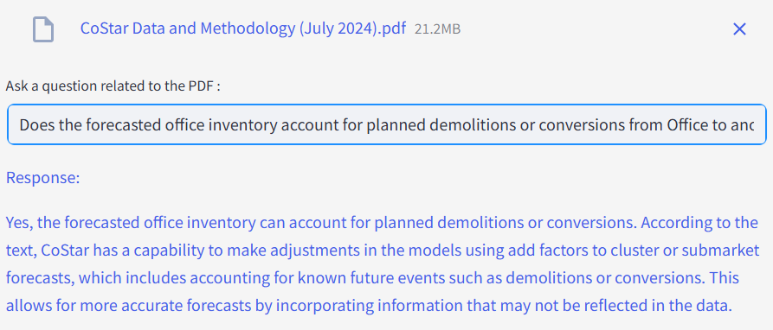
Answer: The market level guidelines are just using historical averages of demolitions in the forecast. I don’t believe they’re in the property forecast until they happen, but then it’s history

Slide 12
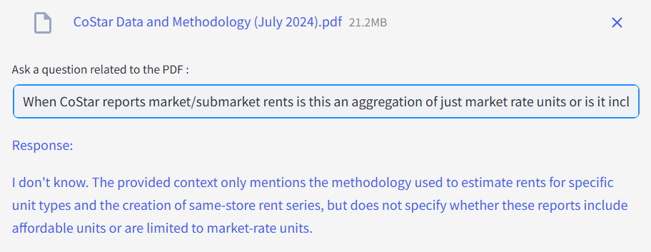
Answer: Aggregate market/submarket rents are only of market rate units

Slide 13
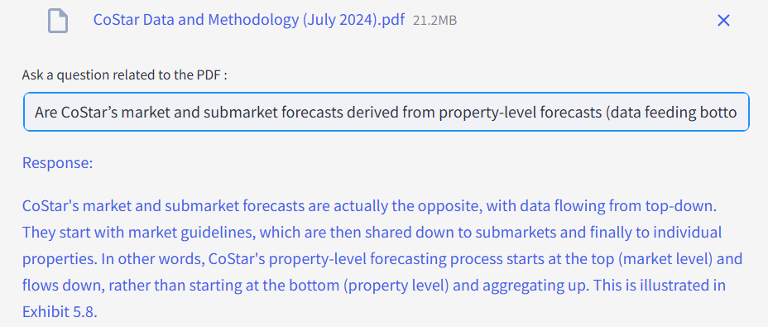
Answer: CoStar’s market and submarket forecasts are derived from property level forecasts that take into account individual building characteristics as well as those of nearby buildings such as impacts from new construction. These property forecasts, however, are also driven by a market level forecast based on an econometric model that takes into account each market’s historical trends and macroeconomic factors such as interest rates and employment.

Slide 14
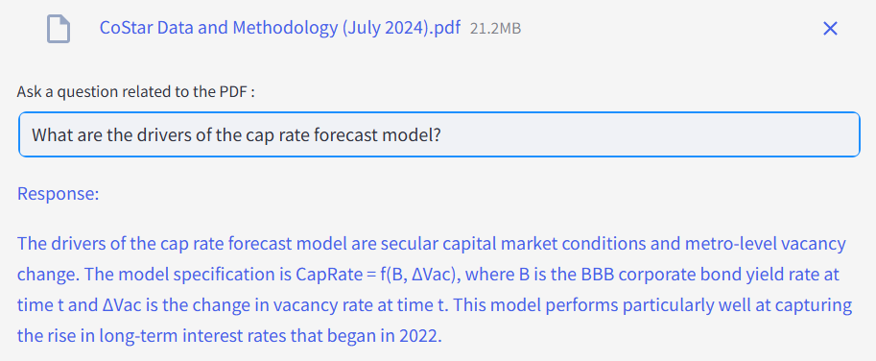
Answer: BBB corporate bond yield and change in vacancy rate

Slide 15
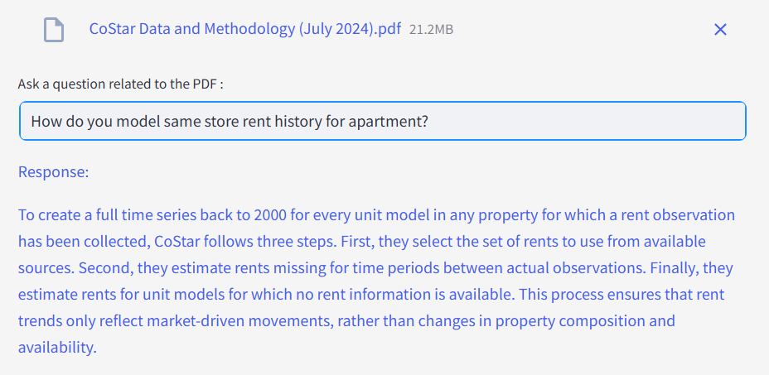

Slide 16
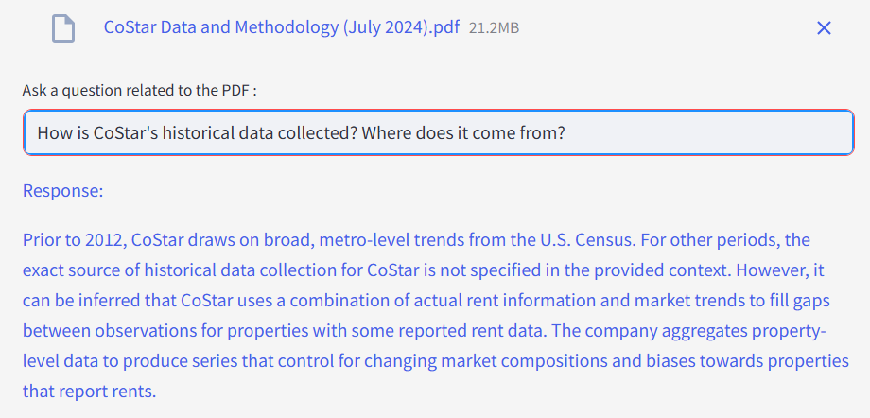
Above is true for apartment, and in general. Need vectors to keep context: separate by heading? Or more naturally?

Slide 17
Glossary

Slide 18
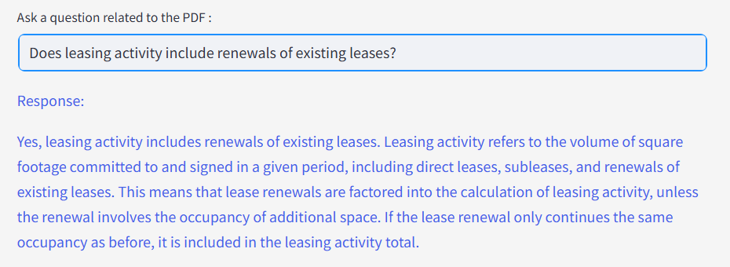
First two sentences are true, then adds extraneous details.

