Slide 1
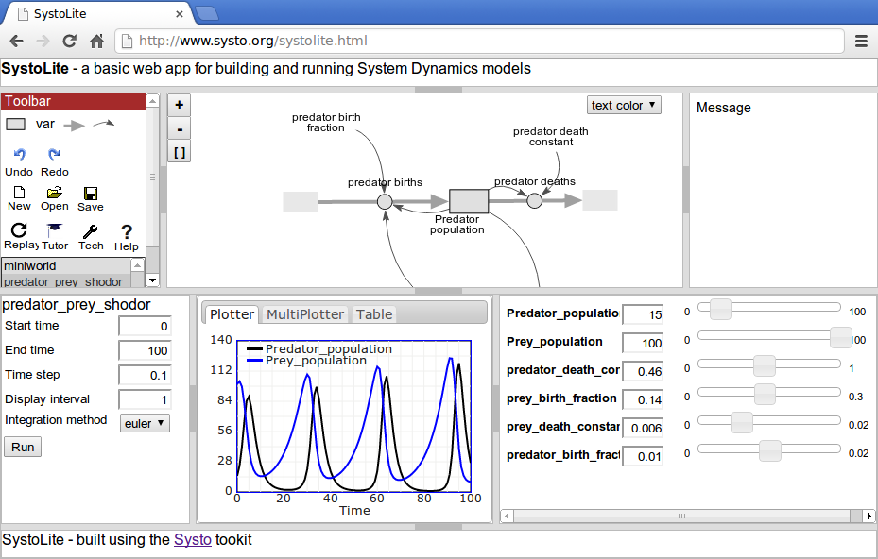
Toolbar panel
Diagram panel
Message panel
Run control panel
Display panel
Slider panel

