Slide 1
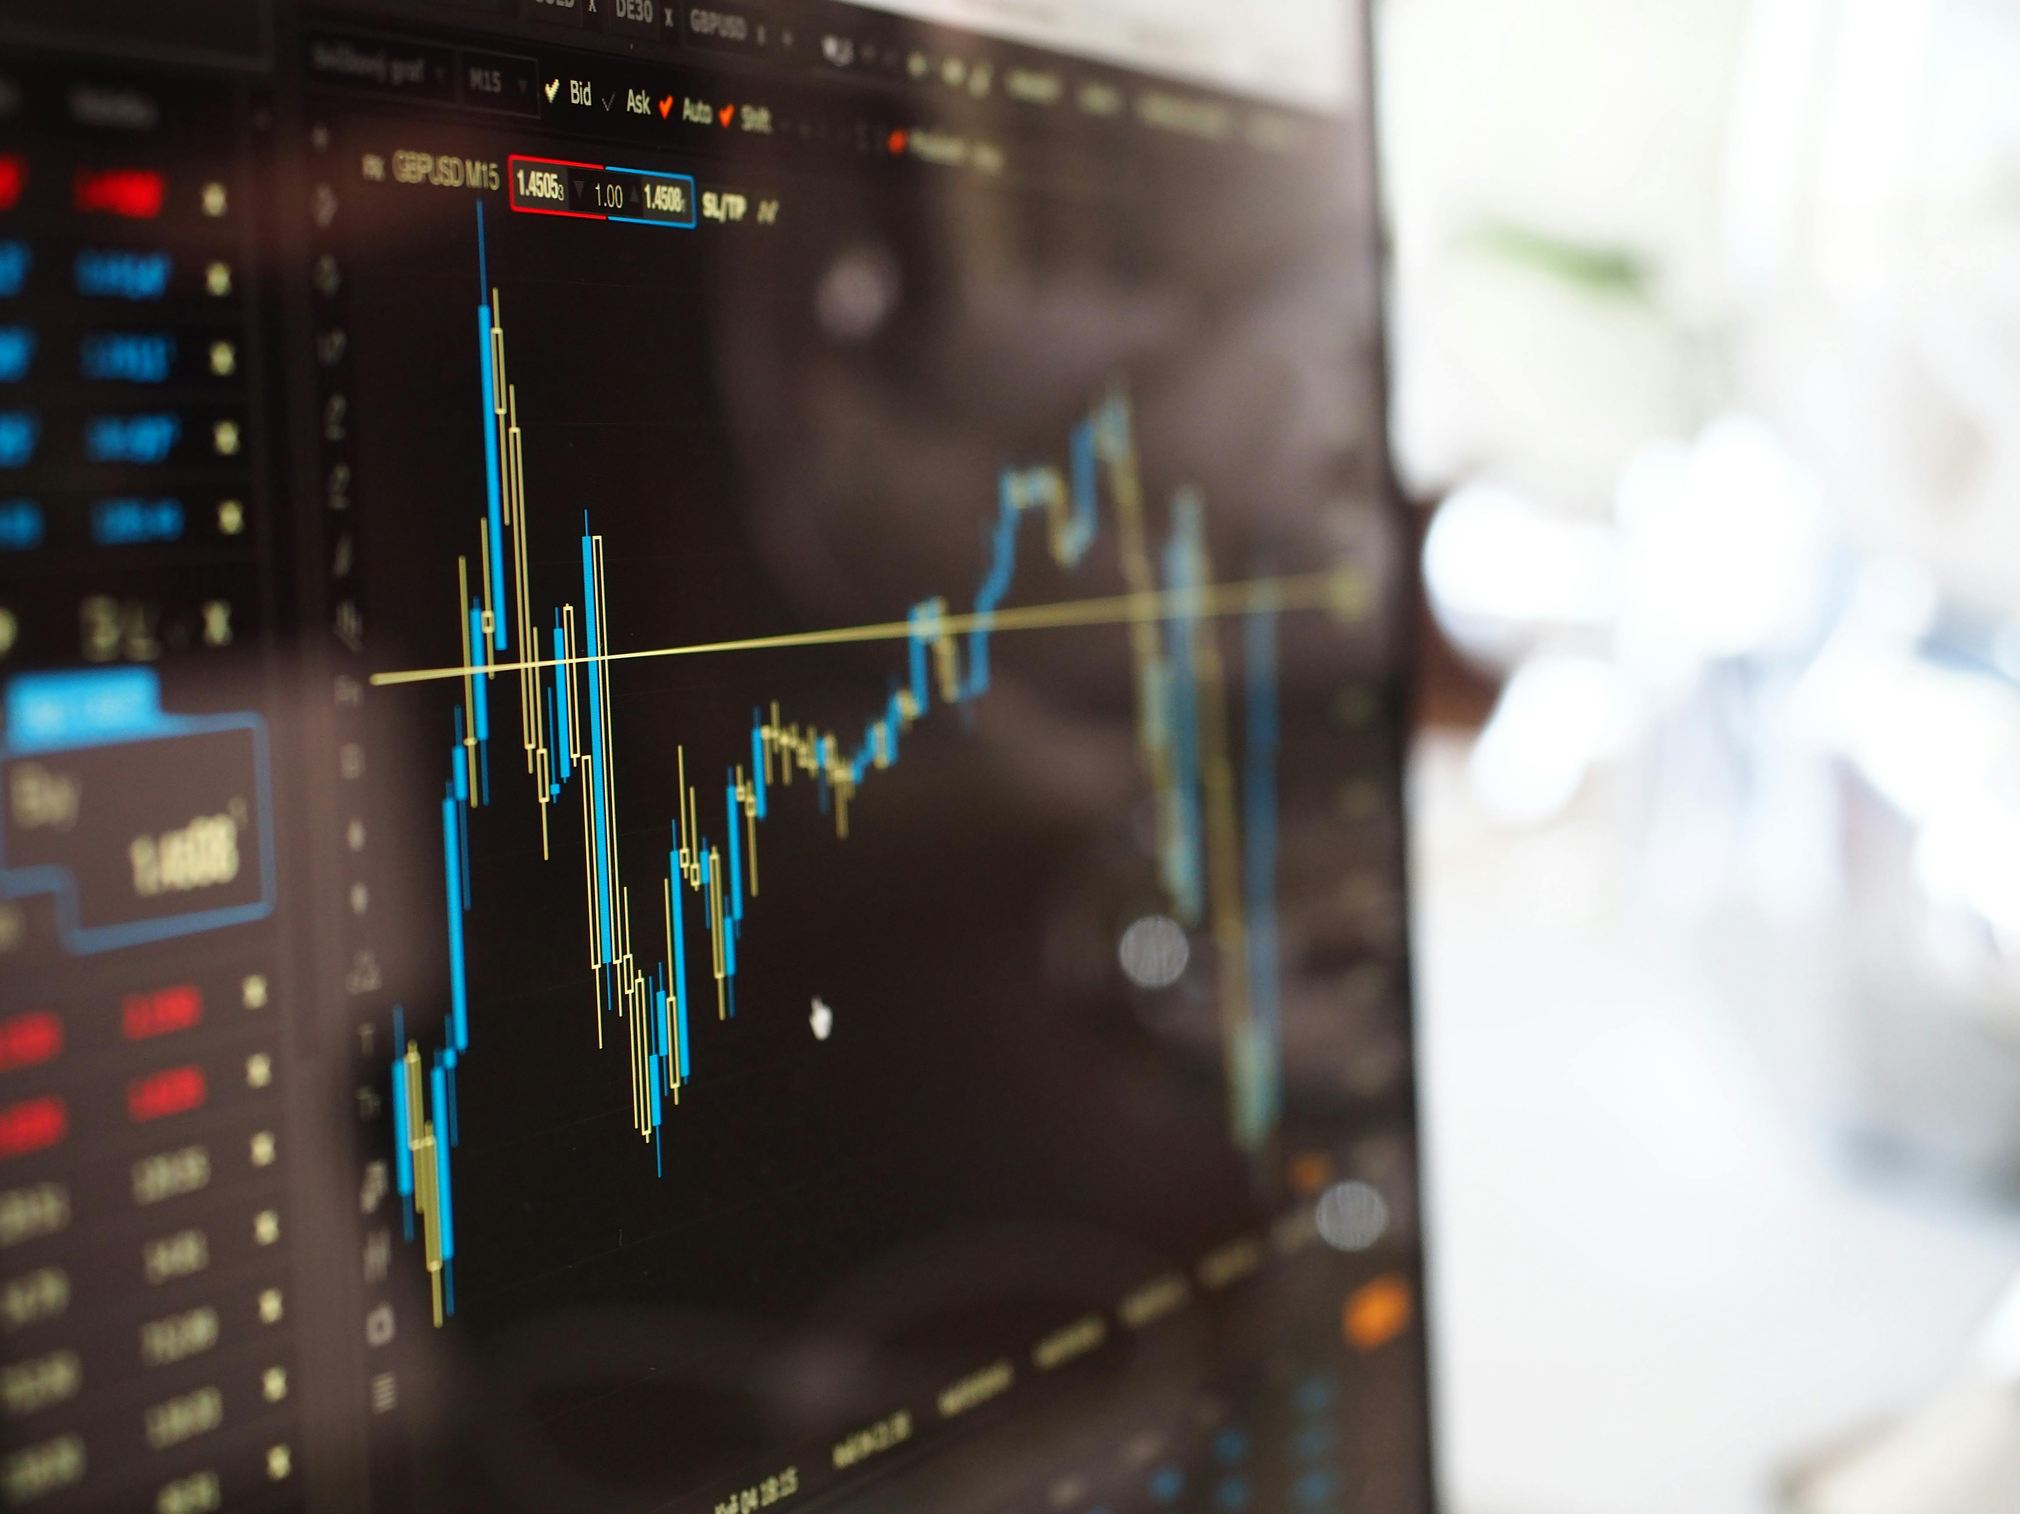
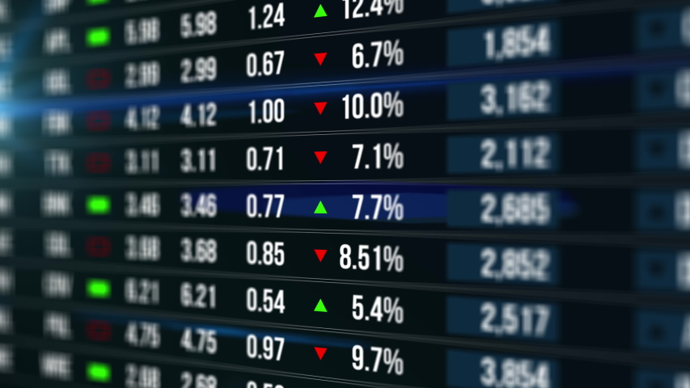
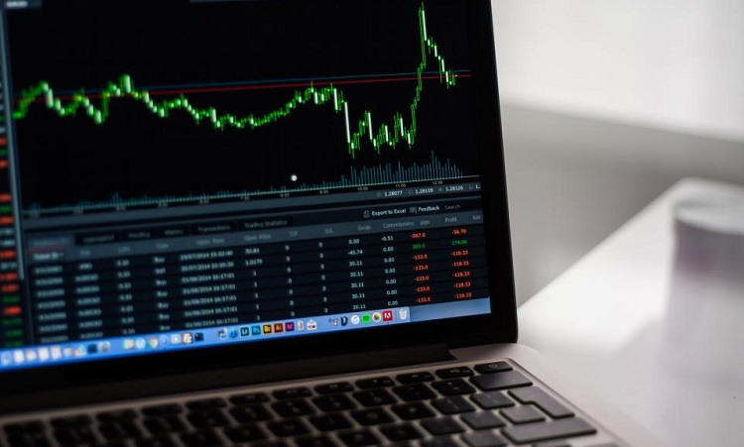
Introduction
The stock market is a dynamic environment influenced by global news, economic reports, and social
media trends. Current tools often fail to provide:
- Accurate sentiment analysis
- Robust real-time alerts
- Effective integration of data and visualization
This project integrates real-time sentiment analysis, reinforcement learning, and interactive dashboards
to address these gaps.
This Photo by Unknown Author is licensed under CC BY-NC
Notes:
This slide introduces the challenges in stock market analysis and highlights the need for integrating advanced tools like sentiment analysis, reinforcement learning, and visualization.

Slide 2
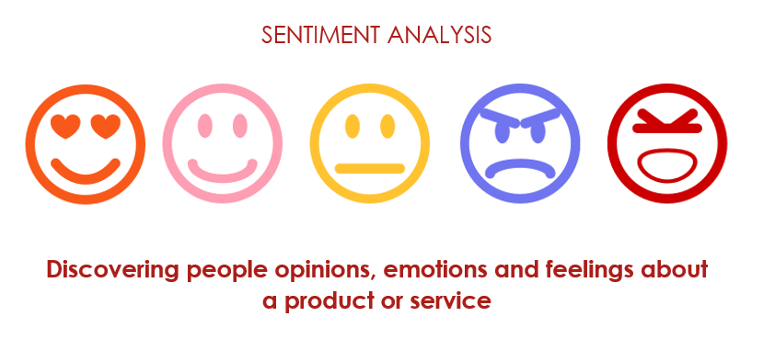

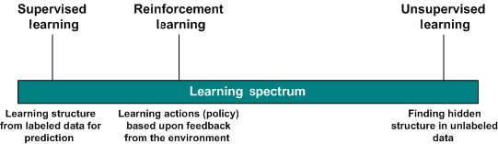
Literature Review
Key advancements in:
- Sentiment analysis using NLP models like BERT and GPT
- Technical analysis tools for trend prediction
- Reinforcement learning for adaptive strategies
Gap: Lack of integrated platforms combining these advancements for comprehensive insights.
This Photo by Unknown Author is licensed under CC BY-SA
This Photo by Unknown Author is licensed under CC BY-SA
This Photo by Unknown Author is licensed under CC BY-SA
Notes:
This slide discusses the foundational research and advancements in sentiment analysis, technical analysis, and reinforcement learning that shape the project.

Slide 3
Methodology
Key Components:
1. Data Collection: Historical and real-time stock data from APIs
2. Sentiment Analysis: NLP models for nuanced text interpretation
3. Automated Trading: Reinforcement learning for adaptive decision-making
4. Interactive Dashboards: Built using Plotly for real-time visualization
5. Trading Execution: Alpaca API for programmatic trades
Notes:
This slide outlines the methodology used to develop the project, including data collection, sentiment analysis, automated trading, and visualization components.

Slide 4
Results and Visualization
The platform features:
- Real-time sentiment and technical analysis integration
- Interactive dashboards for actionable insights
- Reinforcement learning for trade optimization
Snapshots include sentiment trends, price data, and real-time visualizations.
Notes:
This slide presents the results, emphasizing the platform's real-time analysis, interactive dashboards, and reinforcement learning optimization.

Slide 5
Discussion
Strengths:
- Comprehensive integration of sentiment and technical analysis
- Adaptive strategies with reinforcement learning
Limitations:
- Limited training scope due to computational constraints
- Challenges with nuanced sentiment interpretation
Notes:
This slide discusses the strengths and limitations of the project, highlighting areas for improvement and the value it provides to traders.

Slide 6
Conclusion and Future Work
Conclusion:
- A robust system combining machine learning, visualization, and automation
Future Work:
- Expand stock coverage
- Enhance computational efficiency
- Integrate advanced risk analysis features
Notes:
This slide summarizes the project's impact and outlines future work, including expanding coverage and enhancing computational efficiency.

Slide 7
References
1. Liu, B. (2012). Sentiment Analysis and Opinion Mining.
2. Lo, A. W. (2016). Adaptive Markets: Financial Evolution at the Speed of Thought.
3. Shneiderman, B. (2020). Data Visualization: The End of Manual Data Management?
4. Bird, S., Klein, E., & Loper, E. (2009). Natural Language Processing with Python.
5. Vasiliev, Y. (2020). Natural Language Processing Using Python.
6. Hochreiter, S., & Schmidhuber, J. (1997). Long Short-Term Memory.
7. Vaswani, A., et al. (2017). Attention is All You Need.

