Slide 1
Angular Basics
Getting started with Typescript
Week 1 – 04.11.2021

Slide 2

Community guidelines
please keep your webcam on if possible
pay attention, participate and ask questions
turn on your mic only when you need to speak
follow your trainer - our workshops are hands-on and we need you to run commands and write the same code as your trainer
time is money & time is the only thing you cannot buy so feel free to leave the meeting if you’re no longer interested

Slide 3

Roșu Andrei
Working in the industry since 2017
Using git since that time
Full-Stack developer at SaguaroNET

Slide 4
Summary
Prerequisites:
Installed Git
Installed VS Code
Setting up Typescript
First TS program
TypeScript Types
Job done!

Slide 5

What is Typescript?
TS – Type Script
a strongly typed programming language that builds on JavaScript giving you better tooling at any scale.
can find errors before the building step, JS can’t

Slide 6

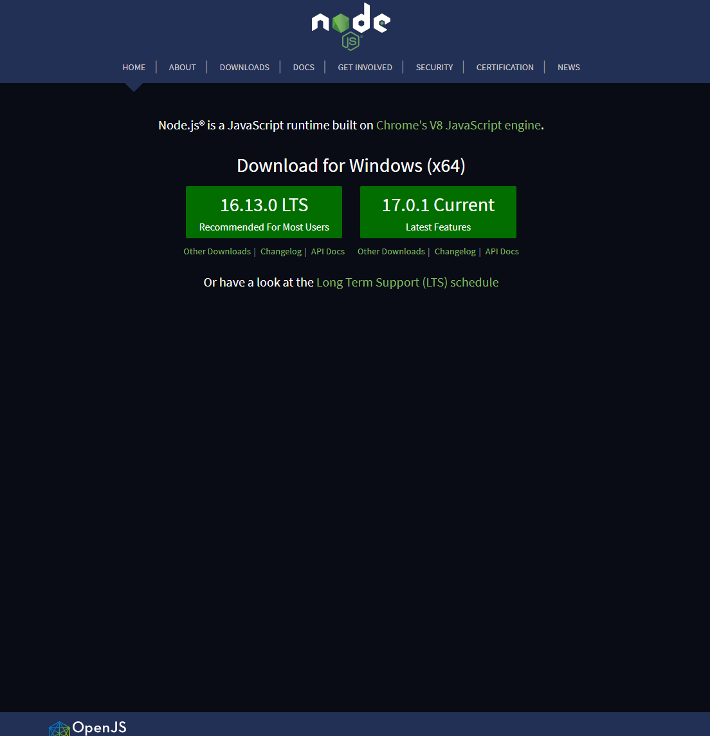
Setting up Typescript
1. Install NodeJS – download and install the LTS version from https://nodejs.org/en/

Slide 7
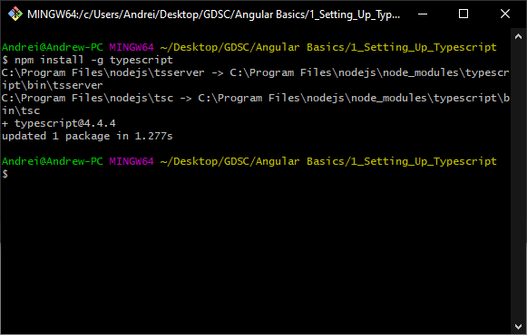

Setting up Typescript
2. Install Typescript – this is done by running the following command:
npm install –g typescript
3. Install Typescript – check if the process was successful by running the following command:
tsc

Slide 8
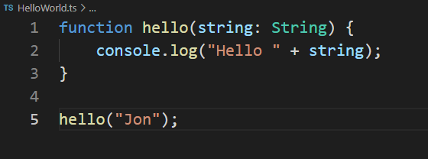
Running your first Typescript program
Let’s create our first TS program.
Initialize the project: tsc --init
Configure the project file tsconfig.json:
"outDir": "./out",
"target": "es2015",
Create a typescript file: HelloWorld.ts
Implement the code on the right
Compile the code with: tsc –p tsconfig.json
Run the program: node out/HelloWorld.js

Slide 9

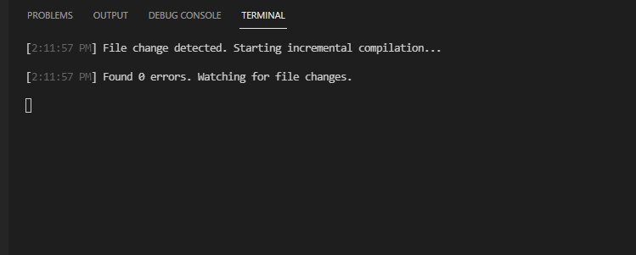
I am lazy … is there a faster way to compile?
Yes there is!
Just run: tsc --watch –p tsconfig.json

Slide 10
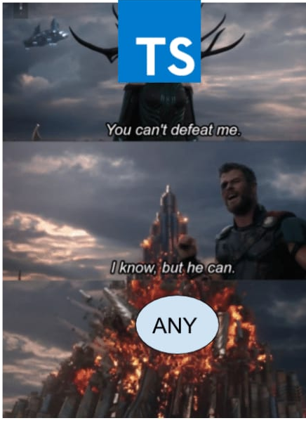
Typescript Types
Most common types:
any
Number (int, double, unsigned from C)
String
Boolean
Arrays
Enums
Objects
Function return types

Slide 11
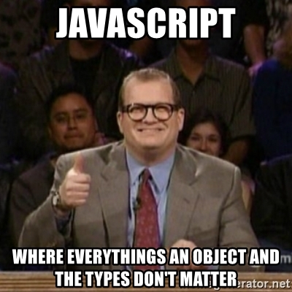
Objects
A TypeScript object is:
a fundamental data type that is used to pass around data in a group form
We use it to group data in a structure that we can more easily use in our programs.
Very easy to use, has no rules regarding what members can have => we have no control on what data we expect => easy to break a complex program.

Slide 12
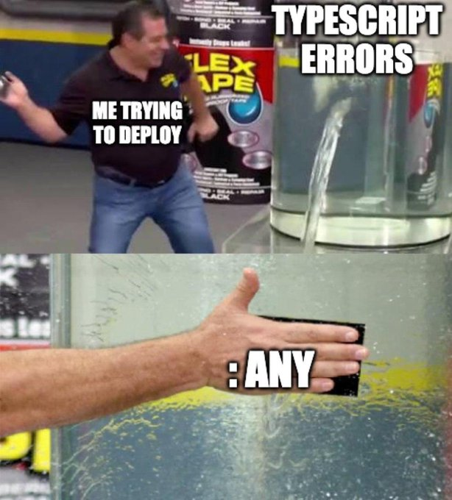
Interfaces
What are interfaces?
A way to create complex data types in a typescript environment
A way to avoid errors regarding object data accessing
Protects us against undefined data accessing in objects.

Slide 13



Interfaces
Let’s say we have the following function. What problems can arise?
Not the best output & no errors:
We have the following function calls:

Slide 14

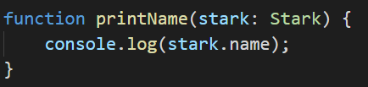
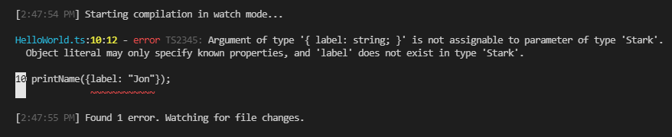
Interfaces
The fix is simple, make an interface:

Slide 15
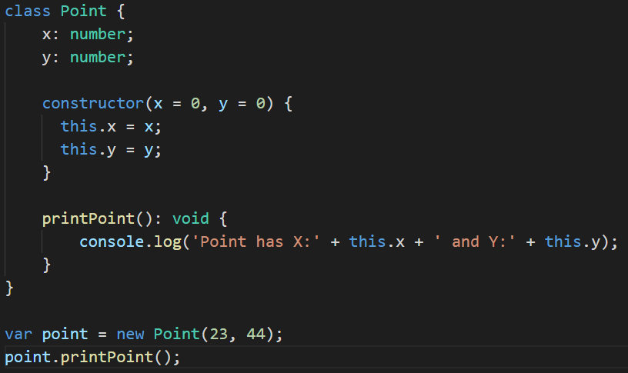

Classes
Classes are a smart way to group data and functionality in one place.
Let’s create out Point class and give it some functionality

Slide 16
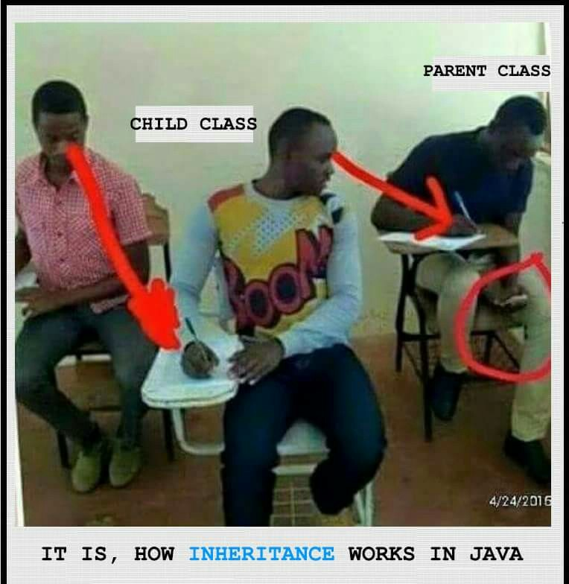
Inheritance
Like other languages with object-oriented features, classes in JavaScript can inherit from base classes.
There are 2 big methods of inheritance:
Extending a class
Implementing an interface
Knowing this let’s extend our Point class.

Slide 17
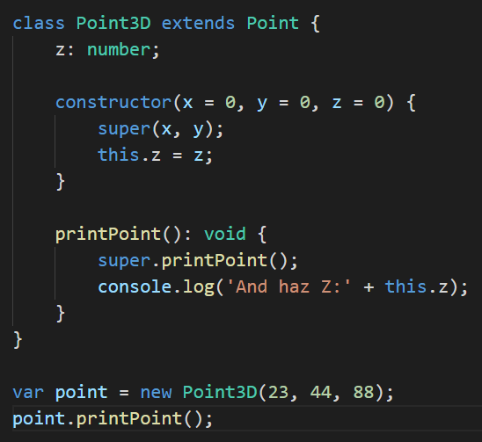
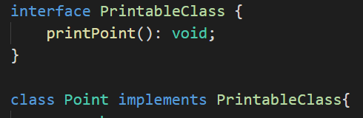

Inheritance
Your changes should look something like this:

Slide 18


Imports & Exports
Importing modules is a good way to keep your file size small and easy have the code reusable.
First let’s create 2 ts files:
PritableClass.ts
Point.ts
Move the respectable interface and class to those files.
On the right you have all the required changes.
The code we have now is more clean and reusable.

Slide 19
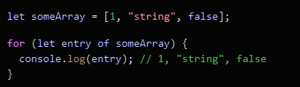
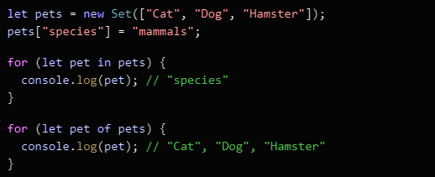
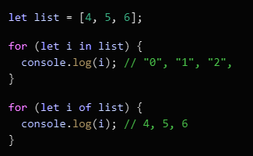
Iterators and Generators
An object is deemed iterable if it has an implementation for the Symbol.iterator property. Some built-in types like Array, Map, Set, String, Int32Array, Uint32Array, etc. have their Symbol.iterator property already implemented.

Slide 20
