Slide 1


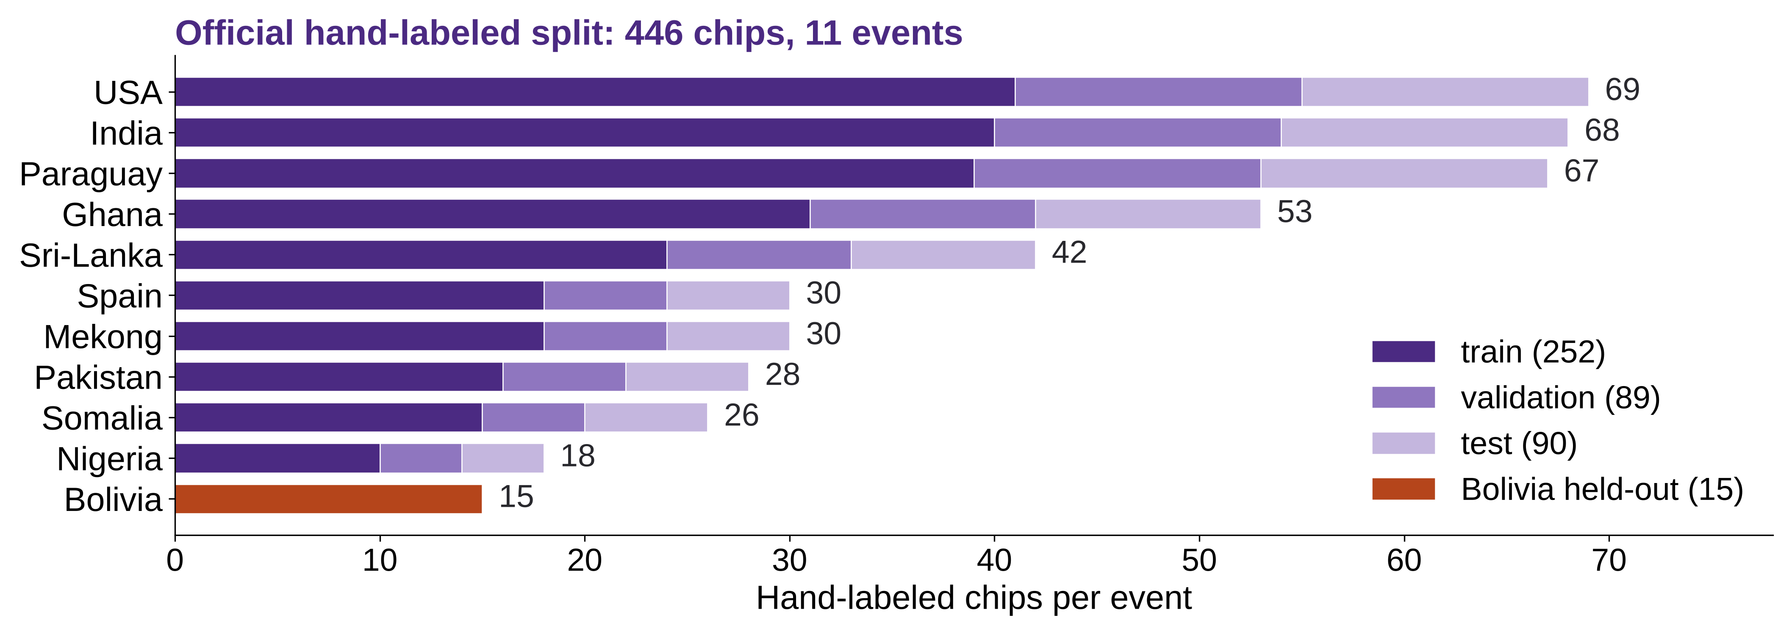
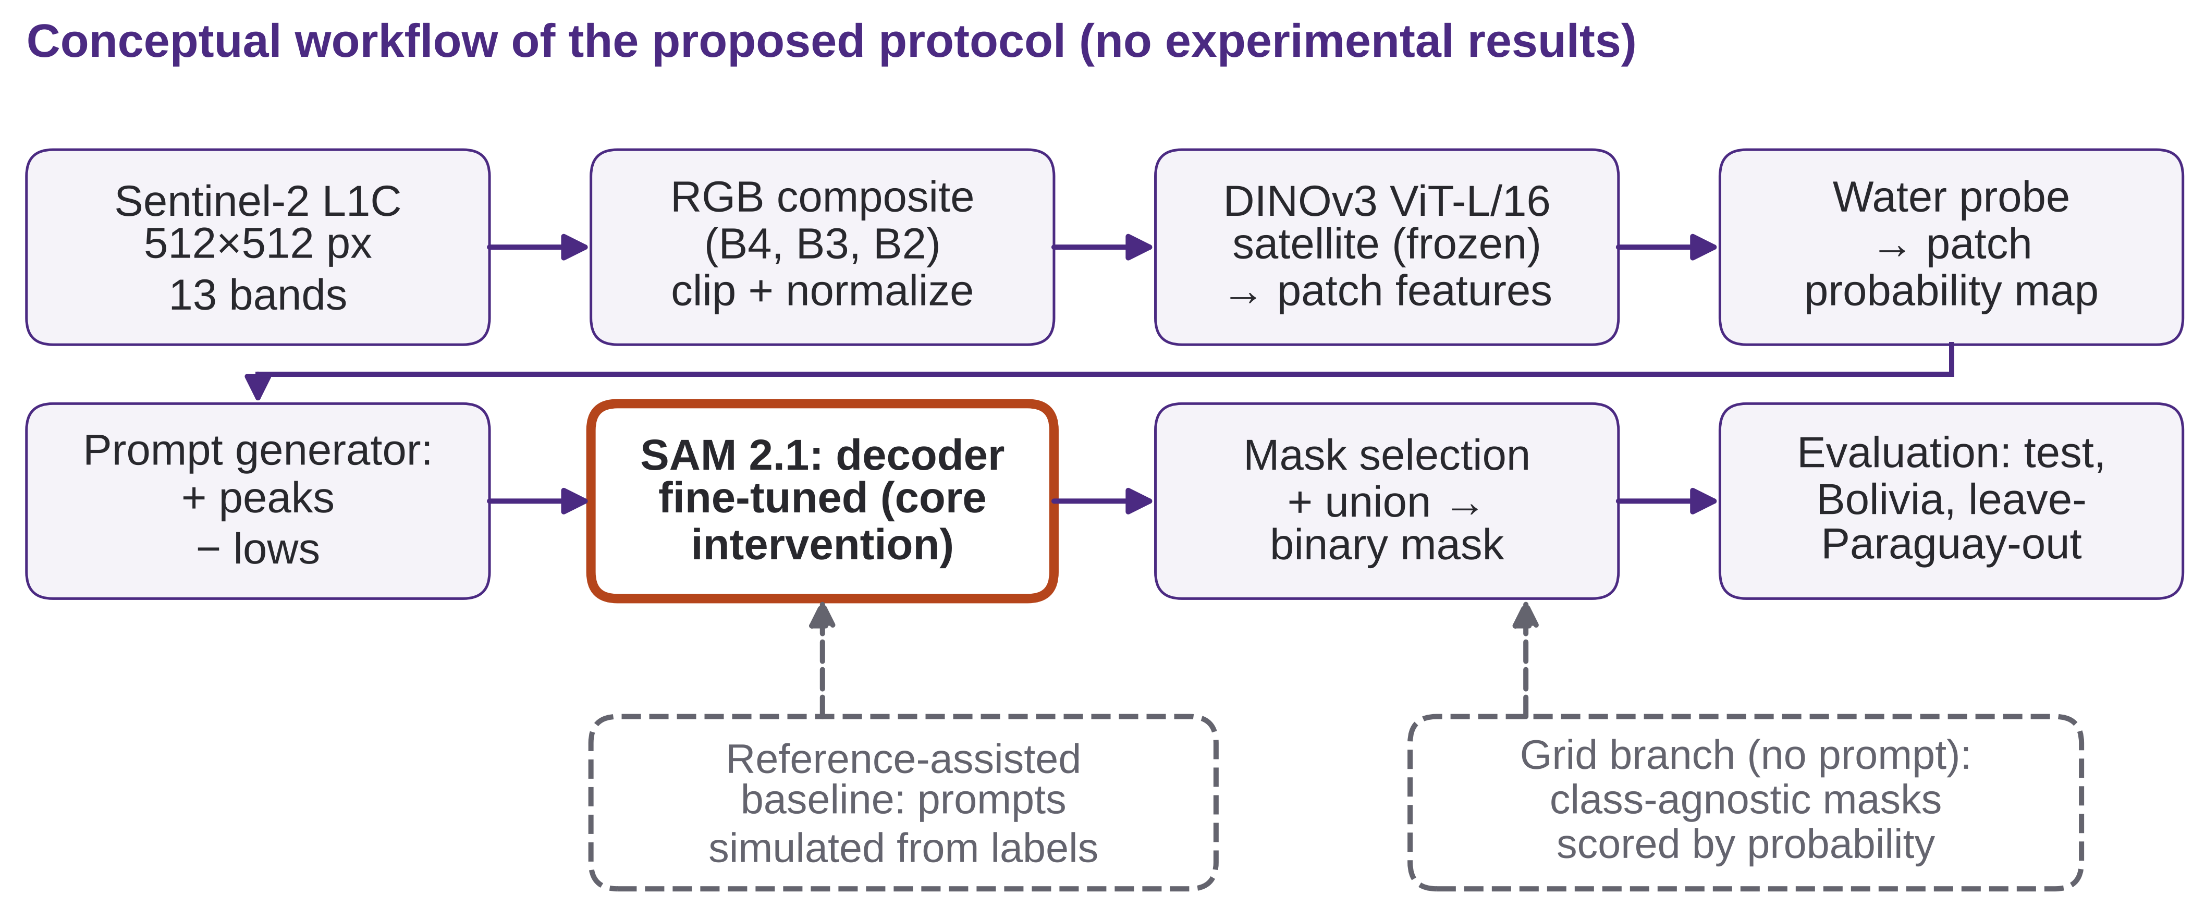
Workshop on Artificial Intelligence and Machine Learning Applications
The Cost of the Prompt: Automatic DINOv3-Derived Prompts for SAM 2.1 Water Segmentation in Sentinel-2 Imagery
[VILLARREAL QUISPE, ELIEZER GUIDO]¹ • [CHAVEZ JAVIER, ROBERTO ABEL]¹
¹[Department / group – confirm], Pontificia Universidad Católica del Perú, Lima, Peru | Corresponding author: [e-mail]
[PLACE PROJECT / GROUP LOGOS HERE – none supplied]
MOTIVATION & RESEARCH PROBLEM
OBJECTIVES / CONTRIBUTION
Why it matters: surface-water maps support water monitoring and flood assessment (Pekel et al., 2016; Tellman et al., 2021).
Prompt dependence: SAM 2 needs clicks, boxes or masks from a person; it has no text prompt. Zero-shot SAM struggled on remote-sensing targets (Li et al., 2024).
Domain gap: 10 m Sentinel-2 chips vs. natural-image/video training of SAM 2 and 0.6 m satellite pretraining of DINOv3 (model card).
Gap: the cost of replacing simulated human prompts by automatic ones is not measured under event-level shift.
Research question: how much water IoU is lost when simulated human prompts (reference-assisted baseline) are replaced by automatic DINOv3-derived prompts for SAM 2.1, and how does that loss change on a geographic event unseen in training?
Contribution: a controlled measurement; no new prompting method is claimed.
Scope: surface water (incl. permanent water), not flood-only detection.
PLANNED EVALUATION (NO RESULTS YET)
METHODOLOGY
Two shifts kept apart: natural→satellite (frozen vs. fine-tuned) and geographic (test vs. Bolivia / leave-Paraguay-out).
Metrics: water IoU (pooled, per-event mean, per-chip median/IQR); precision, recall, Dice; two-class mIoU. Chips without water: excluded from per-chip IoU, false-positive area reported.
Teardown: parameters and FLOPs per block; median latency (warm-up, batch 1, synchronized GPU); peak memory.
Data (fact): Sen1Floods11, 446 hand-labeled Sentinel-2 L1C chips (512×512 px, 10 m, 13 bands). Official split 252/89/90 + 15 Bolivia held out.
Decisions: tune on validation only; test and Bolivia scored once; leave-Paraguay-out (67 chips) for event-level shift. RGB (B4, B3, B2) with model-specific normalization; invalid pixels ignored.
Reference-assisted baseline: frozen SAM 2.1 with points sampled from ground-truth labels (not deployable).
Automatic prompts: frozen DINOv3 ViT-L/16 satellite → water probe (train labels only) → peaks = positive, lows = negative points → SAM 2.1 per component, best predicted-IoU mask, union. Grid branch: class-agnostic masks scored by mean probability.
Core intervention: fine-tune only the SAM 2.1 mask decoder (BCE + Dice).
Ablations: A1 prompt source, A2 points k, A3 decoder frozen vs. fine-tuned. H1: DINOv3 points fall between reference and grid; H2: IoU saturates with k; H3: fine-tuning helps seen events more than Bolivia.
KEY REFERENCES
Bonafilia, D., Tellman, B., Anderson, T., & Issenberg, E. (2020). Sen1Floods11: A georeferenced dataset to train and test deep learning flood algorithms for Sentinel-1. In 2020 IEEE/CVF Conference on Computer Vision and Pattern Recognition Workshops (CVPRW) (pp. 835–845). IEEE. https://doi.org/10.1109/CVPRW50498.2020.00113
Drusch, M., Del Bello, U., Carlier, S., Colin, O., Fernandez, V., Gascon, F., Hoersch, B., Isola, C., Laberinti, P., Martimort, P., Meygret, A., Spoto, F., Sy, O., Marchese, F., & Bargellini, P. (2012). Sentinel-2: ESA’s optical high-resolution mission for GMES operational services. Remote Sensing of Environment, 120, 25–36. https://doi.org/10.1016/j.rse.2011.11.026
Kirillov, A., Mintun, E., Ravi, N., Mao, H., Rolland, C., Gustafson, L., Xiao, T., Whitehead, S., Berg, A. C., Lo, W.-Y., Dollár, P., & Girshick, R. (2023). Segment anything. In 2023 IEEE/CVF International Conference on Computer Vision (ICCV) (pp. 3992–4003). IEEE. https://doi.org/10.1109/ICCV51070.2023.00371
Li, W., Hsu, C.-Y., Wang, S., Yang, Y., Lee, H., Liljedahl, A., Witharana, C., Yang, Y., Rogers, B. M., Arundel, S. T., Jones, M. B., McHenry, K., & Solis, P. (2024). Segment anything model can not segment anything: Assessing AI foundation model’s generalizability in permafrost mapping. Remote Sensing, 16(5), Article 797. https://doi.org/10.3390/rs16050797
Liu, Y., Zhu, M., Li, H., Chen, H., Wang, X., & Shen, C. (2024). Matcher: Segment anything with one shot using all-purpose feature matching. In International Conference on Learning Representations (ICLR 2024). https://proceedings.iclr.cc/paper_files/paper/2024/hash/4df9a5e6bad9e64ebcea453e031142bb-Abstract-Conference.html
Ozdemir, S., Akbulut, Z., Karsli, F., & Kavzoglu, T. (2024). Extraction of water bodies from high-resolution aerial and satellite images using visual foundation models. Sustainability, 16(7), Article 2995. https://doi.org/10.3390/su16072995
Pekel, J.-F., Cottam, A., Gorelick, N., & Belward, A. S. (2016). High-resolution mapping of global surface water and its long-term changes. Nature, 540(7633), 418–422. https://doi.org/10.1038/nature20584
Ravi, N., Gabeur, V., Hu, Y.-T., Hu, R., Ryali, C., Ma, T., Khedr, H., Rädle, R., Rolland, C., Gustafson, L., Mintun, E., Pan, J., Alwala, K. V., Carion, N., Wu, C.-Y., Girshick, R., Dollár, P., & Feichtenhofer, C. (2025). SAM 2: Segment anything in images and videos. In International Conference on Learning Representations (ICLR 2025). https://proceedings.iclr.cc/paper_files/paper/2025/hash/45c1f6a8cbf2da59ebf2c802b4f742cd-Abstract-Conference.html
Tellman, B., Sullivan, J. A., Kuhn, C., Kettner, A. J., Doyle, C. S., Brakenridge, G. R., Erickson, T. A., & Slayback, D. A. (2021). Satellite imaging reveals increased proportion of population exposed to floods. Nature, 596(7870), 80–86. https://doi.org/10.1038/s41586-021-03695-w
Zhang, R., Jiang, Z., Guo, Z., Yan, S., Pan, J., Dong, H., Qiao, Y., Gao, P., & Li, H. (2024). Personalize segment anything model with one shot. In International Conference on Learning Representations (ICLR 2024). https://proceedings.iclr.cc/paper_files/paper/2024/hash/4f44e5c82dc7b0ba4472083e5dedb08e-Abstract-Conference.html
EXPECTED CONTRIBUTIONS & LIMITATIONS
Expected: reproducible protocol; SAM 2.1 / DINOv3 teardown; failure analysis under event shift. No gains are promised.
Limits: no results yet; RGB drops NIR/SWIR; 15 held-out chips; one seed; no cloud mask in L1C.
ACKNOWLEDGMENTS / FUNDING
CONTINUE THE CONVERSATION
Course 1INF52 Deep Learning (2026-2), Pontificia Universidad Católica del Perú. Open models: SAM 2.1 (Meta AI) and DINOv3; dataset: Sen1Floods11.
Compute resources: [to complete] Funding: [to complete]
[QR CODE – add repository link]
Repository: [not yet created]
Contact: [corresponding author e-mail]
BRING YOUR RESEARCH. SHARE YOUR IDEAS. JOIN THE CONVERSATION.
WAIMLAp 2026 • November 18–20, 2026 • Lima, Peru • waimlap.org

