Slide 1
Understanding Customer Behavior
Cohort Insights Powered by a Modern ELT Pipeline
Roberto Pera

Slide 2
Unlocking Customer Value:
Cohort-Based Insights from 2024
01
Data:
Jan-Dec 2024
200 customers
1.000 orders
02
Research Questions:
How quickly do customers repurchase?
How does retention differ across cohorts?
How strong are repeat-purchase funnels?
How have cohort sizes changed over time?

Slide 3
Disclaimer
Data Context & Limitations
01
Datascope: • customer first purchases fall within Jan–Jun 2024 → only six cohorts
• sample too small to infer robust causal patterns
02
Limitations: • we do not know the business model, industry, or seasonality patterns
• we do not know the marketing mix, budget, or campaign history
03
Interpretation: • findings should be viewed as directional, not definitive
• recommendations are hypotheses for further investigation
• additional data would be needed for strategic decisions

Slide 4

ELT Data Stack:
From Cloud SQL Extraction
to Databricks Transformation
Extract
raw data from Cloud SQL
Load
directly into Databricks
via Fivetran
Transform
entirely inside the Lakehouse (SQL + Delta)

Slide 5
Medallion Architecture
Structured Data Layers ensure
Analysis Quality and Reproducibility
Gold
cohort_size_by_month
Gold
Bronze
Silver
repeat_purchase_rate_by_cohort
Gold
retention_rate_by_cohort
ecom_orders
cohort_analytics
Gold
retention_rate_by_cohort

Slide 6
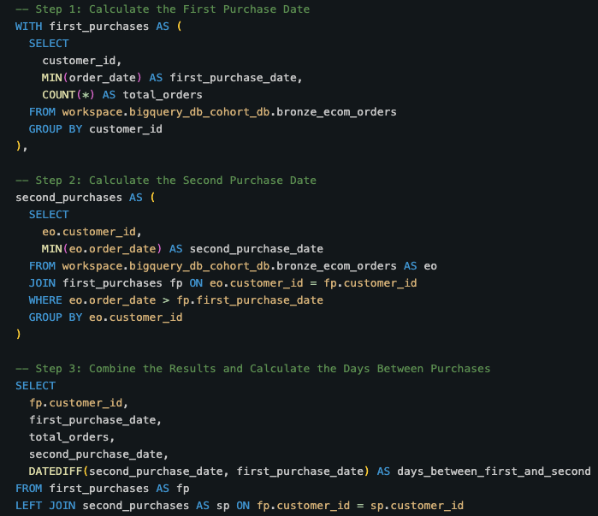
Medallion Architecture
Silver
Derive 1st and 2nd purchase dates
Calculate days between purchases
Count total customer orders

Slide 7
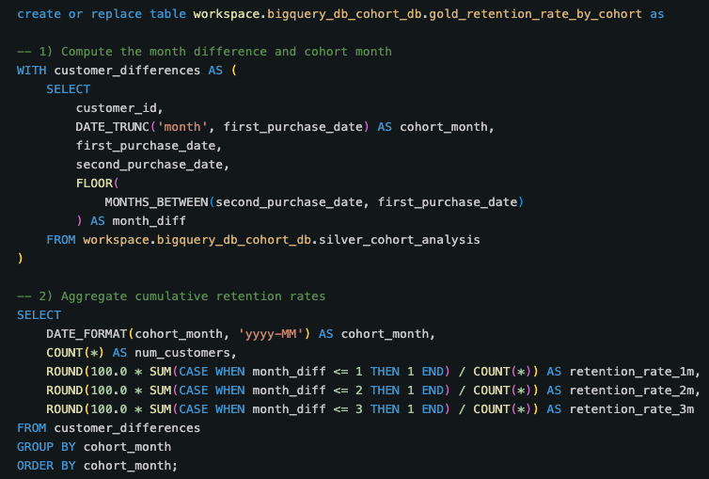
Medallion Architecture
Gold
Calculate month difference:
1st and 2nd purchase
Compute cohort_month
Aggregate cumulative retention rates

Slide 8
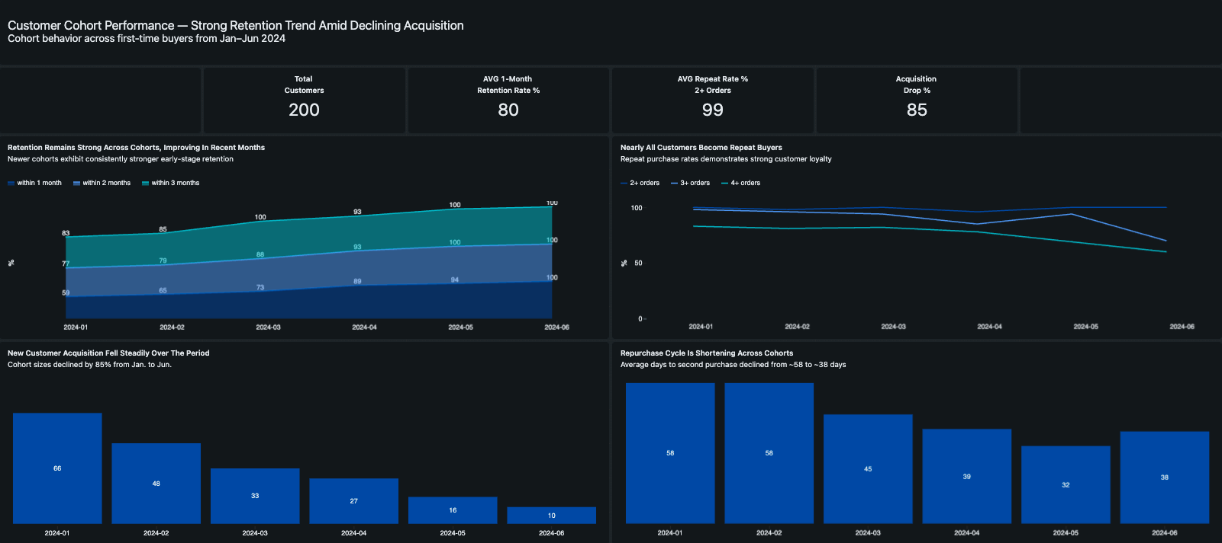
Dashboard Overview

Slide 9
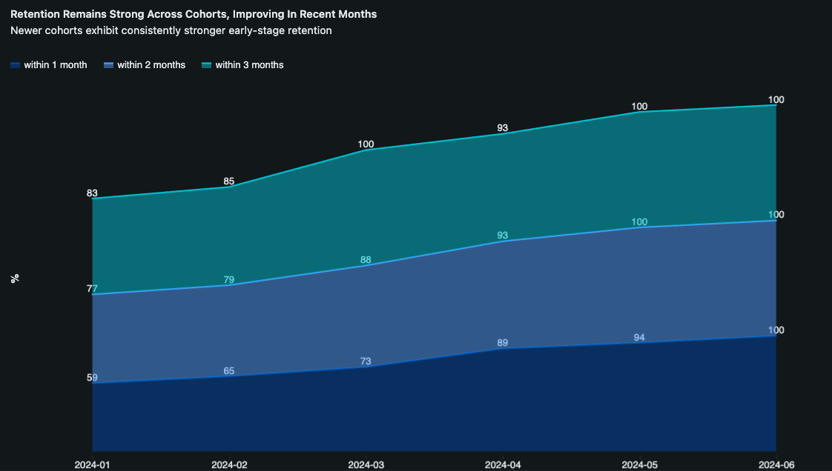
Retention Remains Strong Across Cohorts, Improving In Recent Months
Newer cohorts exhibit consistently stronger early-stage retention
1-month retention:
59% → 100%
2-month retention:
rises steadily across cohorts
3-month retention:
stabilizes around ~90%
in later months

Slide 10
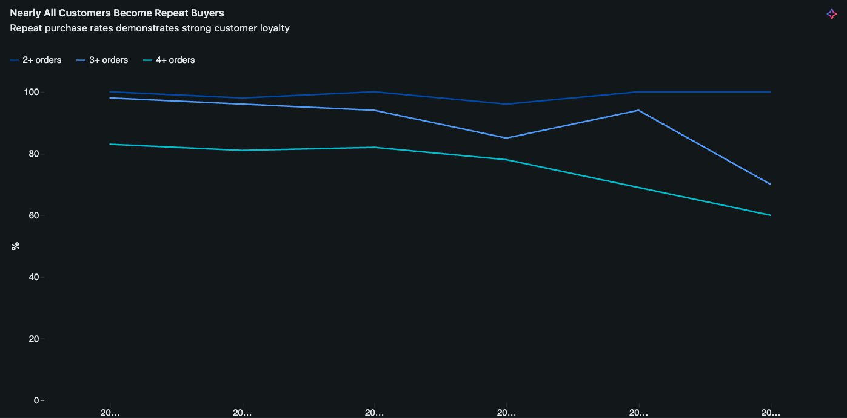
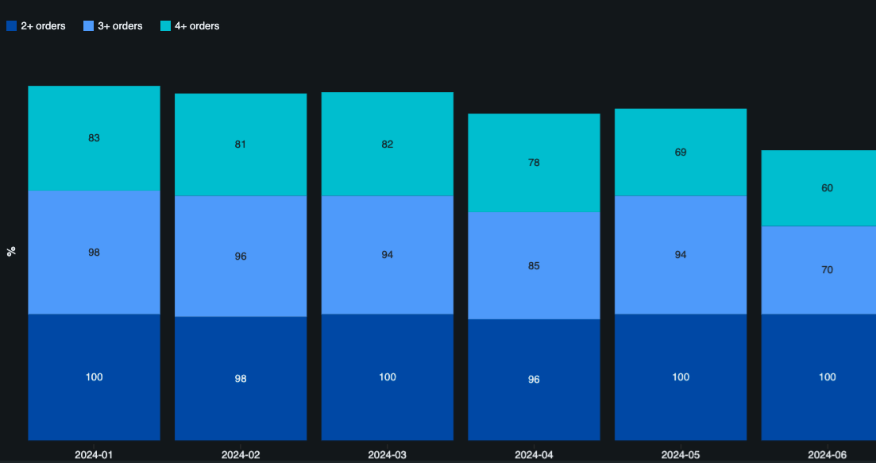
Nearly All Customers Become Repeat Buyers
Repeat purchase rates demonstrates strong customer loyalty
2+ orders:
~100% across all cohorts
3+ orders:
85–96% for early cohorts; slight dip for June
4+ orders:
strong, but decreasing in latest cohort

Slide 11
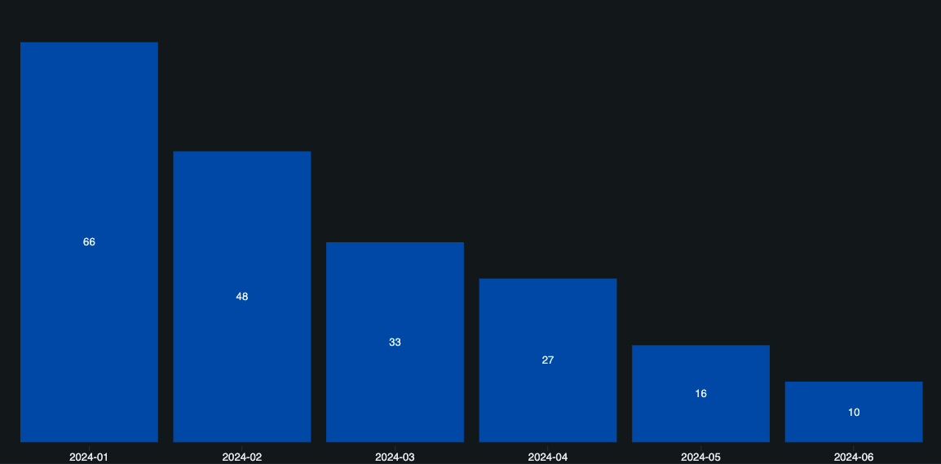
New Customer Acquisition Fell Steadily Over The Period
Cohort sizes declined by 85% from Jan. to Jun.

Slide 12
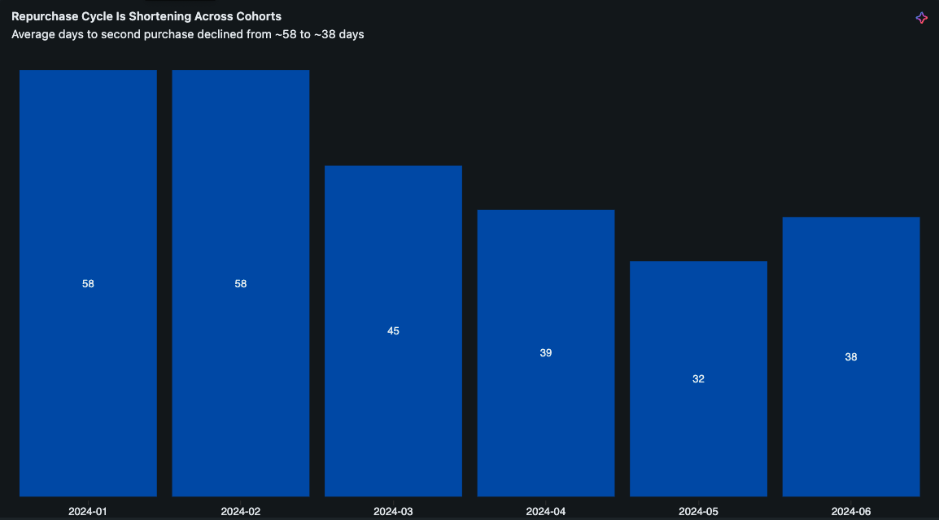
Repurchase Cycle Is Shortening Across Cohorts
Average days to second purchase declined from ~58 to ~38 days

Slide 13
Conclusions & Recommendations
1 — Retention appears strong
• Later cohorts show higher early-stage retention
• This may indicate improved onboarding, acquisition
quality, or product-market fit
Next step:
Review whether internal process changes occurred
during the period
2 — Drastically declining acquisition volume
• This might reflect seasonality, marketing shifts,
or one-time events
• With only six data points, no trend can be confirmed
Next step:
Investigate channel performance, seasonality,
and marketing spend
3 — Repurchase cycles seem to be shortening
• Could reflect better customer engagement or improved
product experience
• But later cohorts have less elapsed time, so estimates
may be biased downward
Next step:
Validate with larger time range and longer follow-up period
4 — Opportunity to strengthen analytics foundations
• Consider scheduling ETL workflows in Databricks once
data volume grows
• Potential long-term enhancements:
• LTV models
• Churn prediction
• Segmentation (behavioral cohorts)

Slide 14

Thank you
Full project documentation on

