Slide 1

OfiLibre URJC:
Free Knowledge and Free Culture
Office at Uni. Rey Juan Carlos
OfiLibre: promoting open access and free knowledge in URJC
Open Access in Science and Research
Webinar Got Energy Talent MSCA-Cofund, 24 March 2021
Jesus M. Gonzalez-Barahona
Francisco Gortázar
Twitter: @jgbarah @fgortazar
Oficina de Conocimiento y Cultura Libres
Despacho 004 – Rectorado (Móstoles)
https://urjc.es/ofilibre
ofilibre@urjc.es
@OfiLibreURJC

Slide 2
Qualquier omen, que lo oya, si bien trovar sopiere,
puede más y añadir et emendar si quisiere,
ande de mano en mano a quienquier quel' pidiere,
como pella a las dueñas tómelo quien podiere.
Pues es de buen amor, emprestadlo de grado,
non desmintades su nombre, nin dedes refertado,
non le dedes por dineros vendido nin alquilado,
ca non ha grado, nin graçias, nin buen amor complado.
Juan Ruiz, Arcipreste de Hita.
Libro de Buen Amor, siglo XIV

Slide 3
Anyone who listen to it, if knows how to create verses,
can add more, or amend them, if would want;
bring it from hand to hand to whomever who would ask for it,
like a ball between girls, may take it whoever can take it;
because it is of good love, lend it willingly,
don't deny its name, don't make it secretive,
don't give it for money, sold or rented,
Because the good love loses its grace if it is bought
Juan Ruiz, Arcipreste de Hita.
Libro de Buen Amor (Book of Good Love), 14th Century

Slide 4
The traditional and the new

Slide 5
For the first time we have tools
that allow us to access
easily, quickly and cheaply
(almost) all intellectual works
produced by humankind...

Slide 6
… but we're preventing using them
with an economic and legal
framework from the age of
information in paper

Slide 7
Aims of the University
To produce knowledge,
to disseminate that knowledge
to the society at large,
to train in that knowledge

Slide 8
Producing knowledge
“If I have seen further
it is by standing
on the shoulders of Giants”
Isaac Newton, 1675
Open Acces, Open Data, Free Software for research results

Slide 9

Training people
Retain
Reuse
Revise
Remix
Redistribute
David Wiley

Slide 10
Diseminating knowledge
Is the traditional approach the best one?
Which new options do technology provide?
Can we benefit from a new framework?

Slide 11
Some definitions

Slide 12
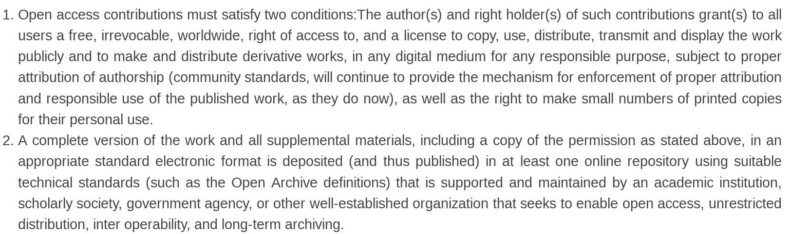
Open access
https://openaccess.mpg.de/Berlin-Declaration

Slide 13
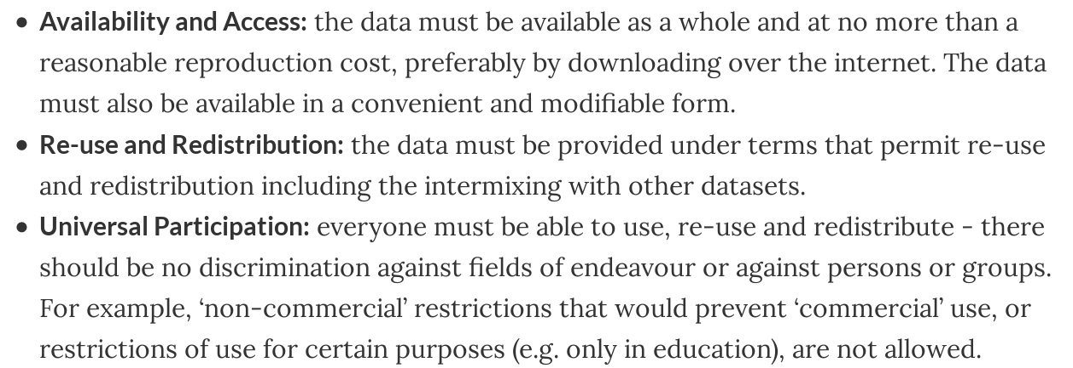
Open Data
http://opendatahandbook.org/guide/en/what-is-open-data/

Slide 14
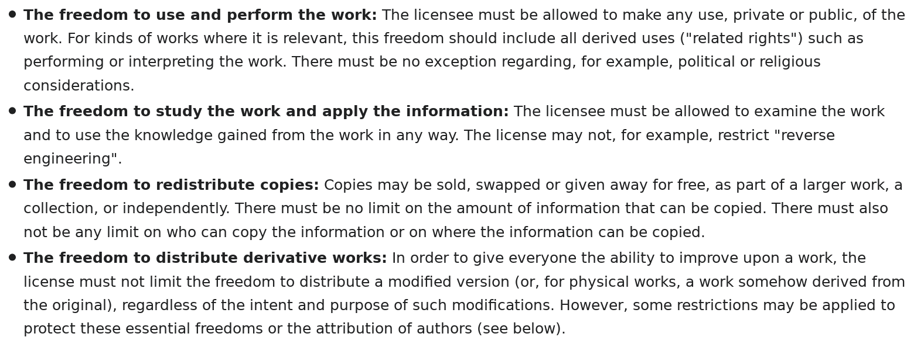
Free culture
https://freedomdefined.org/Definition

Slide 15
OfiLibre at URJC

Slide 16
OfiLibre is born
URJC Governing Board
December 14th 2018:
Creation of the
Free Knowledge and Free culture Office,
attached to the Vice-rectorate of Quality,
Ethics and Good Governance

Slide 17
Scope of action
Open access
Open data
Free culture
Free, open source software

Slide 18
Mandate
Information, promotion, coordination and facilitation tasks,collaborating with all agents in the University

Slide 19
Open access and free knowledge
research results
educational materials
management documents
“Consider if it could be open...”
https://openaccess.mpg.de/Berlin-Declaration

Slide 20
Open Data
Knowledge and use
Publication
Supporting initiatives
“Open data is more useful”
http://opendatahandbook.org/

Slide 21
Free culture
Fostering and outreaching
Promotion of the production
Put interested parties in contact
“Free culture is an option”
https://freedomdefined.org/Definition

Slide 22
Free, open source software
Knowing about options
Supporting users
Promoting releasing as free software
Explanation of implications
“Free software has some advantages”
https://www.gnu.org/philosophy/free-sw.es.html
https://opensource.com/resources/what-open-source

Slide 23
In all scopes
Identification and support to initiatives
Encouragement of new initiatives
Collaboration with communities
Training and consulting
Promotion and outreach
“OfiLibre: being a useful agent”

Slide 24
Some specific initiatives
Outreach to the University community
Training and materials
Making current initiatives visible
Facilitation of releasing degree, master and Phd thesis as open access
Support action to specific communities
        https://www.urjc.es/ofilibre

Slide 25
URJC:
Some actions

Slide 26

Regulation of Open Access and Open Culture
https://ofilibre.gitlab.io/blog/reglamento-acceso-abierto/

Slide 27
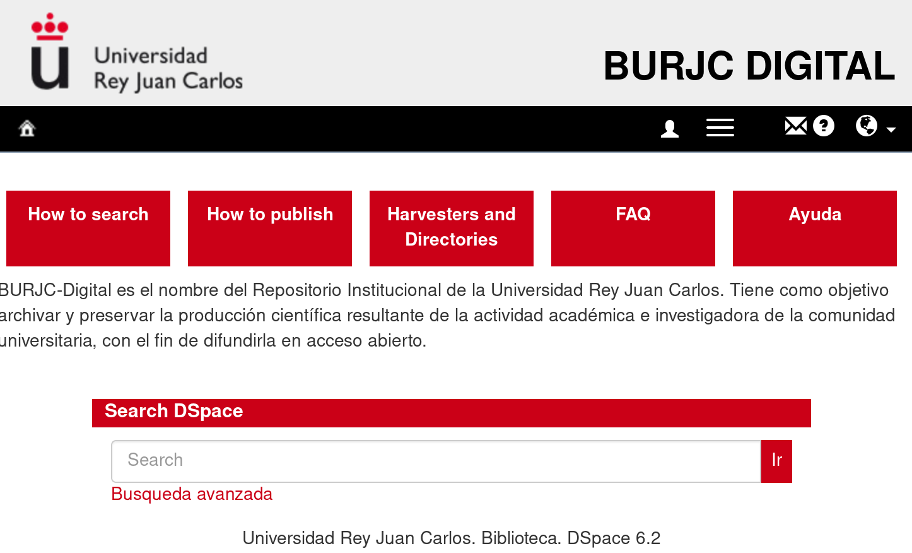
BURJC Digital (Open Archive)

Slide 28
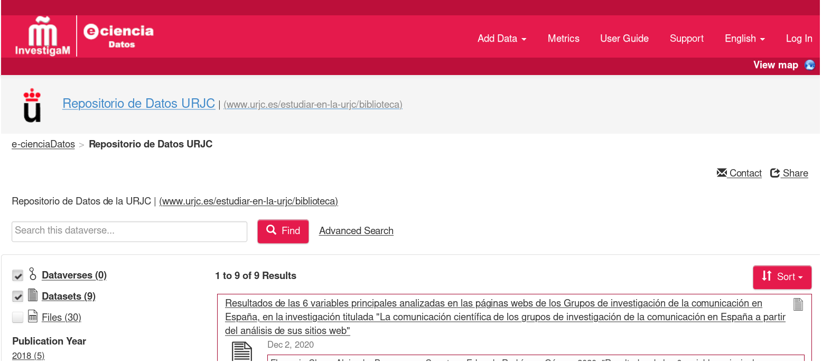
eCiencia Datos (Open Data)
https://edatos.consorciomadrono.es/dataverse/URJC

Slide 29
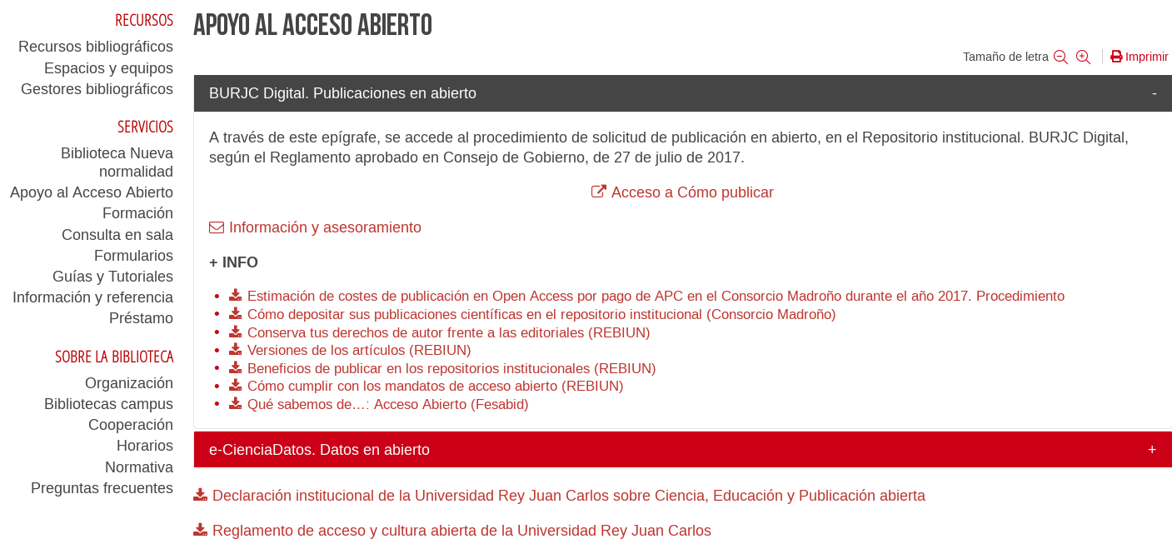
URJC Library: Open Access Resources

Slide 30
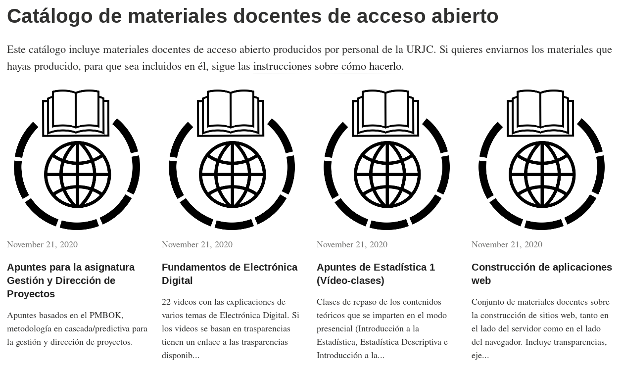
Catalog of Open Educational Resources
https://ofilibre.gitlab.io/catalogo/

Slide 31
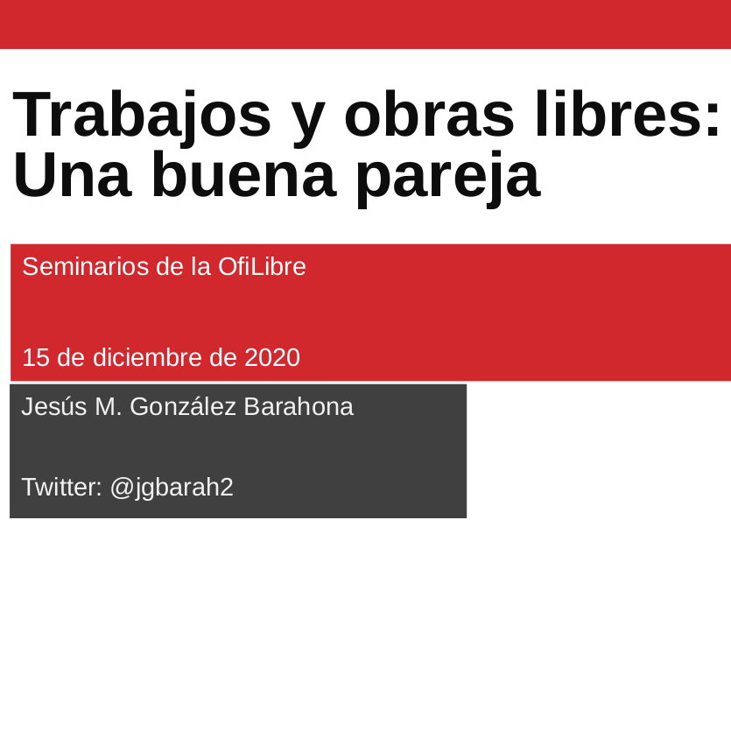
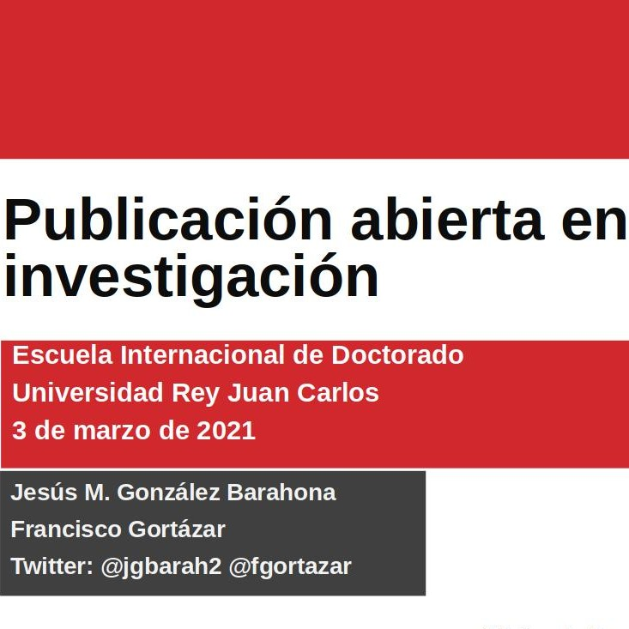
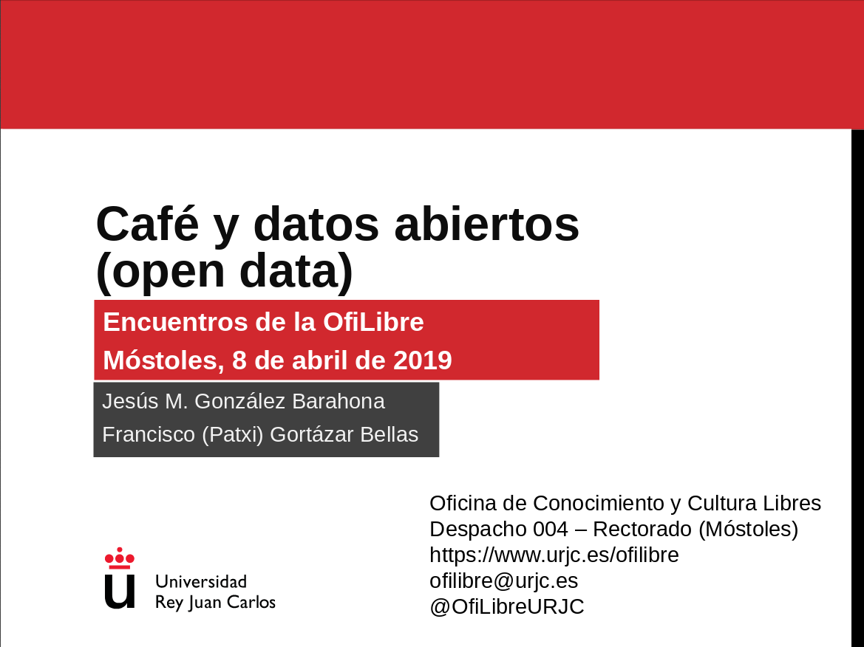
Training and presentations

Slide 32
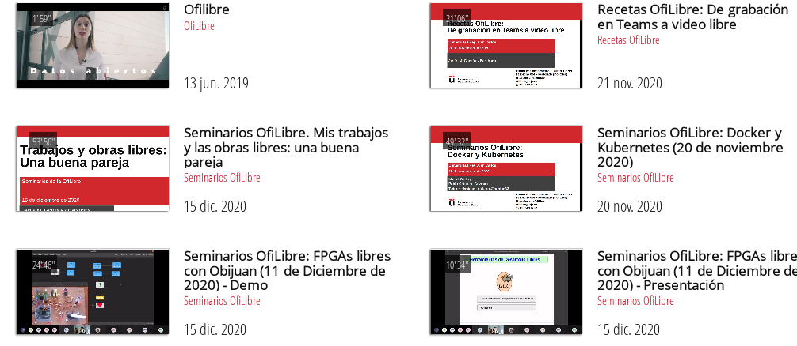
Videos in URJC-TV
https://tv.urjc.es/

Slide 33

Participation in EOSC Association
https://eosc-portal.eu/
https://eosc.eu/

Slide 34
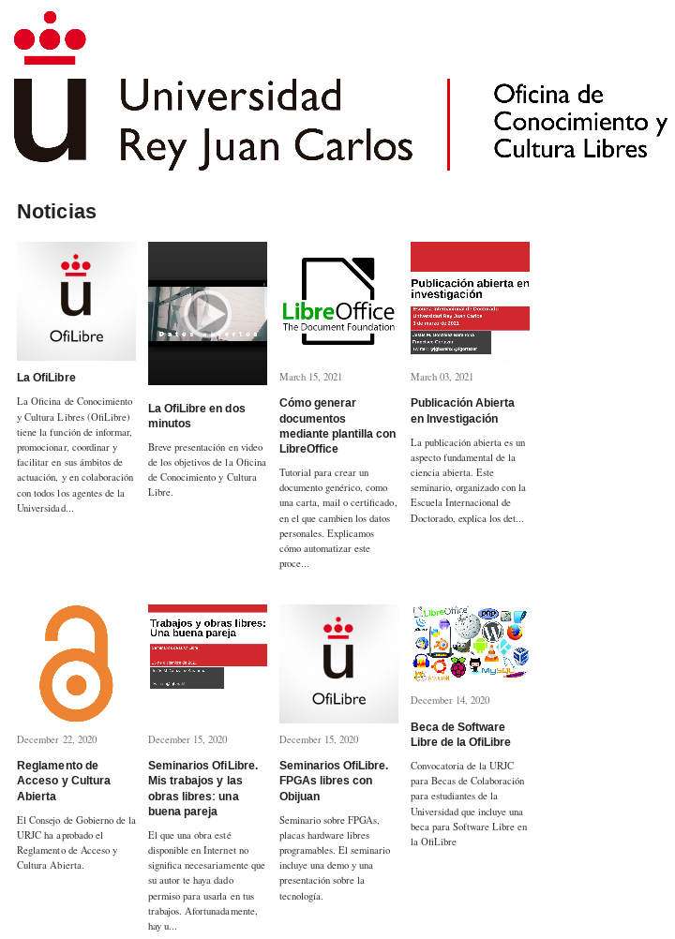
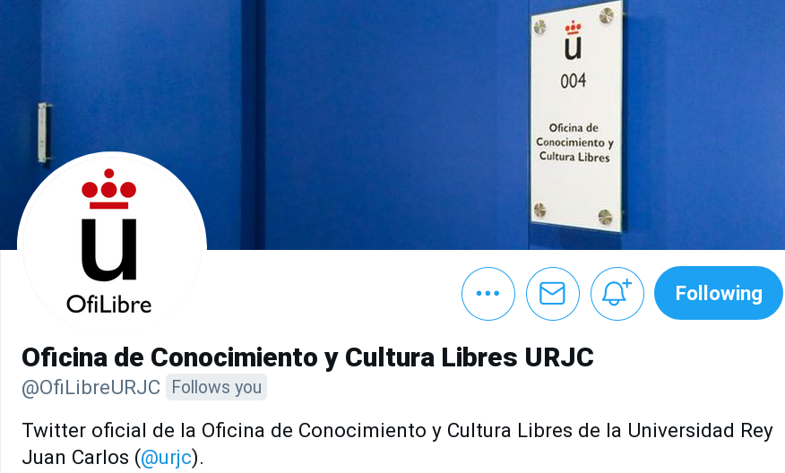
OfiLibre website
https://twitter.com/OfiLibreURJC
https://ofilibre.gitlab.io

Slide 35


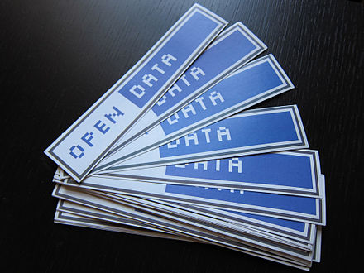

Main take away
Consider the “libre” way
Likely it will be good for you
And good for us all

Slide 36
Copyright 2021 Oficina de Conocimiento y Cultura Libres,
Universidad Rey Juan Carlos
Some rights reserved.
This work is distributed under a
Creative Commons “Attribution-ShareAlike 4.0 International” license
available in
https://creativecommons.org/licenses/by-sa/4.0/
This document (or some other very similar to it) is available from https://ofilibre.gitlab.io

