Slide 1
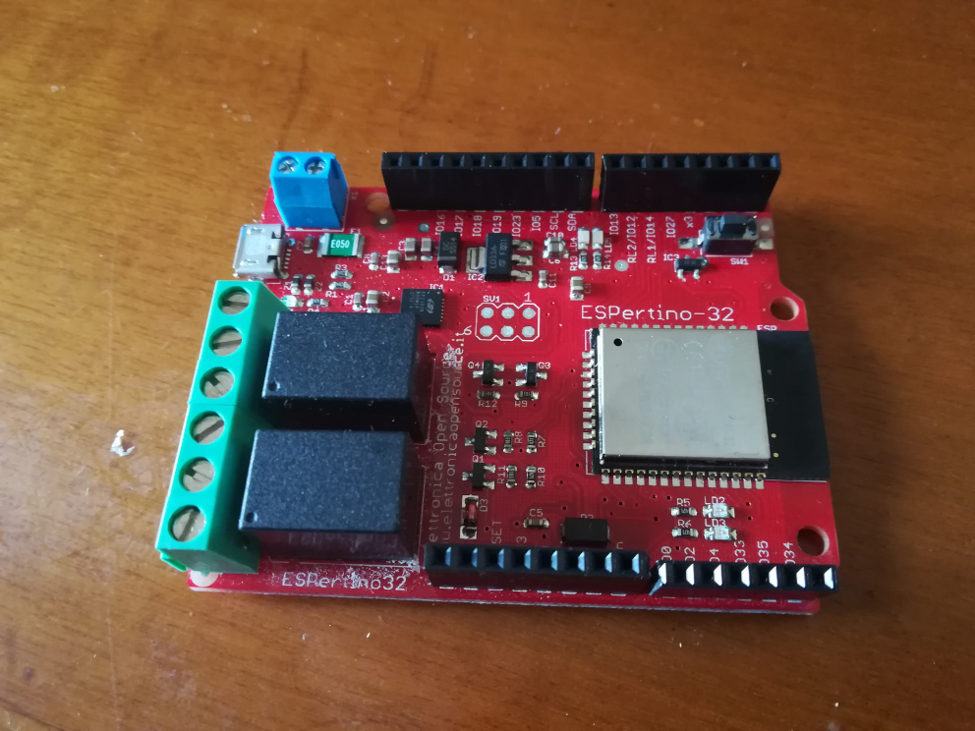

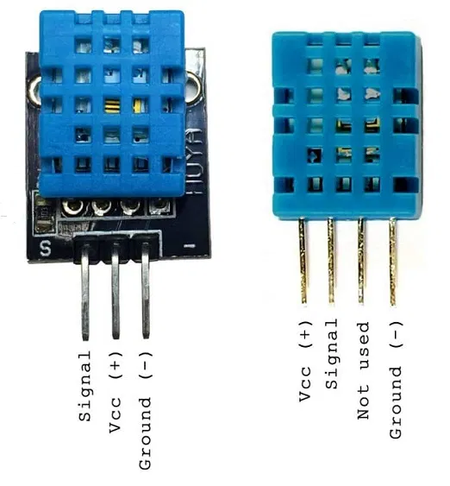
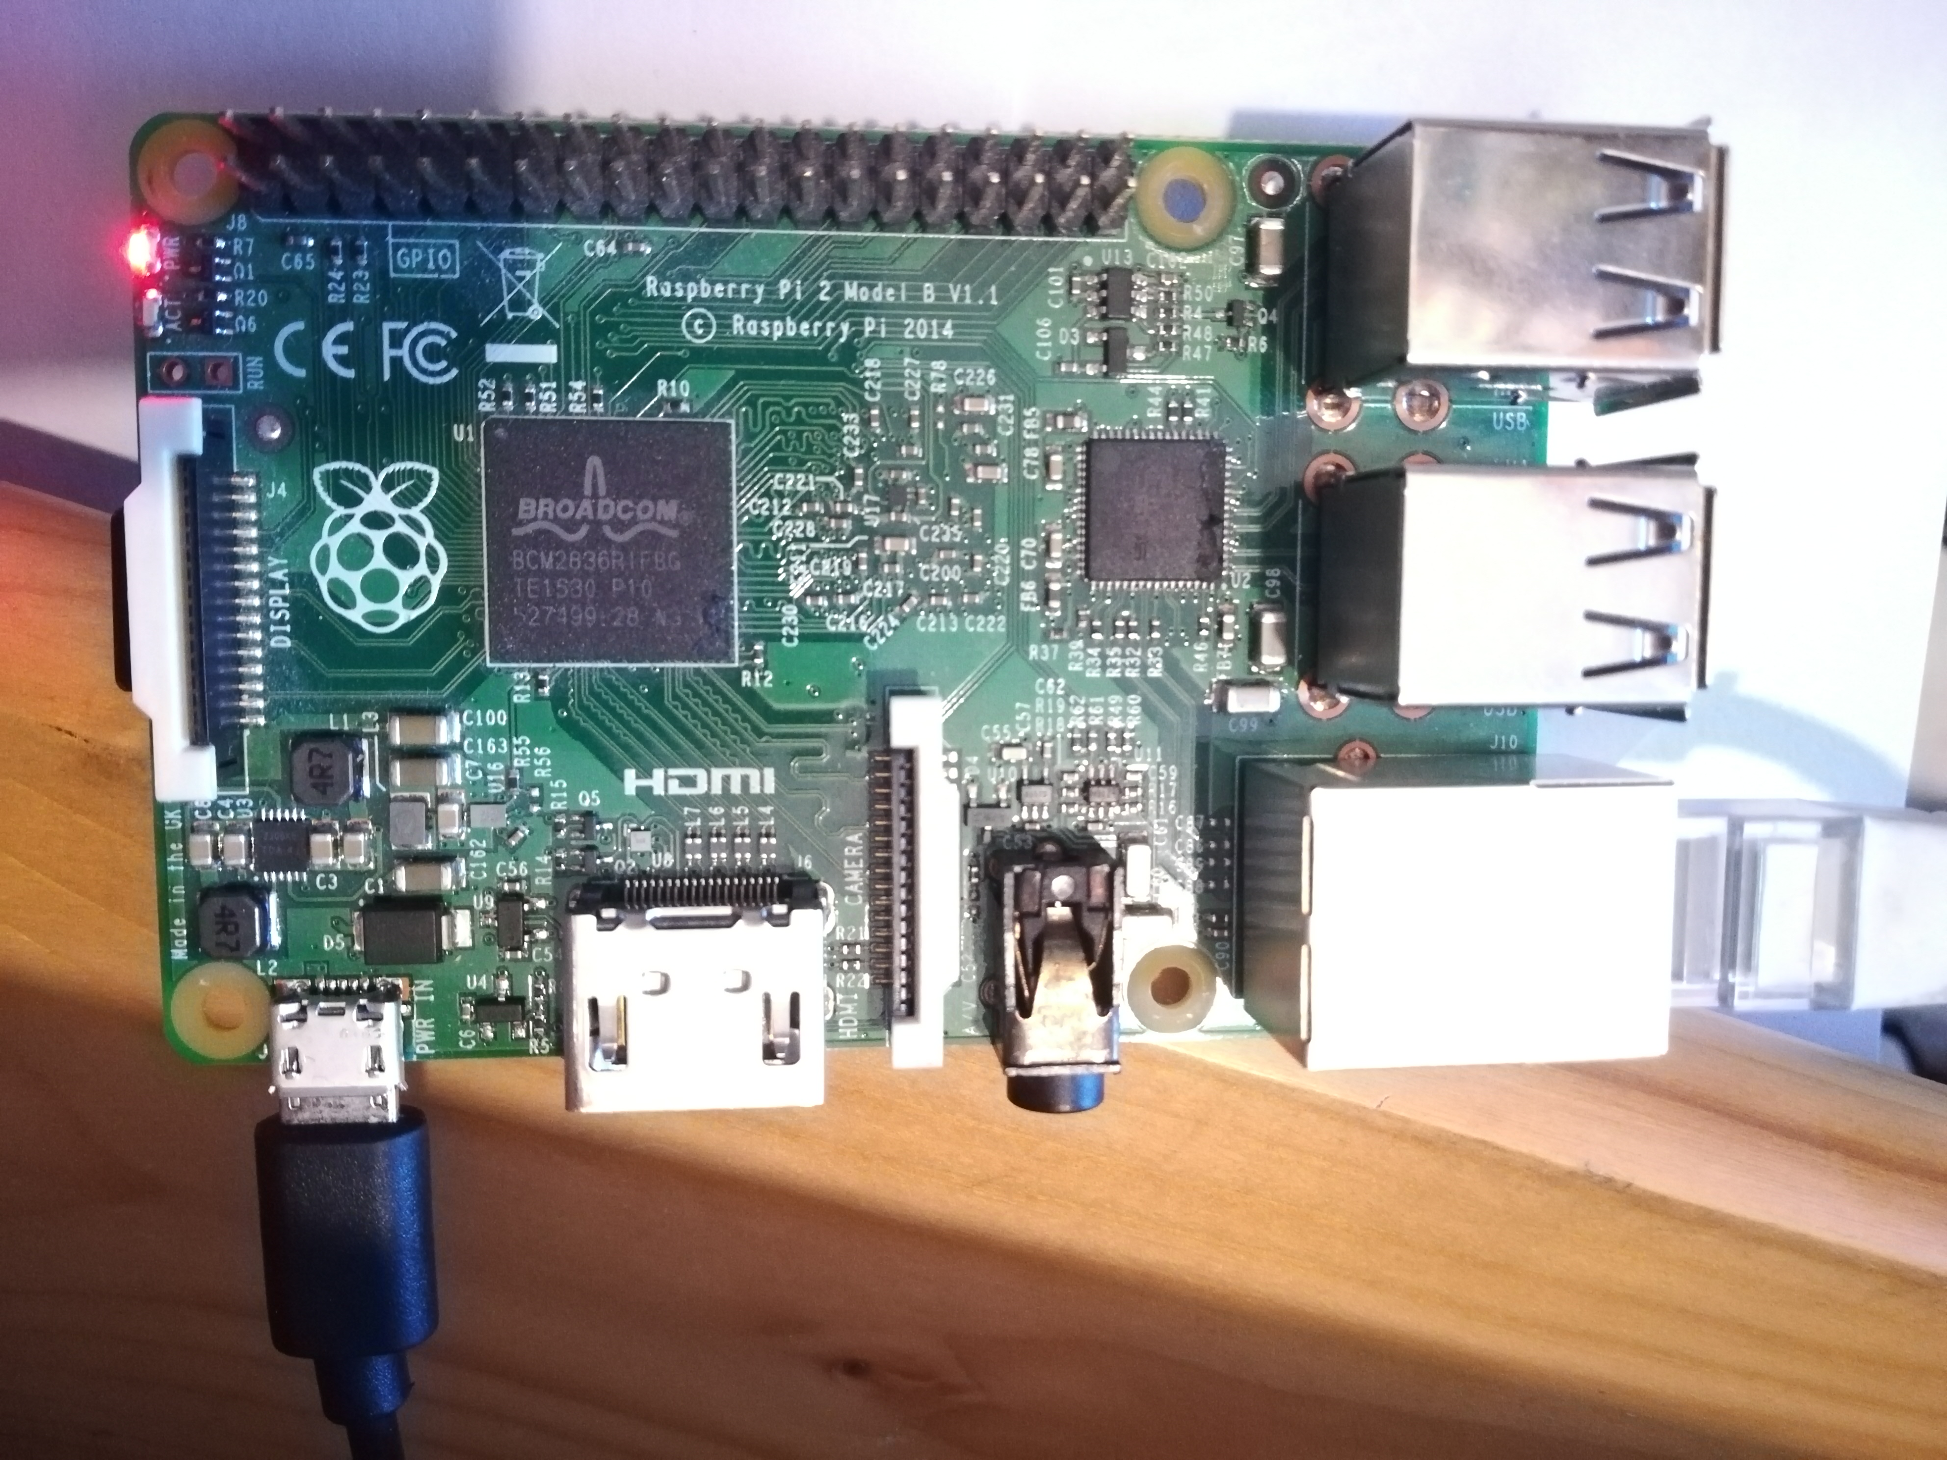
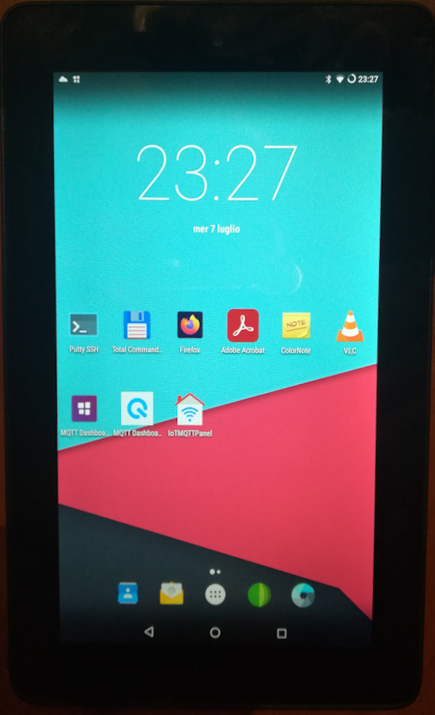

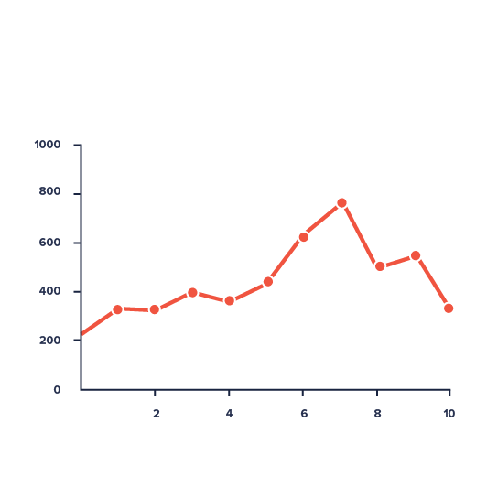
Home
Internet
Cloud
Espertino 1
Server
Humidity &
Temperature
Sensor
Raspberry Pi 2
Embedded Relays
Espertino 2
Tablet
Laptop

