Slide 1

ListenBrainz: What are the users reportedly listening to?
Roberto Arturo Morales Cruz

Slide 2
The Dataset:
When and what track was the user listening to? From which album and artist?
Almost 147 million rows of information!
“Constant” data from February 2005 until July 2018.

Slide 3
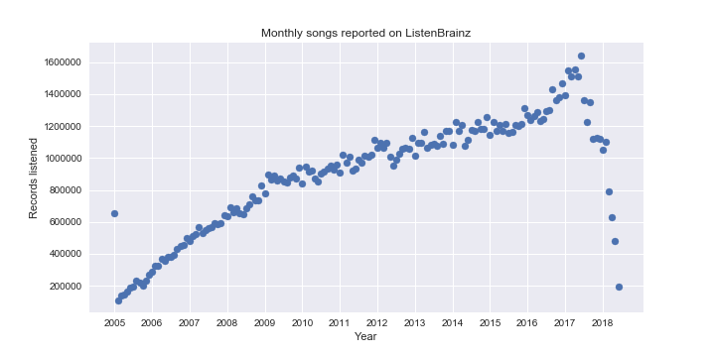
Until 2017, the reported number of songs were growing.

Slide 4
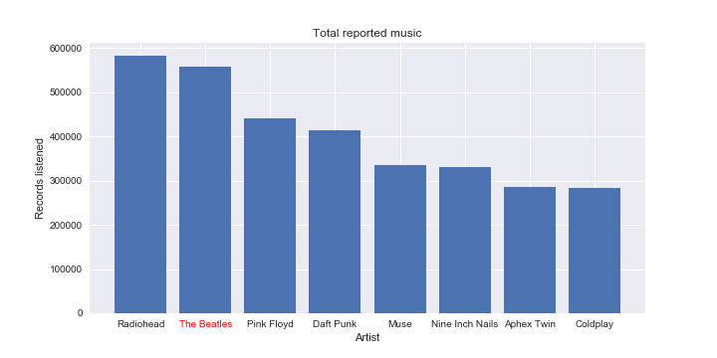
“Nobody is more popular than The Beatles”. Well, think again…

Slide 5
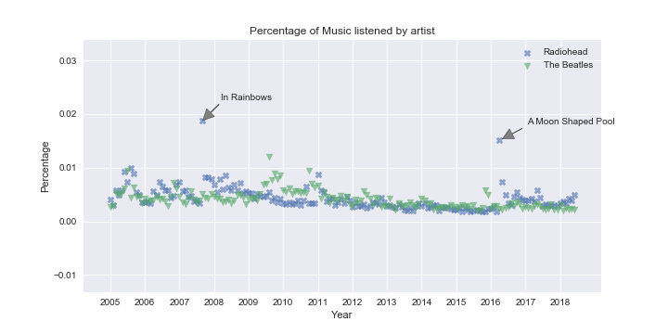
What made the difference? Simple: Radiohead had new albums released

Slide 6
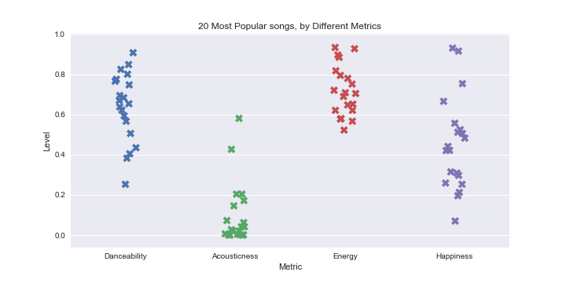
What characteristics[1] did Popular Songs in 2017 had in common?
They are Danceable, low on acoustic, high in Energy and the lyric’s mood is not as important.
[1] Spotify: Track Audio Features.

Slide 7
How do ListenBrainz and Billiboard Compare? End of 2017 lists.
ListenBrainz track_name | artist_name | Reproductions
HUMBLE. | Kendrick Lamar | 4804
Green Light | Lorde | 4644
Shape of You | Ed Sheeran | 4595
Dead End in Tokyo | Man with a Mission | 4242
DNA. | Kendrick Lamar | 4058
Stand By You | Rachel Platten | 3340
Everyday | Ariana Grande | 3140
Something Just Like This (F4ST Remix) | F4ST | 2946
夜空。feat.ハジ→ | miwa | 2899
3人の写真 | Kiroro | 2845
Billiboard track_name | artist_name
Shape of You | Ed Sheeran
Despacito | Luis Fonsi & Daddy Yankee
That's What I like | Bruno Mars
HUMBLE. | Kendrick Lamar
Something Just Like This | The Chainsmokers & Coldplay
Bad and Boujee | Migos ft. Lil Uzi Vert
Closer | The Chainsmokers ft. Halsey
Body like a Back Road | Sam Hunt
Believer | Imagine Dragons
Congratulations | Post Malone ft. Quavo

Slide 8
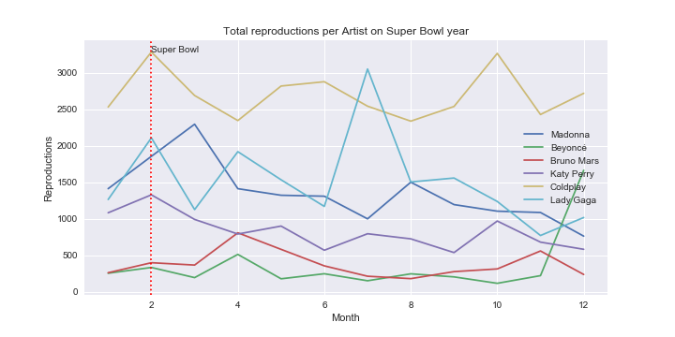
Super Bowl effect:
The NFL doesn’t pay the artists that perform at the half-time of the Super Bowl. They accept because they “get to be in what amounts to a massive commercial in front of over 100 million people” [2].
Can we see this impact in the data?
No. For most artists, the increase was only minimal.
[2] Forbes: Why Maroon 5 And Travis Scott Won’t Be Paid For The Super Bowl Halftime Show

Slide 9
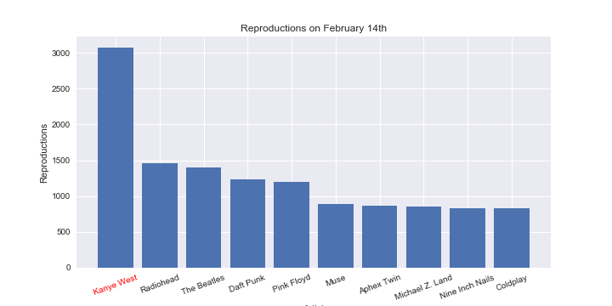
Who did the users listened on Saint Valentine’s? Apparently…
KANYE WEST

