Slide 2

Corso APEX ODCEC Milano: 23-Set-22 - 27-Gen-23
03 Ottobre 2022
Ing. Roberto Capancioni

Slide 3



Chi Sono
Ing. Roberto Capancioni
Sviluppo Oracle APEX
Board Member ITOUG
Email: sviluppo@capancioni.com
Linkedin: https://www.linkedin.com/in/robertocapancioni
ITOUG: https://itoug.it

Slide 4
Comandi SQL

Slide 5
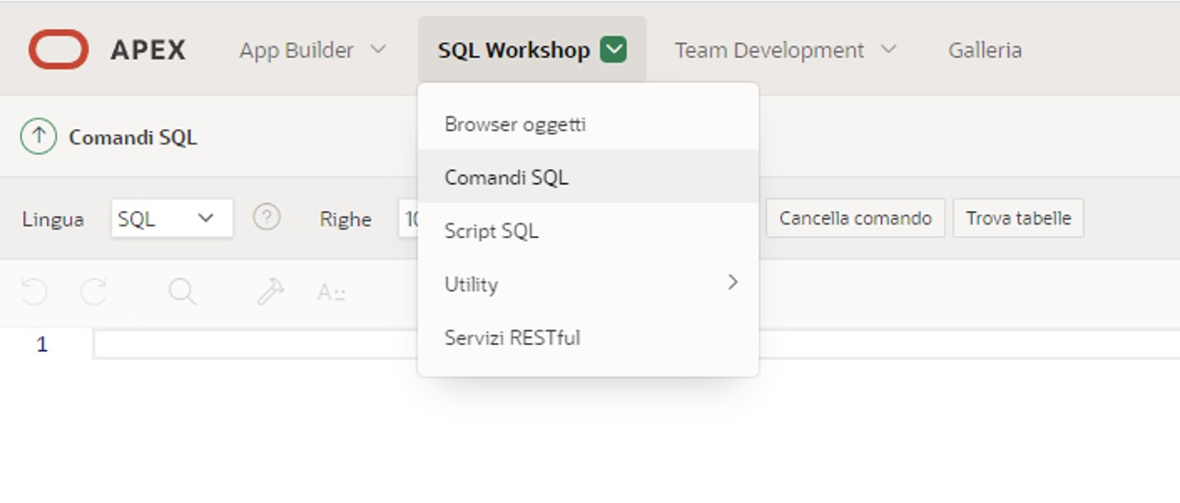
SQL Workshop – Comandi SQL

Slide 6
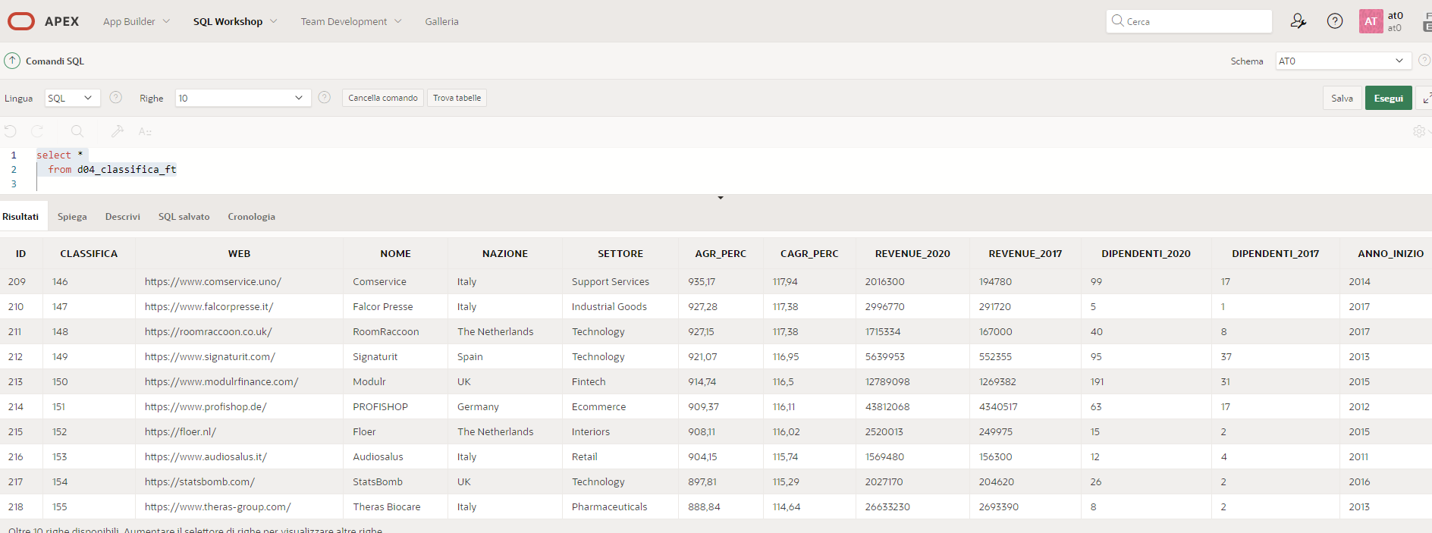
SQL Workshop – Comandi SQL
select *
from d04_classifica_ft

Slide 7
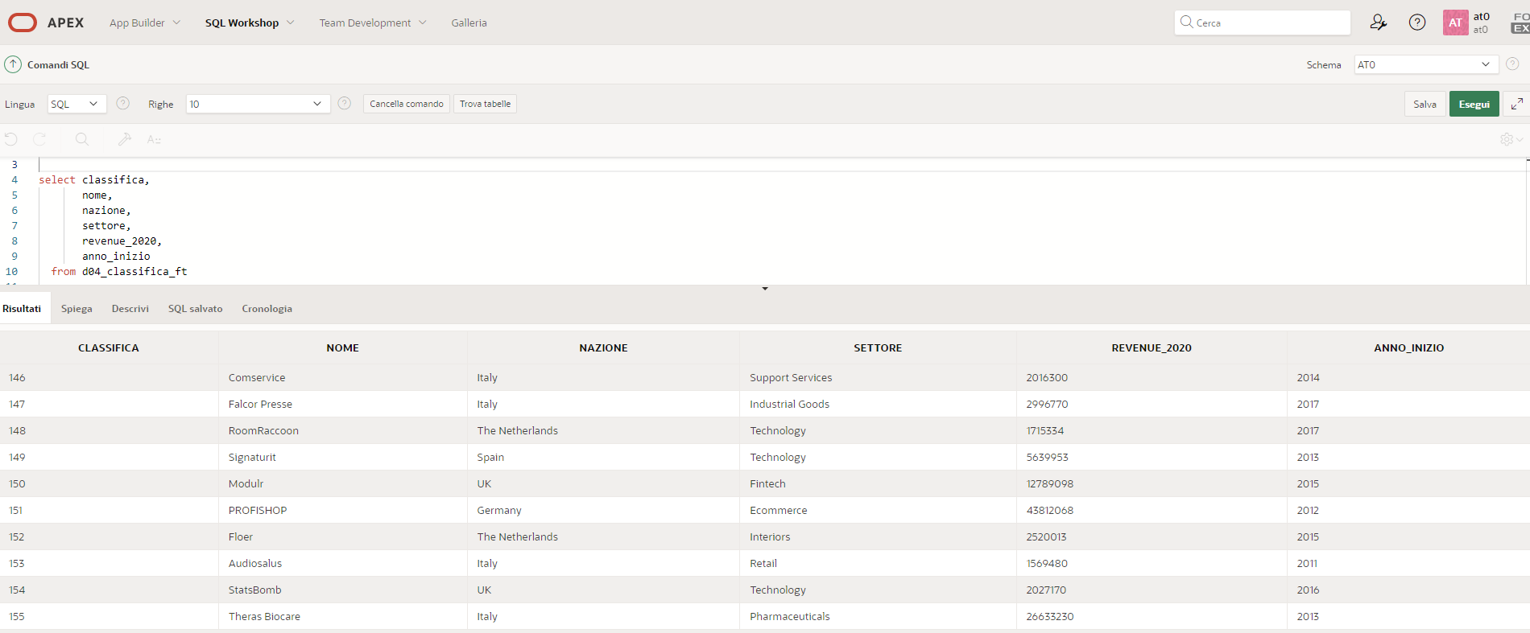
SQL Workshop – Comandi SQL
select classifica,
nome,
nazione,
settore,
revenue_2020,
anno_inizio
from d04_classifica_ft

Slide 8
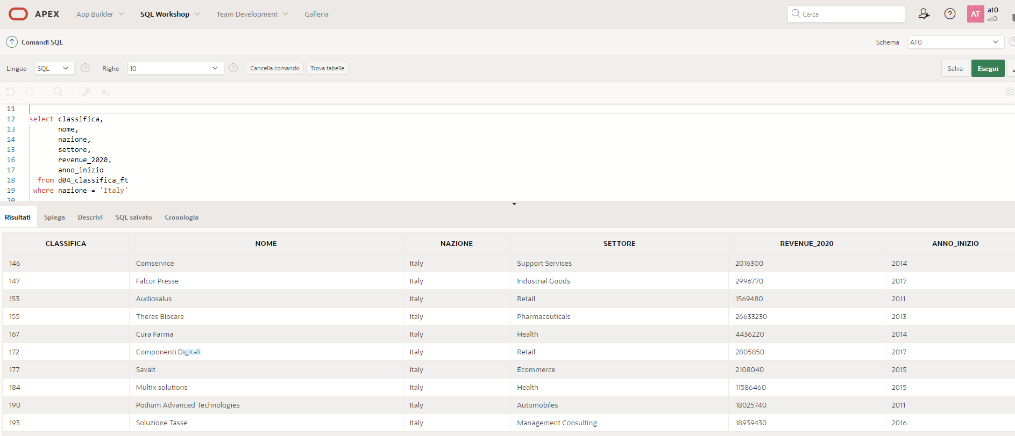
SQL Workshop – Comandi SQL
select classifica,
nome,
nazione,
settore,
revenue_2020,
anno_inizio
from d04_classifica_ft
where nazione = 'Italy'

Slide 9
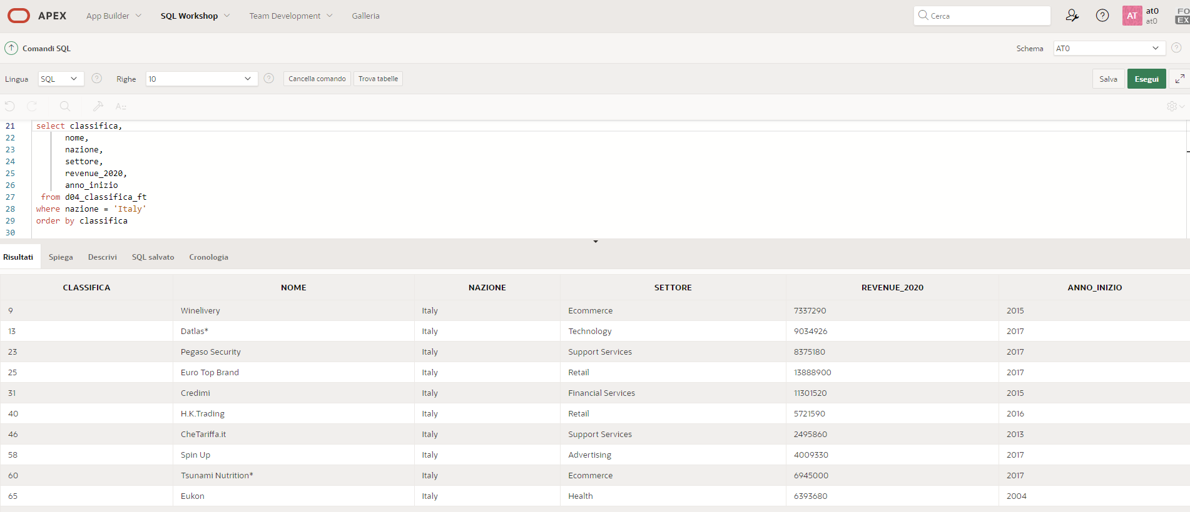
SQL Workshop – Comandi SQL
select classifica,
nome,
nazione,
settore,
revenue_2020,
anno_inizio
from d04_classifica_ft
where nazione = 'Italy'
order by classifica

Slide 10
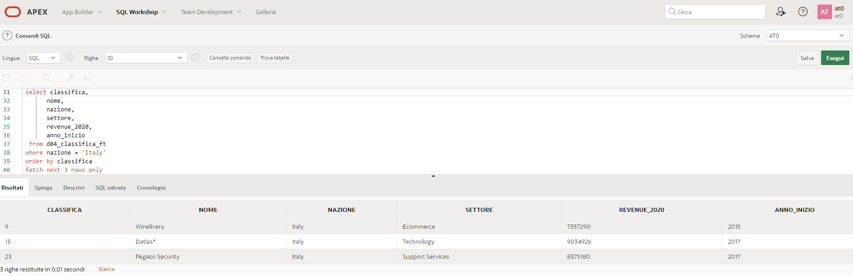
SQL Workshop – Comandi SQL
select classifica,
nome,
nazione,
settore,
revenue_2020,
anno_inizio
from d04_classifica_ft
where nazione = 'Italy'
order by classifica
fetch next 3 rows only
select classifica,
nome,
nazione,
settore,
revenue_2020,
anno_inizio
from d04_classifica_ft
where nazione = 'Italy'
order by classifica
fetch first row only

Slide 11
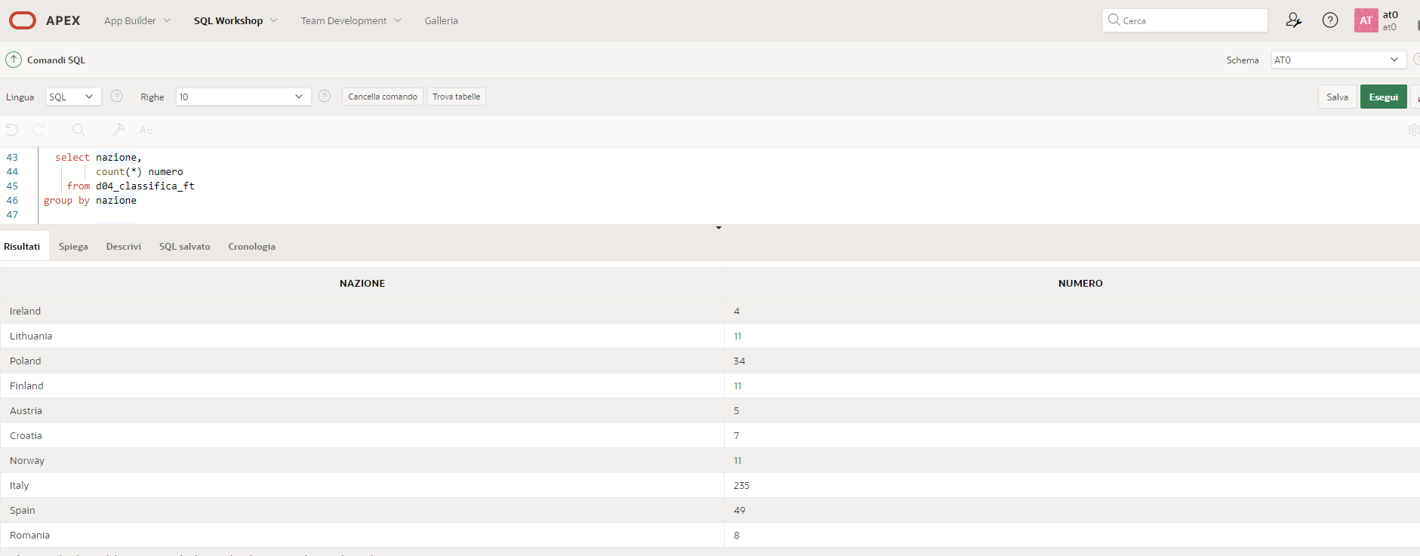
SQL Workshop – Comandi SQL
select nazione,
count(*) as numero
from d04_classifica_ft
group by nazione

Slide 12
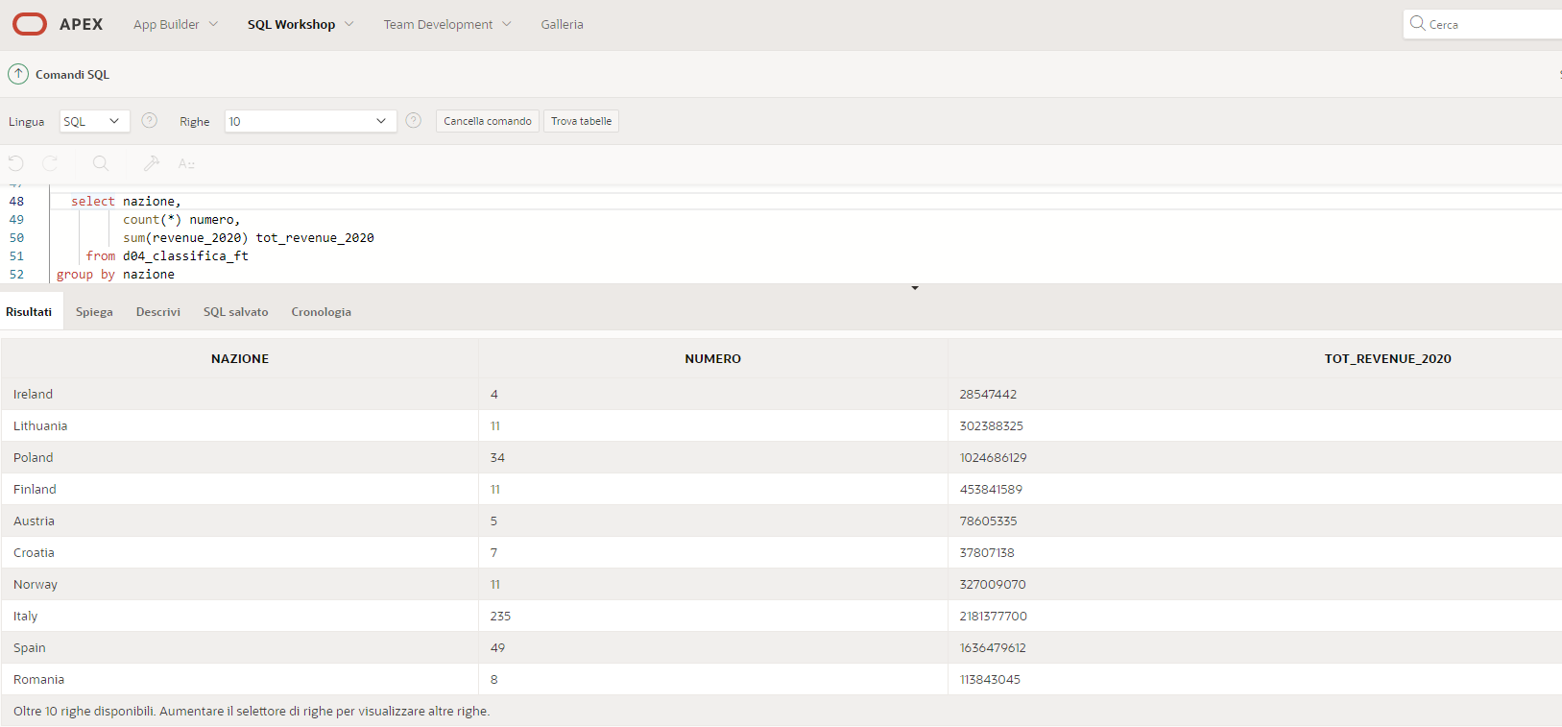
SQL Workshop – Comandi SQL
select nazione,
count(*) as numero,
sum(revenue_2020) as tot_revenue_2020
from d04_classifica_ft
group by nazione

Slide 13
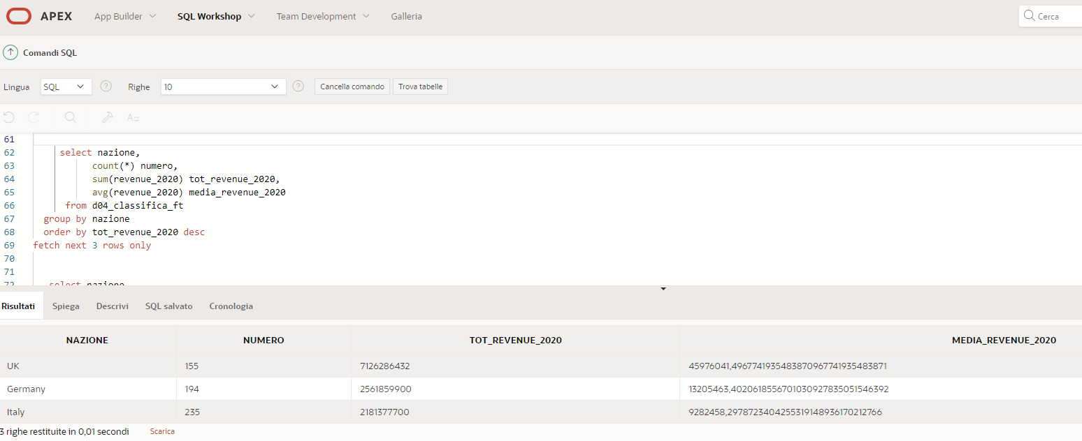
SQL Workshop – Comandi SQL
select nazione,
count(*) as numero,
sum(revenue_2020) as tot_revenue_2020,
avg(revenue_2020) as media_revenue_2020
from d04_classifica_ft
group by nazione
order by tot_revenue_2020 desc
fetch next 3 rows only

Slide 14
SQL Workshop – Comandi SQL
SENZA GROUP BY
CON GROUP BY
select c.classifica,
c.nome,
c.nazione,
c.settore,
c.revenue_2020
from d04_classifica_ft c
where nazione = 'Italy'
order by classifica
fetch first row only
select c.nazione,
count(*) as numero,
sum(c.revenue_2020) as tot_revenue_2020,
avg(c.revenue_2020) as media_revenue_2020
from d04_classifica_ft c
where c.settore = 'Ecommerce'
group by c.nazione
order by tot_revenue_2020 desc
fetch next 3 rows only

Slide 15
FT 1000 Europe’s Fastest Growing Companies

Slide 16
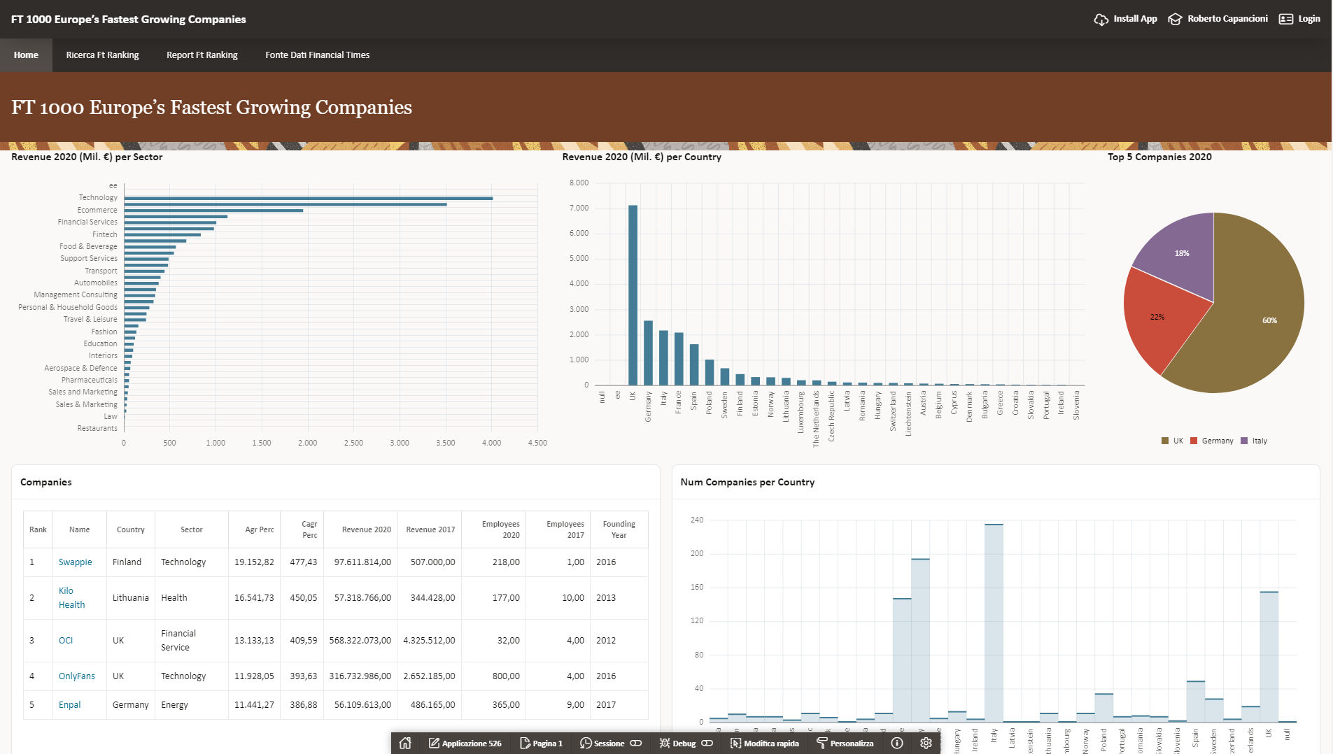
FT 1000 Europe’s Fastest Growing Companies

Slide 17
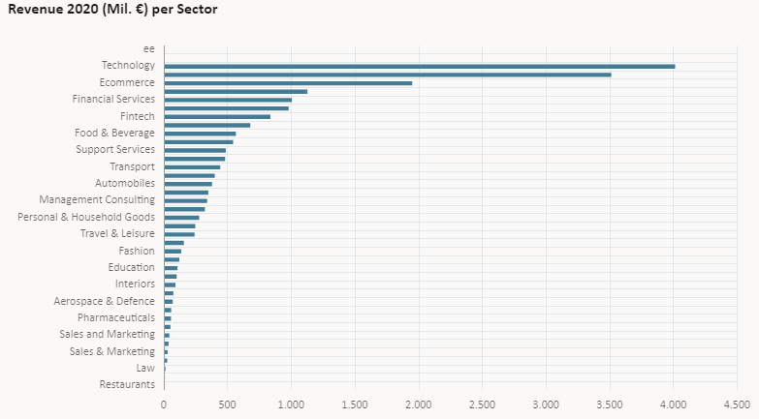
FT 1000 Europe’s Fastest Growing Companies
select settore,
sum(revenue_2020/1000000)
as revenue_2020
from d04_classifica_ft
group by settore
order by revenue_2020 desc

Slide 18
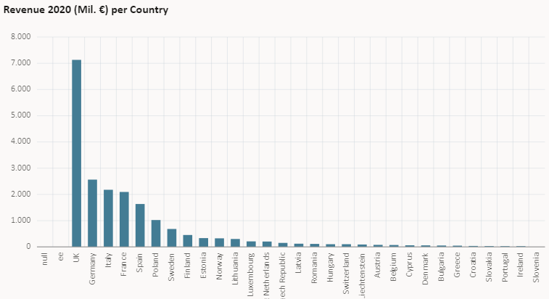
FT 1000 Europe’s Fastest Growing Companies
select NAZIONE,
sum(REVENUE_2020/1000000)
as REVENUE_2020
from d04_classifica_ft
group by NAZIONE
order by REVENUE_2020 desc

Slide 19
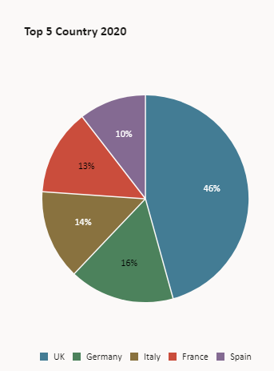
FT 1000 Europe’s Fastest Growing Companies
select NAZIONE,
sum(REVENUE_2020/1000000)as REVENUE_2020
from d04_classifica_ft
group by NAZIONE
order by REVENUE_2020 desc nulls last
FETCH NEXT 5 ROWS ONLY

Slide 20
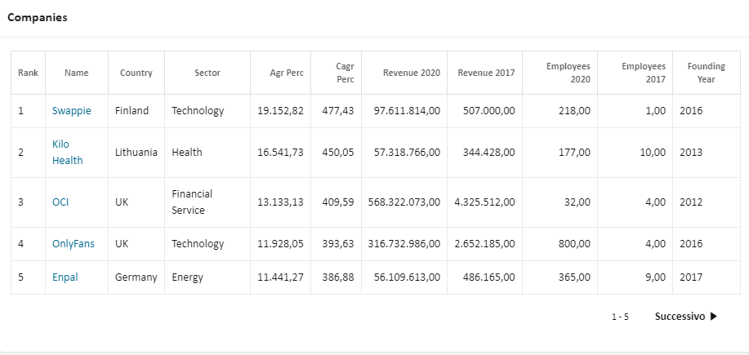
FT 1000 Europe’s Fastest Growing Companies
select id,
classifica,
web,
nome,
nazione,
settore,
agr_perc,
cagr_perc,
revenue_2020,
revenue_2017,
anno_inizio
from d04_classifica_ft

Slide 21
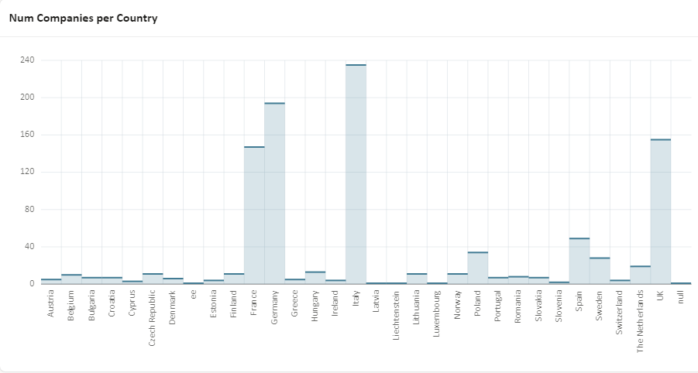
FT 1000 Europe’s Fastest Growing Companies
select count(*) as num,
NAZIONE
from d04_classifica_ft
group by NAZIONE
order by NAZIONE

