Slide 2

Oracle APEX Developing Database Web Applications

Slide 3
Course Objectives
After completing this course, you should be able to:
Create and run a database web application
Manage your database application pages and page components
Develop, use, and customize different types of reports in your application
Create, use and modify forms in your application
Build and use different types of charts in your application
Customize the look and feel of your application
Implement security in your application
Migrate your application between environments
Notes:
In this course, you learn how to design, develop and deploy beautiful, responsive, database-driven web applications using Oracle Application Express.

Slide 4
Course Agenda
Unit 1: Getting Started with Oracle Application Express
Unit 2: Using SQL Workshop
Unit 3: Creating a Database Application
Unit 4: Managing Pages in Page Designer
Unit 5: Developing Reports
Unit 6: Managing and Customizing Interactive Reports
Unit 7: Managing and Customizing Interactive Grids
Unit 8: Creating and Using Forms

Slide 5
Course Agenda
Unit 9: Creating Application Page Controls
Unit 10: Adding Computations, Processes, and Validations
Unit 11: Implementing Navigation in your Application
Unit 12: Using Themes and Theme Styles
Unit 13: Implementing Security in your Application
Unit 14: Adding Additional Pages to your Application
Unit 15: Creating and Using Dynamic Actions and Plug-ins
Unit 16: Migrating Application Development Between Environments

Slide 6
What You Should Know Beforehand
Basic knowledge of SQL
Basic knowledge of PL/SQL, and HTML is beneficial
Basic understanding of Web applications even as an end user

Slide 7
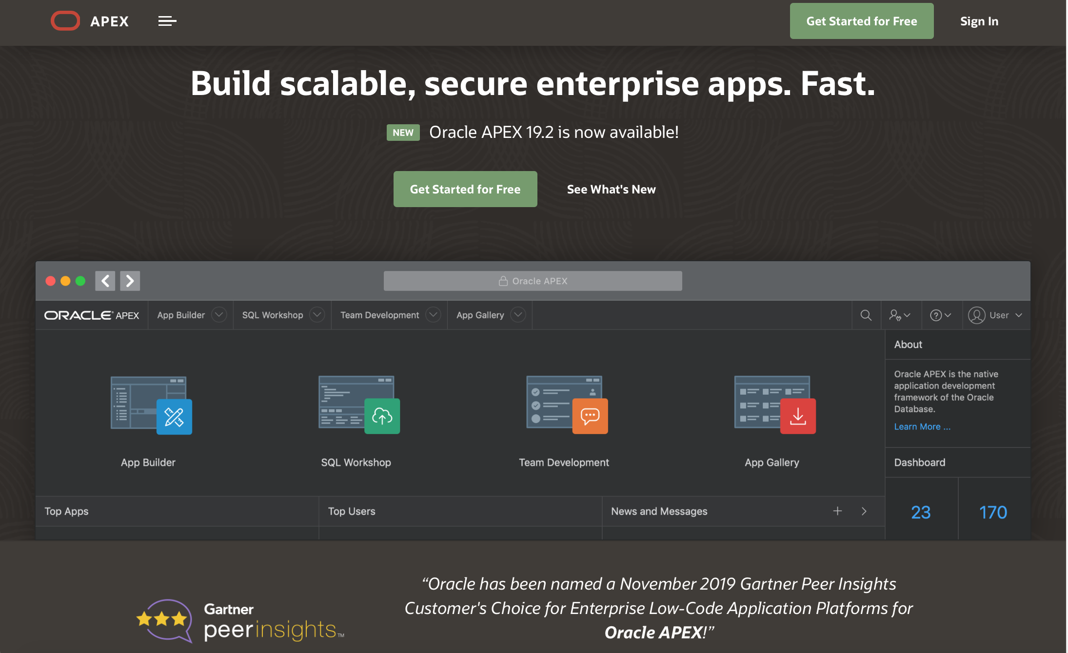
Learn More…
https://apex.oracle.com

Slide 8
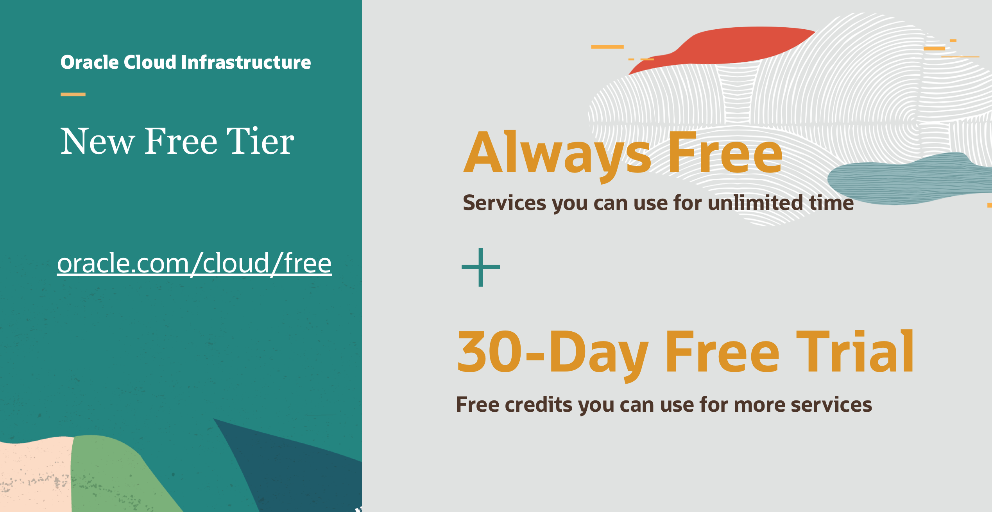

Slide 9


