Slide 1
Plane segmentation using RGBD data
Implementation of a segmentation strategy for RGBD signals that clusters pixels according to their normals

Slide 2
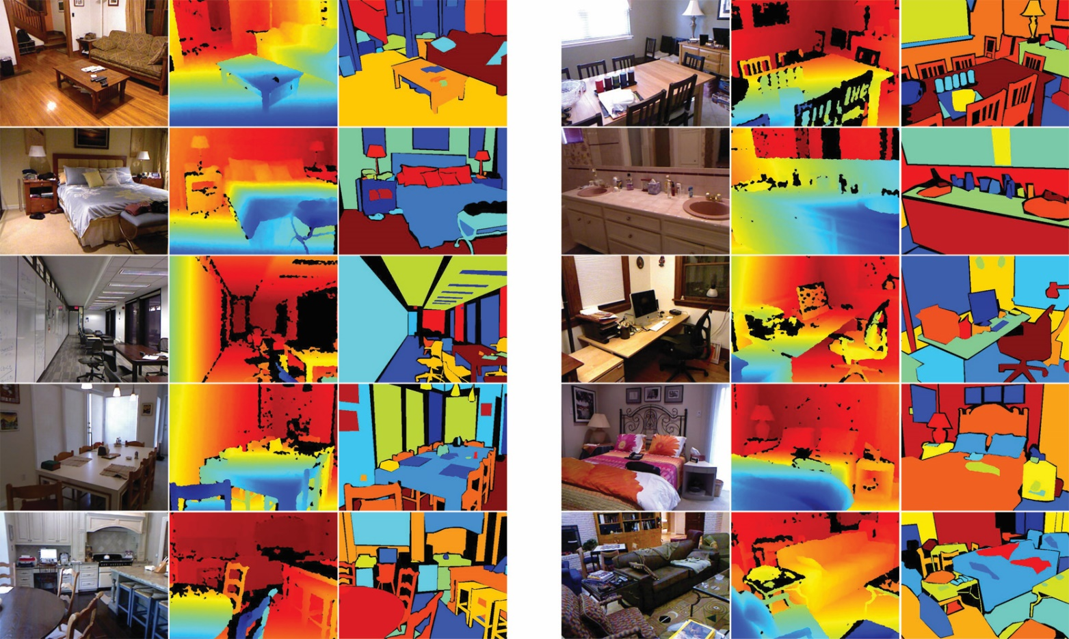
Input dataset
https://cs.nyu.edu/~silberman/datasets/nyu_depth_v2

Slide 3
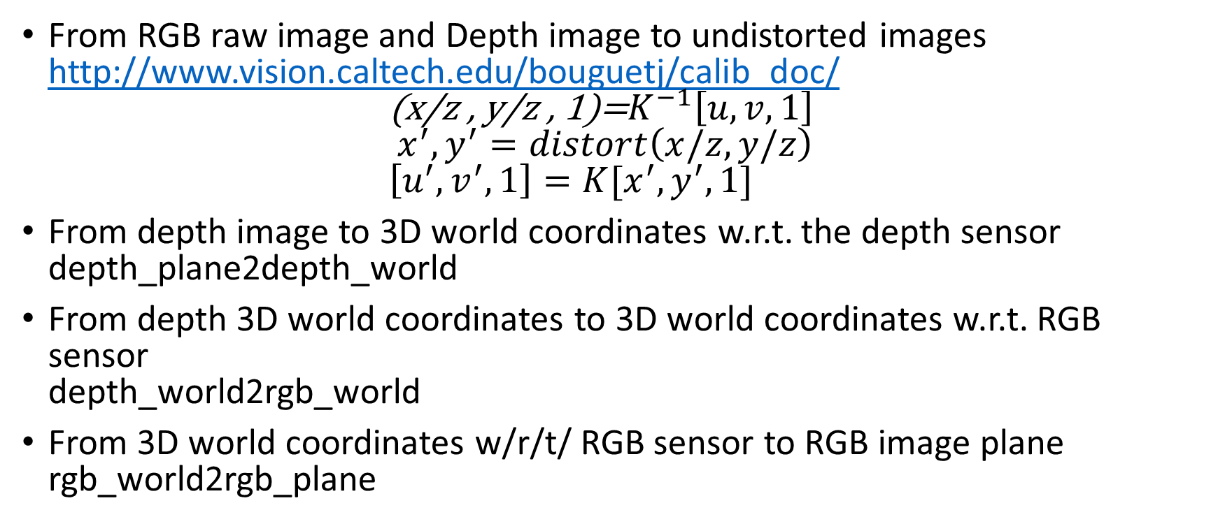
Preprocessing - project_depth_map
From RGB raw image and Depth image to undistorted images
http://www.vision.caltech.edu/bouguetj/calib_doc/
${\text{(}\text{x}\text{/}\text{z}\text{ , }\text{y}\text{/}\text{z}\text{ , 1)=}K}^{−1}\left[u,v,1\right]$
$x^{′},y^{′}=distort\left(x/z,y/z\right)$
$\left[u^{′},v^{′},1\right]=K[x^{′},y^{′},1]$
From depth image to 3D world coordinates w.r.t. the depth sensor
depth_plane2depth_world
From depth 3D world coordinates to 3D world coordinates w.r.t. RGB sensor
depth_world2rgb_world
From 3D world coordinates w/r/t/ RGB sensor to RGB image plane
rgb_world2rgb_plane

Slide 4
Processing from ToF P.C. in rgb world
https://www.willowgarage.com/sites/default/files/holz_rgbd_seg.pdf
Normals from integral images, exploiting the cross product between tangential vectors
Conversion to spherical coordinates
Quantization of the normals
Initial clusters of normals

Slide 5
Cluster merging procedure (not done)
Find the 26 close initial clusters in initial voxel grid (for 3D voxel grid) or
Find the 8 close initial clusters in the initial voxel grid (for 2D spherical voxel)
Find closest neighbor cluster, characterized by the minimum average norm of the difference between the original normals of every initial cluster and the original normals of every one of the neighbor clusters found at the previous point
If the minimum distance between two clusters is lower than a threshold (set equal to the voxel grid cell’s size), and if each cluster is the closest to each other, then merge them and keep track of the merging actions performed together with the distance of the initial cluster merged
If the minimum distance between two clusters is lower than a threshold, but the cluster to be merged is actually closer to another cluster, perform the merging for the other cluster first
Go back to point 1
Cluster according to distance of the plane from origin

Slide 6
To do
Results by varying window size
Machine learning approach

Slide 7
Future work
https://arxiv.org/pdf/1411.4734v4.pdf
https://cs.nyu.edu/~deigen/dnl/

