Slide 1
Software Engineering 2 – CLup project presentation
Robert Medvedec & Toma Sikora
Prof. Matteo Giovanni Rossi

Slide 2

CLup
Customer Line-up application
Project aim:
Easy to use
Control influx of people to the store
Reduce number of people in front of the store
Add additional features to make the shopping experience easier and faster

Slide 3
Goals of the project
Goals:
G1 Allow the user to "line up" /retrieve a number.
G1.1 Allow the user to retrieve a number through the application.
G1.2 Allow the user to retrieve a number physically from the printer.
G2 Allow the store manager to control the entrance of customers via QR code scanning.
G3 Allow the user to receive precise calculations of the waiting time.
G4 Allow the user to be updated on the store waiting time situation.
G5 Allow the user to "book a visit" to the store.

Slide 4
Design choices
Only one application (mobile)
No registration needed for customers
Registered users – store managers connected to a specific store
Adding new stores – manual addition of stores and store managers
Timeslots – 15 minutes
Ticket generation – a number and a QR code
Ticket scanning – through QR code
Different ticket states

Slide 5
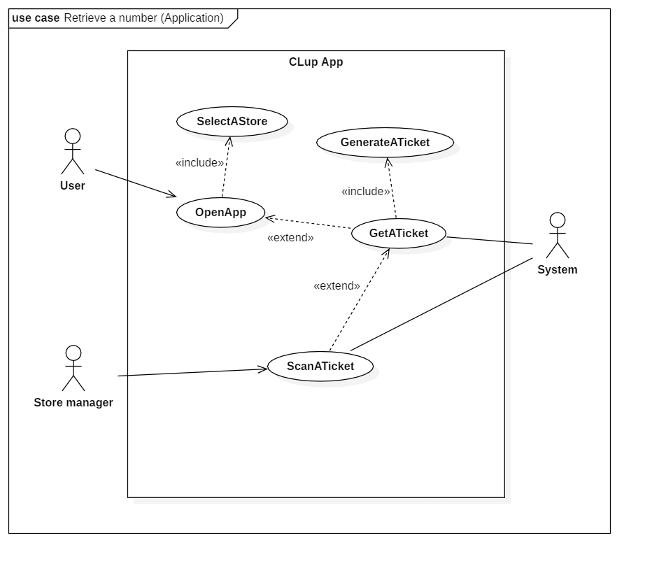

Slide 6
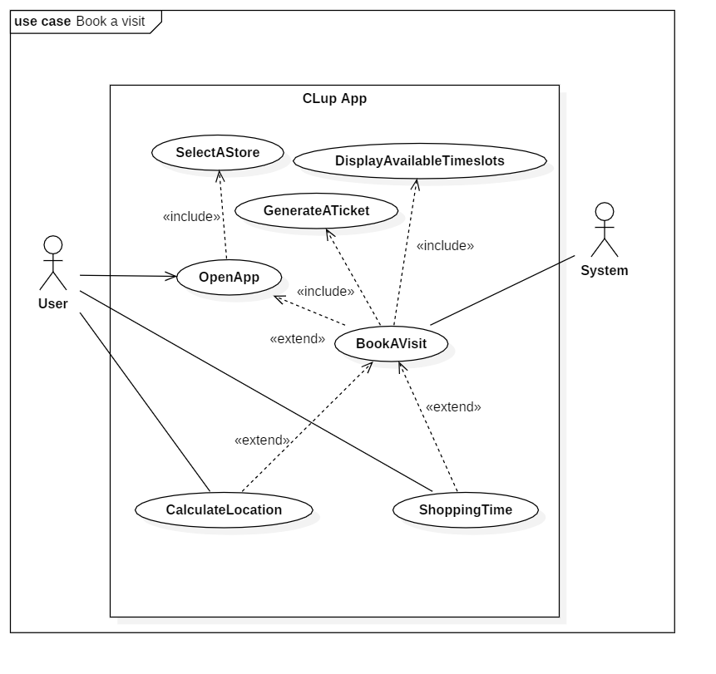

Slide 7
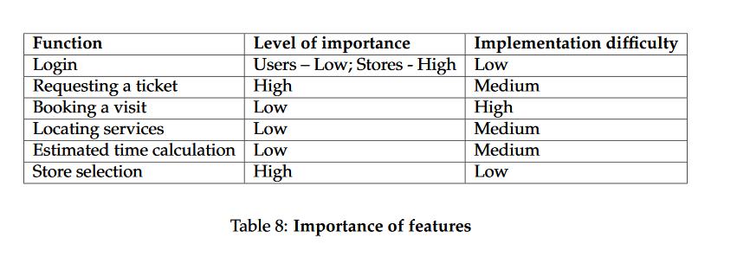
Performance requirements
Internet connection present at all times
Mobile phone with a camera
Smartphone for tickets (or a real world ticket printing machine)

Slide 8
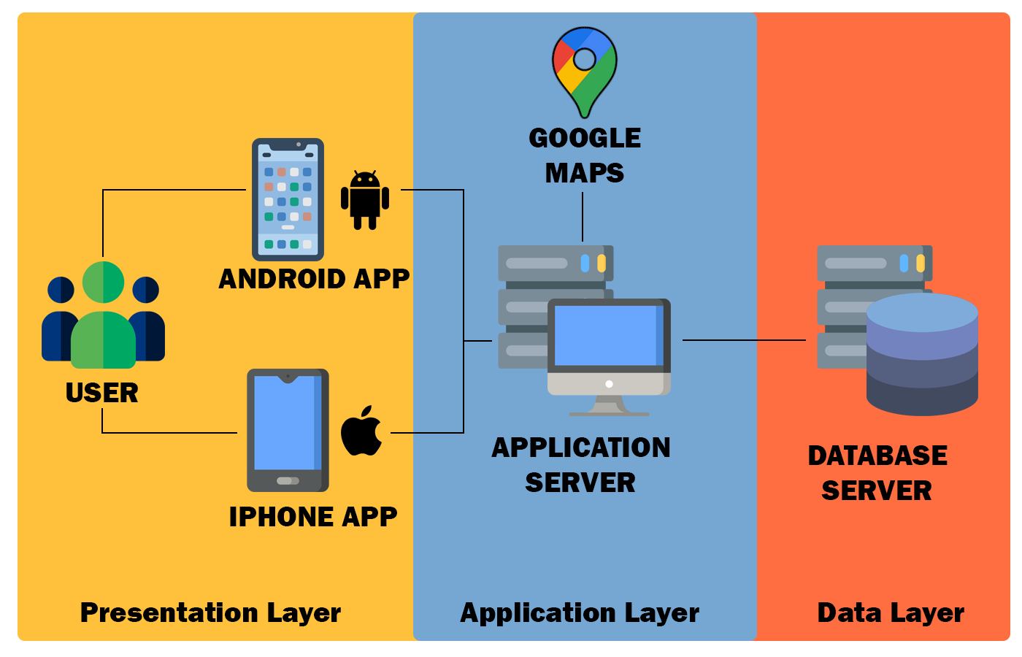
Code design ideas
Thin vs. Thick client
Model-View-Controller three layer architecture

Slide 9
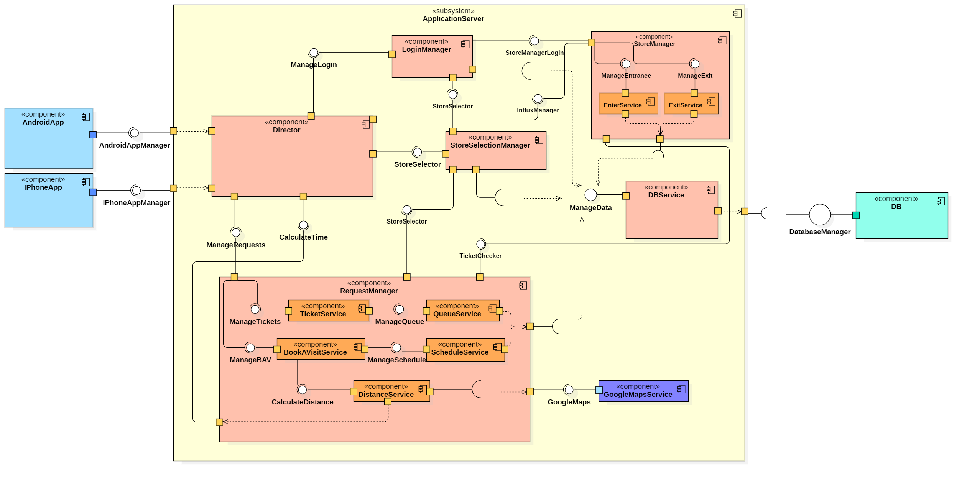

Slide 10





Implementation
Android Studio – Java, XML, UI design
Firebase Realtime Database – database
Photoshop – color schemes and app themes

Slide 11
Fulfilled requirements
R1 The user must be able to select a specific store in which they want to do the shopping.
R2 The user must be able to request a number and a ticket.
R3 The user must be able to receive a number and a ticket.
R6 The store manager must be able to scan a QR code.
R7 The store manager must be informed by the application if a user tries to enter the store out of order.
R8 The store manager must be informed when the capacity of the store is full.
R9 The store manager must be able to alert the system whenever a customer exits the store.
R10 The store manager must be provided with the login credentials upon request to the system administrator.
R19 Allow the user to be at most five minutes late for his reservation before cancelling his ticket.

Slide 12
Unfulfilled requirements
R4 The user must be able to physically retrieve a ticket from the printer containing a number and a QR code. – Real world
R5 A new ticket must be printed whenever a user physically retrieves the old one. – Real world
R11 Allow the user to receive a precise estimation of waiting time when retrieving a number. – Number of customers
R12 The system must calculate an estimation of the waiting time based on data. – Number of customers
R13 The system must be able to update its estimated waiting time in real time. – Number of customers
R14 The system must be able to send an update to the user in specific intervals regarding estimated waiting time until it’s their turn. – Not implemented
R15 The user must be able to request to see all the available timeslots in that specific store. – Book a visit
R16 The system must be able to provide the user with the list of all available timeslots upon the request. – Book a visit
R17 The user must be able to select a specific timeslot. – Book a visit
R18 The user must be able to receive a confirmation of his timeslot reservation, along with a number and a ticket. – Book a visit
R20 The user must be able to specify expected duration of his visit to the store. – Book a visit

Slide 13
Changes between R&DD and implementation
Ticket status
Fat client
Timeslots
Some controllers and services
Firebase instead of a traditional database

Slide 14
Security
Firebase authentication for registration
Firebase authentication for login (no passwords stored in the database)
AES 128-bit for QR code encryption
User interface ”back button” security
No customer data stored anywhere (GDPR)

Slide 15
Testing
Functional testing
UI testing
Security testing

Slide 16
Code and database demonstration

