Slide 1
DocumentDb powered app
Roberto Grassi
Creando una web app con DocumentDb

Slide 2
Notes:
Carlos

Slide 3
Notes:
Carlos

Slide 4



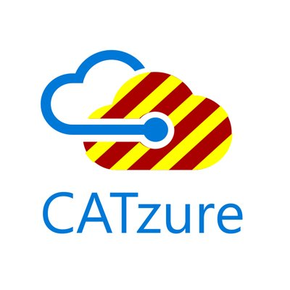
Roberto Grassi
Software architect and cloud passionate
Tech writer for SogetiLab
dotNet enthusiastic developer
Fisher and nature passionate
Find me at:

Slide 5
DocumentDb powered app

Slide 6
DocumentDb
Azure DocumentDB is a fully-managed, highly-scalable, NoSQL document database service provided by Azure.
Its many benefits include:
  rich query over a schema-free JSON data model
  transactional execution of JavaScript logic
  scalable storage and throughput
  Rich rest API to interact with
  Sdks ready for almost all technology stack

Slide 7
Hands on Lab
In this lab, you will learn how to build a to-do list web application using Azure DocumentDB.
The web application will be a C# MVC application
The goal will be wire the basic CRUD operations to methods that use DocumentDB

Slide 8
Hands on Lab
This lab includes instructions for the following tasks:
  Creating a DocumentDB database account
  Creating a new ASP.NET MVC application
  Adding DocumentDB to your project
  Setting up the ASP.NET MVC application
  Wiring up DocumentDB: create, update, get, delete and search
  Running the application locally
Explications here
Clone repository to get the solution

Slide 9
DocumentDb powered app

