Slide 1
Language Extensions
A case for code reusability and feature sharing

Slide 2
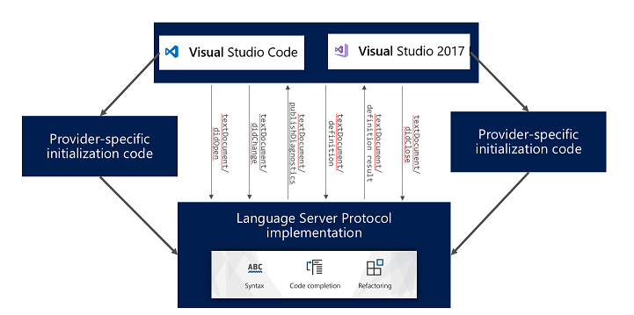
Motivation
Learn about the capabilities of VSCode regarding Language Server support.
Learn about the possibilities of avoiding code duplication between IDEs, especially between VSCode and VS.

Slide 3
Language Extensions
VSCode offers a set of APIs that enable rich language features
Syntax Highlighting
Snippet & language completion
Hover information
Refactoring
Codelenses
…
Some of these features can be added in a declarative way but most of them must be supported programmatically.

Slide 4
Programmatic language features
These are the most interesting features:
Diagnostics
Hover information
Definition
References
Codelenses
Symbols
CodeActions
Format
…
VSCode provides the vscode.languages.* API.
You can also use a Language Server that speaks Language Server Protocol (LSP).

Slide 5
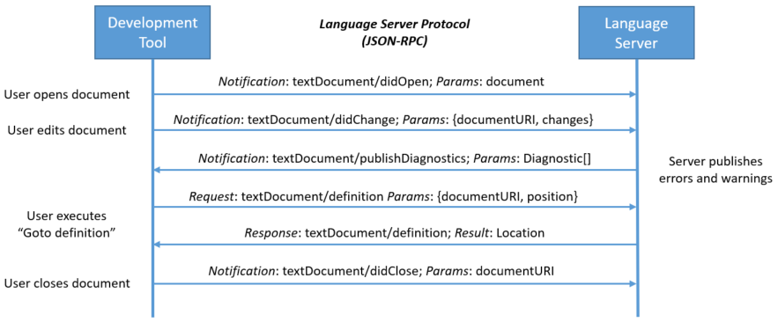
Language Server
A Language Server is meant to provide the language-specific smarts and communicate with development tools over a protocol that enables inter-process communication.
It runs in a separate process and development tools communicate with the server using a language protocol over JSON-RPC.

Slide 6
Language Server Protocol (LSP)
The idea behind the Language Server Protocol (LSP) is to standardize the protocol for how such servers and development tools communicate.
This way, a single Language Server can be re-used in multiple development tools, which in turn can support multiple languages with minimal effort.
LSP defines capabilities.
A development tool and a language server announce their supported features using capabilities.

Slide 7
VSCode Language API vs Language Server
Generally speaking using the Language API is easier if you just want to focus on VSCode.
Language Servers are more flexible and foster feature reusability among different IDEs.
Language Servers run in separated process so they don’t affect IDE’s performance.
 | Language | Separated Process | Support multiple IDEs | Extend LSP capabilities | Web Extension
Language API | TypeScript | No | No | Yes | Yes
Language Server | Any | Yes | Yes | Yes | Yes

Slide 8
Language Server limitations
In order to support VSCode web extensions or Theia based editors, the Language Server should be written in TS/JS or compiled to WASM (Rust).
Not all development tools support the same capabilities (e.g. VS lacks Codelens support at the moment).

Slide 9
DEMO
VSCode extension consuming a Language Server (Rust) to detect log lines.

Slide 10
Appendix

Slide 11
Resources
LSP/LSIF: https://microsoft.github.io/language-server-protocol/
VSCode Language extensions: https://code.visualstudio.com/api/language-extensions/overview
Language Server implementations: https://microsoft.github.io/language-server-protocol/implementors/servers/
LSP supporting tools: https://microsoft.github.io/language-server-protocol/implementors/tools/
LSP extensions for VS 2022: https://docs.microsoft.com/en-us/visualstudio/extensibility/adding-an-lsp-extension?view=vs-2022
Language server capabilities implemented by language: https://langserver.org/#implementations-server
* All links were visited on 2022-07-04

Slide 12
Thanks!
IDE Integration team

