Slide 1
Scala 2.x
"Bringing the Best of Both Worlds: Object-Oriented and Functional Programming"

Slide 2
What is Scala?
Scala is a modern programming language that combines:
Object-Oriented Programming (OOP): Classes, objects, and inheritance.
Functional Programming (FP): Pure functions, immutability, and expressions.
Created around 2001 by Martin Odersky.
1^{st.} official release in 2004
1^{st.} stable release in 2006
The name derives from "Scalable Language", as it works for both small and large projects.
Runs on the JVM (Java Virtual Machine).
PS: Scala is not an extension of Java, but it is completely interoperable with it.

Slide 3
Why Learn Scala?
Interoperability with Java:
Seamlessly reuses Java libraries.
Highly expressive: Concise and powerful code.
Popular in Big Data:
Widely used in tools like Apache Spark and Kafka.
High employability: Increasing presence in startups and major enterprises.
Hybrid paradigms: Learn functional programming without giving up OOP.

Slide 4
Scala vs. Java
Aspect | Scala | Java
Conciseness | Short, expressive code | Verbose
Paradigms | OOP and Functional | Mostly OOP
Immutability | Encouraged | Optional
Syntax | Modern and flexible | Traditional and strict

Slide 5
Key Features of Scala
Strong Static Typing: Errors caught at compile-time.
Expressions instead of Statements: More clarity, fewer side effects.
Immutability by Default: Prevents common bugs.
Interoperability with Java: Direct integration.
Traits and Rich Class Systems: Efficient code reuse.

Slide 6
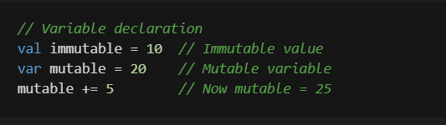
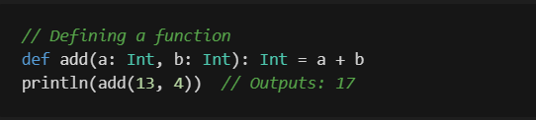
Basic Syntax

Slide 7
Data Types in Scala
Value Types (Primitive Types):
Scala's primitive types are compatible with Java and represent basic values.
Boolean: true or false.
Byte: 8-bit signed integer (-128 to 127).
Short: 16-bit signed integer (-32,768 to 32,767).
Int: 32-bit signed integer.
Long: 64-bit signed integer.
Float: 32-bit floating-point.
Double: 64-bit floating-point.
Char: A single 16-bit Unicode character.
Unit: Represents no value (similar to void in Java).
Reference Types:
String: Immutable sequence of characters.
Collections: Lists, Maps, Sets, etc.

Slide 8
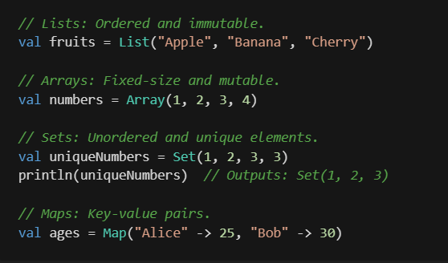
Scala Collections
Immutable by default (e.g., List, Set, Map).
Mutable collections available when necessary (e.g., ArrayBuffer, MutableList).
Rich API for operations like map, filter, reduce.
Support for both sequential and parallel processing.

Slide 9
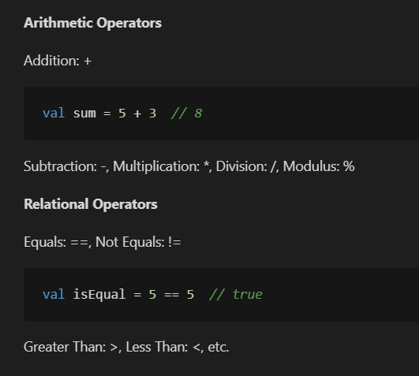
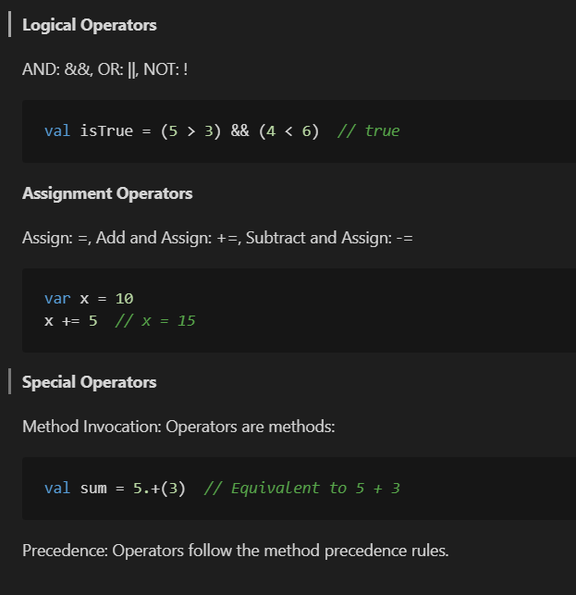
Operators in Scala

Slide 10
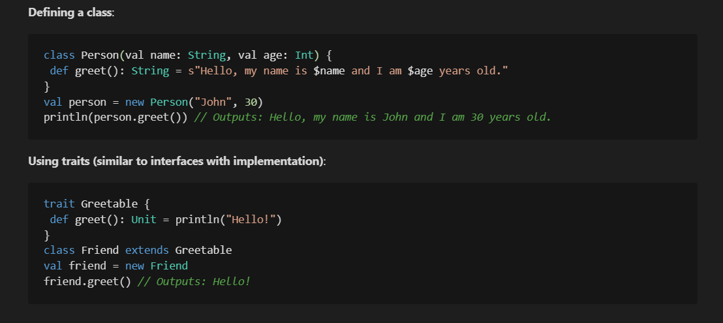
Object-Oriented Programming in Scala

Slide 11
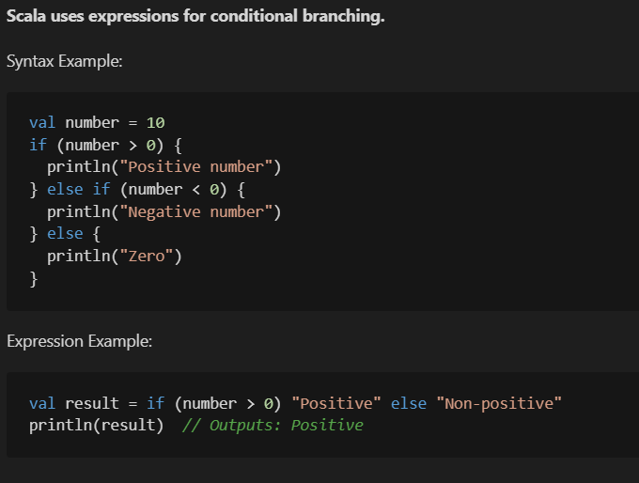
Control Structures in Scala

Slide 12
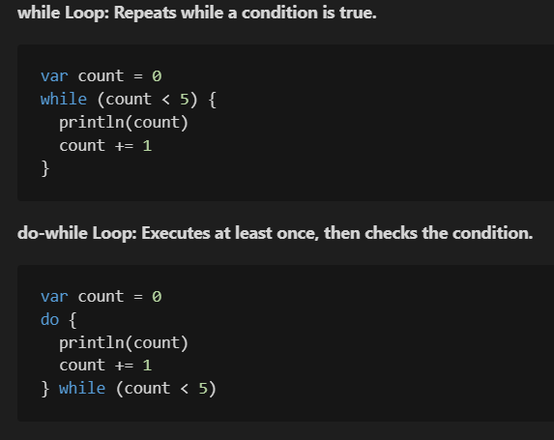
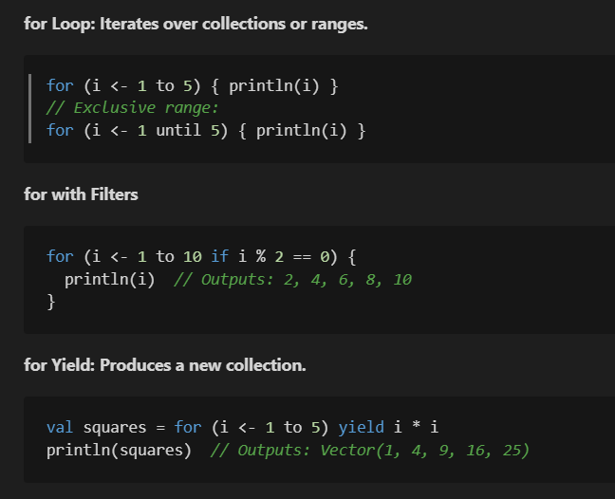
Loops in Scala

Slide 13
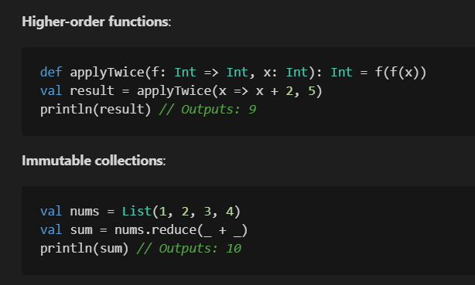
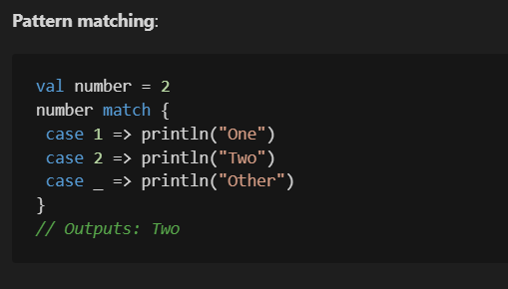
Functional Programming in Scala

Slide 14
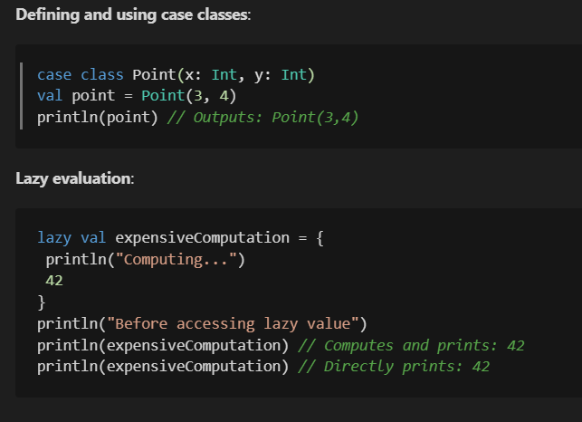
Advanced Code Examples

Slide 15
Scala tools
Scala Compiler: scalac
Scala REPL: Test and experiment with code interactively.
Build Tools: SBT (Scala Build Tool), Maven, Gradle.
Scala playground: Scaltie (https://scastie.scala-lang.org/)

Slide 16
Scala frameworks
Big Data: Core language for Apache Spark.
Web Development: Frameworks like Play! Framework.
Microservices: Lagom, Lift.
In-demand tools: Kafka, Akka, etc.
Query and access databases in Scala syntax: Slick

Slide 17
Challenges with Scala
Learning curve: Mixed paradigms can be challenging for beginners.
Smaller community: Fewer beginner resources compared to Java.
Code complexity: Overuse of features can lead to unreadable code.

Slide 18
Conclusion
Scala is a versatile and powerful language that blends OOP and FP.
Ideal for students interested in Big Data, scalable systems, and modern programming paradigms.
Learning Scala opens doors to diverse job opportunities in high-demand fields.
....
Questions?

Slide 19
Getting Started
1. Install Scala: https://www.scala-lang.org/
2. Set up an IDE: IntelliJ IDEA or VS Code with Scala plugins.
3. Explore the REPL to experiment with code.
4. Practice on Scala Exercises: https://www.scala-exercises.org/.
5. Read the official documentation and start small projects.
OR (for some simple tests)
1. Scala playground: Scaltie (https://scastie.scala-lang.org/)

Slide 20
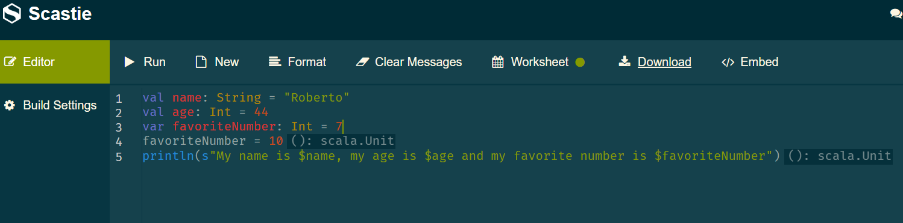
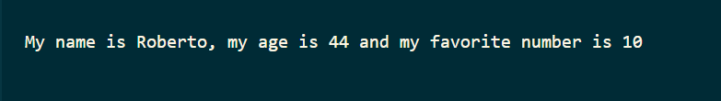
Exercise: Variables and Data Types
Define variables:
One immutable (val) as a String Type with your name
One immutable (val) as a Integer Type with your age.
One mutable (var) with your favorite number.
Modify the mutable variable and print the values.

Slide 21
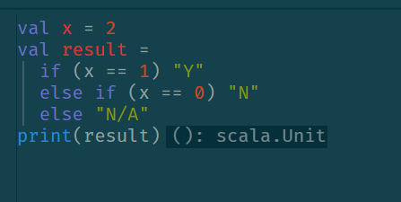
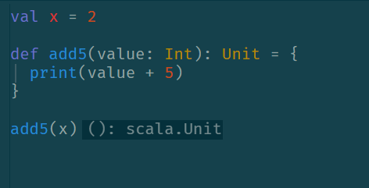
Exercise: Conditional Statements
Write a program that checks whether a number is positive, negative or zero.
Use an if/else block to implement the logic.
Create this logic inside a function that
Receive the number as a parameter
Print, in the end, the number and if it is positive, negative or zero

Slide 22
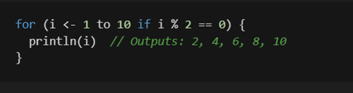
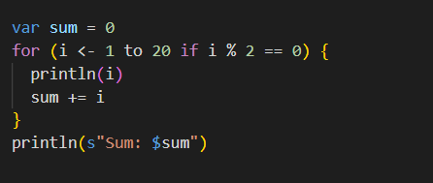
Exercise: Loops
Use a for loop to print all even numbers from 1 to 20.
After:
Modify the program to also calculate the sum and the average of these numbers.

Slide 23

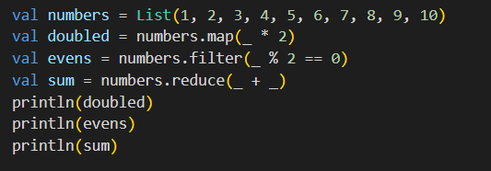
Exercise: Collections and Functions
Create a list of integers from 1 to 10.
Use the following functions:
map: Multiply each number by 3.
filter: Keep only odd numbers.
reduce: Find the sum of the list.
In Scala, the underscore _ is a powerful and versatile symbol used in several contexts, each with its specific meaning.
For this case, it is used as a placeholder for a parameter:

Slide 24
Contact
Roberto Passos Rodrigues Jr.
Developer / Data Engineer / Tech Lead at Natixis
Email: robertoprjr@gmail.com
GitHub: https://github.com/robertoprjr
LinkedIn: https://www.linkedin.com/in/roberto-passos-rodrigues-jr/

