Slide 1
Preamble: CrossPlatformBitmap
Unfortunately Mono for Android and .NET framework use different bitmap classes. We have created CrossPlatformBitmap to abstract way these difference, since this class is tedious to write we have given you it’s definition in the solution.

Slide 2
Task One: Create the Lorenz System
In “LorenzSystem.fs” write a function that takes 6 parameters, the 3 constants sigma, beta, rho, and 3 variables, x, y, z. This function should return a triple (3-tuple) each value representing the result of one of the Lorenz equations (from previous slide).
Test your function in “LorenzSystemTests.fsx”
A function that integrates the Lorenz equations is provided. In “LorenzSystemTests.fsx” use this function to check you get the right results.

Slide 3
Task Two: Create the Viewport 3D
It’s the viewport’s job to map from a 3D plane to a 2D one. If we assume the camera is fixed and we’re facing the z-axis this is easier than is sounds! This mapping has three phases.
1) We need to map from the 3D plane to a 2D plane, taking into account that the origin is in a different place
2) We need to taking into account that Y axis on a bitmap is inverted
3) Then we need to scale our values to fit into the bitmap
(I found it convenient to perform 2 & 3 at the same time)

Slide 4
Task Two: Create the Viewport 3D (Cont.)
The following equations perform the phase 1 mapping:
x2d = xOffset + x3d / (z3d + distance)
y2d = yOffset + y3d / (z3d + distance)
A detailed explanation can be found here: http://anthony.liekens.net/index.php/Computers/RenderingTutorial3DTo2D
The maths required for phases 2 & 3 are an exercise for the reader.
Diagram showing the mapping on next slide.

Slide 5
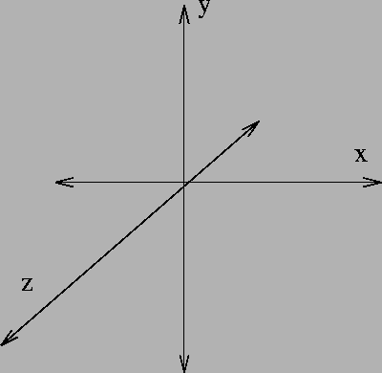
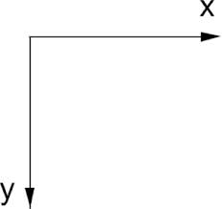
Task Two: Create the Viewport 3D (Cont.)

Slide 6
Task Two: Create the Viewport 3D (Cont.)
In “Viewport3DBitmap.fs” create a class that:
Contains a reference to “CrossPlatformBitmap.fs”
Contain a constant “points” for the number of points it will show
Contain a property “Points” that is a sequence of triples represents a collection of x y z coordinates. The “Points” property should have the following behavior:
  When ‘set’ is called it should store the points for later, then map the points to a 2d plane and draw them on the bitmap. Don’t forget the y plane of the bitmap is upside down!
  When ‘get’ is called it should return the points

Slide 7
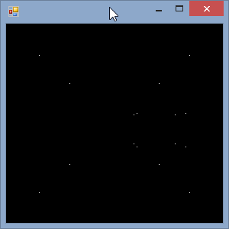
Task Two: Create the Viewport 3D (Cont.)
In “Viewport3DBitmapTests.fsx” are some suggested tests, if working well it should look like:

Slide 8
Task Three: Create the View Model
It is the view model’s job to collect the inputs from the gui and pass them to the domain logic. If an update is required the view model will raise an event.
In “LorenzViewModel.fs” create a class with:
An instance of the Viewport3DBitmap
A “Bitmap” property that exposes the viewport 3D’s bitmap
An “Updated” event that fires whenever the viewport 3D changes
Three properties “Sigma”, “Beta”, “Rho”, that will collect the values from the GUI and update the viewport 3D when they are updated

Slide 9
Task Four: Create the Windows Forms GUI
To create the Windows Forms GUI:
Create an instance of the Form class and an instance of the LorenzViewModel class
Create an instance of the Control class, update the Control’s BackgroundImage property to be the LorenzViewModel’s bitmap property and add the control to the form
Create three TextBox instances and add them to the form, whenever the TextBox’s are updated update the LorenzViewModel class’s Sigma, Beta, Rho properties
An event handler to the LorenzViewModel’s Update event that invalidates the control that contains the bitmap

Slide 10
Task Five: Create the Web Suave GUI
The Suave web framework allows you to associate a handler function with an incoming http request.
More details about the Suave framework can be found here:
http://sauve.io/
A detail example of handlers can be found here:
https://github.com/SuaveIO/suave/blob/master/Example/Program.fs

Slide 11
Task Five: Create the Web Suave GUI
The web app consists of a web page with a form that post back the sigma, beta, rho values of the Lorenz System and dynamically generated image of the Lorenz attractor
We require three handler functions:
A handler function bound to GET /, which produces a static html page with the Lorenz default values
A handler function bound to POST /, which produces a dynamic html page with values send in the forms body
A handler function to /lorenz.png, that dynamically renders the Lorenz attractor image using the view model

Slide 12
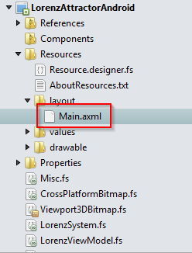
Task six: Create the Android GUI
An XML file containing the layout of the GUI has been provided:

Slide 13
Task six: Create the Android GUI (cont.)
In “MainActivity.fs”, in the “OnCreate” of the “MainActivity” class:
Create an instance of the LorenzViewModel as a class member
Use the FindViewById method to get a reference to each of the controls in “MainActivity.axml”
Call the “SetImageBitmap” method of the ImageView class with a reference to the view model’s “Bitmap” property
When each of the three EditText controls are updated update the appropriate property of the view model

