Slide 1
Xamarin and Cross Platform Apps
Robert Pickering and Robin Neatherway

Slide 2
Workshop Objectives
Create an F# application that:
Is a ‘Line of Business’ like application
Has an architecture that is portable across several platforms
  Windows
  Web
  Android

Slide 3
The Application
The application should:
Create a model of the “Lorenz System”
Display this model in 3D to the user
Allow the user to edit the parameters of the system

Slide 4
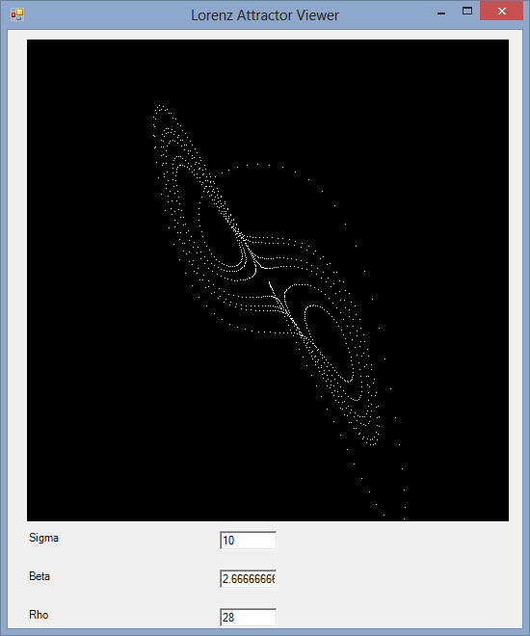
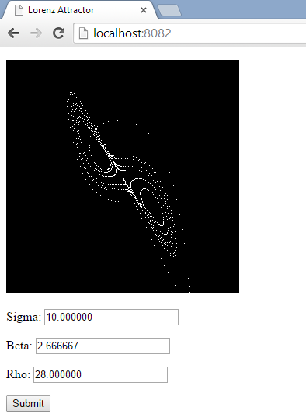
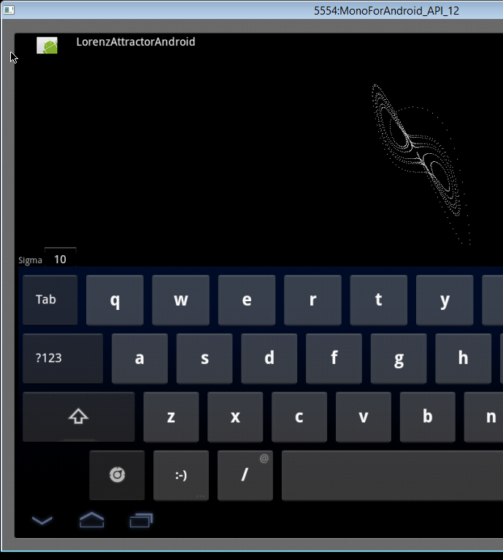
The Platforms
Windows
Web
Android

Slide 5
The Architecture
CrossPatformBitmap
Viewport3DBitmap
LorenzViewModel
Window Gui
Web Gui
Android Gui

Slide 6
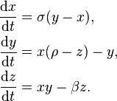
The Lorenz System
The Lorenz System is a system of three ordinary differential equations:

Slide 7
The Lorenz System
The Lorenz System has three constants sigma, beta, rho and three variables x, y, z.
When integrated certain values of the constants produce chaotic effects, that is, when plotted in 3D space the points can be seen to spiral round several points. This spiraling leads them being called the “attractors”.
The value sigma = 10, beta = 8/3, rho = 28 lead to the classic “butterfly” shape and we’ll be using these as our default.

Slide 8

The User Interface
Plot of X Y Z points
Input of the constants
Sigma
10
Beta
2.6
Rho
28

Slide 9
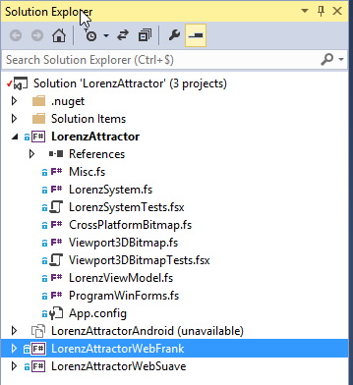
Solution Setup
Windows Form, start here
Android, last part, use Xamarin Studio for this
Web based on Frank FS, ignore for now
Web based on SuaveIO, second bit

Slide 10
Android: Emulator or Device
Emulator:
  Resource hog (though better if your processor support virtualization)
  Deployment fails randomly
Device:
  Requires a physical device and a USB connector!
  Need to activate development mode, a different setting on every Android device

Slide 11
Working with the Android Emulator
Always start and unlock the emulator before trying to deploy
If deployment fails, restart the emulator
If that does work, reboot your machine
Deployment is slow, but should take much more than one minute, if it takes longer it has failed in a hung state

Slide 12
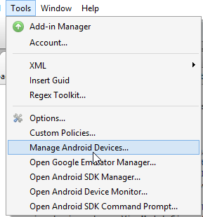
Working with the Android Emulator
Manage Emulators and Physical Devices
Manage Emulators definitions

Slide 13
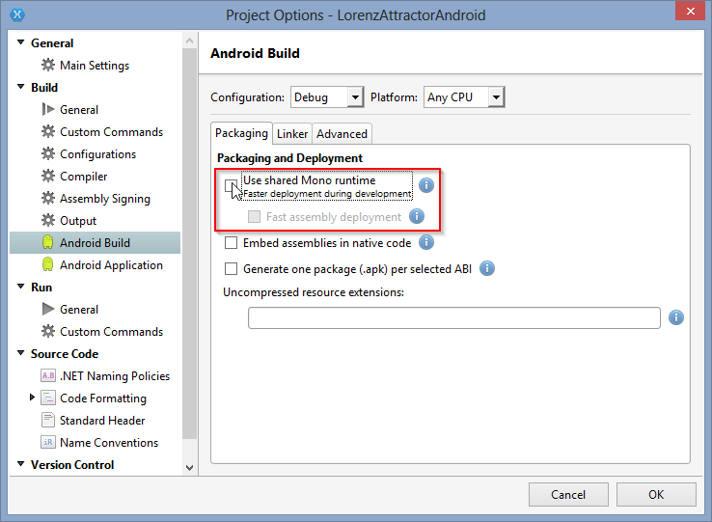
Android: Settings to make deployment work

Slide 14
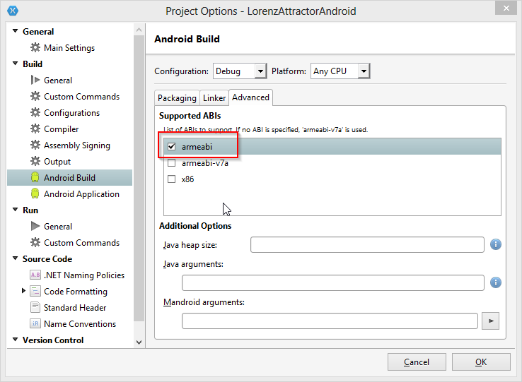
Android: Settings to make deployment work

Slide 15
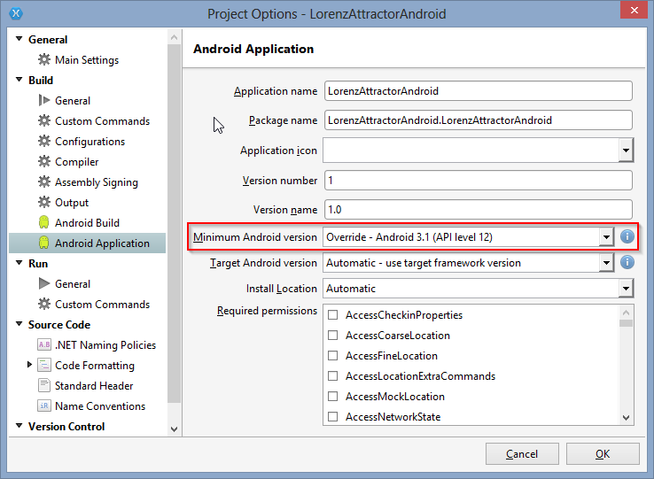
Android: Settings to make deployment work

