Slide 1
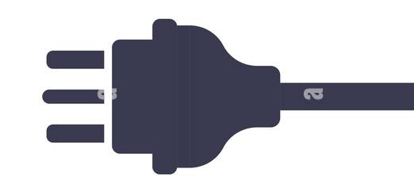
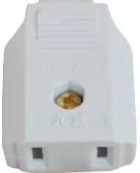
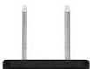
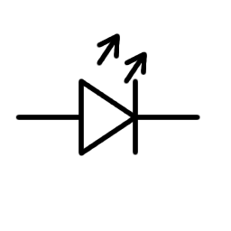
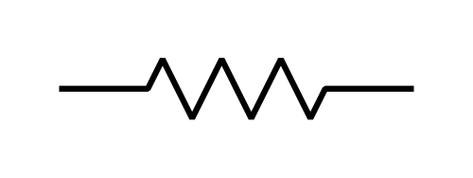
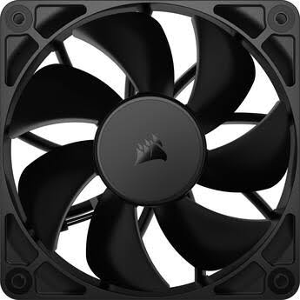
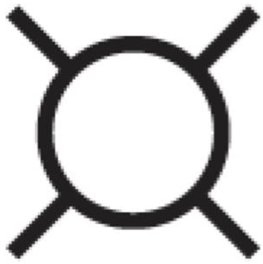

Schematic diagram of the electronics in the blue PET box.
Back panel: 2 SHV high-voltage connectors, 2 BNC signal connectors, AC receptacle and switch, trailer connector for linear stage.
Front panel: low and high voltage switches and LEDs, ethernet plug, USB-A plug, DB9 for stop switches, 3 BNC connectors for monitoring by oscilloscope.
Side panel: DB9 for rotation stage.
Top panel: pilot light (3.3 V).
120 V AC
Switch & Fuse
Ethernet to PC
120 V AC
GND
24 V DC
Switch
USB-C
5 V USB-C supply
2 SHV
Connectors, to PMTs
24 V
DC
Power
Supply
Gen-2 Red Pitaya
Note: the HV wires must be contained within a grounded shield to prevent digital noise from corrupting the detector signals.
To Linear Stage
24 V
E1 Flat Cable
High Voltage wires
24 V DC
Switch
RS232 Cable to Rotation Stage
Trailer Light Plug
E2 Flat Cable
GND
SMA Cables
DB9 RS232 Connector
Amplifiers
Coincidence
Circuit
HV
HV
24 V
Step
Direction
RP-DI05_P
24 V Power for HV Supplies
RP-DI05_N
3.3 V
PET Coincidence Board
USB-A to PC
GND
CPU fan on Red Pitaya
RP-TX
12 V switching regulator
Adafruit USB-UART Bridge
Stepper Motor Controller for Linear Stage
RP-RX
Stepper Motor Controller for Rotation Stage
RP-DI04_P
RP-DI07_P
RP-DI04_N
SMA Cables
RP-DI07_N
5 4
DB9 RS232 Connector
2,3
12 V
1,6
Note: several green wires snake through the box to connect the box panels to ground, because the box construction does not create electrical contacts between the panels.
12 V
24 V
RS232 cable to stop switches
BNC Connectors,
from PMT detectors
Step
Direction
RP-DI03_N
A, B, Trigger BNC Connectors,
to Oscilloscope
3.3 V
RP-DI06_N
24 V
Pilot Light
GND
The RP-DIO signal designations come from the Red Pitaya E1 connector, which copy to the E1 connector on the coincidence board and then map onto the E3 connector, into which a twist-flex cable is inserted. Similarly, the TX and RX signals originate from the E2 connector of the Red Pitaya and map onto the twist-flex cable. The coincidence trigger goes to the Red Pitaya external-trigger input via the flat cable to the E1 connector but is also brought out to a BNC connector on the front panel for viewing on an oscilloscope.
Note: the stepper-motor controllers are in principle supposed to be used with 5 V logic, but they always work fine with the 3.3 V logic supplied by the Red Pitaya.
R.P. Johnson
October 13, 2026

