Slide 1
Dream House Loan Approval Explanatory Data Analysis
Author: Robert Ramos
3/26/2022

Slide 2

Introduction
The data presented in this presentation is loan application data from Dream House loans. The dataset contains includes data that is critical for determining whether an application is approved or denied and also contains data regarding the location of the home and the loan amount requested.

Slide 3
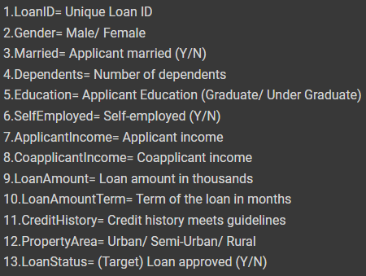
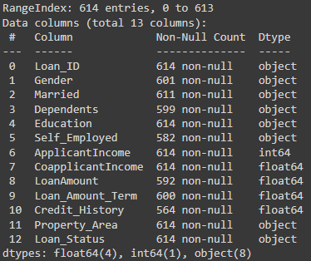
About the Data

Slide 4
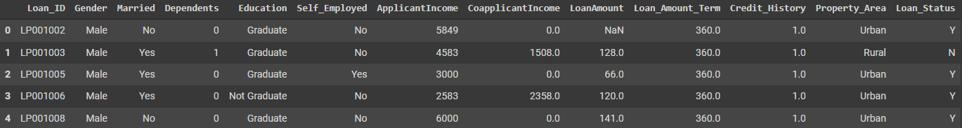
Example of the Dataset
Exploring df_la.head() to look at the first 5 rows of the dataset

Slide 5

Data Cleaning
Notes:
Discuss how 80% of the work is in the EDA

Slide 6
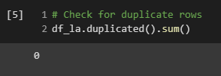
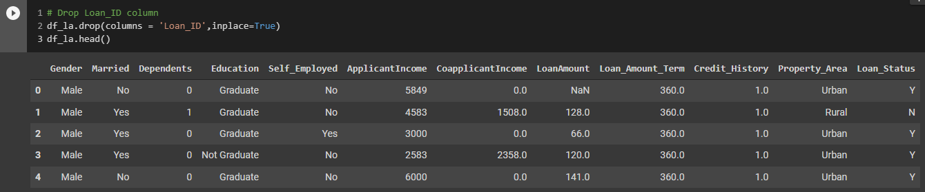
Checking for duplicate values
& Dropping irrelevant columns

Slide 7
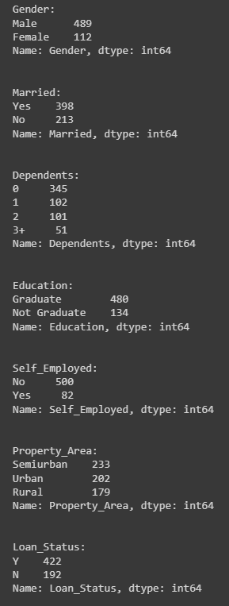
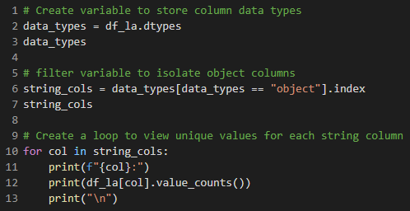
Examine Unique Values of String Columns

Slide 8
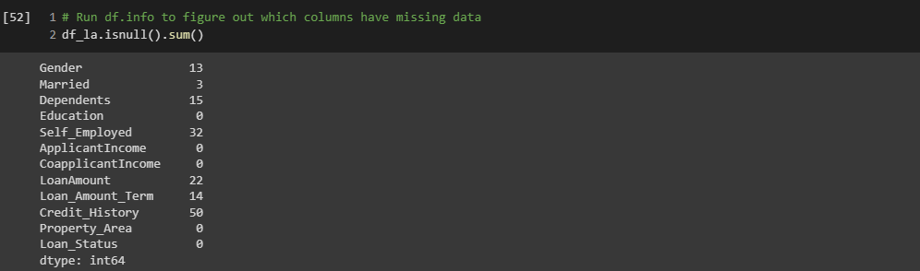
Checking for Null Values

Slide 9
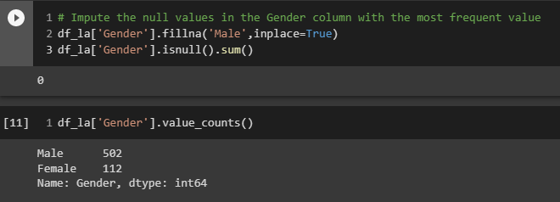
Handling NULL values in Gender Column
The 13 NULL values were imputed with most frequent value as there were only 13 of the original 614 rows with missing values for Gender

Slide 10
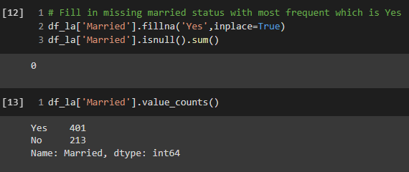
Handling NULL values in Married Column
Imputed NULL married status values with most frequent as there were only 3 missing values

Slide 11
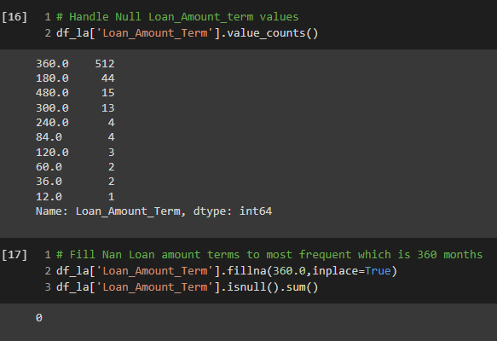
Handling NULL values in the Loan Amount Term Column
Imputed the 14 NULL loan amount term values with 360 as this is the most common loan term for mortgage applications

Slide 12
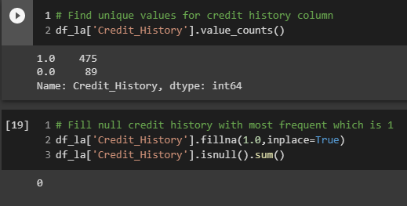
Handling NULL values in the Credit History Column
Imputed the 50 NULL values with a value of 1 (meaning they have credit history) as this was the most frequent value in the dataset

Slide 13
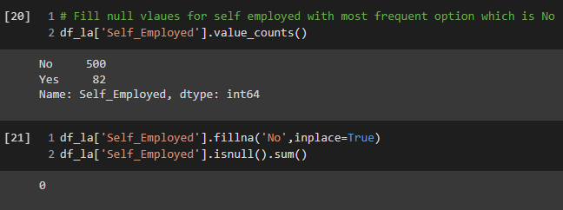
Handling NULL values in the Self Employed Column
Imputed the 32 NULL values with a value of No as this was the most frequent value

Slide 14
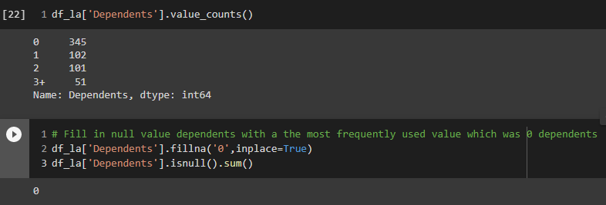
Handling NULL values in the Dependents Column
Imputed the 15 NULL values with a value of 0 dependents as this was the most frequent value

Slide 15
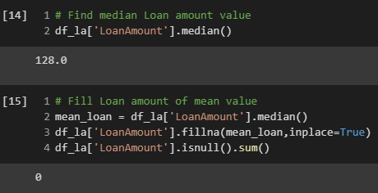
Handling NULL values in the Loan Amount Column
I first found the median loan amount value and then imputed the 22 NULL rows with a median value of 128(thousand $)

Slide 16
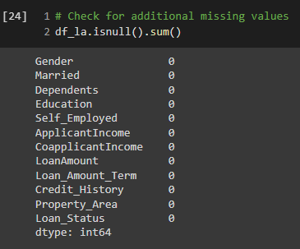
Double check dataframe for any remaining NULL values

Slide 17
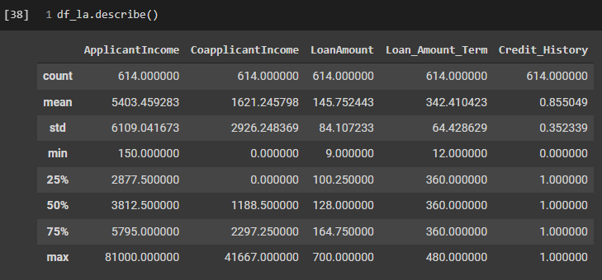
Dataset Statistics

Slide 18

Exploratory Visuals
Notes:
Discuss how 80% of the work is in the EDA

Slide 19
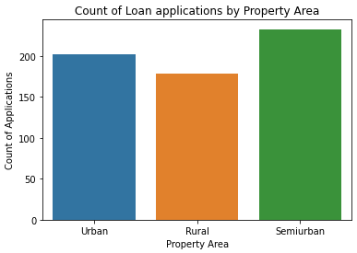
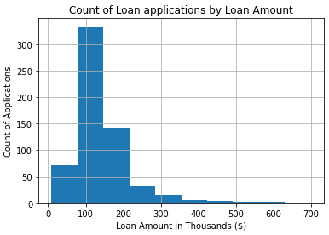
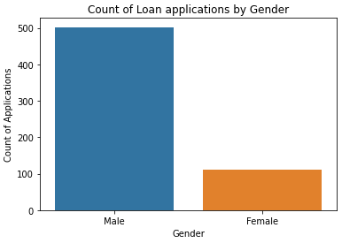
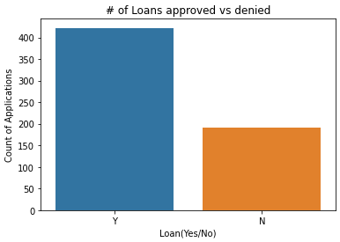

Slide 20

Thank You
Robert Ramos
ramos.robertanthony@gmail.com
https://github.com/robertramos89/Dream-Home-Loan-Approval

