Slide 1

Predicting Item Sales
Author: Robert Ramos

Slide 2

Task to Solve
Using the attributes of products and their outlets, we are tasked with analyzing the data to determine which ones contribute to higher sales as well as creating a machine learning model to predict how to create more sales.

Slide 3
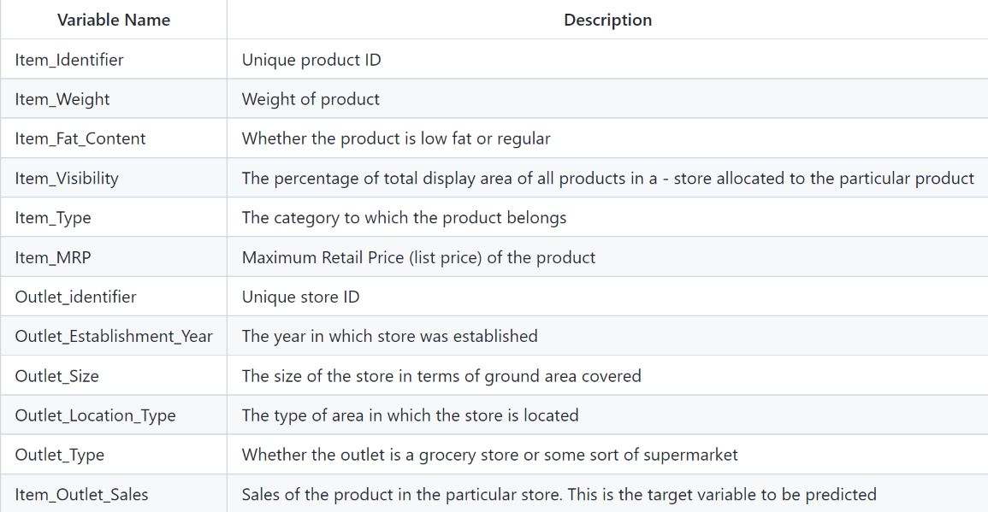
The Data
Item_Identifier 1555
Item_Weight 415
Item_Fat_Content 5
Item_Visibility 6519
Item_Type 16
Item_MRP 5225
Outlet_Identifier 8
Outlet_Establishment_Year 8
Outlet_Size 4
Outlet_Location_Type 3
Outlet_Type 3

Slide 4
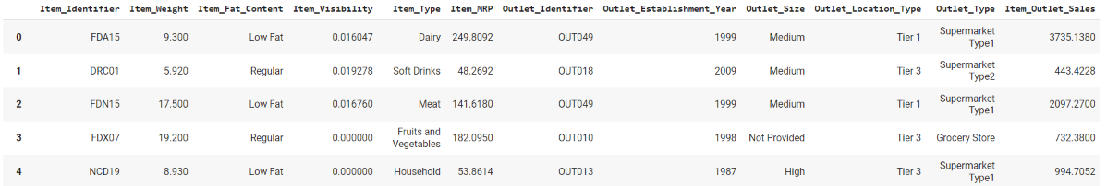
The Problem
The retailer has collected both product and outlet attribute data for items that they sold but need insight as to what can led to items selling.

Slide 5
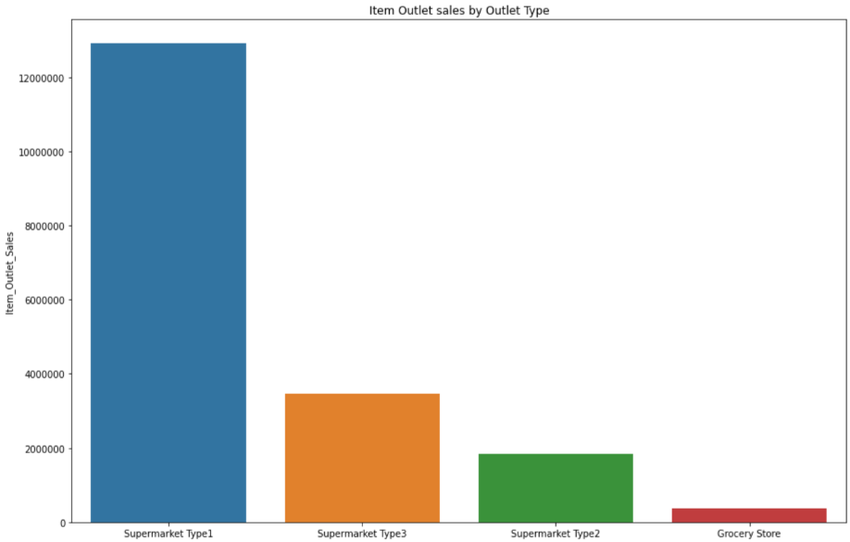
Supermarket Type 1’s has the highest volume of sales at over 12.9M units
Supermarket Type 3’s recorded 3.4M units sold
Supermarket Type 2’s recorded 1.8M units sold
Grocery stores had the least amount of units sold at 368K

Slide 6
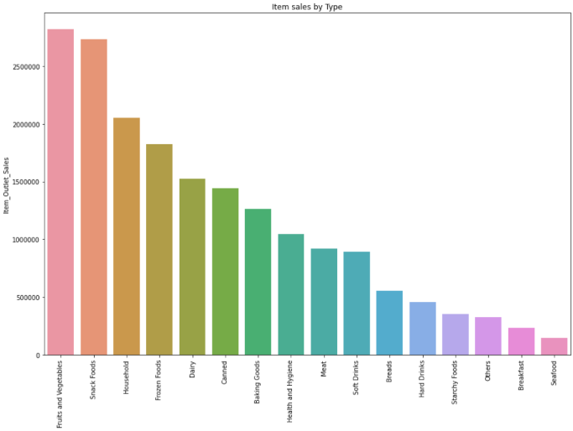
Top 3 Selling Product Categories
Fruits and Vegetables
Snack Foods
Household
Bottom 3 Selling Product Categories
Others
Breakfast
Seafood

Slide 7
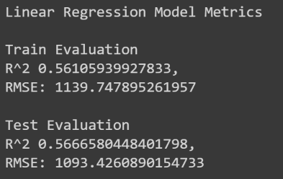
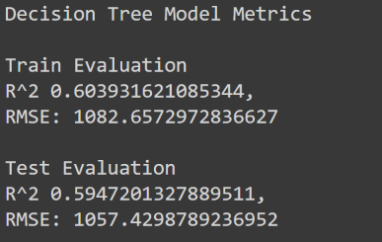
Model Recommendation
Decision Tree
Higher Correlation
More Accurate

Slide 8
Thanks!
Contact me:
Robert Ramos
ramos.robertanthony@gmail.com
https://github.com/robertramos89/Predicting-Item-Sales

