Slide 1
College of Engineering and Computer Science Computer Science Department CSC 131 Computer Software Engineering Spring 2016 Lecture # 1 (Ch. 1, 2, & 3)

Slide 2
What is Software?
A set of instructions that are designed to accomplish a desired task or function.
Software Includes:
Programs
Documents
Data…

Slide 3
Software Characteristics…
Software is engineered or developed.
Software does not wear out, but it deteriorates.
Software is still mostly custom built.

Slide 4
Wear vs. Deterioration

Slide 5
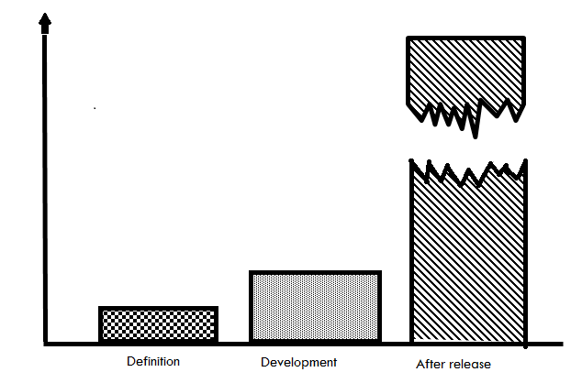
The Cost of Change

Slide 6
Software Applications
System software
Real-time software
Business software
Engineering/scientific software
Embedded software
PC software
AI software
WebApps (Web applications)

Slide 7
Software Engineering Classic Definition (1969)
The establishment and use of sound engineering principles in order to obtain economically software that is reliable and works efficiently on real machines.”
“Software Engineering: (1) The application of a systematic, disciplines, quantifiable approach to the development, operation, and maintenance of software; that is the application of engineering to software. (2) The study of approaches as in (1).”

Slide 8
Software Engineering & Problem Solving
COMPUTER
SCIENCE
CUSTOMER
Theories
Computer
Functions
Problem
SOFTWARE
ENGINEERING
Tools and
Techniques to
Solve Problems

Slide 9
Characteristics of an Engineering Process
Predictable Results
Product will be produced.
Production/release time is known in advance
If results were predictable we would not see
V1.0.1, V 1.0.2, etc. (Are these bug fix releases..?)
Measurable Progress
Product goes through well defined phases
Engineers can reliably measure progress
Metrics can be defined to provide accurate
indication of progress and cost.

Slide 10
Characteristics of an Engineering Process
Ability to React/Adapt to Change
The product is well planned and documented
Changes in requirements is well anticipated
Impact of change more readily assessed.

Slide 11
Characteristics of an Engineering Process
Other Characteristics of an Engineering Process
Well defined and repeatable process
Standardized guidelines and procedures
Documentation

Slide 12
The Process

Slide 13
A Layered Technology
Software Engineering
Software Engineering
tools
methods
process model
a “quality” focus

Slide 14
Software Process
Definition
The activities, techniques, tools, and individuals to produce software/system.

Slide 15
Process Principles
Prescribes all major activities
Uses resources, within a set of constraints, to produce intermediate and final products.
May be composed of sub-processes.
Each activity has entry and exit criteria.
Activities are organized in a sequence.
Has a set of guiding principles to explain goals.
Constraints may apply to activity, resource or product.

Slide 16
Capability Maturity Models
CMM & CMMI
Capability Maturity Model (CMM) & Capability Maturity Model Integration (CMMI)
Developed by SEI – (Software Engineering Institute at Carnegie Mellon)
The CMMI project is sponsored by the U.S. Department of Defense (DoD) and the National Defense Industrial Association (NDIA).

Slide 17
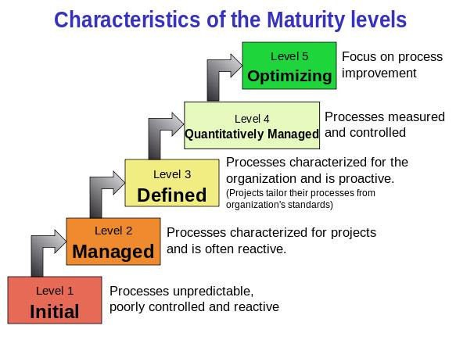
CMM

Slide 18
CMM Five Maturity Levels
initial level, processes are disorganized, even chaotic. Success is likely to depend on individual efforts, and is not considered to be repeatable, because processes would not be sufficiently defined and documented to allow them to be replicated.
repeatable level, basic project management techniques are established, and successes could be repeated, because the requisite processes would have been made established, defined, and documented.

Slide 19
CMM Five Maturity Levels
defined level, an organization has developed its own standard software process through greater attention to documentation, standardization, and integration.
managed level, an organization monitors and controls its own processes through data collection and analysis.
optimizing level, processes are constantly being improved through monitoring feedback from current processes and introducing innovative processes to better serve the organization's particular needs.

Slide 20
CMMI Maturity Levels
Optimizing
Optimizing
5
Focus on process improvement
Quantitatively
Managed
4
Process measured and controlled
Defined
Defined
3
Process characterized for the organization and is proactive
Managed
2
Process characterized for projects and is often reactive
Performed
1
Process unpredictable, poorly controlled and
reactive

Slide 21
Software Process Models
Strategy need to be developed to solve an actual problem.
This strategy encompasses: Process, Methods, and tools.
This strategy is known as a Process Model
The process model is chosen based on the following:
Nature of the project
Methods and tools to be used
Deliverables that are required

Slide 22
Process as Problem Solving Software Development can be characterized as a problem solving process

Slide 23
Variations in the Process
Regardless of exact procedure, all broadly follow the these phases of SW Life Cycle
Requirements phase
Specification phase
Design phase
Implementation phase
Testing phase
Maintenance phase
Some use different terms – some combine phases

Slide 24
Software Life-Cycle Models
Definition
The series of steps through which the product progresses
The model specifies
the various phases of the process
e.g., requirements, specification, design…
the order in which they are carried out

Slide 25
Software Lifecycle Models
Build-and-fix
develop systems
without specs or design
modify until customer is satisfied
Why doesn’t build-and-fix scale?
changes during maintenance
most expensive!

Slide 26
Software Lifecycle Models
Waterfall model - Also known as Linear sequential model
Requirements
Phase
Requirements
Description
Specification
Phase
Specification
Design
Phase
Design Docs
Implementation
& Integration
Phase
Product

Slide 27
Drawbacks of Waterfall Model
Document-driven model
customers cannot understand them …
imagine an architect just showing you a textual spec!
first time client sees a working product is after it has been coded. Problems here?
leads to products that don’t meet customers needs
Assumes feasibility before implementation
re-design is problematic
works best when you know what you’re doing
when requirements are stable & problem is well-known

Slide 28
Software Lifecycle Models
What are some other Software Lifecycle Models?
Research and read about other Software Lifecycle Models?
Class discussion on “Software lifecycle models”

Slide 29
The Primary Goal: High Quality Software
Critical Quality Attributes
Reliability
Maintainability
Dependability
Efficiency
Usability
Other Attributes
Completeness
Compatibility
Portability
Scalability
Robustness
Testability
Reusability……

Slide 30
Questions…?
What is next..?
Continue with Ch. 1, 2, and 3
Next Topic:
System Engineering & Requirements Engineering

