Slide 1
Chapter 27

Slide 2
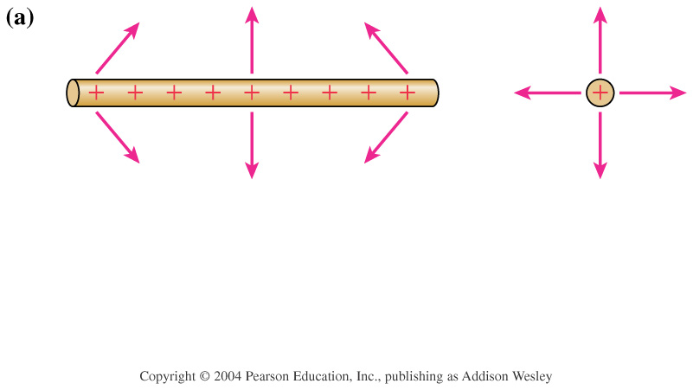
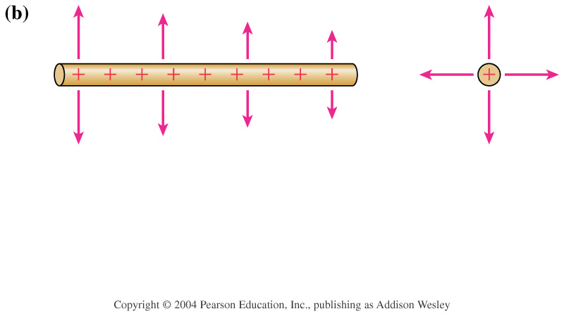
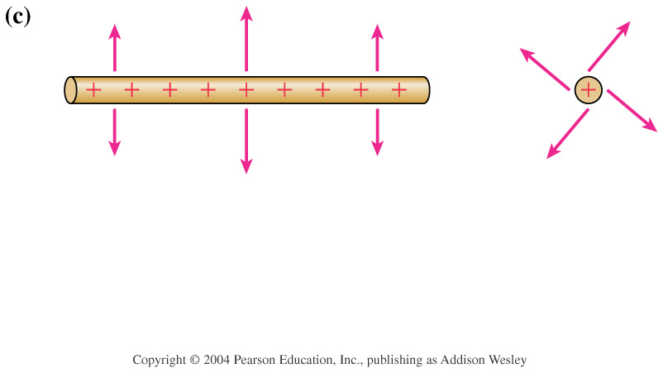

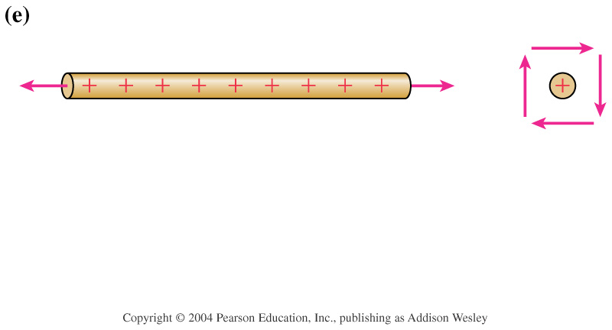
A uniformly charged rod has a finite length L. The rod is symmetric under rotations about the axis and under reflection in any plane containing the axis. It is not symmetric under translations or under reflections in a plane perpendicular to the axis other than the plane that bisects the rod. Which field shape or shapes match the symmetry of the rod?
1. a and d
2. c and e
3. b only
4. e only
5. none of the above
Notes:
STT27.1

Slide 3

A uniformly charged rod has a finite length L. The rod is symmetric under rotations about the axis and under reflection in any plane containing the axis. It is not symmetric under translations or under reflections in a plane perpendicular to the axis other than the plane that bisects the rod. Which field shape or shapes match the symmetry of the rod?
1. a and d
2. c and e
3. b only
4. e only
5. none of the above
Notes:
STT27.1

Slide 4
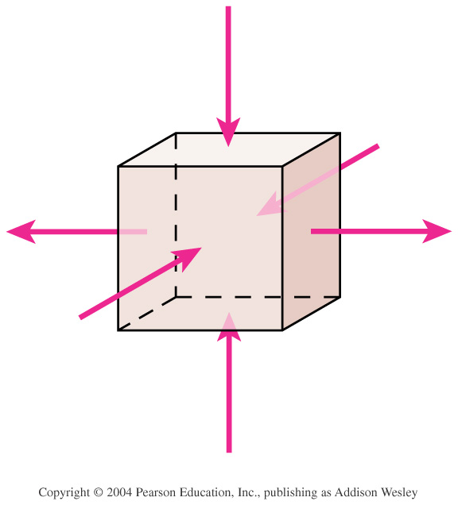
This box contains
1. a net positive charge.
2. no net charge.
3. a net negative charge.
4. a positive charge.
5. a negative charge.
Notes:
STT27.2

Slide 5
This box contains
1. a net positive charge.
2. no net charge.
3. a net negative charge.
4. a positive charge.
5. a negative charge.
Notes:
STT27.2

Slide 6
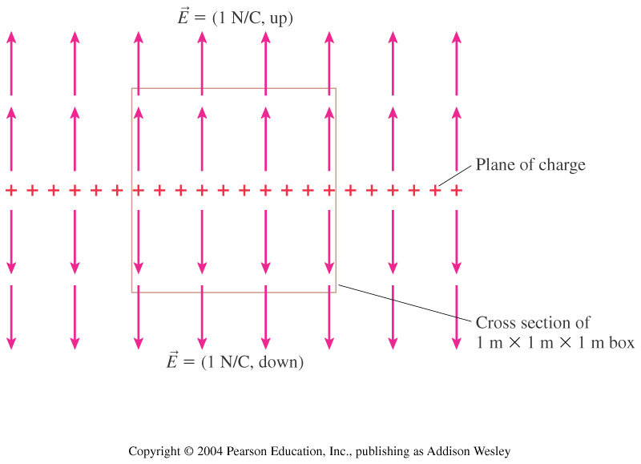
The total electric flux through this box is
1. 0 Nm²/C.
2. 1 Nm²/C.
3. 2 Nm²/C.
4. 4 Nm²/C.
5. 6 Nm²/C.
Notes:
STT27.3

Slide 7
The total electric flux through this box is
1. 0 Nm²/C.
2. 1 Nm²/C.
3. 2 Nm²/C.
4. 4 Nm²/C.
5. 6 Nm²/C.
Notes:
STT27.3

Slide 8

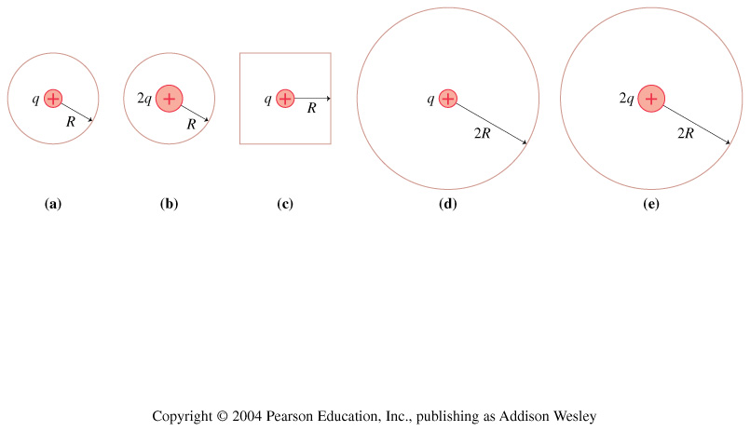
These are two-dimensional cross sections through three-dimensional closed spheres and a cube. Rank order, from largest to smallest, the electric fluxes _{a} to _{e} through surfaces a to e.
1. Φ_{a} > Φ_{c} > Φ_{b} > Φ_{d} > Φ_{e}
2. Φ_{b} = Φ_{e} > Φ_{a} = Φ_{c} = Φ_{d}
3. Φ_{e} > Φ_{d} > Φ_{b} > Φ_{c} > Φ_{a}
4. Φ_{b} > Φ_{a} > Φ_{c} > Φ_{e} > Φ_{d}
5. Φ_{d} = Φ_{e} > Φ_{c} > Φ_{a} = Φ_{b}
Notes:
STT27.4

Slide 9
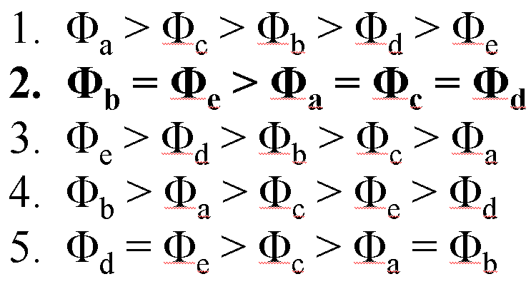
These are two-dimensional cross sections through three-dimensional closed spheres and a cube. Rank order, from largest to smallest, the electric fluxes _{a} to _{e} through surfaces a to e.
Notes:
STT27.4

Slide 10
Which Gaussian surface would allow you to use Gauss’s law to determine the electric field outside a uniformly charged cube?
1. A sphere whose center coincides with the center of the charged cube.
2. A cube whose center coincides with the center of the charged cube and which has parallel faces.
3. Either 1 or 2.
4. Neither 1 nor 2.
Notes:
STT27.5

Slide 11
Which Gaussian surface would allow you to use Gauss’s law to determine the electric field outside a uniformly charged cube?
1. A sphere whose center coincides with the center of the charged cube.
2. A cube whose center coincides with the center of the charged cube and which has parallel faces.
3. Either 1 or 2.
4. Neither 1 nor 2.
Notes:
STT27.5

Slide 12
Chapter 27
Reading Quiz

Slide 13
The amount of electric field passing through a surface is called
1. Electric flux.
2. Gauss’s Law.
3. Electricity.
4. Charge surface density.
5. None of the above.
Notes:
IG27.1

Slide 14
The amount of electric field passing through a surface is called
1. Electric flux.
2. Gauss’s Law.
3. Electricity.
4. Charge surface density.
5. None of the above.
Notes:
IG27.1

Slide 15
Gauss’s law is useful for calculating electric fields that are
1. due to point charges.
2. uniform.
3. symmetric.
4. due to continuous charges.
Notes:
IG27.2

Slide 16
Gauss’s law is useful for calculating electric fields that are
1. due to point charges.
2. uniform.
3. symmetric.
4. due to continuous charges.
Notes:
IG27.2

Slide 17
Gauss’s law applies to
1. lines.
2. flat surfaces.
3. spheres only.
4. closed surfaces.
Notes:
IG27.3

Slide 18
Gauss’s law applies to
1. lines.
2. flat surfaces.
3. spheres only.
4. closed surfaces.
Notes:
IG27.3

Slide 19
The electric field inside a conductor in electrostatic equilibrium is
1. uniform.
2. zero.
3. radial.
4. symmetric.
Notes:
IG27.4

Slide 20
The electric field inside a conductor in electrostatic equilibrium is
1. uniform.
2. zero.
3. radial.
4. symmetric.
Notes:
IG27.4

