Slide 1

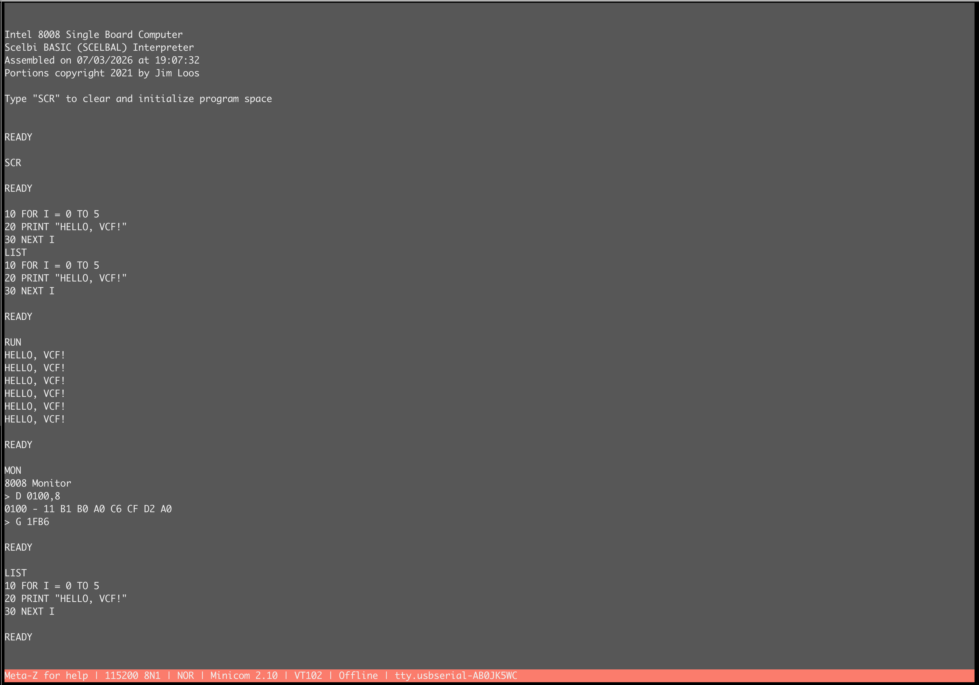
Nothing → CPU
What an FPGA actually is, and what your HDL becomes inside it
Told through a working Intel 8008 in VHDL on a Lattice ECP5 — built with a fully open-source toolchain
Robert Rico
The finish line: it boots into BASIC.
Notes:
Open by naming the real subject: this is an FPGA and HDL talk. The 8008 is the payload — it is what makes the FPGA content concrete instead of abstract. One sentence of setup: "I built a 1972 microprocessor out of an empty chip, and along the way I had to learn what that chip actually is. That is the talk."

Slide 2
ROADMAP
Five questions, in order
1
What IS an FPGA?
LUTs, flip-flops, routing, hard blocks, bitstreams. No hand-waving.
2
What does HDL actually say?
VHDL vs Verilog, the three things you write, and what each becomes in silicon.
3
What does the toolchain do?
GHDL → Yosys → nextpnr → bitstream. Place, route, timing closure — and inference’s sharp edge.
4
Where does it bite you?
The clocking trap, the day the toolchain ate my ROM, and how you prove gateware is right.
5
Can you learn this with an AI?
Yes. I did. And the two attempts I threw away show exactly how not to.
Then: a live 1972 machine, running as a circuit inside a 2013 chip.
Notes:
Set the contract. Software people get 1–2; hardware people get 3–4; question 5 is the one that starts arguments, so flag it early and honestly rather than springing it. Say out loud: "I had never used an FPGA and could not read VHDL when I started. I am going to show you what worked and, more usefully, what did not."

Slide 3
PART 1 — WHAT AN FPGA IS
Three ways to build a digital system
 | CPU + software | FPGA | ASIC
What it is | Fixed circuit, running instructions | Blank circuit you configure | Custom-etched silicon
Change it by | Recompiling (seconds) | Re-synthesizing (minutes) | A new mask set ($$$, months)
Concurrency | A few cores | Everything, at once | Everything, at once
Cost to start | $0 | $50 – $5,000 board | $1M+
Good for | Anything sequential | Parallel, timing-exact, custom I/O | Volume, power, absolute speed
An FPGA gives you the flexibility of software with the behavior of hardware. You do not write a program. You wire up a machine.
Notes:
The single most useful framing for a software audience. An FPGA is not a fast CPU and it is not a simulator — it is a bag of gates you get to arrange, and then rearrange tomorrow. That "rearrange tomorrow" is the whole value proposition; ASIC people only get one shot.

Slide 4
PART 1 — WHAT AN FPGA IS
Inside: a grid of tiny identical tiles
One tile, unpacked
LUT4
any function
of 4 inputs
FF
remembers
one bit
dedicated carry chain (CCU2C) — fast adders without burning LUTs
Multiply that tile by 43,848. Add wires between all of them.
ECP5 fabric: logic tiles (white), block-RAM columns (yellow), I/O ring around the edge
The wires matter as much as the logic: most of an FPGA’s die area — and most of your timing delay — is programmable routing, not gates.
Notes:
Land two ideas: (1) the chip is homogeneous — the same tile, tens of thousands of times; (2) the interesting part is the routing between them. When a design fails timing it is almost always routing delay, not logic delay. Point at the highlighted tile and say: next slide, we open that LUT.

Slide 5
PART 1 — WHAT AN FPGA IS
The LUT: a truth table you can rewrite
A 4-input LUT is 16 bits of memory plus a 16-to-1 multiplexer.
The four inputs are the address. The stored bit is the answer.
The 16 possible answers — each cell is q for one input combo
dcba = 0000..0011
0
0
0
1
dcba = 0100..0111
1
1
1
1
q <= (a and b) or (c and not d);
0
0
0
1
dcba = 1000..1011
dcba = 1100..1111
0
0
0
1
No AND gate is built. No OR gate is built.
The synthesizer evaluates your expression for all 16 input combinations and stores the answers.
Each cell is a q output
Change the function → change 16 bits. Same silicon.
Notes:
This is the "oh!" slide for anyone who has never seen inside an FPGA. Key point to say out loud: all 16 cells are identical memory bits — none of them is special, none of them is "active". At runtime the four inputs d,c,b,a form a 4-bit address and the multiplexer copies exactly ONE cell to q, whether it holds 0 or 1. Walk one concrete lookup: a=1, b=1, c=0, d=0 → address dcba=0011 → that is the 4th cell of the top row, which stores 1 → q=1. Then walk a zero: a=0, b=1, c=0, d=1 → dcba=1010 → 3rd cell of 3rd row, stores 0 → q=0. Same mechanism both times; the LUT does not "know" AND or OR, it just remembers answers. How the grid was filled: the synthesizer evaluated q = (a AND b) OR (c AND NOT d) for all 16 addresses. Row 2 is all 1s because c=1,d=0 makes the second term true no matter what a,b are; the last column of the other rows is 1 because those are the addresses where a=b=1. Punchline: reconfiguring an FPGA is literally rewriting these tables. The ECP5 has ~44,000 of them, and a real LUT4 also has a fast path to its neighbour so wide functions chain cheaply.

Slide 6
PART 1 — WHAT AN FPGA IS
LUTs alone would be wasteful — so: hard blocks
Some things are so common that building them from LUTs is silly. Vendors etch them in as fixed silicon, scattered through the fabric:
Block | ECP5-45F has | What it is | This project uses
LUT4 / FF | 43,848 | The general-purpose fabric | 1,770 LUTs, 591 FFs (4%)
DP16KD | 108 | 18 kb dual-port block RAM | 8 — the 8008’s ROM and RAM
EHXPLLL | 4 | PLL: makes new clocks from one clock | 1 — 100 MHz → 25 MHz
MULT18X18D | 72 | Hardware multiplier / DSP | 0 — a 1972 CPU has no multiply
TRELLIS_IO | 245 | Configurable I/O pin buffers | 63 — UART, LEDs, switches
You do not instantiate these by name. You write a pattern the tool recognizes, and it swaps in the hard block. That is called *inference* — and we come back to it, because getting it wrong is expensive.
Notes:
Real numbers from this project’s nextpnr report — utilization.txt in projects/b8008_basic/reports/. The DP16KD row is the one to dwell on: 8 block RAMs hold the entire 1970s software library. The PLL row sets up the clocking slide later.

Slide 7
PART 1 — WHAT AN FPGA IS
So what is a "bitstream"?
• Every LUT’s 16 bits. Every routing switch. Every I/O standard. Every block-RAM’s initial contents.
• All of it is just configuration SRAM spread across the die.
• The bitstream is a dump of that SRAM — a few megabits — shifted in over JTAG at power-up.
• SRAM-based ⇒ volatile. Power cycle and the chip forgets it was a CPU. Either reload it, or store it in the board’s SPI flash.
.bit file
JTAG
config
SRAM
the chip
IS the
circuit
$ openFPGALoader -c ft2232 -m b8008.bit
Jtag frequency : 6.00MHz
Loading: [==================] 100.00%
Done
This design’s bitstream: 1.7 Mbit — the same file, every power-up.
Notes:
Kill the most common misconception in the room: the bitstream is not a program and the FPGA is not executing it. The bitstream is the *wiring diagram*, written into memory cells that hold switches open or closed. After that it is inert — the circuit just is.

Slide 8
PART 1 — WHAT AN FPGA IS
This is not emulation. Everything happens at once.
An 8008 emulator (software)
An 8008 in an FPGA
while True:
op = mem[pc] # one
pc += 1 # thing
decode(op) # at a
execute(op) # time
ALU
register file
stack
decoder
timing gen
flags
temp regs
I/O buffer
addr mux
Sequential. Fast, but a *model* of the machine — cycle counts are bookkeeping, not physics.
All nine blocks settle simultaneously, every clock edge. There is no loop. There is no "next".
The board is not *running* an 8008. The board is an 8008.
Notes:
The parallelism point is the reason people use FPGAs at all — SDR, video, HFT, protocol bridges. Here it also buys authenticity: the timing is real, so period software that depends on cycle counts just works. If you want one sentence for the software folks: in HDL, every line you write runs on every clock edge, forever, at the same time as every other line.

Slide 9
PART 1 — WHAT AN FPGA IS
The board I used: Lattice ECP5-5G Versa
• LFE5UM5G-45F — 43,848 LUT4/FF, 108 block RAMs (~1.9 Mb), 4 PLLs, 5 Gbps SerDes
• ~$150 dev kit: DIP switches and LEDs become the 8008’s front panel; USB-UART is the terminal
• Chosen for one reason above all: the open-source tools know this chip cold (Project Trellis reverse-engineered the bitstream format)
• No vendor license, no web-install, no node-locked seat. git clone and build.
44K
logic cells
108
block RAMs
25 MHz
system clock
500 kHz
8008 needs
Notes:
The honest reason for ECP5: open toolchain. Xilinx/Intel parts are bigger and faster but you are inside a closed binary. On ECP5 I could read the synthesis log, read the packer, and — as you will see — file a bug against Yosys when it ate my ROM. Optional: hold up the board here.

Slide 10
PART 2 — DESCRIBING HARDWARE
HDL is not a programming language
It looks like one. It is not. Three differences do all the damage:
Everything is concurrent
Statements are not steps. They are wires that exist all the time. Reordering two lines changes nothing.
You describe structure, not behavior over time
Your if becomes a multiplexer. Your + becomes an adder. The code is a schematic in text form.
The clock is the only "when" you get
Nothing happens "next". Things happen at a clock edge, or they happen continuously.
If you find yourself asking "what happens first?", you are still writing software.
Notes:
The single hardest unlearning for a software engineer. My own worst early bugs were all this: assuming sequence where there was none. A good check when reviewing HDL — ask "what gate is this line?" If you cannot answer, it probably will not synthesize the way you think.

Slide 11
PART 2 — DESCRIBING HARDWARE
Two languages, one job
-- VHDL (Ada-flavoured)
process(clk)
begin
if rising_edge(clk) then
if rst = '1' then
count <= (others => '0');
else
count <= count + 1;
end if;
end if;
end process;
// Verilog (C-flavoured)
always @(posedge clk)
begin
if (rst)
count <= 8'b0;
else
count <= count + 1;
end
Verbose. Strongly typed. Refuses to guess.
Terse. Weakly typed. Dominant in US industry.
Same synthesized result: 8 flip-flops and an incrementer on a carry chain.
I chose VHDL because it will not silently truncate a vector — and when a large share of your code is drafted by an AI, a compiler that refuses to guess is a feature.
Notes:
Do not turn this into a language war — 60 seconds. The point is that HDLs are interchangeable at this level, and that the *type strictness* of VHDL was a deliberate safety choice for this particular project. Modern tools mix both freely: this design is VHDL that gets translated to Verilog on the way to the chip anyway.

Slide 12
PART 2 — DESCRIBING HARDWARE
You only ever write three kinds of thing
1 — Combinational
wires and gates. No memory.
2 — Sequential
flip-flops. Remembers.
3 — Structural
wiring sub-blocks together.
sum <= a xor b xor cin;
cout <= (a and b)
or (cin and (a xor b));
-- exists continuously.
-- becomes: 2 LUT4s.
process(clk)
begin
if rising_edge(clk) then
if push = '1' then
sp <= sp + 1;
end if;
end if;
end process;
-- becomes: 3 TRELLIS_FF.
u_alu : entity work.alu
port map (
op_a => temp_a,
op_b => temp_b,
result=> alu_out,
carry => flag_c
);
-- becomes: the netlist.
That is the whole language, for synthesis purposes. Everything else — types, generics, packages — is bookkeeping so humans can manage thousands of these.
This design: 25 files, each one mostly kind 1 and 2, wired by one file of kind 3.
Notes:
Demystifying move: HDL has a small synthesizable core. Most of a VHDL textbook is simulation-only constructs that never reach the chip. If you can read these three patterns you can read this entire project. Note the comments: I want the audience already thinking in "what does it become".

Slide 13
PART 2 — DESCRIBING HARDWARE
A whole real module, start to finish
entity stack_pointer is
port ( clk, reset : in std_logic;
phi1_rising : in std_logic;
stack_push : in std_logic;
stack_pop : in std_logic;
sp : out unsigned(2 downto 0) );
end entity;
process(clk, reset) begin
if reset = '1' then
sp_r <= (others => '0');
elsif rising_edge(clk) then
if phi1_rising = '1' then
if stack_push = '1' then sp_r <= sp_r + 1;
elsif stack_pop = '1' then sp_r <= sp_r - 1;
end if;
end if;
end if;
end process;
This is all the logic of the 8008 stack pointer. The full file is 69 lines — the rest is comments and boilerplate.
It does not know what CALL is. It does not know interrupts exist. It counts, and it wraps 7→0 for free because it is 3 bits wide.
In silicon: 3 flip-flops, an incrementer, a decrementer, and a mux.
It has never had a bug.
Design rule for the whole project: every module is dumb. One job, ~50–100 lines, no knowledge of any other module.
Notes:
Two payoffs, both worth naming. (1) Verification: a module this small is exhaustively testable. (2) It is the unit an AI assistant gets right and a human can fully review — which mattered, because most of this VHDL was drafted by Claude and reviewed by me. The 8008’s wrap-around stack semantics fall out of the 3-bit width; I never wrote code for it.

Slide 14
PART 2 — DESCRIBING HARDWARE
Things that do not exist inside an FPGA
WHAT BITES
WHAT YOU DO
Tri-state buses
The 8008 has one 8-bit bus doing three jobs. Inside the fabric there are no internal tri-states — only at the I/O pins.
Yosys tribuf -logic rewrites every 'Z' into a multiplexer. My "bus" is a mux tree, and it behaves identically.
Free initial values
A signal is not 0 at power-up because you said so. Block RAM contents come from the bitstream; logic comes from your reset.
If you rely on an initial value that the fabric will not honour, simulation is right and hardware is wrong. Reset everything you care about.
"Wait a moment"
There is no delay primitive. after 10 ns is a simulation-only construct and synthesizes to nothing.
Time is counted in clock cycles. My 0.8 µs φ1 pulse is a counter comparing against 20 ticks of a 25 MHz clock.
Notes:
These three are where a 1972 datasheet collides with 2013 silicon. The tri-state one is the fun one: the 8008’s entire personality is a time-multiplexed bus, and the FPGA simply does not have that primitive internally — so the tool rebuilds the same behavior out of muxes. Faithful function, completely different implementation.

Slide 15
PART 3 — THE TOOLCHAIN
All the way down: one line of VHDL → silicon
You write
sp_r <= sp_r + 1;
VHDL
GHDL emits
assign n42 = sp_r + 3'd1;
Verilog
Yosys maps
CCU2C #(.INIT0(...))
ccu_0 (.A0(sp_r[0]), ...);
ECP5 cells
nextpnr places
X23/Y7/SLICEA → X23/Y7/SLICEB
coordinates
Every intermediate file is on my disk, in plain text, because the whole toolchain is open source.
Notes:
This is the spine of the talk for hardware-curious folks: the abstraction stack is only four levels deep and you can inspect all of it. Mention that `build/*.v` and `build/*.json` are readable — I have debugged real problems by grepping the Yosys JSON. Contrast with a closed vendor flow where the intermediate is a binary blob.

Slide 16
PART 3 — THE TOOLCHAIN
Source to silicon, entirely open source
VHDL
GHDL
Yosys
nextpnr
ecppack
board
25 files
analyze +
emit Verilog
synthesize to
ECP5 cells
place & route,
timing
pack .bit
openFPGA
Loader
$ ghdl --synth --std=08 --out=verilog b8008_basic_top > build/top.v
$ yosys -p "read_verilog src/synth/ghdl_gates.v build/top.v; \
tribuf -logic; proc; opt -nodffe; \
synth_ecp5 -top b8008_basic_top -json build/top.json"
$ nextpnr-ecp5 --um5g-45k --package CABGA381 --speed 8 \
--json build/top.json --lpf constraints/b8008_basic.lpf \
--textcfg build/top.config
$ ecppack --input build/top.config --bit build/top.bit
Four tools, one Makefile, no vendor license. Full rebuild: about 90 seconds.
Notes:
These are the real commands out of projects/project.mk. Worth calling out `tribuf -logic` — that is the tri-state rewrite from two slides ago, sitting right there in the flow. And `ghdl_gates.v` is a 40-line shim I had to write because GHDL emits two primitives Yosys does not know. Both are the kind of seam you only get to see, let alone fix, in an open toolchain.

Slide 17
PART 3 — THE TOOLCHAIN
The two hard steps: place, then route
PLACE
ROUTE
Assign each of ~2,400 cells to a physical site on the die.
Objective: things that talk to each other should sit near each other.
It is simulated annealing. It is not deterministic across versions, and two builds can differ in fmax by 20%.
Find a path through the switch matrix for every net.
Wires are a finite resource. A design can fit logically and still fail to route.
Every hop costs picoseconds — which is why placement quality decides your clock speed, not gate count.
Software analogy: synthesis is the compiler, place & route is the linker — except this linker also decides how fast your program runs, and takes minutes to do it.
Notes:
Manage expectations for anyone who might try this: the edit-compile-test loop is minutes, not seconds, and it is stochastic. That changes how you work — you batch changes, you lean much harder on simulation, and you do not chase a 3% fmax difference between two runs because it is noise.

Slide 18
PART 3 — THE TOOLCHAIN
Timing closure: the only question that matters
Between two clock edges, every signal must finish traveling. Longest path wins. That path is your maximum clock frequency.
type curr total
clk-to-q 1.36 1.36 ROM block RAM .DOA0
routing 1.18 2.54 (42,10) -> (31,6)
logic 0.24 2.78 cpu_s0 decode
routing 0.86 3.64 (31,6) -> (28,3)
.. 14 more hops ..
routing 1.13 8.83 cpu_d[0] -> pin
Info: 3.09 ns logic, 5.74 ns routing
Info: Max frequency: 115.66 MHz (PASS at 25.00 MHz)
nextpnr does the split for you: 3.09 ns of logic, 5.74 ns of wire.
Routing is nearly two-thirds of the delay. That is the norm, not an anomaly.
We need 25 MHz and close at 115.66 — 4.6× margin, so I never had to fight for it.
If it had failed: pipeline the path, re-floorplan, or slow the clock.
Real output, abridged — projects/b8008_basic/reports/pnr.txt
The 8008 itself runs at 500 kHz. I had 230× the speed I needed — and I still ran the fabric at 25 MHz just to divide down cleanly.
Notes:
Two things to land. (1) What "fmax" means physically — it is a race between a signal and the next clock edge. (2) This path starts in the ROM block RAM, wanders through instruction decode and the register file, and ends at a data-bus pin — 24 hops, and the routing between tiles costs more than all the logic. Note for honesty: nextpnr prints fmax twice, once after placement (94.58 MHz) and again after routing. 115.66 is the final one. If someone asks how you fix a failing path: add a pipeline register and let the tool re-place it.

Slide 19
PART 3 — THE TOOLCHAIN
Inference: say the magic words, get the hard block
process(CLK)
begin
if rising_edge(CLK) then
if CS_N='0' and RW_N='0' then
ram(idx) <= DATA_IN;
end if;
DATA_OUT <= ram(idx); -- registered read
end if;
end process;
Because both the read and the write are clocked, Yosys recognizes the shape and emits DP16KD — a real block RAM.
All 16 KB of this machine’s ROM and RAM: 8 block RAMs. Zero LUTs.
src/b8008/ram_sync.vhdl — the 8008’s memory
Move the read outside the clocked process…
…and you have asked for an asynchronous-read memory, which a block RAM physically cannot do. Yosys obliges — by building it out of 131,072 flip-flops. The chip has 43,848. It does not fit, and the error arrives three tools downstream, phrased as a placement failure.
The lesson
In HDL, the shape of your code is the request. Same logic, same result in simulation — one version fits in 7% of the block RAM, the other does not fit at all.
Notes:
Best single example of "HDL is not software". Both versions simulate identically and both are correct. One fits in 7% of the block RAM; the other does not fit at all. This is why HDL people talk about "coding styles" — they are not style, they are load-bearing. Also note the deliberate design comment in ram_sync.vhdl: the one-cycle read latency is invisible to the 8008 because the address is latched at T1/T2 and data is not consumed until T3.

Slide 20
PART 3 — THE TOOLCHAIN
What a 1972 computer costs in 2013 silicon
Resource | Used | Available | %
TRELLIS_COMB (LUTs) | 1,770 | 43,848 | 4%
TRELLIS_FF (flip-flops) | 591 | 43,848 | 1%
DP16KD (block RAM) | 8 | 108 | 7%
EHXPLLL (PLL) | 1 | 4 | 25%
TRELLIS_IO (pins) | 63 | 245 | 25%
4%
of the fabric
The whole system — CPU, memory, serial port, clock generator — fits in one twenty-fifth of a mid-range 2013 FPGA.
The 8008 was 3,500 transistors. This chip has roughly a million times the logic and it is not an expensive part.
There is room on this die for 25 of these machines, running side by side.
b8008_basic: CPU + 12 KB ROM + 4 KB RAM + UART + clock generation + front panel
Notes:
Good "wow" beat, and an honest one — those numbers are straight from reports/utilization.txt. The follow-up question you will get is "so what would you do with the other 96%?" Real answer: a 6502, a Z80, and a video generator, all running at once, sharing nothing. That is what the parallelism slide meant in practice.

Slide 21
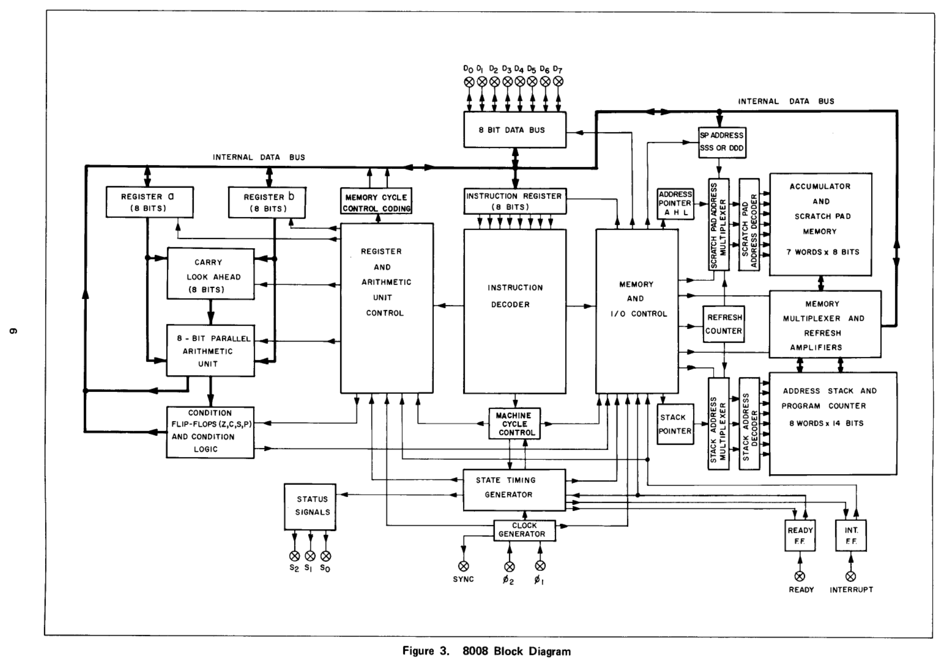
PART 4 — BUILDING THE THING
Where the architecture came from
Every module in this design is one box from that diagram.
Intel drew the *concept*. The RTL partition is mine: 25 independently testable modules, each with explicit control signals and no knowledge of any other — derived from the datasheet, not from any existing implementation.
Intel 8008 User’s Manual, 1972 — the block diagram
As far as I can tell, this is the only block-based 8008 in existence.
Eighteen months of looking — Google Groups, websites that look like they are from 1994, the SCELBI archives. Everything I found is an instruction-set simulator: sequential software that executes one opcode at a time.
If you find another, please tell me. I would genuinely like to see it.
Notes:
This is the keystone slide and it is worth slowing down for. Two separate claims, kept separate. First, provenance: Intel drew a conceptual block diagram; turning those boxes into 25 synthesizable, independently testable modules with explicit control signals is an RTL partition, and that work is mine. Second, the survey: eighteen months of searching turned up only instruction-set simulators. Make the invitation genuinely — you want the counterexample if it exists. Do NOT bring up the AI/training-data angle here — that diagnosis belongs to Part 6, where the survey fact gets cashed in.

Slide 22
PART 4 — BUILDING THE THING
The whole computer, on one die
b8008 CPU core — 25 VHDL modules
rom_12kx8_bram 12 KB firmware — 6 × DP16KD
timing &
control
instruction
decoder
address
stack (8×14)
ram_sync 4 KB program RAM — 2 × DP16KD
address_decoder RAM 0000-0FFF, ROM 1000-3FFF
stack
pointer
register file
A B C D E H L
ALU +
carry lookahead
usart 115200 8N1 over USB
phase_clocks φ1 / φ2, 0.8 µs / 0.6 µs, non-overlapping
condition
flags
temp
registers
I/O buffer
EHXPLLL hard PLL: 100 MHz board → 25 MHz system
debug_clock_control freeze / single-step the CPU
In 1972 all of this was a rack. Intel’s own SIM8-01 reference board needed dozens of TTL chips just to make the CPU usable.
Notes:
This is the "system on chip" slide. The point for an FPGA audience: the CPU is the small part. Memory, clocking, serial, and debug infrastructure are most of the engineering — same as any real SoC. Call out debug_clock_control: being able to freeze the CPU with a DIP switch and single-step it is a debugging superpower you simply cannot have with a physical 1972 chip.

Slide 23
PART 4 — BUILDING THE THING
The trap I fell in: φ1 and φ2 are data, not clocks
The 8008 needs two non-overlapping clock phases. The obvious move is to generate them and clock your logic from them.
Do that and you have just created two new clock domains — hand-made, skewed, un-analyzable by the timing engine, and impossible to close.
-- WRONG: phi1 as a clock
process(phi1)
begin
if rising_edge(phi1) then
sp <= sp + 1;
end if;
end process;
The fix
One real clock — 25 MHz from the PLL. φ1 and φ2 become ordinary signals, plus one-cycle phi1_rising / phi2_rising enable pulses. Every flip-flop in the design is clocked by clk_sys and gated by an enable.
Result: one clock domain, fully timed, closes at 115 MHz.
-- RIGHT: phi1 as an enable
if rising_edge(clk) then
if phi1_rising = '1' then
sp <= sp + 1;
end if;
end if;
Notes:
Best transferable FPGA lesson in the deck. The general rule: derive clocks in a PLL or not at all; everything else is an enable. Divided/gated clocks are the classic beginner mistake and they produce bugs that only show up on hardware, because simulation has no clock skew. The scope captures on the next-to-last slide show the real φ1/φ2 coming out of the FPGA — those are outputs, not internal clocks.

Slide 24
PART 4 — BUILDING THE THING
War story: the day the toolchain ate my ROM
Symptom
CPU hangs at boot on hardware. Simulation passes perfectly.
Red herring #1
Adding 32 bytes of padding "fixes" it. 399 bytes → crash; 431 bytes → fine. Must be a size threshold?
Red herring #2
Shrink the ROM to 1 KB → *different* failure. Runs, but no UART output at all. So, not size.
Root cause
The ROM array was initialized (others => x"FF"). Yosys’ optimizer sees a mostly-all-ones memory and mangles the initialization.
Fix
Change the fill to x"00". One character. Works perfectly, and has ever since.
Written up as a bug report against Yosys — docs/bug-report-yosys-rom-0xff.md. You can only do that when the tools are open.
Notes:
Tell this one as a detective story; it is the most memorable slide in the deck for a technical audience. The moral is not "Yosys is bad" — it is that below your RTL there is a compiler with bugs, and when simulation and hardware disagree, the toolchain is a legitimate suspect. Days lost: about three. Characters changed: one.

Slide 25
PART 4 — BUILDING THE THING
A trick worth stealing: patch firmware, skip the build
Problem: my firmware lives in block RAM. Changing one byte of assembly meant a full 90-second resynthesis — and a new place & route, so new timing, for a change that touches no logic at all.
edit .asm
assemble
ecpbram
patch
repack .bit
flash
The block-RAM contents sit in the post-route config file, not the netlist.
ecpbram finds the old contents by pattern-matching and substitutes the new ones.
Unused ROM space is filled with random bytes so the match pattern is unique.
90 s → 3 s
Same bitstream, same timing, new firmware. The RTL never gets touched, so it cannot regress.
Notes:
Generalizable well beyond this project: if your design has a soft CPU or a lookup table in BRAM, you almost certainly do not need to resynthesize to change its contents. Every vendor has an equivalent (Xilinx updatemem, Intel mif-update). It turns a 90-second loop into an interactive one, which changes how you write firmware.

Slide 26
PART 5 — PROOF
How you know gateware is right
You cannot printf a circuit. Verification is not a phase here — it is the medium you work in.
Layer | What it proves | Result
Per-module testbench | Each dumb block in isolation | 25 modules
Exhaustive ALU sweep | All 1,049,600 arithmetic + logical cases vs a reference model | PASS
Regression suite | Real assembly programs in simulation | 37 / 37
Cycle-exact T-states | Every timing class vs the 1972 datasheet | 27 / 27
ISA self-test on the board | The final word | 46 / 46
The rule I now live by
Simulation passing is a hypothesis.
Hardware is the proof.
Nothing is done until the board says so.
Notes:
Bridge from the war stories to the demo. The exhaustive ALU sweep is worth a beat — 1,049,600 cases is every operand pair × every op × carry-in, checked against an independent model. You can do that for an 8-bit ALU; that is a real advantage of working at this scale. Then: sim-versus-silicon, which is the lesson every single one of these war stories converges on.

Slide 27
PART 5 — PROOF
Beyond tests: proofs, equivalence, fuzzing
Same open-source ecosystem as the build flow — YosysHQ tools, all running in CI on every push.
Layer | What it checks | Scale
SBY property proofs | Module contracts as PSL assertions, proven by SMT solver (k-induction / bounded) | 11 suites
Equivalence checks | RTL vs its synthesized gate netlist (Yosys round trip) | 7 miters + 6 EQY
Exhaustive sweeps | ALU and instruction decoder vs independent Python models | 1,049,600 + 256 cases
cocotb monitors | External bus protocol on the full core; per-instruction control-signal scenarios | RTL + netlist
Differential fuzzer | Random legal programs under three oracles: bus monitor, datasheet timing, RTL-vs-netlist trace diff | seeded, both cores
37 CI jobs on every push · every checker mutation-tested · verification plan: 102 rows, zero gaps
Notes:
One paragraph per row, no deep dive. SBY: the solver proves the assertion for ALL input sequences, not sampled ones — math, not test vectors. Equivalence: the exact netlist headed for the FPGA is proven to match the RTL, so synthesis cannot silently change behavior — the 0xFF war story is why this exists. Exhaustive: every ALU input combination, every opcode, against models written from the datasheet, not from the VHDL. Mutation-tested = plant a bug, watch the checker fail, revert — a checker that cannot fail proves nothing. Anecdote: the bus monitor found a real RTL bug — two machine-cycle type codes transposed on the external bus. The fuzzer runs the same random program on the RTL core and the synthesized-netlist core and diffs the traces.

Slide 28
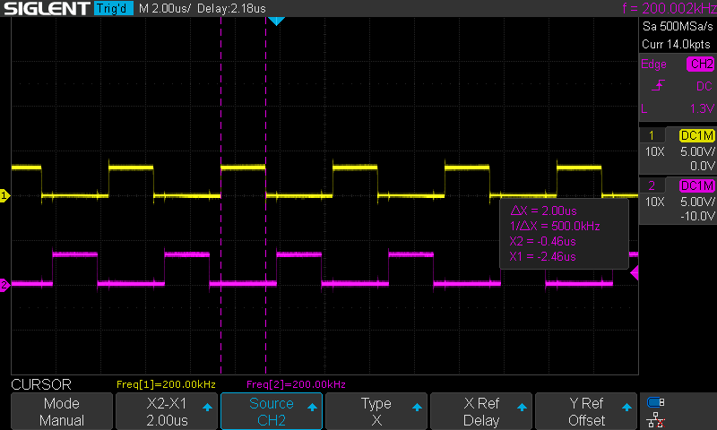
LIVE
The circuit, running
• The clocks — φ1 / φ2 on the scope, generated by the fabric
• Pi to 50 digits — multiprecision arithmetic, ~75 s at 500 kHz
• SCELBI floating-point calculator (1974) — 12.2 X 2.2 = 26.84
• The finale — power on → BASIC → MON → machine monitor → G 1FB6 → back in BASIC, program intact
φ1 / φ2 from the FPGA — non-overlapping, 0.8 µs and 0.6 µs
Notes:
Demo cheat sheet — verify before the talk. Scope: probe the phi1_out/phi2_out pins so the audience sees Part 1 made physical. Pi: L in monitor, send_hex.py, G 2040; narrate while it grinds; 49/50 digits — the 50th is the original 1970s program’s guard-byte truncation, good trivia. Calc: load, G, type the sum live. Finale: power-cycle into the b8008_basic bitstream, type a 3-line FOR/NEXT, RUN, MON, D the program region, G 1FB6, LIST. Fallback recordings ready for all four.

Slide 29
PART 6 — HOW THIS GOT BUILT
Three versions, eighteen months
Eighteen months ago I could not read a VHDL process. Most of the VHDL here was drafted by AI — the architecture, the spec, and every review were mine.
STEP ZERO
The book
Getting Started with FPGAs — Russell Merrick, No Starch Press.
Cover to cover before I wrote a line of VHDL.
VERSION 1
s8008
Monolithic, single-cycle. 1,500 lines in one file.
✗ Passed its entire simulation suite. ALU returned garbage on the board.
VERSION 2
v8008
Multi-cycle rewrite. Too clever, too entangled.
✗ Collapsed under its own complexity.
VERSION 3
b8008
25 dumb modules, derived from the 1972 block diagram.
✓ Silicon validated. 46/46 on the board.
Both failures were the same failure: I was building the architecture the corpus knew — an instruction-set simulator written in VHDL — instead of the one the datasheet drew.
Notes:
Now the whole story lands in one place. 367 commits, two complete rewrites. The diagnosis in the bar is the important sentence and it is not a metaphor: ask a model to implement an 8008 and everything it has ever seen is an emulator — sequential software, one opcode at a time. So its instinct pulls that way, and for two versions I followed it. s8008 is literally an instruction-set simulator expressed in VHDL. What broke the pattern was going back to the primary source and building the picture Intel drew.

Slide 30
PART 6 — HOW THIS GOT BUILT
What it did, and what I had to learn
WHAT THE AI DID
WHAT I HAD TO LEARN MYSELF
Could explain any of it, instantly, at any depth. LUTs, routing, block RAM, bitstreams — perfect answers on demand.
That understanding is not explanation. The book made me build the model, in sequence, with exercises. An AI would have let me skip building it — and then I would have had nothing to check its work against.
What an FPGA is
Drafted most of the VHDL. Reading and critiquing code is a faster way to learn than writing from scratch — this is where it carried the most weight.
The concurrency model. Until you have it you cannot tell correct RTL from *plausible* RTL — and it produces plausible RTL all day long.
What HDL says
Wrote the block-RAM version. Would just as happily have written the async-read version, and never mentioned the difference.
Which one was right — from the utilization report, not from the code. Both simulate identically. One does not fit on the chip.
Inference
The pattern: it was fastest where I could already check it — and useless where I could not.
Notes:
This is the promise from the signpost being kept. Walk it, do not read it. Row one is the least flattering to the AI and it is the one that makes the rest credible: for foundations it is a tempting shortcut that does not work. You can get a perfect explanation of a LUT and still not understand FPGAs. Row two is the honest credit — drafting is real leverage when you can read the output. Row three is the sharpest concrete example in the talk.

Slide 31
PART 6 — HOW THIS GOT BUILT
What it did, and what I had to learn (cont.)
WHAT THE AI DID
WHAT I HAD TO LEARN MYSELF
The toolchain
Assembled the Makefile. Explained the flags.
To read the reports. Routing is two-thirds of my critical path — no model told me that; nextpnr did. The physics is not in the code, so it is not in the model.
φ1 / φ2 as clocks
Would write rising_edge(phi1) without hesitation. Valid VHDL. Simulates perfectly.
That it creates a clock domain the timing engine cannot analyze. Learned from a design that would not close.
The 0xFF bug
Nothing. It could not — the bug lives below the RTL, inside the synthesizer.
Three days of bisection. And that when simulation and silicon disagree, the toolchain itself is a suspect.
The architecture
Pulled toward an instruction-set simulator every time, because that is all its corpus contained.
The block diagram, from the 1972 datasheet. This is the one that mattered — and the one thing no model could have handed me.
Verification
Wrote most of the testbench scaffolding.
isa.json, transcribed by hand from the datasheet. The spec has to come from the source, not the model — otherwise you are grading its homework with its own answer key.
Version three worked because by then I had learned the right-hand column.
Notes:
The payoff. The bar at the bottom is the answer to the question posed back at the signpost, and it should be said slowly. Row four is the keystone — it ties to the block-diagram slide and it is the reason the third attempt is different in kind, not just in quality. Row five is the sentence people write down: grading its homework with its own answer key. If you are short on time, cut rows one and two here; four and five carry the argument.

Slide 32
CLOSE
What I’d tell you about learning this way
Read the book first.
Foundations are not delegable. An AI will explain a LUT perfectly and leave you unable to check its work.
Own the specification.
I transcribed every opcode’s T-state sequence from the 1972 manual by hand. The spec has to come from the primary source.
Derive the architecture yourself.
Its corpus had only emulators. The block-based design came from the datasheet — and it is the thing that made version three work.
Keep modules small enough to fully review.
50 to 100 lines, one job. Small enough for me to check, and small enough for it to get right.
Let it draft. You reject.
It made two complete rewrites affordable — without that I would have shipped version one’s architecture and lived with it.
Nothing is done until the board says so.
Simulation passing is a hypothesis. That goes double for code you did not write.
And: 1972 engineers did all of this with 3,500 transistors, no simulator, and one shot at the mask.
Notes:
Close on the last line — it lands, and it is true. Everything that made this project possible (simulation, regression tests, a rewritable chip, undo, and an AI assistant) is something the original team did not have. The six above are the transferable answer to "can you learn a hard skill this way": yes, and the conditions are specific and non-optional.

Slide 33
Questions?
Robert Rico
Everything is open: VHDL, testbenches, the Makefile, the bug reports.
Start here: “Getting Started with FPGAs” — Russell Merrick, No Starch Press
Toolchain: GHDL · Yosys · nextpnr · Project Trellis · openFPGALoader
Period software: Mike Willegal’s SCELBI archive · SCELBAL port by Jim Loos
The board stays up afterwards — come type at it.
Notes:
Fill in the repo URL when public. Likely questions: "why not Verilog/SystemVerilog" (taste + type strictness), "why not a Xilinx board" (open toolchain), "how much did the AI actually write" (most of the VHDL drafts; all of the specification, verification, and rejection was mine), "could you run it faster" (yes — 230× headroom — but then the period software’s timing loops break).

