Slide 1
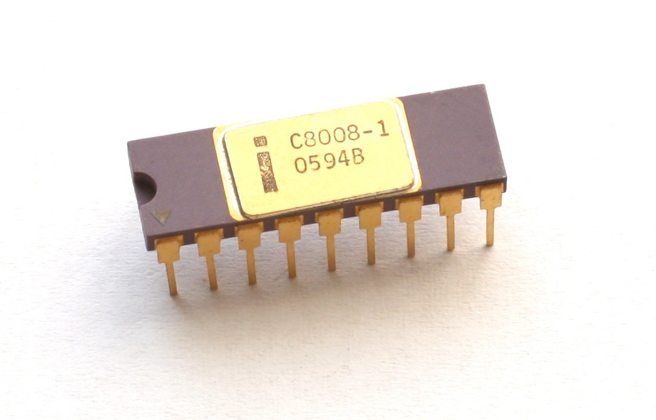


b8008
Resurrecting the World’s First 8-Bit Microprocessor
A cycle-exact Intel 8008 in VHDL, built with an AI pair programmer
Robert Rico
Notes:
One-liner intro. "In 1972 Intel shipped the first 8-bit microprocessor. I spent 8 months bringing it back — and tonight it’s running on the table." Deck color story: Intel blue until we reach the FPGA; charcoal+yellow (Lattice) from there — the theme itself says whose world we’re in. Never say it out loud. Chip photo: Konstantin Lanzet, Wikimedia Commons, CC BY-SA 3.0.

Slide 2

ACT I — WHAT
The Intel 8008 (April 1972)
• World’s first 8-bit microprocessor
• 3,500 transistors, 10 µm PMOS
• 18 pins — for a CPU
• 500 kHz clock; instructions take 5, 8, or 11 T-states
• 16 KB address space (14-bit)
• Seven 8-bit registers (A, B, C, D, E, H, L)
• 48 instructions
Notes:
Emphasize 18 pins — that single number causes most of the weirdness coming up. Modern context: an ATtiny has more pins. Chip photo: Konstantin Lanzet, Wikimedia Commons, CC BY-SA 3.0.

Slide 3
ACT I — WHAT
Built for a terminal, rejected by its buyer
• 1969-70: CTC (Computer Terminal Corp., later Datapoint) designs the Datapoint 2200 "programmable terminal" — CPU built from ~100 TTL chips
• CTC asks Intel and Texas Instruments to shrink it to one chip
• TI’s TMX 1795 (1971): technically first 8-bit CPU chip — never shipped
• Intel’s chip: late, and slower than CTC’s TTL board — CTC walks away
• Intel keeps the rights in trade, sells it as the 8008
PLACEHOLDER
Datapoint 2200 photo
(Wikimedia Commons)
optional: TMX 1795 die
(Ken Shirriff)
Notes:
The ISA was CTC’s design, not Intel’s. TI beat everyone to silicon but never productized — the 8008 outlasted it by shipping.

Slide 4
ACT I — WHAT
Your laptop still carries its DNA
8008
1972
8080
1974
8086
1978
x86
today
The instruction-set lineage in every PC today traces back to a terminal company in San Antonio, Texas.
And in 1974, the SCELBI-8H — arguably the first personal computer — was built around this chip. That’s where our demo software comes from.
PLACEHOLDER
optional: SCELBI-8H photo (willegal.net)
Notes:
Bridge slide — plants SCELBI now so the demos later have context.

Slide 5
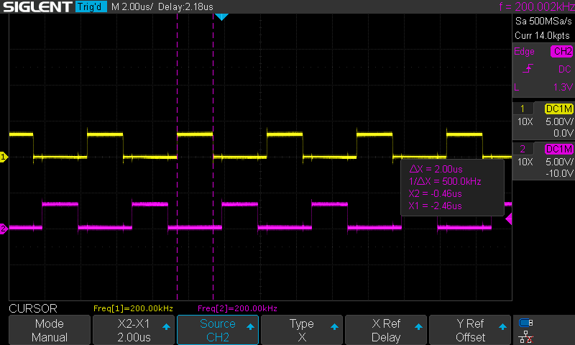
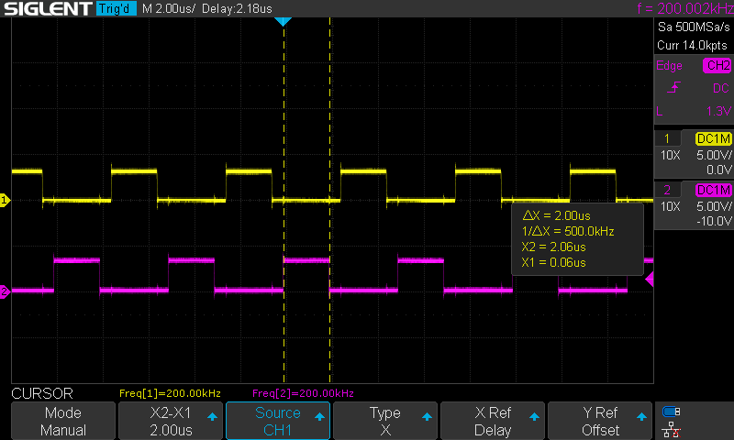
ACT I — THE QUIRKS
Weirdness #1 — Two clocks, never high together
The 8008 needs two non-overlapping clock phases (φ1, φ2).
No single clock pin. External circuitry must generate both phases with guaranteed dead time between them.
Get the overlap wrong → internal buses fight → undefined behavior.
Real capture: the FPGA generating φ1/φ2 on my bench
Notes:
These scope shots are from my bench — this is the FPGA generating the two phases. In 1972 you built this from discrete logic before the CPU would even blink.

Slide 6
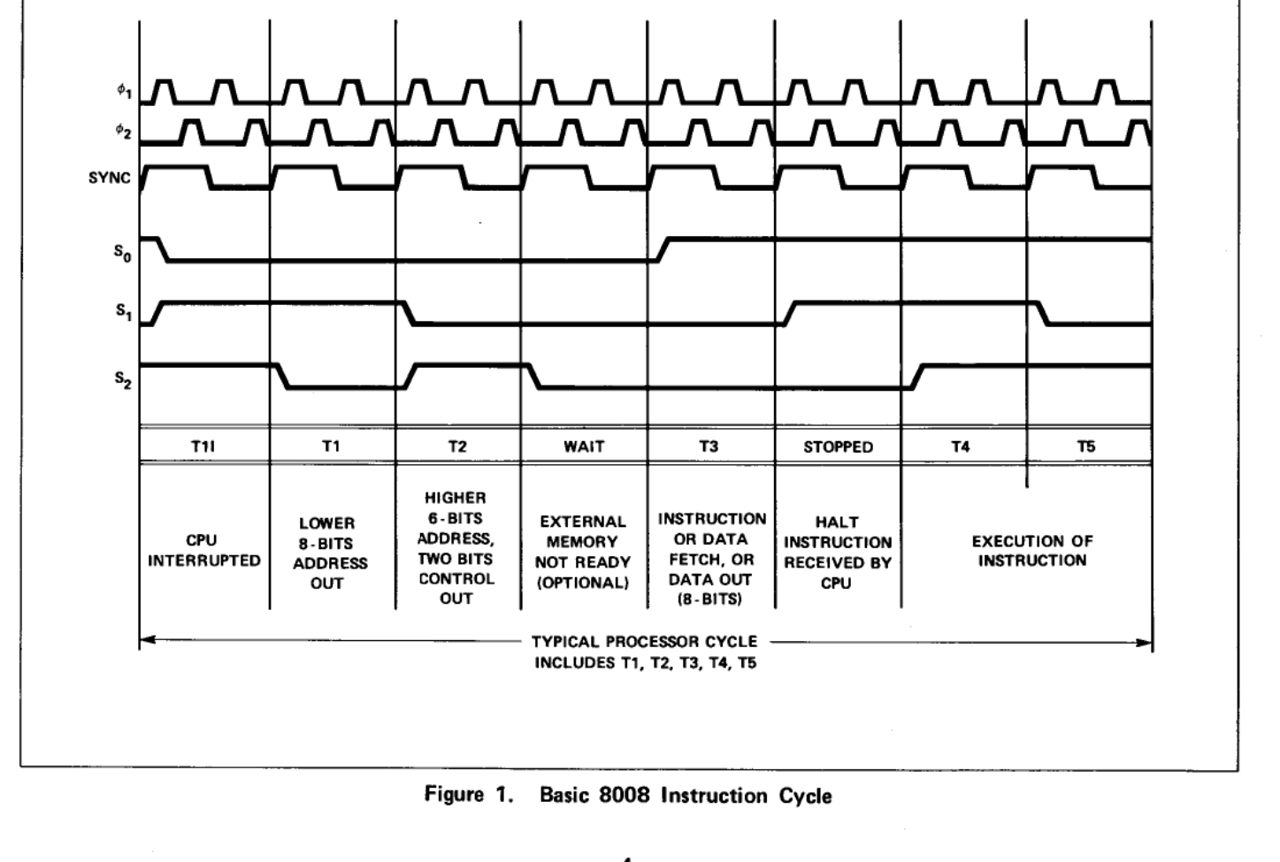
ACT I — THE QUIRKS
Weirdness #2 — One bus, three jobs
18 pins means 8 data pins total. So the bus is time-multiplexed, three ways, every machine cycle:
T-state | What’s on the 8 pins
T1 | Address, low byte
T2 | Address high 6 bits + cycle type
T3 | The actual data
External latches must grab each piece at the right instant.
Fig. 1, 8008 User’s Manual — one instruction cycle
Notes:
"Tri-plexed" bus. Every memory access is a little three-act play. The CPU also broadcasts its internal state on pins S0-S2 so external logic can follow along.

Slide 7
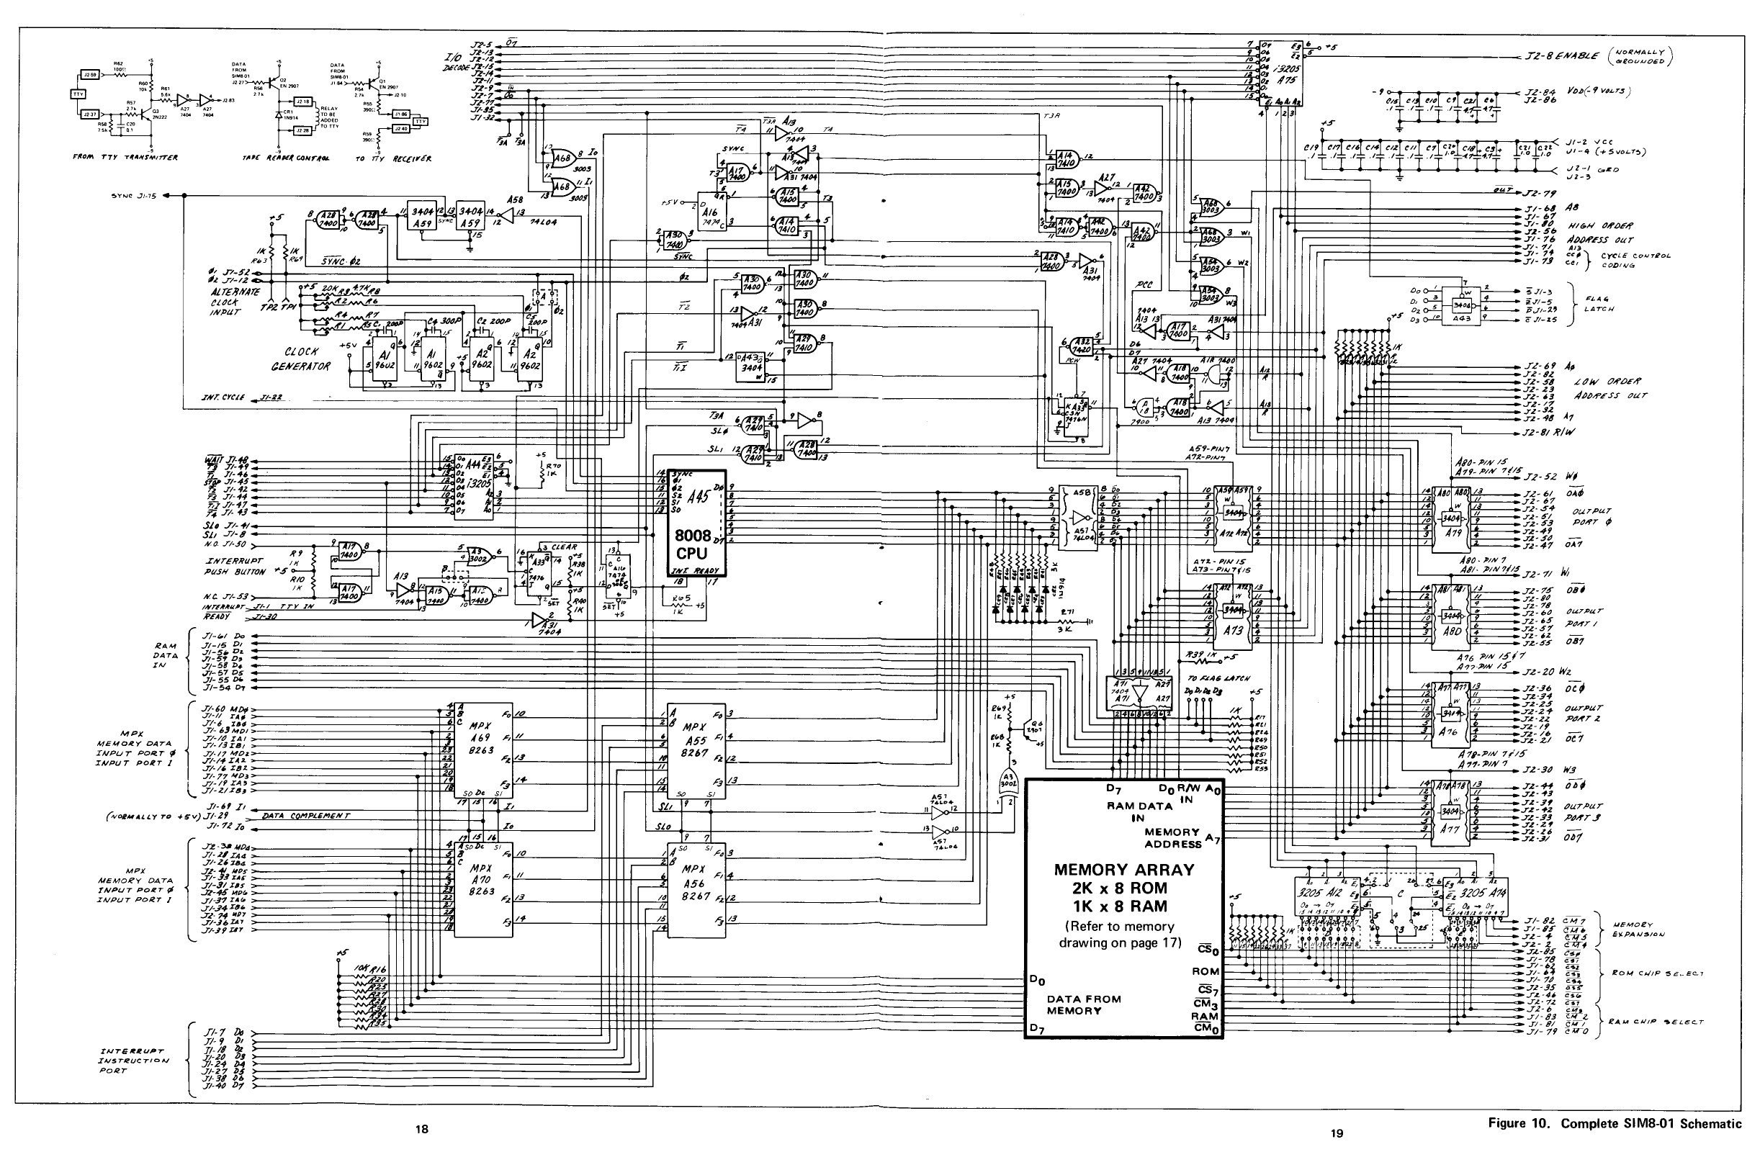
ACT I — THE QUIRKS
Weirdness #3 — It boots by being interrupted
• No reset vector. At power-on the PC is garbage.
• The *only* way to start it: assert the interrupt line and jam an instruction onto the bus (typically RST 0)
• Startup is an interrupt. Interrupts are instruction injection. It’s injection all the way down.
• Intel’s own reference design (SIM8-01) needed dozens of TTL support chips just to make the CPU usable.
SIM8-01: find the CPU. (Hint: the small box in the middle.)
Notes:
This is why "just wire up the CPU" was never an option — in 1972 or now. The support glue is half the project.

Slide 8
ACT I — THE QUIRKS
Weirdness #4 — There is no program counter
…there are eight of them.
The PC is whichever slot of an 8 × 14-bit address stack the stack pointer selects.
• CALL = SP moves forward (old slot keeps the return address)
• RET = SP moves back
• 7 levels of nesting; the 8th CALL silently wraps onto the oldest
No stack in memory. No PUSH/POP of data. 1972 had opinions.
slot 7
slot 6
slot 5 ← SP (this IS the PC)
slot 4
slot 3
slot 2
slot 1
slot 0
8 × 14-bit address stack
Notes:
Remember this one — it becomes the heart of the final design later. Implemented structurally, exactly as drawn, the stack-wrap behavior falls out for free.

Slide 9
ACT II — FPGA PRIMER
The FPGA I chose: Lattice ECP5-5G Versa
• LFE5UM5G-45F — 44K LUTs, 1.9 Mb block RAM, 5 Gbps SerDes
• Dev board: DIP switches + LEDs become the 8008’s front panel; UART over USB is the terminal
• Best-in-class open-source toolchain support: Yosys + nextpnr know this chip inside out
• Design runs at 25 MHz system clock; timing closes at ~95 MHz. The 8008 needs 500 kHz.
PLACEHOLDER
ECP5-5G Versa board photo
or product shot / logo
(user supplies)
The entire 1972 computer system: 1,672 LUTs — 3% of the chip
Notes:
THEME FLIP: we just left Intel’s world (blue) and entered Lattice’s (charcoal + yellow) — the deck stays this way to the end. Numbers from the real b8008_basic build reports: 1,672/43,848 LUT4s (3%), 8/108 block RAMs (7%), fmax ~95 MHz vs 25 MHz system clock. The chip is comically oversized for the job — the whole 1972 rack fits in a corner of it.

Slide 10
ACT II — FPGA PRIMER
30-second FPGA primer
• A chip full of uncommitted logic blocks and programmable wiring
• You describe a circuit; the toolchain configures the chip to *become* it
• Not emulation, not software — it is the circuit, in real silicon, in parallel
• This project targets a Lattice ECP5-5G using a fully open-source toolchain (GHDL + Yosys + nextpnr)
PLACEHOLDER
FPGA fabric diagram
(generic LUT/routing illustration)
or draw grid graphic
Notes:
For the software folks: the 8008 design isn’t simulated on the board — the board is wired up as an 8008. All that 1972 support glue — clocks, latches, ROM, RAM, UART — fits inside the same chip.

Slide 11
ACT II — FPGA PRIMER
Hardware description languages in one slide
Two mainstream ways to describe digital hardware — same job: describe registers and logic; tools synthesize real gates.
Verilog — C-flavored, terse, dominant in US industry
VHDL — Ada-flavored, verbose, strongly typed
always @(posedge clk)
if (en)
count <= count + 1;
process(clk) begin
if rising_edge(clk) then
if en = '1' then
count <= count + 1;
end if;
end if;
end process;
This project: VHDL, one file per functional block.
Notes:
Don’t linger. "Verbose but strict — it catches a class of mistakes at compile time, which matters when your collaborator is an AI."

Slide 12
ACT III — THE AI-AIDED PROJECT
The project: 9 months, 3 attempts
Nov 2025 → Aug 2026 — 367 commits. 3 iterations, 2 complete bottom-to-top rewrites.
✗ s8008
monolithic, single-cycle
Worked in simulation.
Broke on hardware.
✗ v8008
multi-cycle rewrite
Collapsed under its own
complexity.
✓ b8008
block-based, cycle-exact
SILICON VALIDATED
Built in collaboration with Claude (Anthropic’s AI) — every line reviewed, tested, and frequently rejected
Notes:
Set expectations honestly: this was NOT "AI, build me an 8008." Nine months of iteration, and I threw the whole thing away twice. Here’s what the first two attempts taught me.

Slide 13
ACT III — THE AI-AIDED PROJECT
s8008: when "all tests pass" lies to you
The monolithic version passed its whole simulation suite.
On the FPGA, ALU operations returned garbage.
• Single-cycle timing masked bugs simulation couldn’t see
• One 1,500-line file nobody — human or AI — could fully reason about
Rule adopted: nothing is "done" until it’s proven on silicon.
Notes:
This failure defined the whole methodology afterward: sim-pass is a hypothesis, hardware is the proof. The v8008 rewrite then failed differently — too clever, too entangled. Two failures, one diagnosis: complexity nobody could reason about.

Slide 14
ACT III — THE AI-AIDED PROJECT
The AI wrote most of the VHDL. Here’s why that worked.
It worked because I could tell when it was wrong.
• I had to learn the 8008 cold: T-states, machine cycles, every ISA quirk
• Built isa.json — every opcode mapped to its documented T-state sequence — as ground truth
• 37-test regression suite; cycle counts diffed against the datasheet automatically
The AI multiplied effort. The verification was the job.
// docs/isa.json - ground truth
{ "operation": "CAL",
"D[7:0]": "01XXX110",
"num_states_execution": 11,
"num_cycles": 3,
"cycle_1": {
"T1": "PCL OUT",
"T2": "PCH OUT",
"T3": "FETCH INSTR.",
...
"cycle_3": {
...
"T4": "REG.a TO PCH",
"T5": "REG.b TO PCL" }}
Notes:
The transferable lesson for this audience: AI collaboration shifts your work from writing to specifying and verifying. You must know enough to catch it being confidently wrong — and it will be. SEGUE: "So attempt #3 needed a design that a human AND an AI could each fully reason about. Turns out Intel drew it for us in 1972."

Slide 15
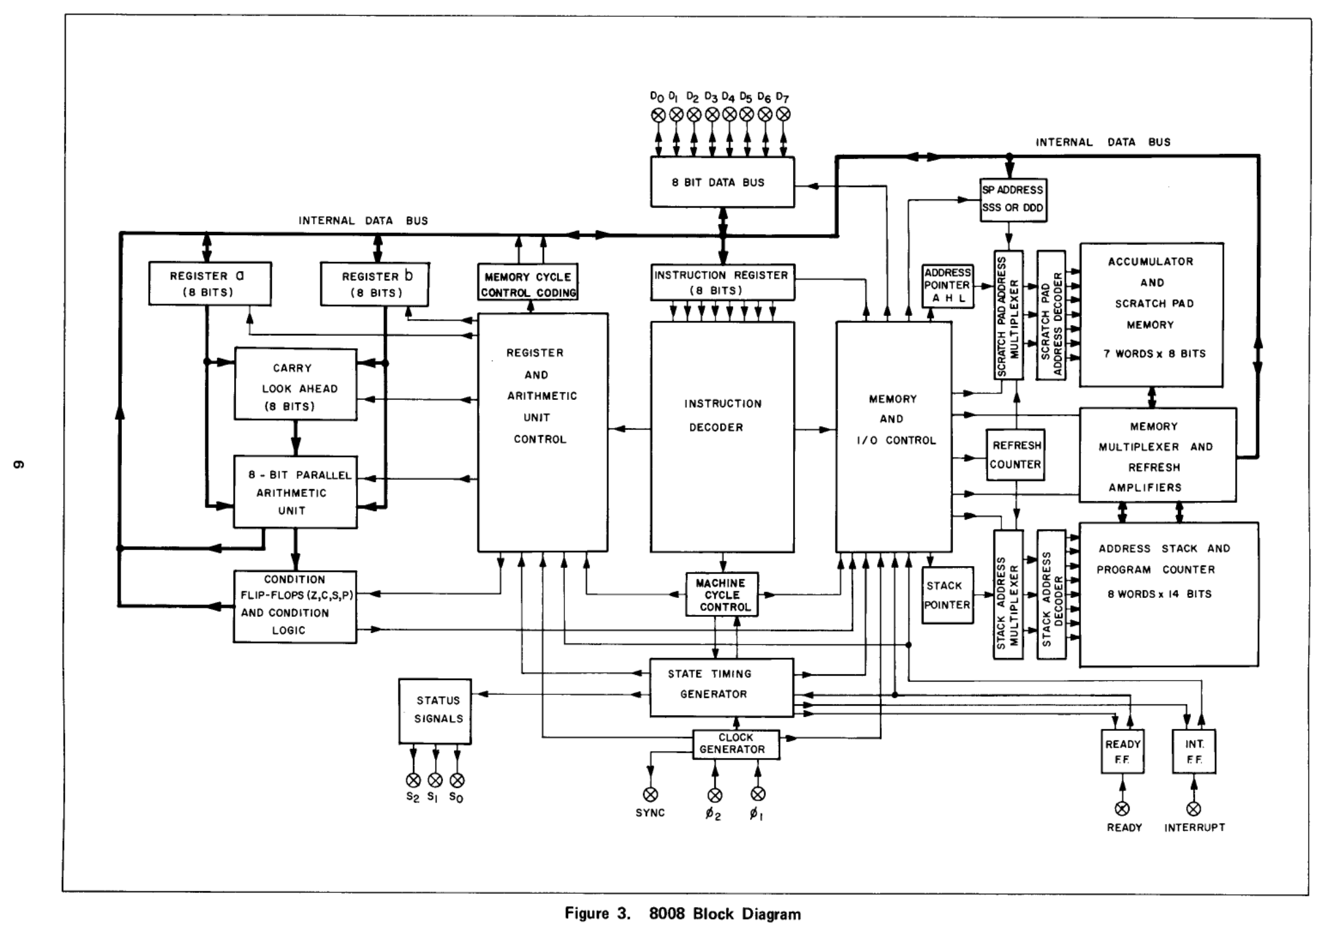
ACT IV — THE DESIGN THE FAILURES FORCED
The fix: build Intel’s own block diagram. Literally.
Attempt #3:
one module per block.
No cleverness.
Fig. 3, 8008 User’s Manual (1973)
Notes:
After two failures from complexity, the answer was radical simplicity: stop inventing an architecture and copy the one on the datasheet. Walk the diagram: address stack, scratchpad registers, ALU, instruction register/decoder, timing & control. Every box becomes a VHDL file.

Slide 16
ACT IV — THE DESIGN THE FAILURES FORCED
Design rule: every module is dumb
25 VHDL files. Each block:
• Does one job, ~50–100 lines
• Knows nothing about instructions, interrupts, or other modules
• Responds only to explicit control signals
• Has its own testbench
All the intelligence lives in one place: the timing & control unit.
Timing & Control Unit
(the only smart module)
address
stack
stack
pointer
register
file
ALU
instr.
decoder
control signals only — no module knows what a "JMP" is
Mirrors Fig. 3 box-for-box —
the diagram IS the architecture
Notes:
Direct answer to the s8008 postmortem: when a module can’t know about instructions, it can’t harbor an instruction-specific bug. Debugging becomes: which control signal was wrong, and when? Also the AI payoff: a 70-line module with one job is something Claude gets right — and something I can fully review.

Slide 17
ACT IV — THE DESIGN THE FAILURES FORCED
The whole stack pointer. All of it.
if reset = '1' then
sp <= (others => '0');
elsif rising_edge(clk) then
if phi1_rising = '1' then
if stack_push = '1' then
sp <= sp + 1; -- wraps 7 -> 0
elsif stack_pop = '1' then
sp <= sp - 1; -- wraps 0 -> 7
end if;
end if;
end if;
src/b8008/stack_pointer.vhdl
69 lines including comments.
It has never had a bug.
It doesn’t know what CALL is. It doesn’t know interrupts exist.
It counts.
Notes:
CALL/RET/RST semantics — even the stack-wrap behavior from Weirdness #4 — emerge from structure, not from logic.

Slide 18
ACT V — HOW DO I KNOW IT WORKS?
The real test suite was written in 1974
Directed tests prove what you thought to test.
Period software proves the machine.
PLACEHOLDER
SCELBI book cover or
Byte May 1976 cover
(period flavor)
• SCELBI floating-point calculator (1974)
• HEXPAWN — self-modifying learning game (1973)
• STARS (Byte magazine, 1976)
• Pi digit generator, Mandelbrot renderer
• SCELBAL BASIC (1976)
Each ported with a minimal, documented change ledger — I/O shims and memory-map constants only.
Notes:
If a self-modifying 1973 game and a floating-point interpreter both run, the CPU is right in ways no directed test can claim. This software exercised corners I’d never have thought to test.

Slide 19
ACT V — HOW DO I KNOW IT WORKS?
Verification scorecard
Check | Result
Regression suite | 37/37
Cycle-exact T-states vs datasheet (all 27 timing classes) | 27/27
Interrupt suite | 10/10
Hardware ISA self-test, running on the board | 46/46
Flags spec-exact (INR/DCR preserve carry; rotates carry-only) | ✓
Interrupts at instruction boundaries only (User’s Manual Fig. 2) | ✓
Notes:
"Cycle-exact" means: not just the right answer — the right answer in exactly the number of clock states the 1972 datasheet specifies, for every instruction class. Optional: swap table for green run_all_tests.sh terminal screenshot.

Slide 20
ACT V — HOW DO I KNOW IT WORKS?
Beyond tests: proofs, equivalence, fuzzing
Layer | What it checks | Scale
SBY property proofs | Module contracts as PSL assertions, proven by SMT solver (k-induction / bounded) | 11 suites
Equivalence checks | RTL vs its synthesized gate netlist (Yosys round trip) | 7 miters + 6 EQY
Exhaustive sweeps | ALU and instruction decoder vs independent Python models | 1,049,600 + 256 cases
cocotb monitors | External bus protocol on the full core; per-instruction control-signal scenarios | RTL + netlist
Differential fuzzer | Random legal programs under three oracles: bus monitor, datasheet timing, RTL-vs-netlist trace diff | seeded, both cores
37 CI jobs on every push · every checker mutation-tested · verification plan: 102 rows, zero gaps
Notes:
One paragraph per row, no deep dive. SBY: the solver proves the assertion for ALL input sequences, not sampled ones — math, not test vectors. Equivalence: the exact netlist headed for the FPGA is proven to match the RTL, so synthesis can’t silently change behavior. Exhaustive: every ALU input combination, every opcode, against models written from the datasheet, not from the VHDL. Mutation-tested = plant a bug, watch the checker fail, revert — a checker that can’t fail proves nothing. Anecdote: the bus monitor found a real RTL bug — two machine-cycle type codes transposed on the external bus. The fuzzer runs the same random program on the RTL core and the synthesized-netlist core and diffs the traces.

Slide 21
ACT VI — LIVE PROOF
LIVE
Live: 1970s software on the board
1. Pi — 50 digits via Machin’s formula, multiprecision arithmetic (2013 program for SCELBI hardware)
2. SCELBI Calculator (1974) — 23-bit floating point: 12.2 X 2.2 = 26.84
3. HEXPAWN (1973) — self-modifying code: it learns as it loses
4. Finale — the tiny OS: power on → BASIC → MON → monitor dumps the tokenized program from RAM → G 1FB6 → back in BASIC, program intact
Notes:
Rig (rig slide cut — say it here): Versa board, minicom 115200 8N1, local echo off, DEL for rubout; monitor commands D/W/L/G; DIP switches = interrupts + READY/WAIT.
DEMO CHEAT SHEET (verify commands before talk):
• Pi: L in monitor → send hex via send_hex.py → G 0040. ~75 s at 500 kHz for 50 digits — narrate history while it grinds. 49/50 digits correct; the 50th is the ORIGINAL program’s guard-byte truncation — great trivia beat.
• Calc: load, G, type 12.2 X 2.2 = live.
• HEXPAWN: play 2 quick games, point out it stops making the losing move. DROP CANDIDATE if running long.
• Tiny OS: power-cycle board into b8008_basic bitstream. Type a 3-line FOR/NEXT program, RUN, MON, D the program region, G 1FB6, LIST — program survived.
• Fallback: pre-recorded terminal captures of all four in case hardware misbehaves.

Slide 22
ACT VI — TAKEAWAYS
What I’d tell you to steal
• Dumb modules, smart control — structure beats cleverness; the block diagram was right all along
• Simulation passing is a hypothesis. Hardware is the proof.
• AI pair programming works when you own the ground truth — I specified and verified; it multiplied
• Old software is the best test suite — it encodes assumptions no one thinks to write down
• 1972 engineers did all of this with 3,500 transistors. Respect.
Notes:
Close on the human point: the 8008’s designers had no simulator, no regression suite, no second chances on a mask set.

Slide 23
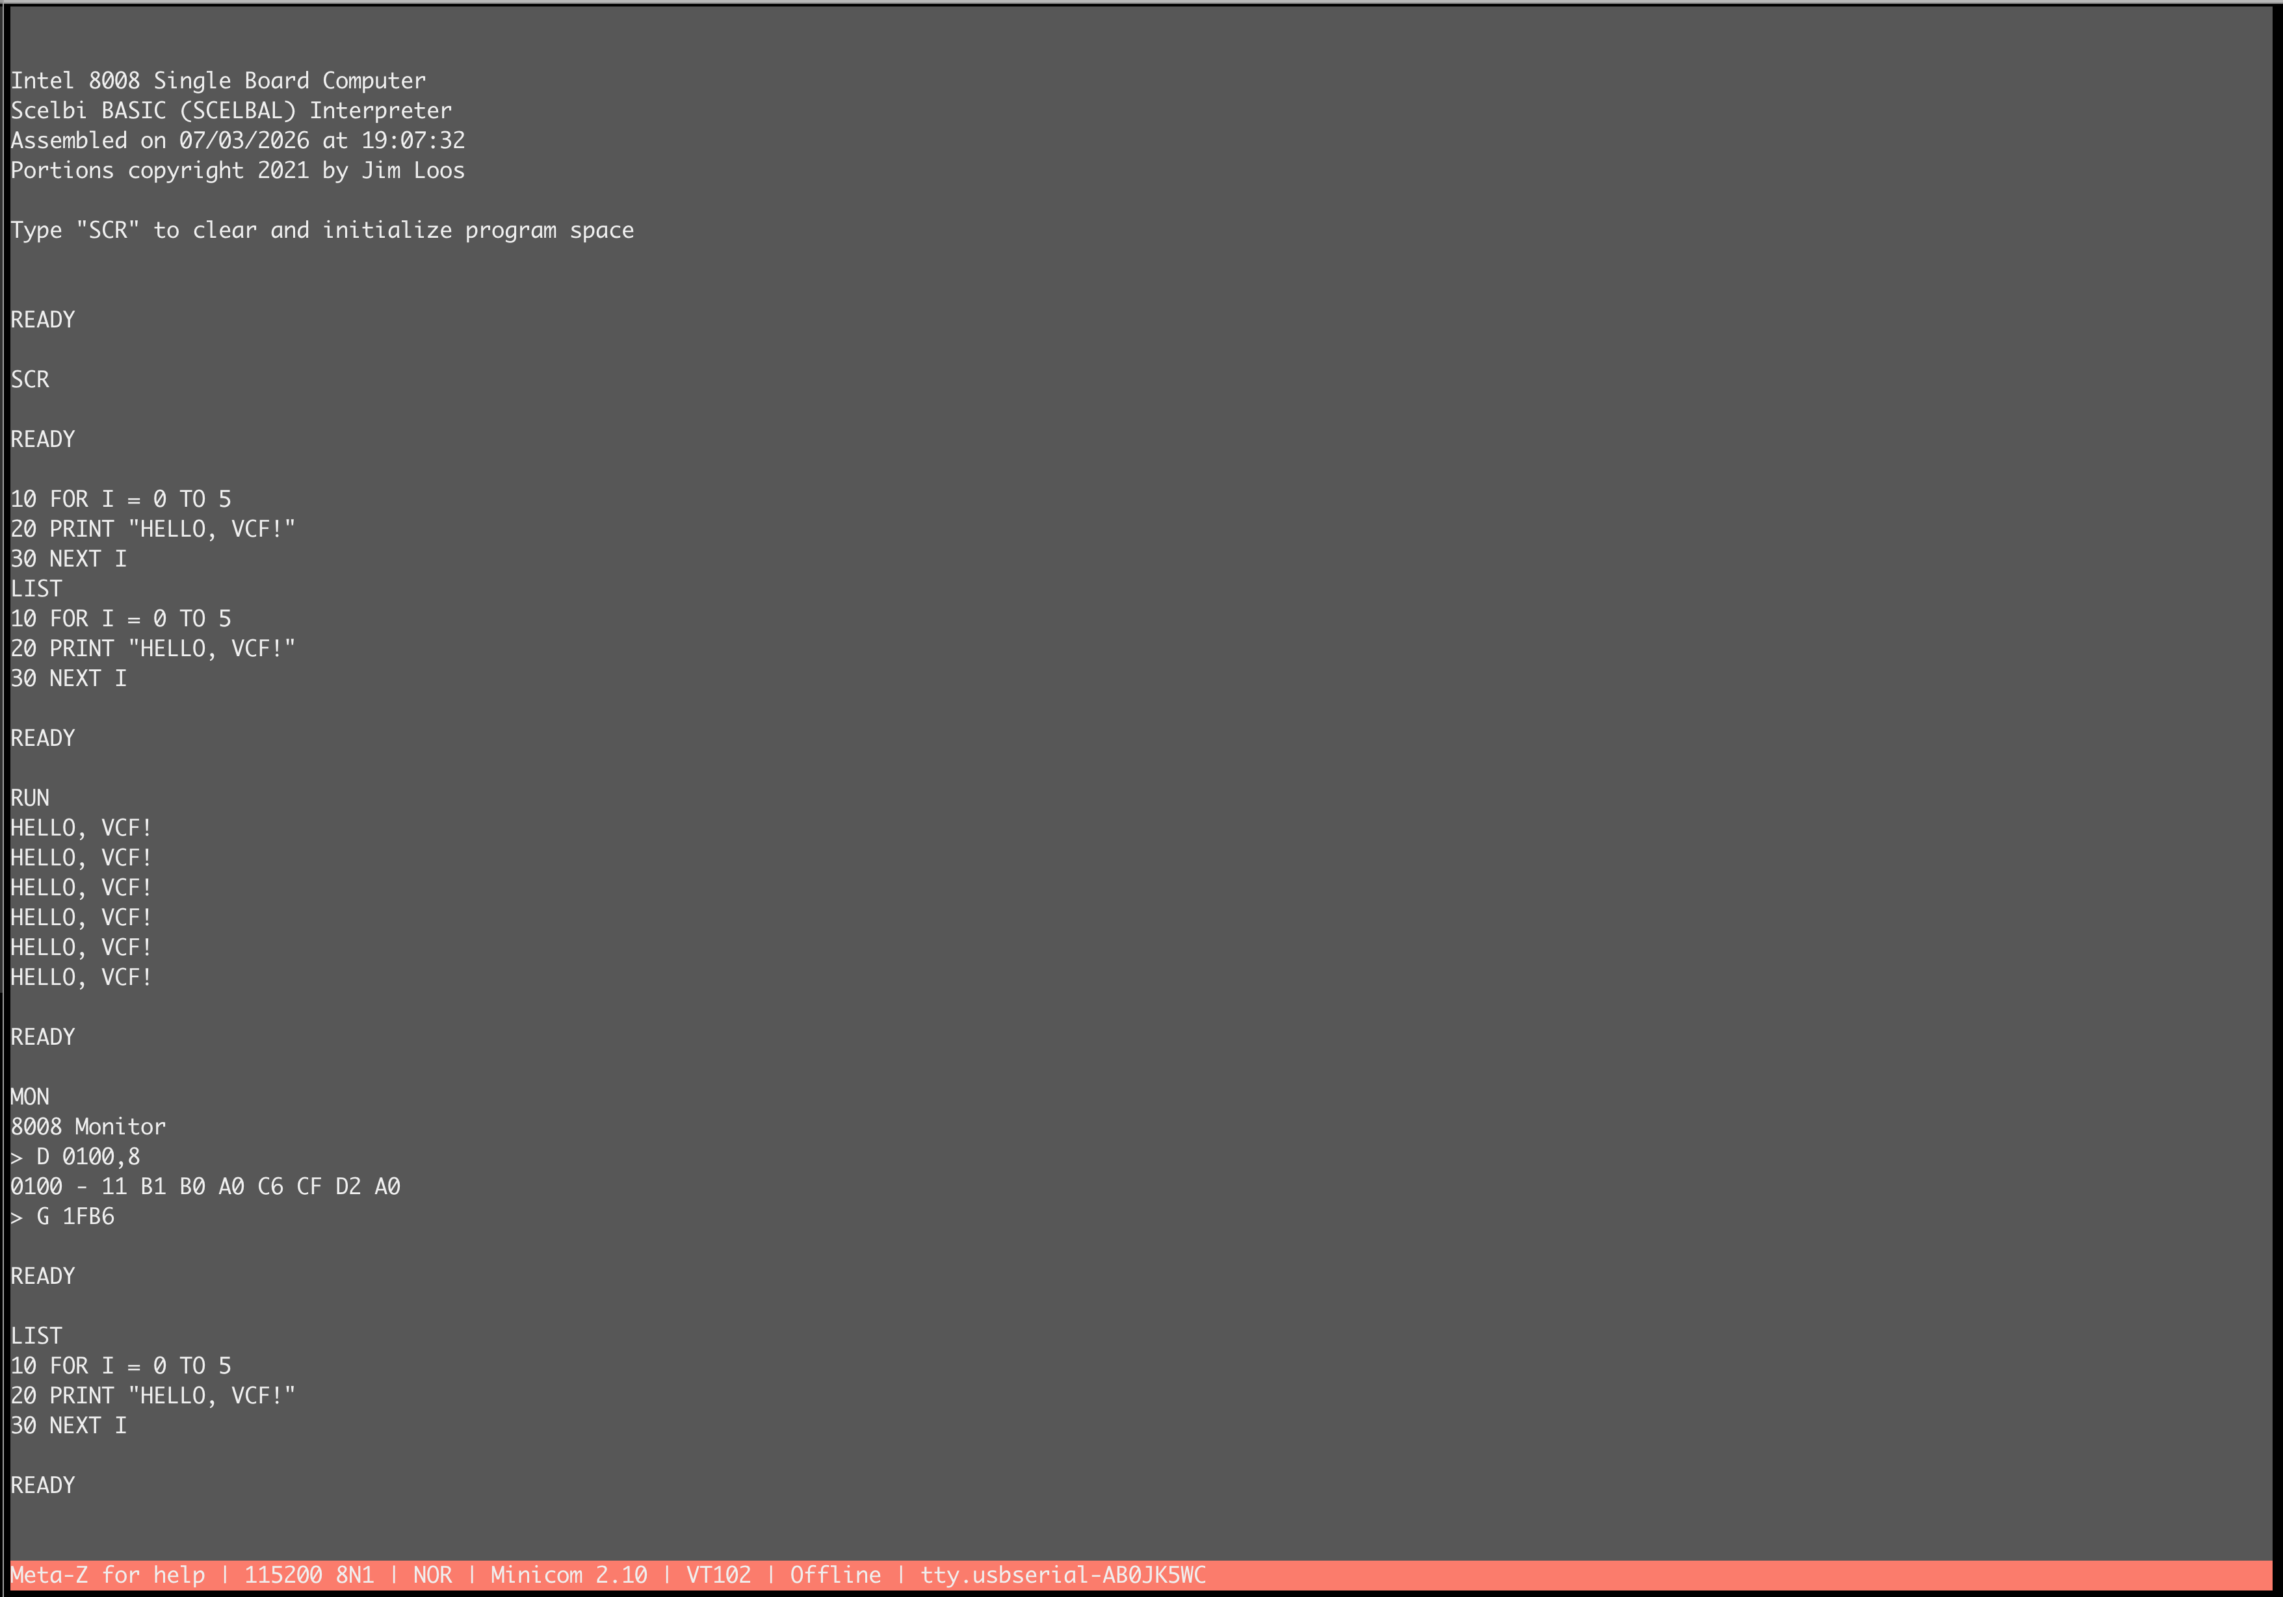
Questions?
Robert Rico
Project: github.com/robertrico/intel-8008-vhdl
SCELBAL: Jim Loos (jim11662418/8008-SBC)
Period software: Mike Willegal’s SCELBI archive (willegal.net)
Original SCELBAL: Arnold & Wadsworth, 1976
Board stays up after — come play with BASIC.
Notes:
Fill in real repo URL if/when public. Invite people to type at the machine — most memorable 8-bit demo is the one they drive.

