Slide 1
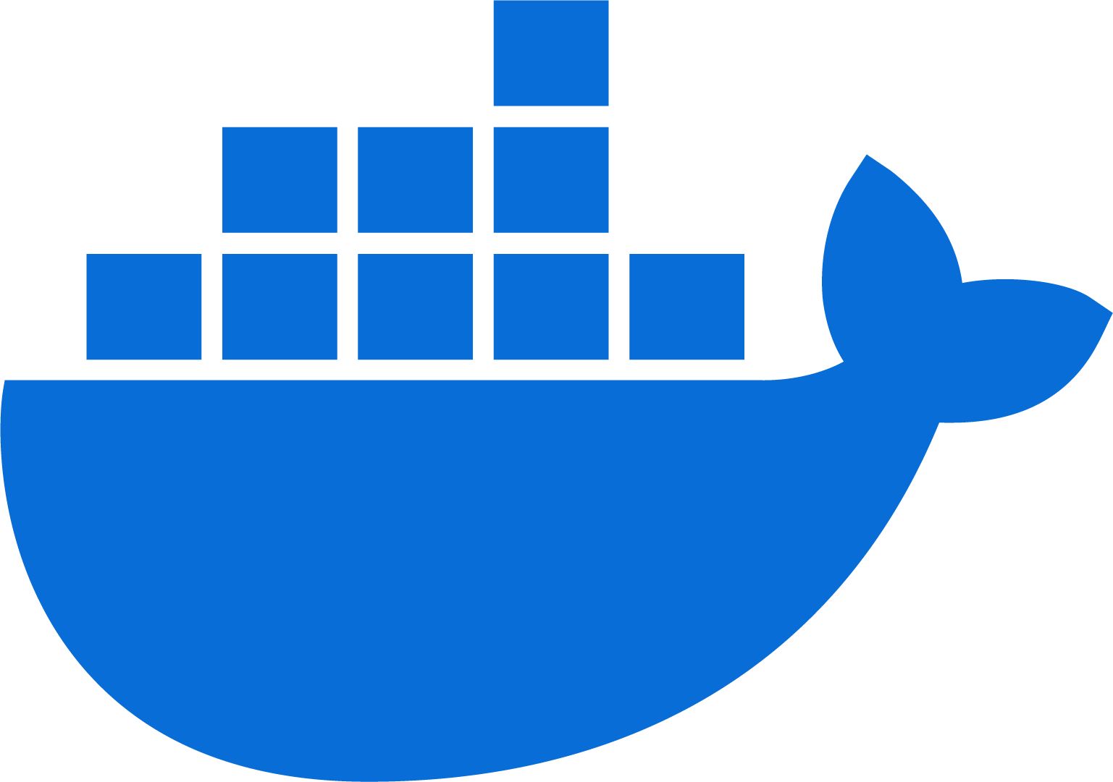
Docker 101
Rob Rico
2024-03-28

Slide 2
A bit about Rob
Been developing since 2013
Graduated with a Degree in Computer Science
Working for an EdTech company as Head of Engineering
Currently run a freelance company

Slide 3
Understanding Containerization
The encapsulation of an application and its dependencies into a container that can run on any Linux or Windows based system.
Traditional virtualization involves running multiple operating systems on a single physical server via virtual machines (VMs)
Resource Intensive
Containerization, by contrast, allows multiple applications to share the same OS kernel with each container running as an isolated process in user space.
Shared resources, or small machines in the Cloud

Slide 4
Introduction to Docker
A leading platform for developing, shipping, and running applications in containers.
Over 3.5 million applications have been placed in containers using Docker technology, with millions of developers worldwide.
Over 37 billion containerized applications have been downloaded.
Docker’s works very well in a continuous integration/continuous deployment (CI/CD) pipelines and microservices architecture.
Currently running AWS ECS Fargate instances using ECR.
Notes:
vagrant

Slide 5
Docker Architecture
Docker Engine
The core of Docker, it's a lightweight runtime and toolkit that manages containers, images, and builds, enabling the creation and running of Docker containers on any compatible operating system.
Docker Images
Blueprint of the application along with its dependencies and environment settings needed to run it. Images are immutable, ensuring consistency across different development and production environments.
Containers
Running instances of Docker images that encapsulate specific applications and their runtime environment. Containers are isolated from each other and the host system, but share the OS kernel, making them lightweight and fast.

Slide 6
Docker Architecture
Dockerfile
A text document containing all the commands a user could call on the command line to assemble an image. Developers use Dockerfiles to automate the creation of Docker images.
Image Building Process
Developers write Dockerfiles to define the application’s environment. Docker uses these Dockerfiles to automatically build images. These images can be used repeatedly to create new containers.
Online Repositories
Docker Hub: A public registry where users can push their own images and pull images created by others.
AWS ECR: A private cloud repository hooked up to the AWS infrastructure.

Slide 7
Benefits of Docker for Dev Teams
Ensuring Consistency
Docker standardizes the development environment by allowing developers to work in containers that replicate the production environment exactly.
This uniformity eliminates discrepancies between working environments and reduces deployment conflicts.
Accelerating Development Cycles
Docker enhances development speed by allowing developers to create and replicate environments quickly and efficiently.
This capability reduces setup times for new projects and speeds up the transition from development to production.
Enhancing Team Collaboration
Every team member works with identical setups, fostering quicker feedback loops and significantly reducing the common "it works on my machine" problem.
Docker's approach promotes a more integrated and collaborative development process.

Slide 8
Package Management with Docker
Managing Application Dependencies
Docker encapsulates an application and all its dependencies within a container.
This encapsulation ensures that the application will run identically, regardless of the deployment environment, whether it's on a developer's local machine, a test environment, or production servers.
Version Control with Docker Images
Docker supports version control by allowing developers to tag images with version numbers.
This helps facilitate easy and reliable rollback procedures.
Legacy or old-outdate applications
Docker has been a saving grace for multiple projects I’ve managed over the years.
Containerized an old PHP 5.3 application running ancient packages.
This allowed me to roll a modern, CI/CD pipeline with a decade old app

Slide 9
Demo: Dockerizing a PHP Server
What are we building
A simple PHP application—a basic web server displaying 'Hello, World!'. This application serves as an ideal candidate for containerization because it's lightweight and represents a typical use case for web development environments.
Typically, if all dev machines have the same PHP version and libraries, using a framework or even `php –S` to start a local server can suffice.

Slide 10
Demo: Dockerizing a PHP Server
Code Time!

Slide 11
Demo: Dockerizing a PHP Server
This demo highlights Docker’s capability to simplify and standardize the deployment process, demonstrating both its simplicity and efficiency.
By using Docker, we ensure that our development and production environments are identical, mitigating common deployment issues related to environment discrepancies.
PLUS – Includes containers ready to go with PHP dependencies such as Apache or Nginx

Slide 12
Docker Caveats
Complex Concepts for Beginners
Docker involves concepts like containers, images, and Dockerfiles, which can be complex for beginners to grasp initially. The abstraction of app deployment and system-level details may require a mindset shift for those accustomed to traditional development environments.
Docker Installation Process
Challenge: Installing Docker requires understanding the differences between Docker Engine and Docker Desktop, which can be confusing.
Specifics: Docker Desktop provides a GUI and is suited for local development on Windows and Mac, integrating Docker Engine, Docker CLI client, Docker Compose, and more.
In order to master Docker, you need to know CLI and not rely on the GUI ( although you can get very far )

Slide 13
Docker Caveats
System Resource Requirements
Docker can be resource-intensive, particularly Docker Desktop on Windows or Mac. Running multiple containers simultaneously may require significant system resources, which can impact the performance of other applications and the system overall.
Network Configuration
Setting up and managing internal Docker networks to allow containers to communicate with each other and the outside world involves a learning curve.
Users must understand Docker networking modes like bridge, host, and overlay, which can be complex depending on the application architecture.

Slide 14
Conclusion and Q&A
Docker presents a paradigm shift in how applications are developed, deployed, and managed, which naturally comes with a learning curve.
While it offers numerous advantages, the initial setup, understanding of core concepts, and integration into existing systems can pose challenges for teams and individuals new to Docker.
Questions?

Slide 15
Further Resources and Learning
Docker Documentation
https://docs.docker.com/
Docker Hub
https://hub.docker.com/
AWS ECS – ECR
https://docs.aws.amazon.com/AmazonECS/latest/developerguide/ecr-repositories.html
Docker Blog
https://www.docker.com/blog/

