Slide 1

Social Data Mining
Assignment Four
Robert Routledge
200449068
https://www.youtube.com/watch?v=EirKK9_sBlQ

Slide 2
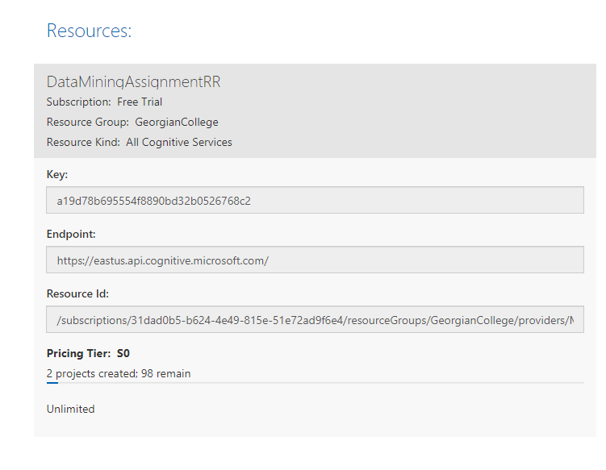
Step One: Get Cognitive Services Key
Login to customvision.ai, get the key and endpoint from my Azure account

Slide 3
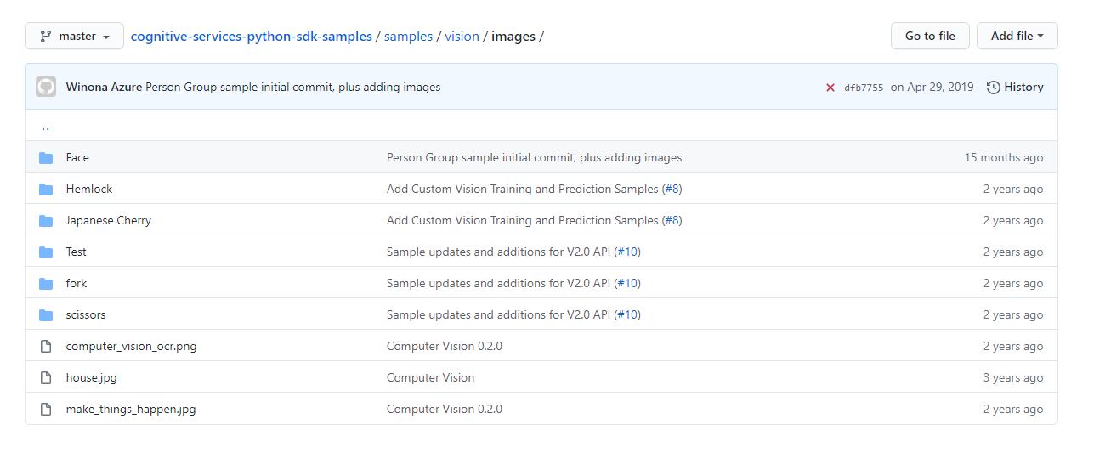
Step Two: Download Sample Images
Clone the provided Git.

Slide 4
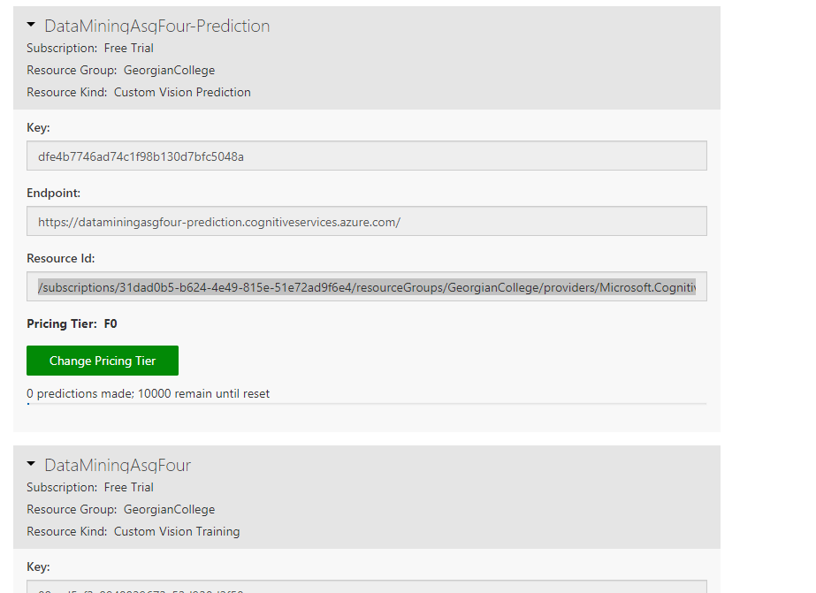
Step Three: Get Predictive Service Keys
Get API Keys from customvision.ai

Slide 5
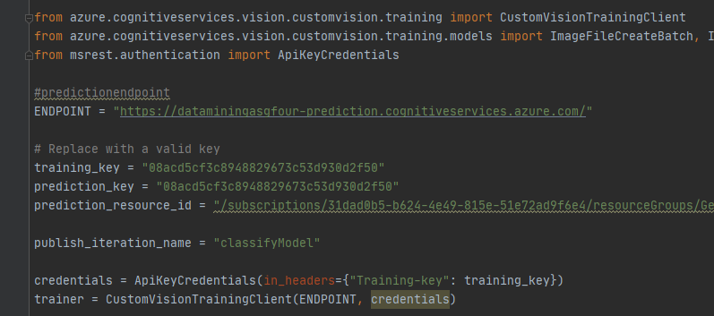
Step Four: Code Connection
Connect to cognitive services in Azure through Python

Slide 6
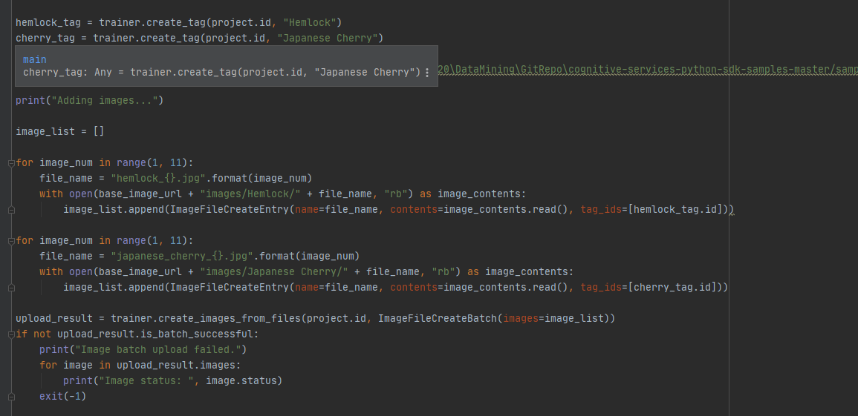
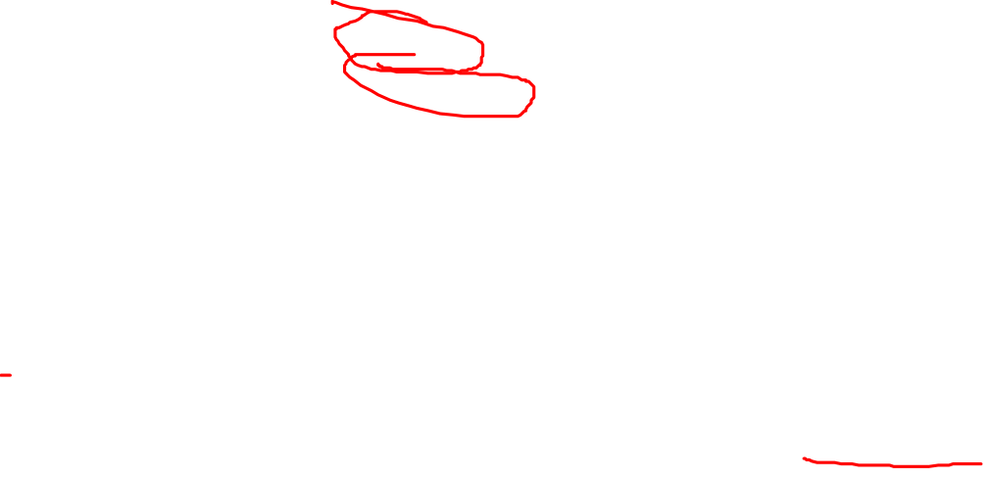
Step Five: Tag Training Images
Build a list of images and tag them with either hemlock or cherry.
These are the images we’ll train the ai with.

Slide 7
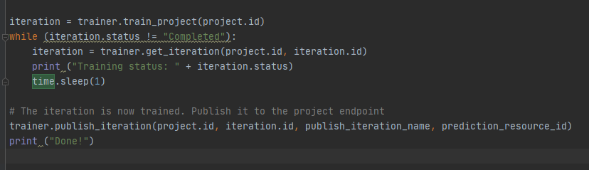
Step Six: Train Images
Train the model on the images created on the last slide

Slide 8
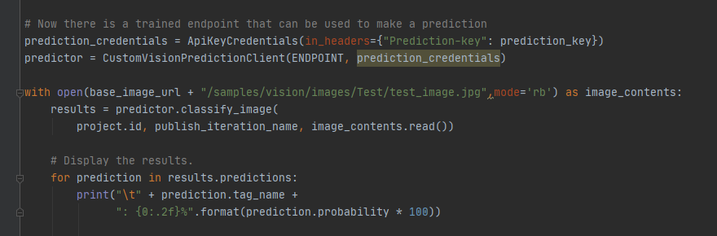
Step Seven: Make Predictions
Connect to the prediction client,
Make a prediction on the test image, showing how confident the ai is that it is one of the images we trained on earlier.

Slide 9
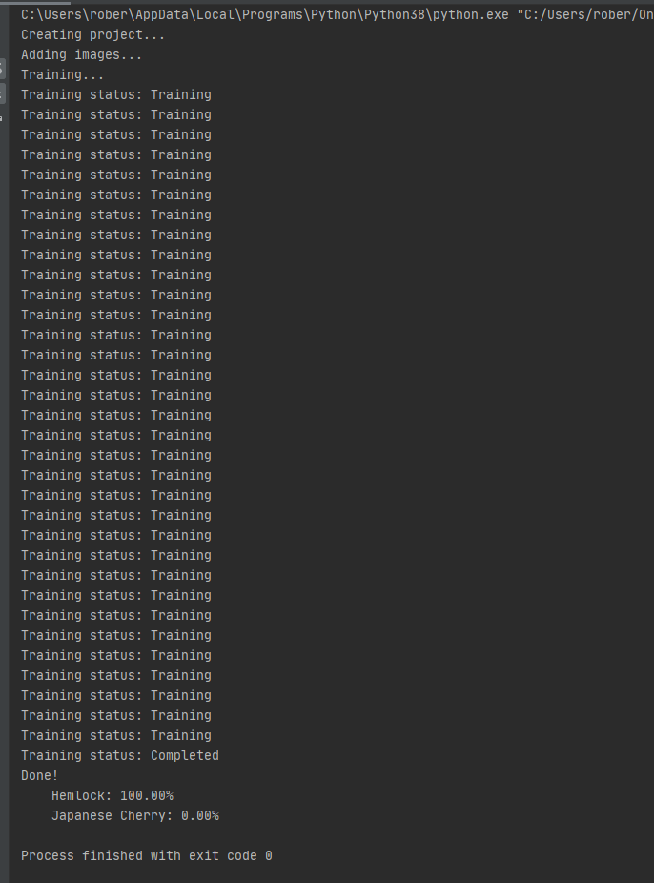

Step Seven: Make Predictions
Our prediction is that the sample test image provided is 100% likely to be Hemlock and 0% likely to be Japanese Cherry.

Slide 10
IMAGES
Note that images can be found in

