Slide 1
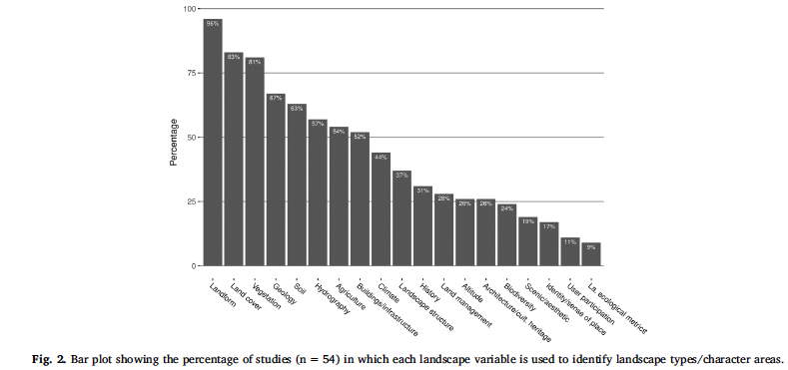
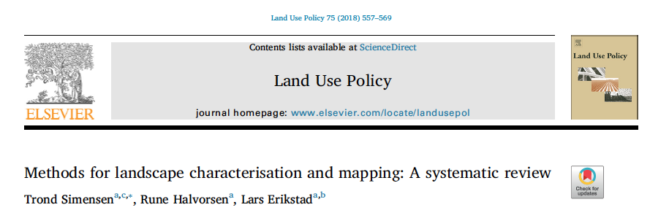

Slide 2
“Our review confirmed a major distinction between approaches rooted in the natural sciences and approaches rooted in the arts and the humanities. Three substantially different methodological approaches or strategies were identified: 1) ‘holistic’ landscape character assessment approaches, by which visual perception and socio-cultural aspects of the landscape are emphasised; 2) landscape characterisation methods based on a priori selection of geo-ecological and land-use-related properties of the landscape; and 3) biophysical landscape characterisation approaches which rely strongly on statistical analyses in order to identify gradients of variation in the presence and/or abundance of landscape elements and properties.”

Slide 3
Statistical analysis of landscape pattern
Spatial representation: Points, lines, polygons, rasters, graphs
Pattern description (e.g., landscape metrics, geostatistics, spatial autocorrelation analysis)
  Fixed scale
  Multi-scale
  Patch vs. gradient view
    Categorical vs. numerical variables

Slide 4
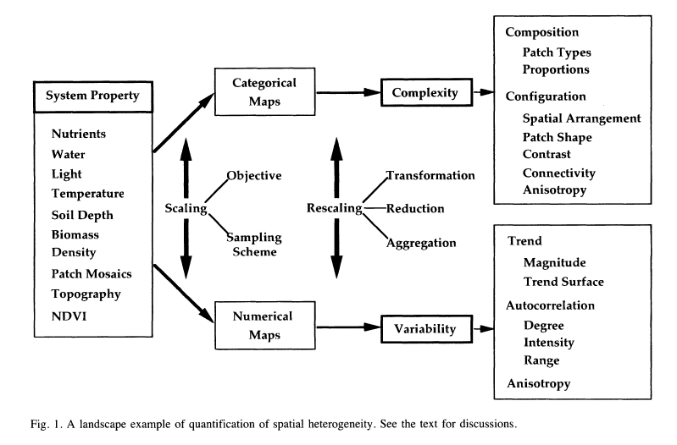
Li and Reynolds, Oikos (1995)

Slide 5
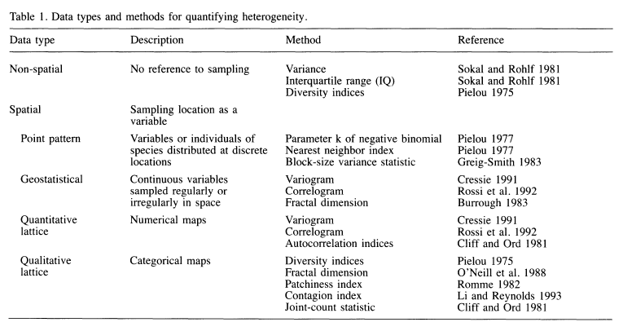
Quantifying heterogeneity
Li and Reynolds, Oikos (1995)

Slide 6
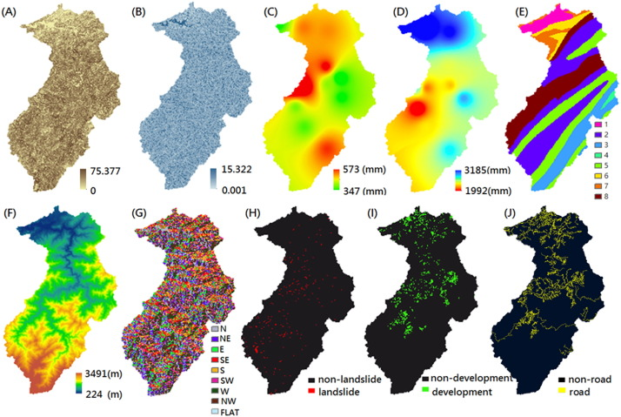
Quantifying spatial association
Categorical maps
  Chi-squared
  Mutual information
Categorical <> numerical
  Classification trees
  Polychotomous logistic regression
Numerical <> numerical
  Spatial regression
  Ordination (RDA, CCA)
  Co-kriging
https://doi.org/10.1016/j.scitotenv.2017.12.039

Slide 7
Lab objectives
Examine Burton Mesa case study area
Raise awareness of issues that arise when analyzing spatial association between maps
Learn one entropy-based approach: Mutual Information Analysis

Slide 8


Joint Entropy
where p_{j} is the proportion of the map in map class j, j=1,2…u.
where p_{jk} is the proportion of the map where x is in class j and y is in class k

Slide 9

Mutual Information

