Slide 1

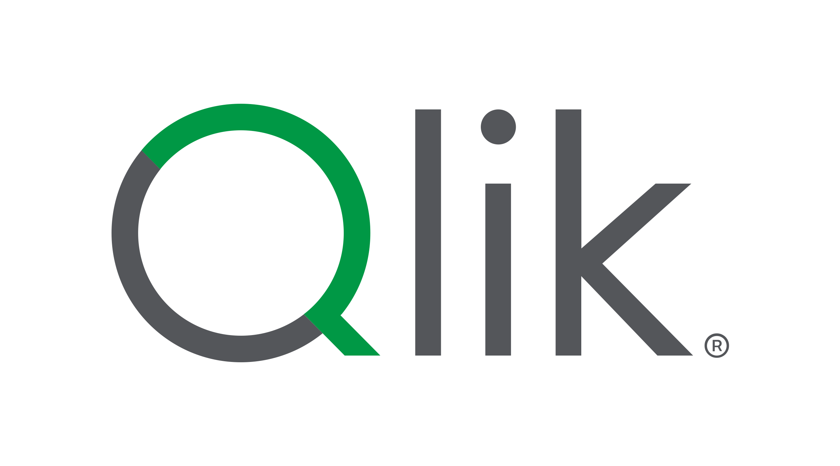
Meridian Commerce Group
Project Qlarity
The end-to-end Qlik Cloud demo
Qlik + Clarity: a repeatable framework for demoing the full Qlik Cloud stack, end to end.
Integrations
Governance
Analytics
AI & Outcomes
Notes:
Open here. Project Qlarity — Qlik plus Clarity — is our repeatable framework for demoing the full Qlik Cloud stack end to end. Be clear it is a demo framework, not a product or a customer platform. Set up the arc: a fictional retailer with a messy data estate, walked through four connected acts — Integrations, Governance, Analytics, and AI & Outcomes.

Slide 2


What is Project Qlarity
The initiative in plain terms — a repeatable framework for demoing the full Qlik Cloud stack, end to end
"Qlik" + "Clarity" = Project Qlarity
A repeatable framework for demoing how Qlik Cloud turns fragmented, messy data into trusted, AI-ready data products.
What it is
How it comes to life
▸ Meridian Commerce Group (MCG) — a fictional global retail / commerce company
▸ One git repository holds the whole demo
▸ MCG's data estate is scattered across 47 fragmented systems
▸ One command — npm run deploy — stands it up
▸ Project Qlarity is the framework for demoing that mess becoming trusted, governed Qlik data
▸ A self-hosted MCG Deploy console (web wizard) drives it
▸ A complete, presentable end-to-end Qlik demo environment — a framework, not a product
▸ Four connected stories: Integrations, Governance, Analytics, AI & Outcomes
From 7 data-quality nightmares (~$127M/year, 47 systems) to gold data products, governed knowledge, and AI outcomes — all in one repo.
Project Qlarity • MCG Demo • Qlik Cloud
2
Notes:
Frame it plainly: this is a framework for demoing Qlik Cloud, not a platform we are selling. Meridian Commerce Group is our fictional global retailer with data scattered across 47 systems. The whole demo lives in one git repo and stands up with one command through the MCG Deploy console. Land the phrase: a framework, not a product.

Slide 3
The Problem
Before Qlarity — why MCG's data estate needs a transformation
7
~$127M
47
data quality nightmares
cost per year
fragmented systems
recurring failure patterns across the estate
the price of dirty, fragmented data
no single, trusted source of truth
Symptoms show up everywhere: WISMO calls, cold-chain spoilage, late deliveries, mismatched addresses, and duplicated customer records — all traced back to untrusted data.
Project Qlarity's job
Show 47 systems consolidated into one governed Qlik Cloud environment — so every downstream analytic, document, and AI answer stands on data the business can trust.
Project Qlarity • MCG Demo • Qlik Cloud
3
Notes:
Set the stakes fast: seven recurring data-quality nightmares, roughly 127 million dollars a year, across 47 fragmented systems with no single source of truth. This is the before. Keep it concrete — WISMO calls, cold-chain spoilage, late deliveries, mismatched addresses, duplicate customers — all tracing back to untrusted data.

Slide 4

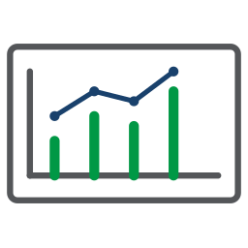
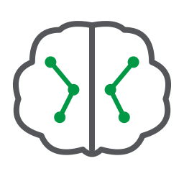
The Four Stories
One narrative, told in four connected chapters — the spine of the whole demo
1
Integrations
Land 3 messy source feeds into the Open Lakehouse — WMS change data, IoT cold-chain streams, and CRM records.
2
Governance
Turn raw data into trusted data — trust scores, data-quality rules, lineage, a business glossary, and stewardship.
3
Analytics
Publish gold data products and apps that answer supply-chain and last-mile questions on data people believe.
4
AI & Outcomes
Qlik Predict, Qlik Answers, Discovery Agent, and the agentic layer turn trusted data into decisions and action.
Project Qlarity • MCG Demo • Qlik Cloud
4
Notes:
The spine of every demo, four connected acts. Integrations lands three messy feeds into the Open Lakehouse. Governance turns raw data into trusted data. Analytics publishes gold data products and apps. AI & Outcomes turns trusted data into decisions and action. Each act maps to a live click-path and a Demo2Win script.

Slide 5

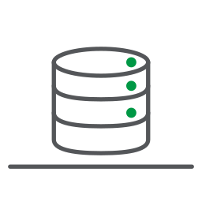
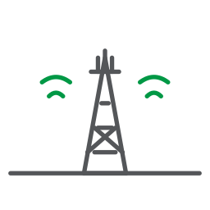
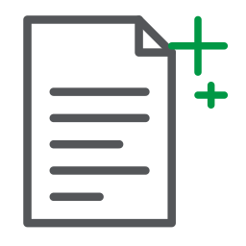
Architecture at a Glance
Three source feeds flow through a medallion lakehouse into gold data products, apps, and AI
3 SOURCE FEEDS
OPEN LAKEHOUSE
GOLD DATA PRODUCTS + APPS & AI
Apache Iceberg on S3 · medallion
Supply Chain Health
PostgreSQL WMS
BRONZE
gold data product · trust-score SLA
CDC
raw landed data
Last Mile Performance
Kafka IoT cold-chain
▶
▶
gold data product · trust-score SLA
SILVER
streaming
Analytics apps + Qlik Predict
cleansed + trust-scored
2 AutoML models on trusted data
Meridian CRM
GOLD
Qlik Answers + agents
every 15 min
governed data products
governed knowledge and AI outcomes
One flow, end to end: raw feeds → bronze/silver/gold on the Open Lakehouse → trusted gold data products that feed every app, document, and AI experience.
Project Qlarity • MCG Demo • Qlik Cloud
5
Notes:
One picture of the whole flow. Three source feeds — PostgreSQL WMS via CDC, Kafka IoT cold-chain streaming, and Meridian CRM every 15 minutes — land in the Open Lakehouse on Apache Iceberg, flow bronze to silver to gold, and surface as two governed gold data products that feed apps and AI. No copies; everything downstream reads trusted data.

Slide 6
Assets — Presentations & Narrative
The story-telling layer: decks that frame the value and scripts that walk it through live
3 PowerPoint decks
18 demo-script walkthroughs
▸ Demo Overview / Four Stories (35 slides)
▸ One guided walkthrough per demo topic
▸ Technology Architecture
▸ Demo2Win "Tell → Show → Tell" format
▸ Company Profile & Data Quality
▸ Qlik-branded DOCX, presenter-ready
▸ Map each of the Four Stories to a live click-path
▸ Keep the narrative consistent across presenters
Decks set the strategic frame; the 18 scripts make every capability demonstrable, live, in a repeatable Tell → Show → Tell flow.
Project Qlarity • MCG Demo • Qlik Cloud
6
Notes:
The story-telling layer. Three core decks frame the value and 18 Demo2Win scripts walk it through live. This is what makes the demo repeatable — any SE runs the same narrative the same way, every time.

Slide 7
Assets — The Demo2Win Scripts
18 presenter-ready walkthroughs — every capability has a script, so any SE runs the same winning demo the same way
Every script, the same anatomy
18 modules across the Four Stories
▸ Limbic emotional opening — hook before feature
▸ Integrations — Infrastructure, Connections, Open Lakehouse (3)
▸ Tell → Show → Tell narration frame
▸ Governance — Lineage/Trust, Data Products, Stewardship, Glossary (4)
▸ Click-by-click steps + an interaction prompt
▸ Analytics — Analytics Apps, Alerting, Automations (3)
▸ "So You Can" value chain per module
▸ AI & Outcomes — Predict, Answers, Discovery Agent & MCP (3)
▸ Talking points + a troubleshooting table
▸ Metadata: duration, phase, nightmares, components
▸ Agentic Engineering — Pipelines in VS Code, 3 agents, Talend Routes (5)
Every capability in Project Qlarity has a matching Demo2Win script — the same winning demo, run the same way, by any presenter.
Project Qlarity • MCG Demo • Qlik Cloud
7
Notes:
Our flagship enablement asset. Every capability has a script with the same anatomy — a Limbic emotional opening, Tell then Show then Tell, click-by-click steps, a So You Can value chain, and a troubleshooting table. Eighteen modules cover all four acts plus the agentic engineering work.

Slide 8
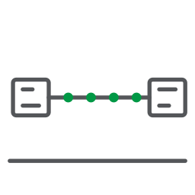
Assets — Data & Pipelines
PIPELINES: PREVIEW
The data foundation: declarative pipelines, the medallion lakehouse, gold products, and messy-data simulators
Pipelines & lakehouse
Data products & simulators
▸ 2 declarative QTCP pipeline projects (preview)
▸ 2 gold data products: Supply Chain Health + Last Mile Performance
▸ mcg-batch-pipeline (4 tasks) + mcg-streaming-pipeline (2 tasks) = 6 tasks
▸ Both API-shared, each with a trust-score SLA
▸ Shipped as a VS Code template (per-project settings, CLAUDE.md, Copilot instructions)
▸ 3 data simulators: PostgreSQL WMS, Kafka IoT, Meridian CRM
▸ Schema kit installed locally via npm run pipeline:template
▸ Simulators generate the intentionally-messy demo data
▸ Open Lakehouse medallion — Apache Iceberg on S3
▸ The mess that Governance and Analytics then clean up
Declarative Data Pipelines are a Qlik internal preview (June 2026) — roadmap, not GA. Availability and timing may change.
Project Qlarity • MCG Demo • Qlik Cloud
8
Notes:
The build layer. Two declarative QTCP pipeline projects, six tasks total, shipped as a VS Code template you can author by hand or with an AI coding agent. Two governed gold data products, and three simulators that generate the intentionally-messy demo data. Flag that declarative pipelines are a Qlik internal preview.

Slide 9

Assets — Governance & Knowledge
The trust layer: a document knowledge base, a shared vocabulary, and automations that keep watch
Knowledge & vocabulary
5 automations (Teams alerts)
▸ 25 operational documents → Qlik Answers knowledge base
▸ Daily app-reload alert
▸ SOPs, contracts, policies, incident reports, training, compliance, POs, shipments, suppliers, recall, minutes, brief
▸ Cold-chain exception alert
▸ Pipeline-health alert
▸ 25 business glossary terms — one shared vocabulary
▸ WISMO-rate alert
▸ Trust scores + lineage + stewardship across the estate
▸ Talend address-correction loop
Governance makes the data trustworthy; the knowledge base and glossary make it understandable; automations keep it that way in the flow of work.
Project Qlarity • MCG Demo • Qlik Cloud
9
Notes:
The trust layer. A 25-document Qlik Answers knowledge base, 25 business glossary terms as one shared vocabulary, and five Teams automations — plus trust scores, lineage, and stewardship. Governance makes the data trustworthy, the knowledge base and glossary make it understandable, and automations keep it that way in the flow of work.

Slide 10

Assets — AI & Agentic
MCP: PREVIEW
The intelligence layer: prediction, document intelligence, discovery, and the agentic data-engineering stack
AI capabilities
Agentic Data Engineering
▸ Qlik Predict — 2 AutoML models: Cold Chain Exceedance + Late Delivery
▸ Declarative pipelines authored by AI coding agents
▸ Qlik Answers — document intelligence over the 25-doc knowledge base
▸ Data Product, Data Quality, and Catalog & Business Glossary agents
▸ Discovery Agent — guided, conversational data exploration
▸ Delivered as Qlik Answers capabilities — not separate products
▸ Qlik MCP Server (preview) — governed Qlik context to any AI assistant
▸ Talend Agentic Routes — LLM / RAG steps inside pipeline tasks
The Qlik MCP Server is a Qlik internal preview (June 2026). The three governance agents are Qlik Answers capabilities, not separate products or SKUs.
Project Qlarity • MCG Demo • Qlik Cloud
10
Notes:
The intelligence layer. Qlik Predict with two AutoML models, Qlik Answers over the knowledge base, the Discovery Agent, and the Qlik MCP Server, plus the agentic data-engineering capabilities. Two honesty callouts: the MCP Server is a preview, and the three governance agents are Qlik Answers capabilities, not separate products or SKUs.

Slide 11
How It Deploys — One Repo, One Command
The whole environment stands up from a single repository with a single command
npm run deploy
one git repository · dry-run first · deploy-to-qlik.js engine
MCG Deploy console
Dry-run first
Declarative pipelines
A self-hosted web wizard on port 3939 walks you through the deployment step by step.
Preview every change before anything is written — validate, then commit for real.
The QTCP pipeline projects are imported via API as part of the same deployment.
From clone to a live, presentable Qlik Cloud demo: one repository, one command, dry-run safety, and the full stack imported for you.
Project Qlarity • MCG Demo • Qlik Cloud
11
Notes:
The punchline that makes this a framework, not a one-off. One repo, one command — npm run deploy — driven by the MCG Deploy console, a web wizard on port 3939. Always dry-run first: it previews every change before anything is written, then commit for real. The declarative pipelines import via API as part of the same deployment.

Slide 12
Project Qlarity — By the Numbers
Everything in the demo, counted — the grounded asset inventory at a glance
3
18
25
25
3
PowerPoint decks
Demo-script walkthroughs
Knowledge-base documents
Business glossary terms
Source feeds
2
6
5
3
2
Gold data products
Pipeline tasks (2 projects)
Automations
Data simulators
Qlik Predict models
Grounded figures only — every number above ships in the Project Qlarity repository.
Project Qlarity • MCG Demo • Qlik Cloud
12
Notes:
A quick recap of scale, and every figure here ships in the repo — nothing invented. Three decks, 18 scripts, 25 knowledge-base documents, 25 glossary terms, three source feeds, two gold data products, six pipeline tasks, five automations, three simulators, and two Predict models.

Slide 13
Meridian Commerce Group
Project Qlarity
One repository, one command, the full Qlik stack.
Qlik + Clarity: a repeatable framework for demoing the full Qlik Cloud stack, end to end.
4
3
2
1
Connected Stories
Presentation Decks
Gold Data Products
Repo · One Command
Deploy it: clone the repo and run npm run deploy (dry-run first) via the MCG Deploy console on port 3939
Resources: Project Qlarity repository & demo guide — [placeholder]
Notes:
Wrap it. Project Qlarity is one repository, one command, the full Qlik stack — a repeatable framework any SE can stand up and present. Point to the resources link for the repository and the demo guide, and offer to walk any of the four acts live.

Slide 14
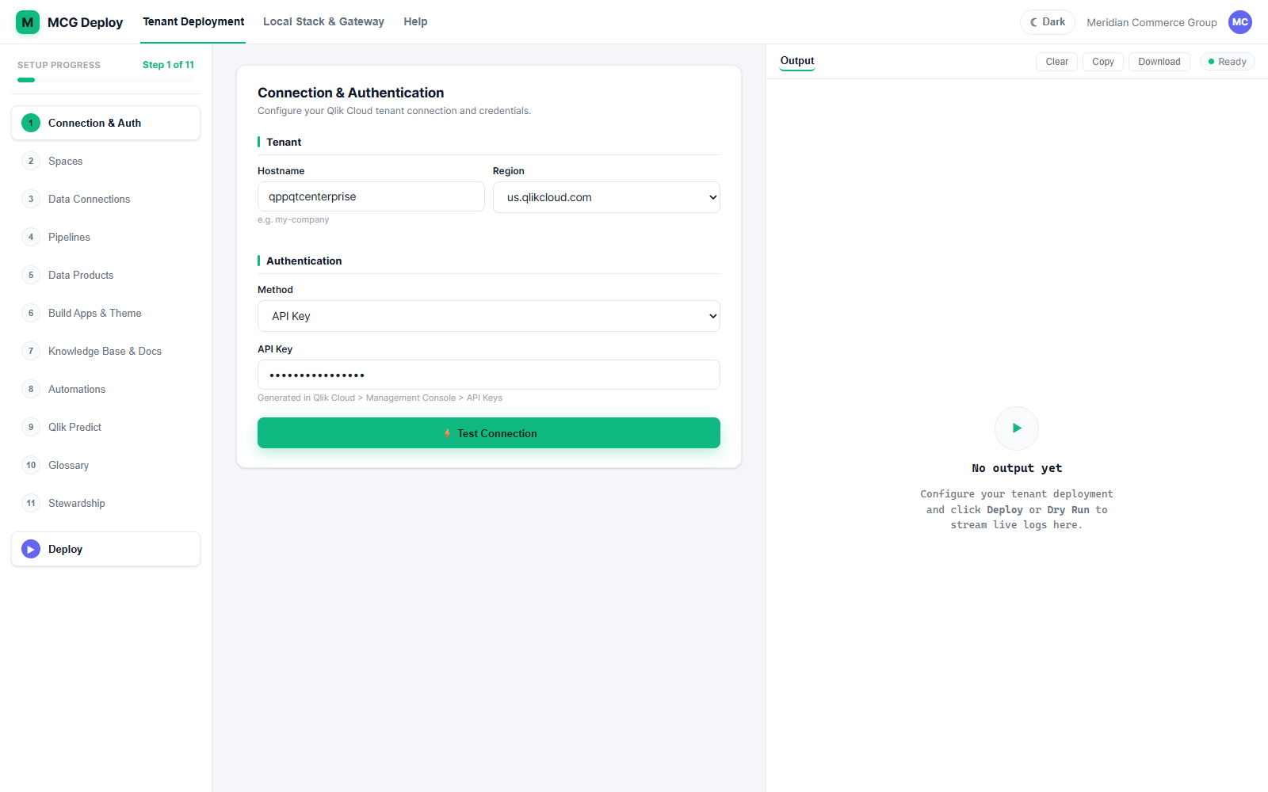
Deploy Console
The whole environment deploys from one repository.
The MCG deploy console — 11 setup steps, Stewardship at step 11
Project Qlarity • MCG Demo • Qlik Cloud
14

