Slide 1









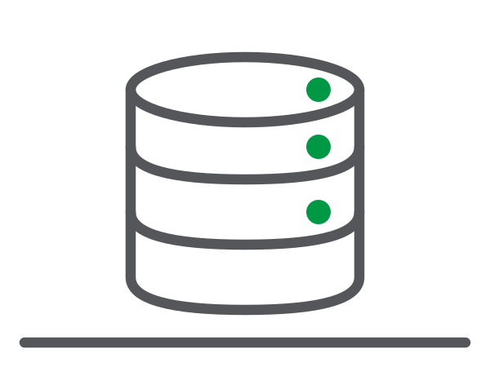


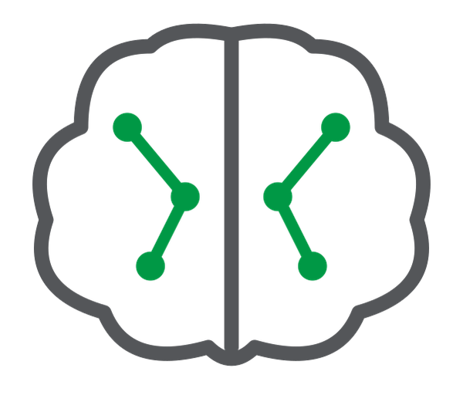








Meridian Commerce Group — Agentic Data Engineering
INTERNAL — DEMO ENABLEMENT · Pipelines as code, agents that govern, AI in the pipeline — raw feeds to trusted, AI-ready data products
WHERE COMMERCE HAPPENS
SYSTEM OF RECORD
AGENTIC DATA ENGINEERING
DECISION-READY FOUNDATION
TRUSTED, AI-READY DATA
PostgreSQL WMS
Data Integration
Analytics Workload
Outcomes
Warehouse system
LAKE
Inventory · Shipments
Author declaratively, govern with agents, enrich in the pipeline
Curated · Governed · Always-on
What your customer is buying
CDC real-time
Cold-chain IoT
1 · Author as Code
Cloud Platform
Pipelines as Code
Tive/Sensitech feeds
OPEN LAKEHOUSE
Scales with the business
2 projects · 6 tasks
Temp · GPS · Battery
EXTRACT
LOAD
SERVE
VS Code + AI agent
Kafka streaming
Declarative YAML
Carrier events
— VS Code + AI agent
Trusted Metrics
Governance Agents
6 carrier webhooks
Powered by Qlik Trust Score
Product · Quality
5 languages, 1 stream
2 · Govern with Agents
Qlik Answers, NL
Kafka streaming
Data Product Agent
Data Quality Agent
Catalog + Glossary
Agent (draft, human-
reviewed)
Qlik Answers, in NL
Meridian CRM
AI / ML Foundation
Agentic Routes
Contacts + orders
Pipelines as code
YAML · VS Code · AI agent
Agents govern
Product · Quality · Glossary
Talend Agentic Routes
LLM · RAG in-task
MCP + trust
governance to any AI
Predict trained on
governed lakehouse
Human-in-the-loop:
agent drafts, you OK
LLM · RAG in-task
Product master
Talend · in-task AI
MySQL CDC
Product master
3 · Enrich + Expose
Qlik MCP Server
CRM tables
Products · lineage
Weights · suppliers
Talend Agentic Routes
LLM · RAG in-task
Qlik MCP Server
Governance to any AI
Governance & Security
Governance to any AI
MySQL CDC
Lineage
Operational docs
Impact analysis
Trusted Products
SOPs + contracts
ONE STORE, AS CODE
Right access
2 gold products
25 DOCX knowledge base
Compliance built-in
Trust + provenance
Qlik Answers
HIPAA · HITRUST · SOC 2 · ISO 27001
Why customers buy this story: pipelines as code · agents that govern · AI in the pipeline · trusted, AI-ready data products
Notes:
TALK TRACK · 60 SECONDS
Meridian Commerce Group runs on three systems that never talked: a PostgreSQL warehouse database, cold-chain IoT through Kafka, and Meridian CRM. Agentic Data Engineering changes how that data is built and governed.
The pipeline is code. Two declarative Qlik Talend Cloud projects — six tasks across batch and streaming — are version-controlled YAML that lands and transforms every feed in the Open Lakehouse. The same definition is editable three ways: visually in the UI, programmatically in VS Code, or agentically with an AI coding agent that reads the schema, generates the change, and hands it back for a one-line git review.
On top of the lakehouse, conversational agents do the governance work — a Data Product Agent to package the two gold products, a Data Quality Agent to define and run rules with a steward, and a Catalog and Business Glossary Agent to generate draft glossary terms for human review. These are Qlik Answers capabilities, not separate products. Inside the pipeline tasks, Talend Agentic Routes add LLM calls and RAG; the Qlik MCP Server then exposes the governed data products, quality, and lineage to any MCP-compatible AI assistant.
The result is a path from raw data to a trusted, AI-ready data product that keeps human expertise in the loop at every step. (Declarative pipelines and the Qlik MCP Server are Qlik internal preview, June 2026 — positioned as forward-looking.)

