Slide 1


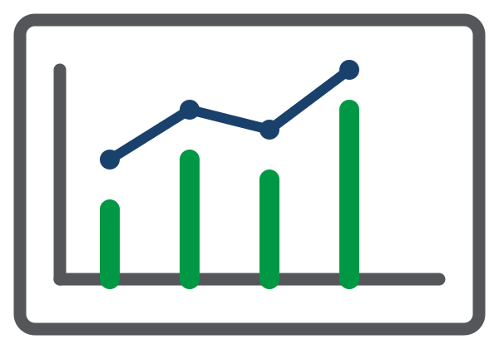
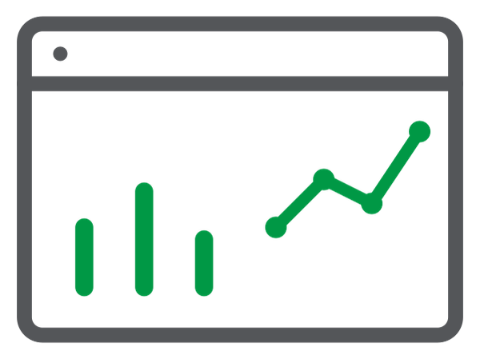


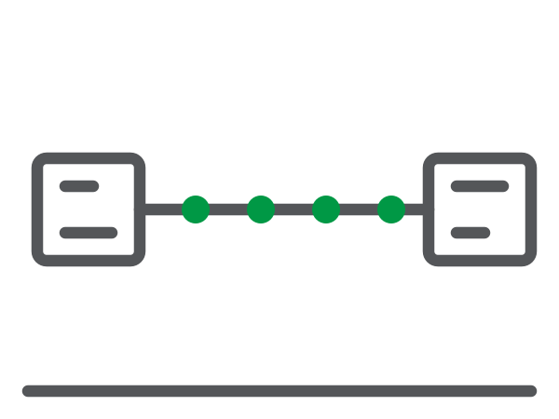







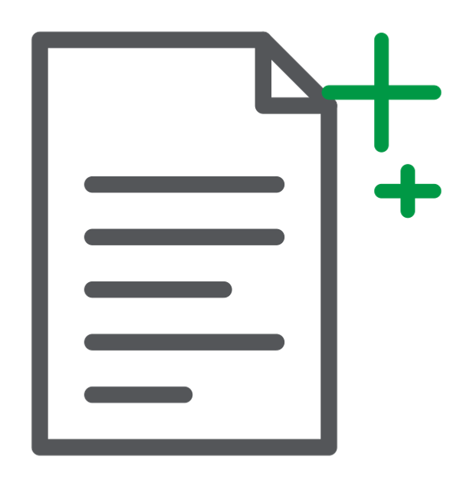

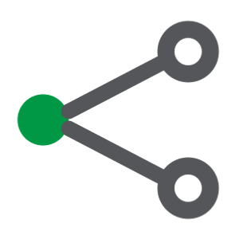


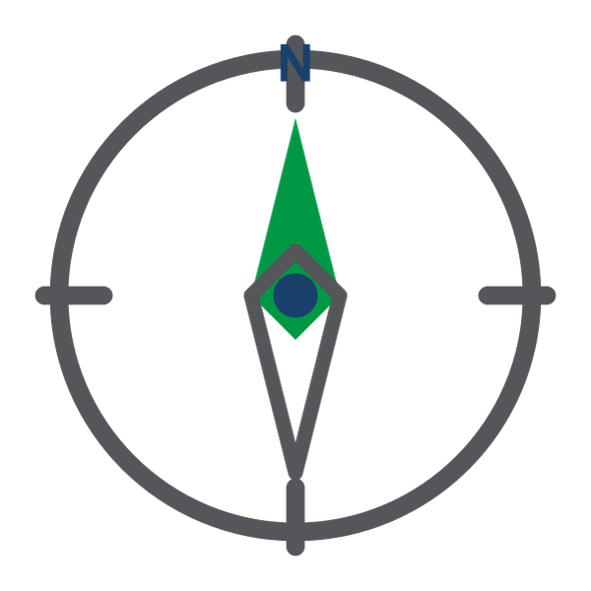


Meridian Commerce Group — From Three Silos to Trusted AI
INTERNAL — DEMO ENABLEMENT · How MCG lands WMS, IoT, and CRM in the Open Lakehouse for governed analytics and AI
WHERE COMMERCE HAPPENS
QLIK CLOUD PIPELINES
SYSTEM OF RECORD
DECISION-READY FOUNDATION
RESULTS THAT SELL
PostgreSQL WMS
Data Integration
Analytics Workload
Outcomes
Warehouse system
LAKE
Inventory · Shipments
Two declarative projects land three feeds as code
Curated · Governed · Always-on
What your customer is buying
CDC real-time
Cold-chain IoT
1 · Ingest as Code
Cloud Platform
Dashboards
Tive/Sensitech feeds
OPEN LAKEHOUSE
Scales with the business
2 apps · 10 sheets
Temp · GPS · Battery
EXTRACT
LOAD
SERVE
Sheets via Qlik MCP
Kafka streaming
Pipelines as code
Carrier events
— YAML, via API
Trusted Metrics
KPIs
6 carrier webhooks
Powered by Qlik Trust Score
IRA · On-time · WISMO
5 languages, 1 stream
2 · Cleanse + Conform
2 data products
Kafka streaming
8 silver routes
Carrier + UoM fixes
Talend + Nominatim
address validation
Stewardship the rest
Salesforce CRM
AI / ML Foundation
AI · Agentic
Contacts + orders
Iceberg open tables
bronze · silver · gold
Every feed captured
CDC + streaming + SaaS
Read via Athena
Glue catalog · any engine
Governance native
Trust Score · Lineage
Predict trained on
lakehouse datasets
Exceedance + late-delivery
models on governed data
Discovery Agent + MCP
Product master
Claude on live data
Every 15 min
Product master
3 · Serve Gold Products
AI · Generative
Salesforce objects
Answers on 25 docs
Weights · suppliers
2 data products
API-attached
Daily 06:00 UTC
Open to any engine
Governance & Security
Cited, grounded RAG
Every 15 min
Lineage
Operational docs
Impact analysis
AI · Predictive
SOPs + contracts
ONE OPEN STORE ON S3
Right access
Qlik Predict models
25 DOCX knowledge base
Compliance built-in
Exceedance · SLA risk
Qlik Answers
HIPAA · HITRUST · SOC 2 · ISO 27001
Why customers buy this story: pipelines as code · 15-minute freshness · trusted data products · AI that ships
Notes:
TALK TRACK · 60 SECONDS
Meridian Commerce Group runs on three systems that never talked: a PostgreSQL warehouse database, cold-chain IoT sensors streaming through Kafka, and Salesforce. Seven data-quality nightmares cost them $127M a year.
The fix is efficiency by design. Two declarative Qlik Cloud Pipelines — version-controlled YAML, imported through the API — land every feed in the Open Lakehouse: Iceberg tables on S3, bronze to silver to gold. Eight transformation routes canonicalize six carrier vocabularies, standardize units, and score trust. Talend validates and geocodes every Salesforce address on a 15-minute cycle, routing the unfixable to Stewardship.
Two governed data products serve the business — read straight from the lakehouse through Amazon Athena, no copies. On top: two analytics apps whose sheets are authored by an AI agent over MCP, Predict models for exceedance and late-delivery risk, Answers grounded on 25 operational documents, and a Discovery Agent watching it all.
One command deploys the whole stack. That's pipelines as code, and AI that actually ships.

