Slide 1

Devin: The AI Software Engineer
Notes:
Open warmly. Thank the CTO/CISO for their time. Set the frame: 'This is a discovery conversation, not a demo. My goal is to understand your world first, then show only what is relevant.' Confirm time available and who is in the room.

Slide 2
TODAY
Agenda
01
Cognition Overview
30,000-foot view of the company, products, and how we serve customers
02
Market Environment & Challenges
Why software delivery is the bottleneck, and why now
03
Meet Devin!
Architecture, workflow, security model, and live examples
04
Customer Impact
Stories and measurable outcomes
05
Next Steps
How to get started?
Cognition | Devin
2
Notes:
Walk the agenda quickly. Ask: 'Is there anything you want to make sure we cover, or anything you'd rather skip?' Adjust in real time. Emphasize that section 1 is the longest on purpose.

Slide 3
RECAP & DISCOVERY | CONFIRM, CORRECT, AND ADD TO THIS
Our understanding of Shopify
Your business
Your objectives
How Cognition can help
▪ Commerce OS for millions of merchants in 175+ countries; ~$300B annual GMV, ~$9B revenue, growing 25%+.
▪ Every storefront renders through Liquid; every merchant depends on your platform's uptime and speed.
▪ Moving up-market (Enterprise, Commerce Components) while defending the SMB core.
▪ "Reflexive AI usage" mandate: prove AI cannot do the job before asking for headcount.
▪ Ship faster on the world's largest Rails codebase while keeping quality and performance.
▪ Protect merchant trust: security, uptime, and safe rendering of untrusted templates.
▪ Scale the developer ecosystem (themes, apps) without scaling support load.
▪ Devin turns the AI mandate into merged PRs, not just faster typing: migrations, tests, bugs, and upgrades done end to end.
▪ Devin Wiki and Review compound knowledge and quality across thousands of engineers and repos.
▪ Enterprise controls (VPC, SSO, audit logs, no training on code) fit a platform millions of merchants trust.
Questions for the room
▪ CTO: since the AI mandate, what share of PRs are AI-assisted, and how has merge time or defect rate changed?
▪ CTO / VP Eng: what is the biggest chunk of engineering time that is not roadmap right now?
▪ CISO: what did you need to see before approving Cursor and Copilot for engineers? Would an autonomous agent be judged differently?
▪ Business: which merchant-facing initiative slipped last quarter because engineering was the constraint?
Cognition | Devin
Notes:
Spend 6-8 minutes here. Read the three columns in 60 seconds, then STOP and ask. The goal is to get the CTO to name a real constraint and the CISO to name an approval bar. Write their words down and reuse them on the value slides and in the pilot proposal. Facts to re-verify the morning of: latest quarterly revenue/GMV, Tobi Lutke's AI memo wording (April 2025), current CTO name.

Slide 4
VALUE FRAMING | FROM BUSINESS OBJECTIVE TO ENGINEERING OUTCOME
Where Devin moves Shopify's initiatives
Shopify initiative
Engineering work it creates
What Devin does
Business outcome
Reflexive AI usage; headcount only where AI cannot do the job
Backlog of well-specified tickets, tests, and upgrades nobody has time for
Sessions: takes tickets from Slack/GitHub to tested, reviewed PRs, many in parallel
Mandate becomes measurable: PRs merged and hours reclaimed per team
Storefront performance and reliability (Liquid, themes, checkout)
Perf regressions, edge-case bugs, filter/tag features requested by theme devs
Sessions + Review: reproduce, fix, benchmark; Review catches regressions on every PR
Faster storefronts, fewer merchant-facing incidents, higher conversion
Largest Rails monolith in the world: keep it modern
Ruby/Rails upgrades, gem CVEs, deprecations across thousands of modules
Automations: scheduled dependency and CVE sweeps that open PRs automatically
Security debt shrinks continuously instead of in painful annual pushes
Grow the theme and app developer ecosystem
Docs drift; partners and new hires ask the same questions of senior engineers
Wiki + Ask Devin: always-current architecture docs and codebase Q&A
Faster onboarding, fewer interrupts for senior engineers, better partner experience
Merchant trust: security and compliance at scale
Every automated actor needs auditability, scoped access, and data guarantees
Security: VPC option, SSO/SCIM, encrypted secrets, immutable session logs, no training on code
AI adoption the CISO can sign off on
Cognition | Devin
Notes:
This is the bridge slide. Each row is one initiative you recapped; the third column names the Devin surface you will demo for it. Say explicitly: 'Everything in the demo maps to a row on this table.' If the CTO named a different constraint on the recap slide, add it verbally here as row six.

Slide 5
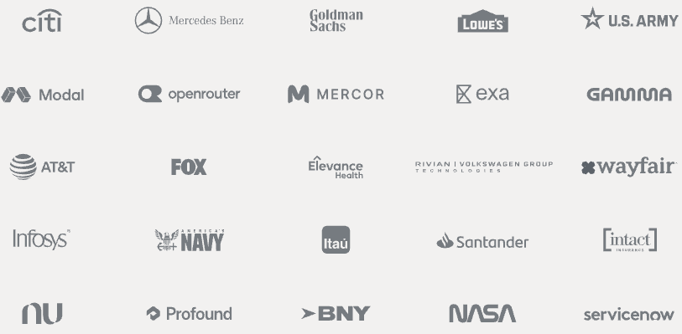












WHO WE ARE
the applied AI lab behind Devin
Mission: build collaborative AI teammates that expand what engineering teams can ship.
Nov 2023
July 2025
Sept 2026
Founded
Windsurf Acquisition
$1B+ Revenue
Devin Launched
Banks, fintech, SaaS customers
March 2024
Global Expansion
Cognition | Devin
8
Notes:
Founded in 2023 by a team of competitive programming champions
Cognition has grown rapidly to become a leader in AI-powered software engineering
Launched Devin in 2024—our flagship AI software engineer product that can autonomously handle real engineering work like investigating codebases, fixing bugs, and executing complex development workflows independently
Expanded globally across multiple regions and customer bases, including Fortune 500 enterprises
Crossed $1 billion in revenue as of September 2026—demonstrating product-market fit and strong enterprise adoption
Core Mission
• Build a collaborative team of AI teammates that genuinely expand what engineering teams can ship—not just assist individuals, but transform how teams work at scale
• Move beyond the "AI copilot" model (autocomplete and suggestions) to create true autonomous agents that take ownership of real work
• Empower engineering leaders to tackle bottlenecks that headcount alone cannot solve—modernization work, technical debt, and high-volume routine tasks

Slide 6
SECTION 01
Market Environment & Challenges
Notes:
Transition: 'I'd like to spend the first 10-15 minutes listening.'

Slide 7
THE MARKET CHALLENGES
Engineering is every business's bottleneck
~40%
$85B+
Months
Weeks
of developer time is spent on maintenance and toil rather than building (McKinsey)
estimated annual cost of technical debt to enterprises
to onboard a new engineer to a large legacy codebase
median time known CVEs stay unpatched in production dependencies
▪ Every company is now a software company, but headcount growth cannot match demand for software.
▪ Legacy systems, migrations, and compliance work consume the most experienced engineers.
▪ Security teams inherit vulnerability debt they cannot fix themselves.
Enterprises need a multiplier on engineer capability and time allocation
Cognition | Devin
12
Notes:
Engineering Time Allocation Problem
• 40% of engineering time is spent on maintenance rather than building new features or shipping roadmap items—this is a systemic drain on productivity
• Maintenance work is unglamorous but necessary: refactoring legacy code, fixing security vulnerabilities, updating deprecated dependencies, handling PR backlogs
Technical Debt Economics
• Technical debt has a profound cost to enterprises—not just in slowed velocity, but in risk, compliance exposure, and inability to modernize
• Legacy systems (COBOL, older monoliths) require specialized knowledge that's disappearing: 47% of organizations cannot find COBOL developers, 92% plan retirement by 2030
• Traditional COBOL modernization projects fail 68% of the time—they're complex, risky, and resource-intensive
Onboarding & Knowledge Gaps
• New engineers take months to become productive in large, complex legacy codebases—they must learn undocumented systems, understand business logic embedded in code, and figure out architectural decisions made years ago
• Subject matter experts are bottlenecks: you need them to explain the system, answer questions, and validate changes—pulling them from other work
Why Headcount Doesn't Solve This
• Hiring more engineers doesn't automatically reduce the percentage of time spent on maintenance—it just scales the problem
• New hires still need to be onboarded, managed, and coordinated. The cost-per-engineer increases, but productivity gains diminish
• You need a multiplier on engineer capability and time allocation, not just more engineers

Slide 8
TEAM CHALLENGES
What we hear from engineering leaders
Reactive
Execution bottleneck
Context Switching
40-60% of engineering time goes to maintenance, migrations, and toil, not roadmap.
Teams are the constraint by headcount
Headcount constraints are real
Team is stuck doing repetitive, low-value work.
Meetings & interruptions hinder deep productivity
Technical debt
Security & Compliance
Quality vs Speed
Compounds & delayed refactoring makes systems harder to modify
Bandwidth limitations → Dependency upgrades and CVE patches are 'known and deferred'
Legacy systems slow shipping velocity
Essential but time consuming
Engineers already paste code into consumer AI tools.
Security has limited visibility or control.
Pressure to ship
Keep pace with revenue demands
Copilots help type faster but do not take work off the board.
Cognition | Devin
6
Notes:
Reactive vs. Proactive Culture
• Teams are trapped in reactive mode: fighting fires, fixing bugs, addressing urgent requests—leaving little bandwidth for strategic roadmap work
• Maintenance work expands to fill the available time, crowding out innovation and long-term strategic initiatives
Execution Bottleneck
• The real constraint is not ideas or strategy—it's execution capacity. Teams have roadmaps they can't ship because they don't have the engineering bandwidth
• Headcount constraints are real: hiring is expensive, long-term, and doesn't immediately increase productive capacity
• CTOs are looking for ways to multiply the output of their existing team, not just hire more people
Compounding Technical Debt
• Technical debt doesn't stay static—it compounds. Delayed refactoring makes systems harder to modify, slowing velocity further
• This creates a vicious cycle: more debt means slower development, which means less time to address debt, which means more debt accumulates
• Engineering leaders feel the urgency but lack the resources to break the cycle
Bridge: 'Does any of this resonate? Which one is loudest for you?' Do not move on until they have picked at least one. Their pick becomes the anchor for the rest of the deck.

Slide 9
THE SHIFT
Copilot → Colleague
AI Copilot (Gen 1)
AI Software Engineer (Gen 2)
▪ Suggests the next line inside the editor
▪ Requires a human at the keyboard for every step
▪ No environment: cannot run tests or fix CI
▪ Productivity gain: ~10-20% per developer
▪ Backlog size unchanged
▪ Takes a ticket and returns a tested pull request
▪ Works asynchronously and in parallel: many agents at once
▪ Own sandboxed machine: shell, browser, CI, deployment
▪ Human shifts to reviewer and architect
▪ Backlog actually shrinks
Cognition | Devin
13
Notes:
Ask the CTO: 'How many of your open tickets could be handed to a capable junior engineer with a clear spec?' That is the addressable pool.
Gen 1: AI Copilots (Autocomplete)
• These assist individual developers in real-time within their IDE—providing code suggestions, completing variable names, generating simple functions
• They amplify the skills of experienced developers but require a human to direct every step: write the spec, review the suggestion, validate the output, run tests, handle failures
• Useful for individual productivity but doesn't solve the team bottleneck or free up senior engineers to focus on higher-value work
Gen 2: Agentic AI Software Engineers (Devin)
• Devin is not an autocomplete tool. It's an agent you can actually delegate real engineering work to and walk away from
• You tag Devin in Slack/Linear/GitHub with a ticket ("Refactor the auth module" or "Fix security vulnerability XYZ"), and it plans, executes, tests, and opens a PR—autonomously
• Devin reads your codebase, understands your architecture, drafts an editable plan, executes code in an isolated sandbox, fixes failing CI/tests, self-reviews, and delivers a production-ready PR
• Runs async across your environment—doesn't require hand-holding or continuous supervision. Engineers can review the PR and merge it

Slide 10
VALUE FRAMING | WHY THIS CODEBASE TELLS THE STORY
Demo repo: Shopify/liquid
Liquid is the open-source template engine behind every Shopify storefront theme, used by millions of merchants and the entire theme-developer ecosystem.
It is small enough to understand in a 40-minute meeting (~7k lines of Ruby, strong test suite, active CI) and important enough that every change matters: a bug or a slow filter shows up on real storefronts.
It is also a security-sensitive codebase by design: Liquid exists so merchants can edit templates without running arbitrary code on Shopify's servers. That makes it the right place to talk about safe, reviewed, auditable change.
~7k
Millions
lines of Ruby, 60+ standard filters
of storefronts render Liquid
Active
Ruby 3.x
CI on GitHub Actions, maintained by Shopify
maintained by the Rails-heaviest company on earth
github.com/Shopify/liquid | In the demo, Devin works on a fork with the same code, tests, and CI.
Cognition | Devin
Notes:
Pre-empt the 'toy repo' objection: Liquid is a production dependency for millions of stores. Also note that the same workflow applies to any repo in Shopify's org; Liquid is just the one everyone in the room can follow.

Slide 11
DEMO | FIVE DEVIN SURFACES, ONE STORYLINE
Live demo: a day in the life of a Liquid maintainer
1 Wiki
2 Session
3 Review
4 Automation
5 Security
Onboard in minutes
Ticket to PR
Quality gate
Keep it modern
CISO view
Open the Devin Wiki for Shopify/liquid: architecture, render pipeline, how filters are registered. Ask Devin: 'Where would I add a new standard filter and what tests must change?'
From Slack: '@Devin add an `average` filter alongside `sum`, with tests, docs and a History.md entry.' Devin plans, edits, runs the suite, opens a PR.
Devin Review comments on the PR: correctness, edge cases (nil, non-numeric), style vs. repo conventions. Show a finding and the fix.
Show a scheduled automation: weekly gem/CVE sweep on the repo that opens PRs and posts a Slack summary.
Settings tour: SSO, repo scoping, secrets vault, session audit log, VPC option, data-retention and no-training policy.
Ties to: Ecosystem & onboarding
Ties to: AI mandate; storefront features
Ties to: Storefront reliability
Ties to: Rails monolith; security debt
Ties to: Merchant trust
Integrations shown throughout: Slack trigger, GitHub PR, CI status. Backup: pre-recorded session if live run is slow.
Cognition | Devin
Notes:
Timing: ~15 minutes total. Start the Session FIRST (before slides 1-2 of the demo) so it is finishing by the time you reach step 2; narrate the plan and the live PR. Always have a completed session and PR from the night before as a fallback. Call out the 'Ties to' line on each step out loud: that is what the exercise is grading.

Slide 12


SECTION 02
Meet

Slide 13
MEET DEVIN
Ticket → Merged PR
Assign
Plan
Execute
Verify
Deliver
Tag @Devin in Slack, Jira, Linear, or GitHub. Or run on a schedule.
Devin reads the codebase, Wiki, and Knowledge; drafts a plan you can edit.
Codes in a sandboxed VM with shell, editor, and browser. Runs tests and lint.
Fixes failing CI, records browser tests, self-reviews the diff.
Opens a PR with a rationale. Responds to reviewer comments until merged.
Humans stay in control
▪ Devin never merges its own code; every change goes through your normal PR review and branch protection.
▪ Full session transcript: every command, file edit, and browser action is logged and replayable.
▪ Interrupt, redirect, or take over the session at any time.
Cognition | Devin
15
Notes:
If demoing live, this is the moment. Otherwise, walk a concrete example: 'Add is_debug() helper to a framework, with tests.' Emphasize the PR is the unit of delivery.
Devin is Cognition's AI software engineer - an agent you can actually delegate a real engineering task to.
It is a fully autonomous, cloud-based agent. what that means in practice is…you hand it a task — via chat, Slack, Linear, Jira, GitHub, or the API — and it works asynchronously in its own sandboxed environment (Linux shell, code editor, browser), planning, writing, testing, and shipping a pull request without a human watching every step.
It plans the work, writes the code, tests it, and opens a pull request inside your existing GitHub, Slack, and Linear workflows — the same way a new hire would.

Slide 14
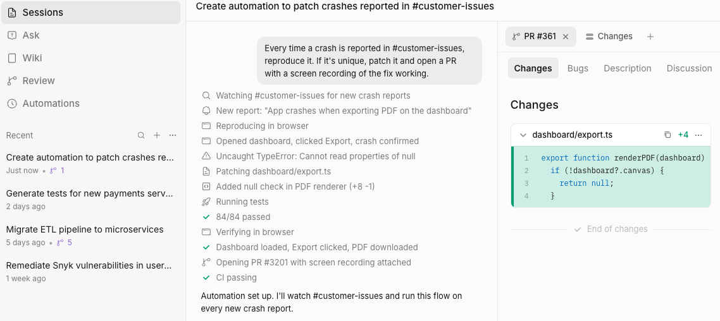
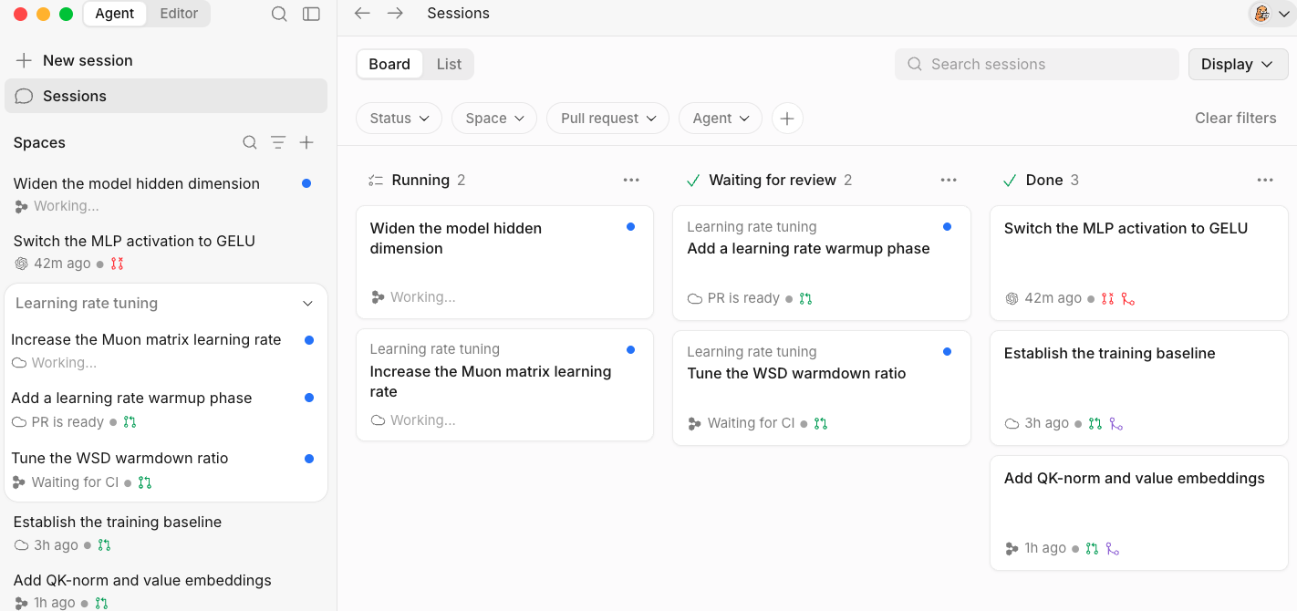
MEET DEVIN
One platform, two ways to work with AI
Devin | Autonomous cloud agent
Devin Desktop | Agentic IDE
▪ Delegate whole tasks: 'Upgrade this service to Java 21 and open a PR.'
▪ Runs in its own sandboxed machine with shell, editor, and browser.
▪ Plans, codes, tests, fixes CI, and responds to review comments.
▪ Triggered from Slack, Jira, Linear, GitHub, or the API.
▪ Where engineers work interactively, with deep codebase awareness.
▪ Cascade agent for multi-file edits in the editor.
▪ Hand off to Devin when a task is ready to run unattended.
▪ Agent command center
Supporting capabilities
Devin Review
Devin Wiki & DeepWiki
Devin CLI
Playbooks & Automations
AI code review on every PR: bugs, security, style
Auto-generated, always-current codebase documentation
AI Software Engineer in your terminal, with every frontier model
Reusable procedures, scheduled and event-driven runs
Cognition | Devin
9
Notes:
Frame: Desktop is for the engineer in the loop; Devin is for the work you want off your plate. Most customers start with Devin on a well-defined class of tasks.
And it's not just Devin the cloud agent — it's a full platform:
Devin Desktop for local development with the Agent Command Center so you can manage local and cloud based agents, PRs in one place.
There is also Devin Review for PR and visual QA, DeepWiki for auto-generated documentation and architecture diagrams for any codebase,
The best engineers we work with are not just pair programming with one agent at a time. They are using agents to scope and plan work, delegating tasks to cloud agents, reviewing progress, and deciding what makes it to production
We're so confident in the ROI that our Enterprise plan comes with a productivity guarantee — if Devin doesn't deliver more engineering value than you're paying for, we credit the difference, up to $10 million

Slide 15
MEET DEVIN | ARCHITECTURE
Built to understand large, messy codebases
Codebase Intelligence
Reproducible Environments
Scale & Orchestration
▪ Devin Wiki indexes every repo into living architecture docs.
▪ Devin Search answers 'where is X handled?' across services.
▪ Knowledge: your conventions, gotchas, and runbooks, learned once and reused.
▪ Each session runs on an isolated VM built from a versioned blueprint (deps, services, secrets).
▪ Snapshots make startup fast and deterministic.
▪ Devin can browse, run services, and drive a real browser to verify UI.
▪ Run dozens of Devins in parallel on a migration backlog.
▪ Playbooks encode repeatable procedures; Automations trigger on schedules or events.
▪ API and Slack-native: fits existing workflows, no new UI to learn.
Cognition | Devin Discovery
16
Notes:
For the CTO: the reproducible environment is what separates a toy from an engineer. For migrations, parallelism is the headline: 1,000 repos in a week, not a year.
Where it really shines for large organizations is the unglamorous, high-volume work engineers dread:
legacy code migrations,
refactors,
security-vulnerability fixes, and
PR backlog.
Mercedes-Benz used it to cut an 8-month COBOL modernization down to 8 days.
Nubank saw an 8-to-12x efficiency gain refactoring a 6-million-line ETL monolith.
The best engineers we work with are not just pair programming with one agent at a time. They are using agents to scope and plan work, delegating tasks to cloud agents, reviewing progress, and deciding what makes it to production

Slide 16
MEET DEVIN | EXAMPLE USE CASES
Where Devin delivers first
Migrations & upgrades
Test coverage & flaky CI
Bug fixes & on-call toil
Language/framework version bumps, Python 2 to 3, Angular to React, cloud re-platforming. Repetitive, well-specified, and enormous.
Backfill unit tests, fix flaky suites, keep coverage gates green while humans build features.
Triage Sentry/Datadog alerts, reproduce, fix, and open PRs before the on-call engineer wakes up.
Security & dependency debt
Codebase Q&A & onboarding
Internal tools & integrations
Patch CVEs across hundreds of repos, rotate deprecated APIs, enforce lint and policy.
New hires ask Devin instead of interrupting seniors. Docs stay current automatically.
Build the internal dashboards, scripts, and glue code that never make the roadmap.
Cognition | Devin
18
Notes:
Circle the one or two that match the pain they named. Say it explicitly: 'You mentioned the Java 8 migration. That is exactly the shape of work Devin does best.'
Where it really shines for large organizations is the unglamorous, high-volume work engineers dread:
legacy code migrations,
refactors,
security-vulnerability fixes, and
PR backlog.
Mercedes-Benz used it to cut an 8-month COBOL modernization down to 8 days.
Nubank saw an 8-to-12x efficiency gain refactoring a 6-million-line ETL monolith.
The best engineers we work with are not just pair programming with one agent at a time. They are using agents to scope and plan work, delegating tasks to cloud agents, reviewing progress, and deciding what makes it to production

Slide 17
COMPETITIVE | COMPLEMENTARY TOOLS, DIFFERENT JOB
Devin vs. Copilot, Cursor, and Claude Code
Copilot
Cursor
Claude Code
Devin
Where it runs
In the IDE
In the IDE (fork of VS Code)
In your terminal
Its own cloud VM per task; parallel
Who drives
Developer, keystroke by keystroke
Developer, prompt by prompt
Developer, in a live terminal
Devin, end to end; humans review
Unit of work
Line / function
File / multi-file edit
Task in a local session
Ticket to merged PR, with CI
Runs tests, fixes CI, drives a browser
No
Partly (agent mode)
Yes, on the dev's machine
Yes, in an isolated sandbox with full audit log
Org knowledge
Per-user context
Per-repo rules
CLAUDE.md per repo
Wiki, Knowledge, Playbooks shared org-wide
Runs unattended (schedules, events)
No
No
Scriptable by you
Automations built in; Slack/Jira/GitHub triggers
Security posture
GitHub enterprise controls
Privacy mode, SOC 2
Runs with the dev's local access
VPC option, SSO/SCIM, scoped GitHub App, secrets vault, SOC 2
Position: keep Cursor/Copilot for the engineer in the loop. Devin is for the work you want off the engineer's plate.
Cognition | Devin
Notes:
Shopify engineers already use Cursor, Copilot, and Claude Code. Do NOT attack them. The line: 'Those tools make your engineers faster. Devin adds engineers.' Then the three differentiators: (1) autonomous, parallel, sandboxed execution to a merged PR; (2) org-wide compounding knowledge (Wiki, Knowledge, Review) instead of per-user context; (3) enterprise control plane (audit, VPC, scoping, automations) the CISO can govern. Competitor rows are high-level and should be double-checked against current product pages before the meeting.

Slide 18
MEET DEVIN | ENGAGEMENT MODEL
How we serve customers
1. Scope
2. Connect
3. Pilot
4. Expand
Identify 2-3 high-volume, well-specified task types (migrations, test coverage, bug fixes).
Integrate with GitHub/GitLab, Slack, Jira. Configure Devin's environment and Knowledge.
Run 4-8 weeks with a champion team. Measure PRs merged, cycle time, hours saved.
Roll out playbooks and automations org-wide. Enterprise controls, SSO, VPC.
What you get from Cognition
▪ Dedicated forward-deployed engineering during onboarding; we learn your codebase alongside Devin.
▪ Success metrics agreed up front and reported throughout the pilot.
▪ Enterprise support, security documentation, and a shared roadmap channel.
Cognition | Devin
10
Notes:
This is where you show you are a partner, not a tool vendor. Tie step 1 back to the pain they named in discovery.

Slide 19
SECTION 05
Customer Impact
Stories and measurable outcomes

Slide 20
CUSTOMER STORY | FINANCIAL SERVICES
Nubank: a multi-year migration in months
Challenge
One of the world's largest digital banks needed to migrate a critical ETL codebase spanning millions of lines. Estimated at 1,000+ engineer-weeks of repetitive, high-risk work.
Approach
Cognition's team and Nubank engineers ran many Devins in parallel against the migration, with humans reviewing and merging every PR.
Outcome
Migration completed in a fraction of the projected time, with human engineers redeployed to customer-facing work.
12x
20x
efficiency improvement vs. manual migration
cost savings on the migration
MLOC
Months
millions of lines of code migrated
not years, to completion
Cognition | Devin Discovery
20
Notes:
Public case study on cognition.ai. Key line: 'The bank's engineers stayed in control; Devin did the volume.' Ties directly to the CISO's concern about oversight.

Slide 21
CUSTOMER STORIES
Impact across industries
Goldman Sachs
Global bank
Ramp
Fintech
Piloting Devin as an AI engineer alongside its ~12,000 developers, focused on legacy code modernization and augmenting developer productivity under strict governance.
Uses Devin for backlog tasks and internal tooling, freeing engineers to focus on product velocity in a fast-scaling environment.
MongoDB
Developer platform
Bilt
Consumer fintech
Adopted Devin to accelerate engineering work across a large, distributed codebase, with Devin handling well-scoped tasks end to end.
Leverages Devin to expand engineering capacity without proportional headcount growth.
Cognition | Devin Discovery
21
Notes:
Choose the story closest to the prospect's industry and tell it in detail; mention the others in one sentence. Interview note: the Goldman Sachs pilot was reported publicly in July 2025; other details are drawn from Cognition's public customer references and should be refreshed before a real pitch.

Slide 22
IMPACT | ROI FRAMEWORK
The business case
Lever
How to measure
Illustrative impact
Capacity reclaimed
Engineer-hours on tasks completed by Devin
Team of 50 x 20% toil = 10 FTE-equivalents
Cycle time
Ticket-to-merge time for Devin-eligible tasks
Days to hours; parallel execution
Migration cost
Cost per repo/service migrated
10-20x reduction (Nubank)
Security posture
Mean time to patch known CVEs
Weeks to days, org-wide
Onboarding
Time to first meaningful PR for new hires
Weeks shaved via Wiki and Ask Devin
Pilot success criteria are set jointly against these levers and reviewed weekly.
Cognition | Devin Discovery
22
Notes:
Do not over-claim. Use the customer's own numbers from discovery: team size, toil %, fully loaded cost per engineer. Let them do the math out loud.

Slide 23
SECTION 06
Next Steps
A proposal to prove value in your environment

Slide 24
NEXT STEPS
Proposal: a 6-week scoped pilot
Week 0-1 | Security & setup
Week 2-5 | Run
Week 6 | Decide
▪ Security review: SOC 2 report, DPA, architecture Q&A
▪ Connect repos, Slack, issue tracker
▪ Define 2-3 target task types and success metrics
▪ Champion team assigns real backlog tickets to Devin
▪ Cognition forward-deployed engineer embedded
▪ Weekly metrics: PRs merged, cycle time, hours saved
▪ Executive readout vs. agreed criteria
▪ ROI model with your actual numbers
▪ Rollout plan and commercial proposal
What we ask of you
One executive sponsor, one champion team (5-10 engineers), a security point of contact, and a backlog of real tickets. We bring the rest.
Cognition | Devin Discovery
24
Notes:
Make the ask concrete and small. Suggest specific dates. Confirm the sponsor in the room. Offer to send the security package today.

Slide 25
Give your engineers a teammate. Give your roadmap a chance.
Devin takes on the migrations, tests, and toil that consume your best people,
inside the security boundaries your CISO defines, with every change reviewed by your team.
Proposed next step
Security review kickoff and pilot scoping session within the next two weeks.
[Your Name] | [email] | cognition.ai
Notes:
Close with a question, not a statement: 'Does a two-week window work for the security review? Who should I coordinate with on your side?' Then stop talking.

Slide 26
SECTION 06
Appendix

Slide 27
DISCOVERY | FOR THE CTO
Where does engineering time actually go?
Delivery & Velocity
Backlog & Scale
▪ What share of engineering capacity goes to new features vs. maintenance, migrations, and tech debt?
▪ Which roadmap items slipped last quarter, and why?
▪ How long does a typical PR take from open to merge? Where does it stall?
▪ What is the ratio of senior to junior engineers, and where are seniors spending review time?
▪ What is sitting in the backlog that never gets prioritized: version upgrades, test coverage, flaky CI, documentation?
▪ Are there large migrations (language, framework, cloud, monolith-to-services) on the horizon?
▪ How many repos and services does a new hire need to understand to be productive?
▪ If you had 30% more engineering capacity tomorrow, what would you point it at?
Cognition | Devin Discovery
4
Notes:
Pick 3-4 questions, do not read the slide. Listen for: migration projects, test debt, slow onboarding, senior engineers buried in review. Write down their exact words; you will echo them back in the proposal.

Slide 28
DISCOVERY | FOR THE CISO
What does 'safe adoption' look like to you?
Governance & Risk
Controls & Vulnerability Debt
▪ Are engineers already using AI coding tools? Sanctioned or shadow?
▪ What is your policy on source code leaving your environment or being used for model training?
▪ Which compliance frameworks matter most: SOC 2, ISO 27001, HIPAA, PCI, FedRAMP?
▪ How do you audit who or what changed production code today?
▪ How do you manage secrets and access for automated systems (CI, bots, service accounts)?
▪ How long do known CVEs in dependencies sit open before they are patched?
▪ Would you require VPC or self-hosted deployment, SSO, and audit logs for an AI agent?
▪ What would an AI agent need to prove before you would allow it to open a pull request?
Cognition | Devin Discovery
5
Notes:
For the CISO, lead with respect for the concern. Surface deal-breakers early: data residency, training on code, deployment model. Note which controls are 'must-have' vs 'nice-to-have'. This shapes the pilot scope.

Slide 29
HOW IT WORKS | SECURITY
Security and trust, designed for the CISO
Data Protection
Deployment & Access
Compliance & Audit
▪ Your code is not used to train models.
▪ Encryption in transit and at rest.
▪ Secrets stored in an encrypted vault and injected at runtime; never exposed in transcripts.
▪ Configurable data retention.
▪ Multi-tenant SaaS, or Enterprise VPC deployment in your cloud account.
▪ SSO/SAML, SCIM, role-based access, repo-level scoping.
▪ Devin authenticates as a scoped GitHub App, not a personal token.
▪ SOC 2 Type II attested.
▪ Complete, immutable session logs for every action taken.
▪ No self-merge; branch protection and CODEOWNERS enforced.
▪ Devin Review and code scans surface vulnerabilities in existing code.
Cognition | Devin Discovery
17
Notes:
Address the CISO directly here. Offer the security package (SOC 2 report, pen test summary, DPA) as an immediate next step. Note for interview: confirm current certifications (SOC 2, ISO, HIPAA readiness) on cognition.ai/security before presenting.

Slide 30
BACKUP
Appendix: objections and responses
"We already have Copilot."
"AI code isn't trustworthy."
Great, keep it. Copilot helps engineers type; Devin takes tickets off the board. Customers run both; the value is additive.
Neither is any unreviewed code. Devin runs tests, fixes CI, and never self-merges. Your review process is unchanged; the volume of reviewable work increases.
"Our code can't leave our environment."
"Will this replace engineers?"
Enterprise VPC deployment runs in your cloud account. No training on your code, encrypted secrets, full audit logs.
It replaces toil. Customers redeploy engineers to product work and report higher retention when migrations and maintenance are automated.
"How do we measure it?"
"What does it cost?"
Jointly defined pilot metrics: PRs merged, cycle time, hours saved, CVEs patched. Reported weekly.
Consumption-based (ACUs) with team and enterprise tiers. Pilot pricing is scoped to the agreed use cases; we model ROI on your numbers.
Cognition | Devin Discovery
26
Notes:
Backup slide for Q&A. Pricing changes frequently; check cognition.ai/pricing before the interview and be ready to state current Core / Team / Enterprise tiers.

