Slide 1
Hillside 1 Rankability: normalizing k
10/20/2019

Slide 2
Compared to what?
For a given D matrix, we report to the user: k* = #
p* = #
But is that good?
Compared to what?
random?
average?
worst case?
best case?

Slide 3
SIMODS 3 Polytope Paper
From the structure of the polytope, we know that for a given D matrix, k_{sum}=k*+k_{worst}=C_{sum} is the worst case number of hillside count violations for a matrix with that n, nnz, and exact same graph structure.

Slide 4
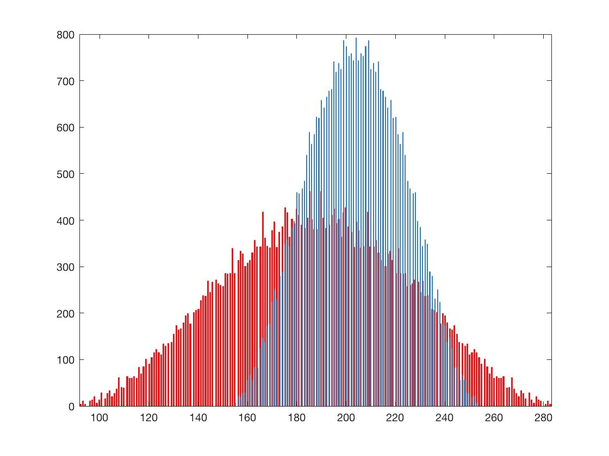
k-histograms
The k-histogram of rankings for the IP polytope is symmetric about a mean.
less rankable 2008 season, p=6, k*=155, k_{worst}=253, k_{sum}=408
more rankable 2005 season, p=4, k=92, k_{worst}=283, k_{sum}=375
p*
k*

Slide 5
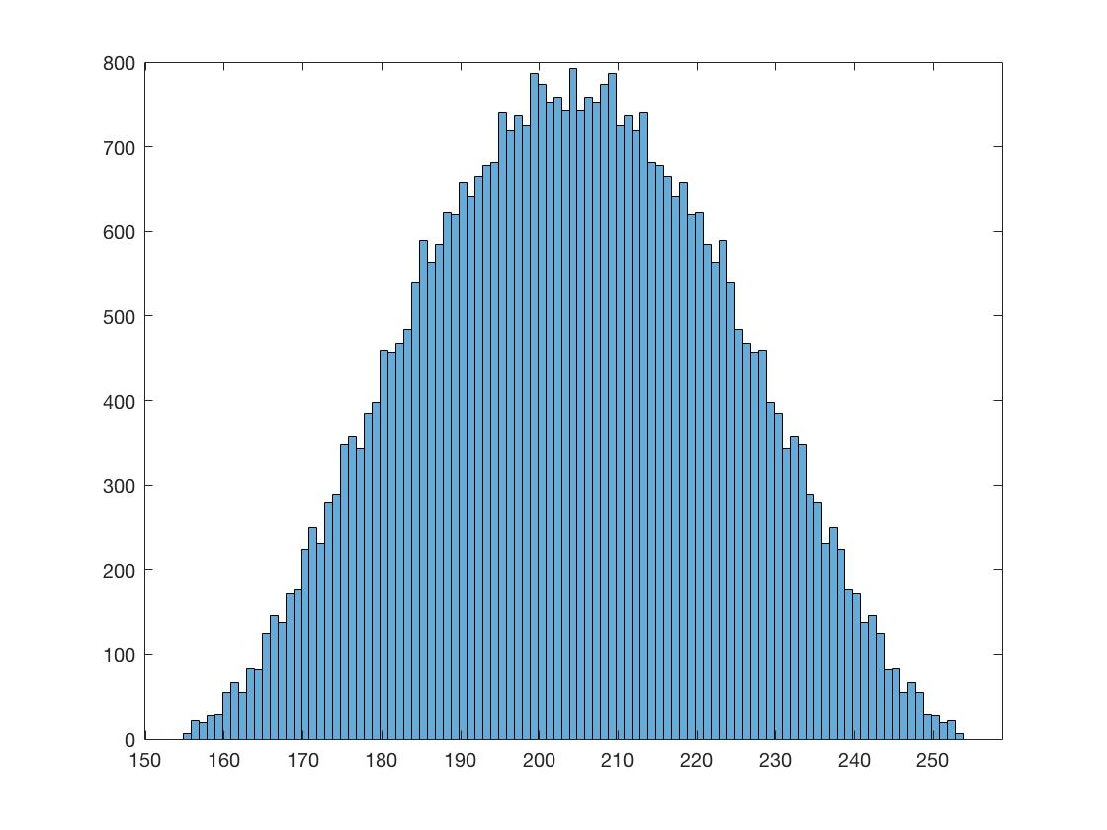
k-histograms
We don’t need the whole k-histogram, just the two ends.
Get k*, r* by solving LP.
Get p* by Alg. 4.1.
Get k_{worst} by evaluating the objective function for the reverse ranking r. k_{worst} = sum of upper triangle of C(r, r).
r_{k} = (k_{worst} – k*)/((k_{worst} + k*)
p*
k*
k_{worst}

Slide 6
k-histograms
The k-histogram of rankings for the IP polytope is symmetric about a mean.
less rankable 2008 season, k=155, p=6, r_{k} = .24
more rankable 2005 season, k=92, p=4, r_{k} = .51
p*
k*

Slide 7
k-histograms
THOMAS: can you produce more figures like this for many more conferences and seasons? Or chess? Or US News colleges?
Trying to find the narrowest histogram from real data to make Tim’s point that any ranking is nearly as bad as any other ranking for that particular dataset.
less rankable 2008 season, k=155, p=6, r_{k} = .24
more rankable 2005 season, k=92, p=4, r_{k} = .51
p*
k*

Slide 8
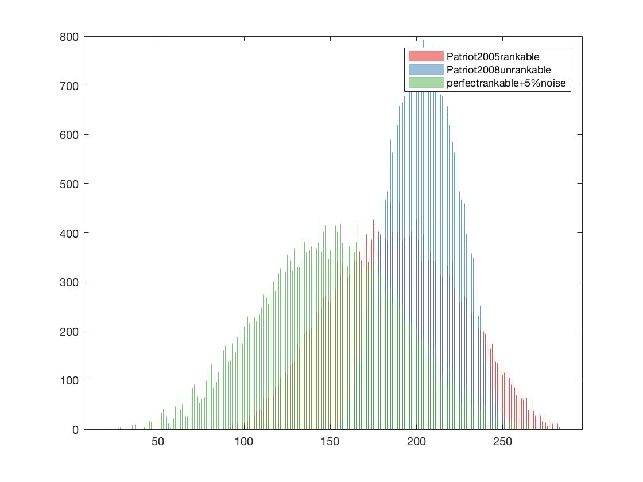
Comparing to data at the extremes
Compare given data, 2005 Patriot, to randomly generated nearly perfectly rankable data with same n
less rankable 2008 season, p=6, k*=155, k_{worst}=253, k_{sum}=408, r_{k} = .24, nnz=45
perfectly rankable + 5% noise , p=1, k*=24, k_{worst}=279, k_{sum}=303, r_{k} = .87, nnz=31
more rankable 2005 season, p=4, k=92, k_{worst}=283, k_{sum}=375, r_{k} = .51, nnz=41

Slide 9
Comparing to data at the extremes
ISSUES:
What is the other extreme of unrankable data for Hillside Count? Not 0 or E matrices. Maybe Random?
The nearly perfectly rankable data is shifted left relative to the Patriot data. Why? Maybe because, even though n is the same, nnz is not.
How to generate random data with given nnz?
less rankable 2008 season, k=155, p=6, r_{k} = .24
perfectly rankable + 5% noise , k=20, p=1, r_{k} = .87
more rankable 2005 season, k=92, p=4, r_{k} = .51

Slide 10
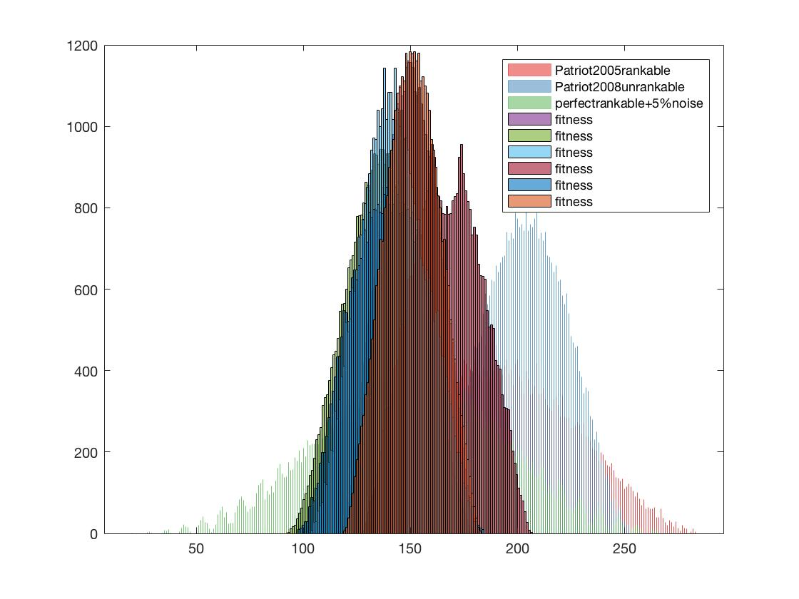
Comparing to data at the extremes
less rankable random data
less rankable 2008 season, k=155, p=6, r_{k} = .24
more rankable 2005 season, k=92, p=4, r_{k} = .51
perfectly rankable + 5% noise, k=20, p=1, r_{k} = .87

Slide 11
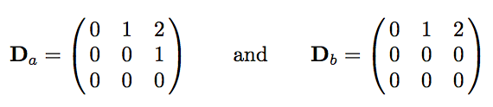
Comparing to data at the extremes
ISSUE:
What is the bad extreme for unrankable data for Hillside Count? The 0 or E matrices do not work for the current definition of hillside. BUT we could modify the definition of hillside to disallow ties so that D_{b} gives a worse k rankability than D_{a}.

Slide 12
Comparing to data at the extremes
ISSUE: How to generate random D1 data with given nnz?
same matchups, same outcome, randomly reassigning point differentials to the same nonzero locations.
same matchups, random outcome, randomly reassigning point differentials to the new nonzero locations.
same matchups, random outcome, random new point differentials in the same range assigned to the same nonzero loations.

Slide 13
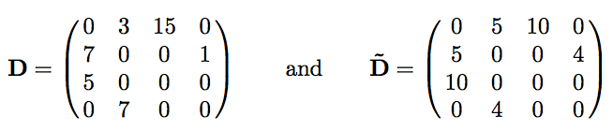
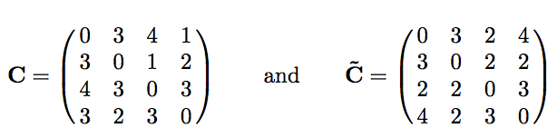
Paul’s idea: comparing to smoothed data
ISSUE: How to generate random D1 data with given nnz?
same matchups, smoothed outcome
Head-to-head matchups give no pairwise rankability info but there is triplet transitivity info from the number of votes movies got.
asymmetric
symmetric
k*=14
k_{worst}=18
k_{sum}=32
k*=16
k_{worst}=16
k_{sum}=32

Slide 14
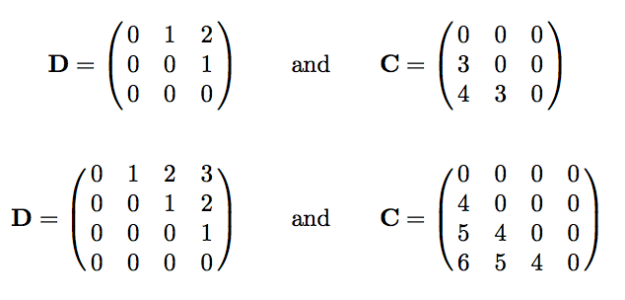
D1 matrices that are half-dense
(point differential data)
Perfect hillside D1 matrices with their C matrices
n=3
n=4
Ds are half hillsides.
For D1 (point differential) matrices of size n with nnz=.5n(n-1), then the worst case number of hillside violations is ⅔n³-n²+⅓n.
So movie data is kinda like this, right? There are matchups between nearly every pair of movies?

Slide 15
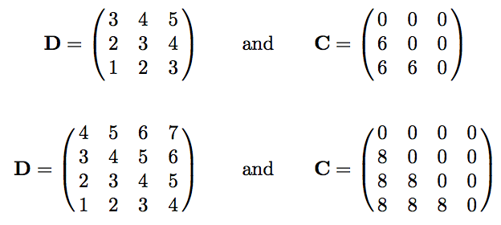
D2 and D3 matrices that are dense
(point score and point ratio data)
Perfect hillside D2/D3 matrices with their C matrices
n=3
n=4
Ds are full hillsides.
For D2 or D3 (point score or ratio) matrices of size n with nnz=n(n-1), then the worst case number of hillside violations is n³-n².
So movie data is kinda like this, right? There are matchups between nearly every pair of movies?

