Slide 1
Weighted Data and Hillside Form
Amy Langville
Mathematics Department
College of Charleston
4/9/2019

Slide 2
Ranking: Minimizing the Number of Violations to Hillside Form
Kathryn Pedings
College of Charleston

Slide 3
Outline
Introduction
Point Differential Matrix
Hillside Form
Evolutionary Optimization Approach
BILP
Applications
March Madness

Slide 4
Introduction - Point Differential Matrix
Pairwise match up data
Only positive differences between the final scores of the games
Example: If team 4 beat team 11 by 23 points, P_{4,11} = 23 and P_{11,4} = 0
If multiple games are played, you take the sum or average of all the differences

Slide 5
Kathryn’s Comment on encoding D
Data: 52—49 score where team i beat team j
D(i,j)=52 and D(j,i)=49
D(i,j)=3 and D(j,i)=0
D(i,j)=52/49=1.06 and D(j,i)=0
point differential
point ratio

Slide 6
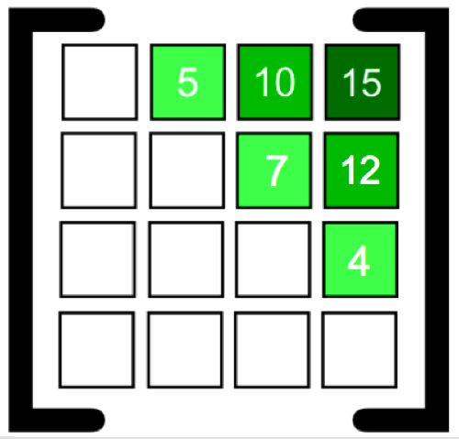
Introduction - Hillside Form
Example of perfect hillside form.
Perfect Hillside Form
Diagonal and lower triangular are zero
Each row is an increasing sequence
Each column is a decreasing sequence
Mathematically, P_{mxn} is in perfect hillside form if:

Slide 7
Hillside Form and Ranking
In the context of ranking, it makes sense because we want the first place team to beat the second by a little, the third by a little more, etc
Goal: Symmetrically reorder the rows and columns to get the matrix as close to hillside form as possible.

Slide 8
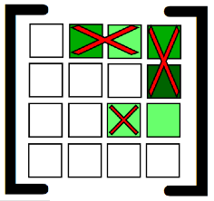
Violations to Hillside Form
Count the number of times the entries break hillside form.
Maximum number of violations for n x n matrix:

Slide 9
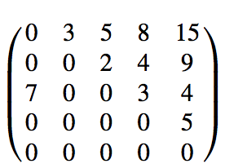
Violations are naturally weighted
accounts for 6 of the 7 violations in this matrix
Violations that occur near the top of the ranking (upper left part of the reordered D matrix) and far from the diagonal naturally carry more weight as they are involved in more violations.
0
7
accounts for 4 of the 5 violations in this matrix

Slide 10
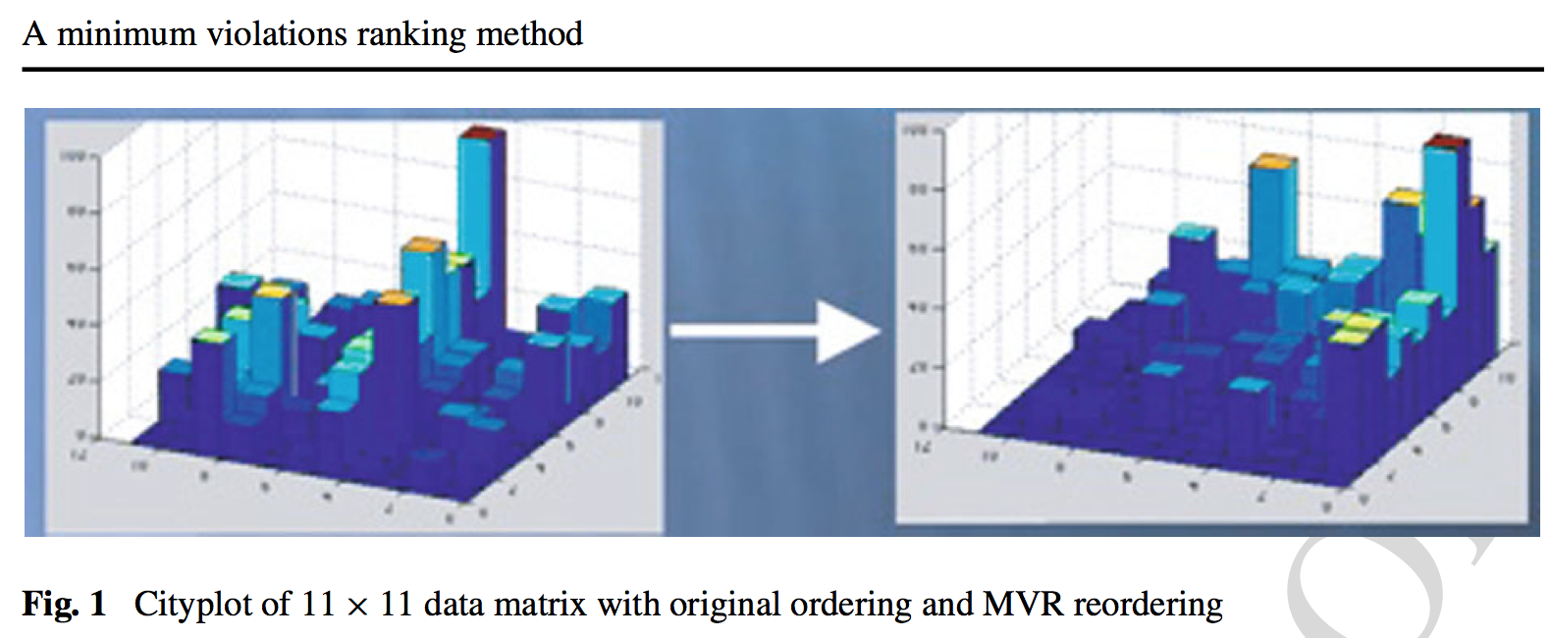
Optimization
Goal: Find the permutation vector that minimizes the number of violations to hillside form

Slide 11


Slide 12
BILP
Minimum violations to hillside form
Input Matrices
BILP

Slide 13
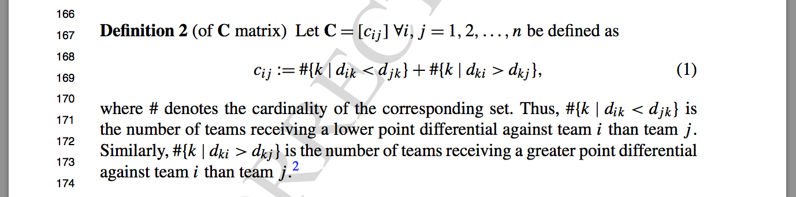
BILP
Input Matrix C is built from D

Slide 14
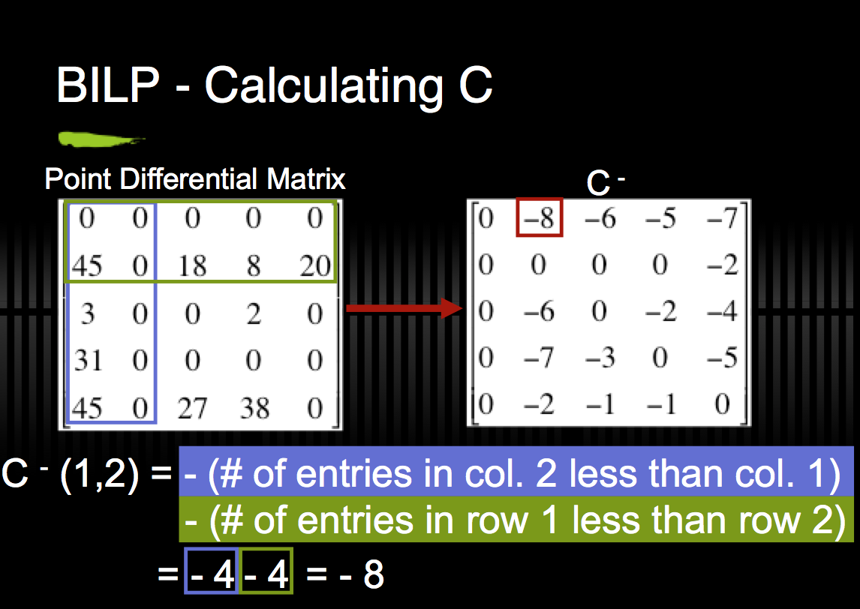

Slide 15
BILP - Relaxation
This BILP can be relaxed to a LP

Slide 16
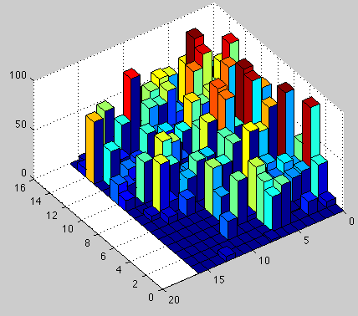
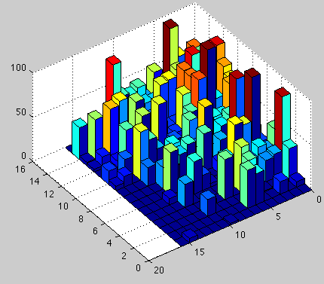
2009 Australian Football Results
AFL Standings
St. Kilda
Geelong
West. Bulldogs
Collingwood
Adelaide
Brisbane Lions
Carlton
Essendon
Hawthorn
Pt. Adelaide
West Coast
Sydney
N. Melbourne
Fremantle
Richmond
Melbourne
EO Results
St. Kilda
Geelong
West. Bulldogs
Collingwood
Adelaide
Carlton
Brisbane Lions
Hawthorn
Sydney
Essendon
West Coast
Pt. Adelaide
Fremantle
Melbourne
N. Melbourne
Richmond
Fitness = 862
Fitness = 844
Time = 33.6 sec

Slide 17
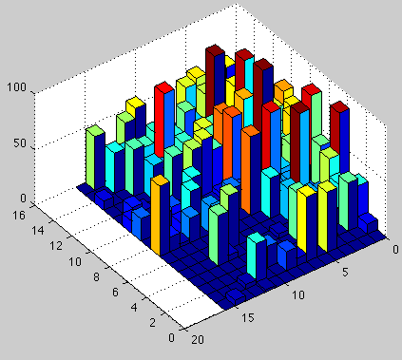
2009 Australian Football Results
AFL Standings
St. Kilda
Geelong
West. Bulldogs
Collingwood
Adelaide
Brisbane Lions
Carlton
Essendon
Hawthorn
Pt. Adelaide
West Coast
Sydney
N. Melbourne
Fremantle
Richmond
Melbourne
BILP Results
St. Kilda
Carlton
West. Bulldogs
Geelong
Collingwood
Brisbane Lions
Adelaide
Fremantle
Sydney
West Coast
Pt. Adelaide
Essendon
Hawthorn
Richmond
N. Melbourne
Melbourne
Fitness = 862
Fitness = 677
Time = .45 secs

Slide 18
2009 Australian Football Results
EO Results
St. Kilda
Geelong
West. Bulldogs
Collingwood
Adelaide
Carlton
Brisbane Lions
Hawthorn
Sydney
Essendon
West Coast
Pt. Adelaide
Fremantle
Melbourne
N. Melbourne
Richmond
BILP Results
St. Kilda
Carlton
West. Bulldogs
Geelong
Collingwood
Brisbane Lions
Adelaide
Fremantle
Sydney
West Coast
Pt. Adelaide
Essendon
Hawthorn
Richmond
N. Melbourne
Melbourne
Fitness = 844
Time = 33.6 sec
Fitness = 677
Time = .45 secs

Slide 19

SoCon Example

Slide 20
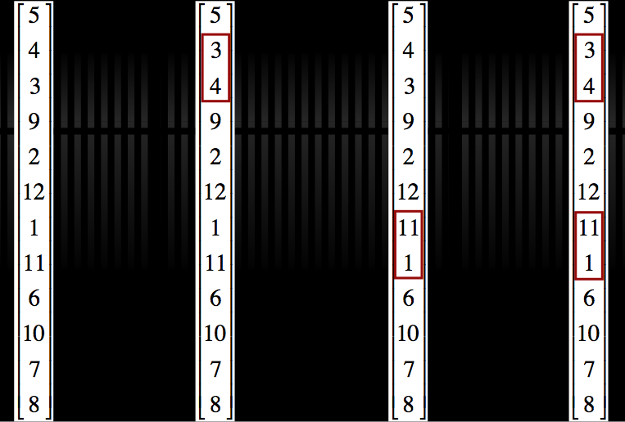
BILP: multiple optimal solutions
2009 SoCon Example
2 two-way ties

Slide 21
IP Rankability as Ranking Method on March Madness
n=68 exact P or early terminated approximate partial P
choose any member of P as ranking
choose every member of P as rankings
choose Markov’s aggregate vector t of P as ranking
n=340 approximate info for P from P>
use row sums of P> in descending order as ranking
use col sums of P> in ascending order as ranking

Slide 22
How to use Hillside for Rankability?

Slide 23
Original rankability measure r
r = 1 – kp
k = minimum number of changes to transform graph to dominance graph.
p = |P| = number of rankings, given that k.
k_{max} = (n²-n)/2
p_{max} = n!
k_{max} p_{max}
r = 1 for perfect rankability when k = 0 and p = 1 (dominance graph)

Slide 24
Hillside rankability measure r
r = 1 – (# violations) p
# violations to hillside form
p = |P| = number of MOSs
maxviolation = ?
p_{max} = n! ?
(maxviolations)(p_{max})

Slide 25
Finding all Hillside MOSs
Paul’s Pruning Tree using Hillside optimal objective
Hillside will have small # of MOSs so we can use
Gurobi PoolSearch: keep rankings associated with best hillside k, next best hillside k, … . Filling in P this way enables the creation of P_{a}, P_{d}, P> matrices.

Slide 26
Unweighted Data and Hillside Form
4/16/2019

Slide 27
Examples with unweighted D
 | k = # violations | p | (k*p)/(k_{max}*p_{max})
Empty | 0 | n!=720 | 0
Completely Connected | 30 = n(n-1) | n!=720 | 1
Cyclic | 30 = n(n-1) | n!=720 | 1
NCD: 3-dom + 3-dom + 1 to 4 | 12 | 4
SIMODS | 19 | 2
Empty + 2 | 0 | 8
Dom + 2 | 12 | 1
Dom - 2 | 2 | 1
Dom | 0 | 1 | 0
issue!
Issue? OK if upsets are worse than weak wins.
perfectly rankable
NOTE: Empty graph needs to be fixed. Right now there is a bias toward sparse graphs.

Slide 28
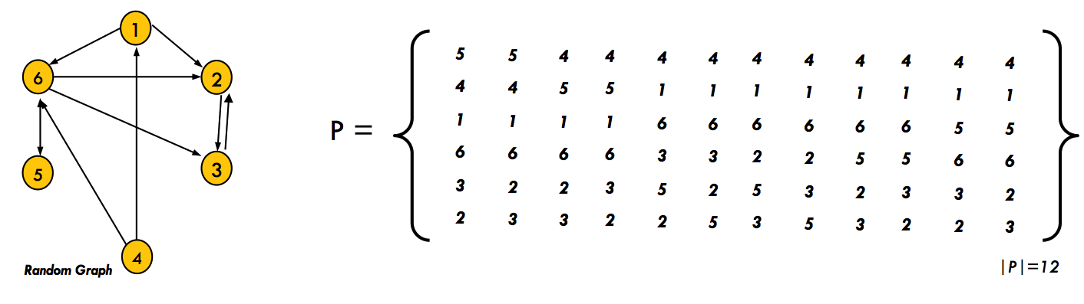
SIMODS Example
Original Rankability: k = 9
p = 12

Slide 29
SIMODS Example
original k
9 9 9 9 9 9 9 9 9 9 9 9
hillside k
22 23 21 20 20 22 22 23 20 19 19 20
Original Rankability: k = 9
p = 12
Hillside Rankability: k = 19
p = 2

Slide 30
SIMODS Example
original k
9 9 9 9 9 9 9 9 9 9 9 9
hillside k
22 23 21 20 20 22 22 23 20 19 19 20
5 4 1 6 2 3
4 1 5 6 3 2
5
4
1
6
2
3
0 0 0 0 0 0
0 0 1 1 0 0
0 0 0 1 1 0
0 0 0 0 1 1
0 0 0 0 0 1
0 0 0 0 1 0
4
1
5
6
3
2
0 1 0 1 0 0
0 0 0 1 0 1
0 0 0 0 0 0
0 0 0 0 1 1
0 0 0 0 0 1
0 0 0 0 1 0
D(r,r) =
D(r,r) =

Slide 31
Why Hillside Rankability for unweighted D?
Naturally weights the location of violations so that violations near the diagonal, i.e., between nearly equal teams, incur less penality. There’s no way to weight by location in ranking with original rankability. EO can do this type of weighting for original rankability, but it can’t get members of P.
Code will be the same for both unweighted and weighted graphs. Just the denominator (max violations) will likely change between the two cases.
Hillside P set is smaller than original P set. And finding all or nearly all members of P with tie-finding rule is easy. Or we can use Gurobi PoolSearch with different random reorderings, which should do a good job getting P, since it’s small.
Con: P>, matrix with advice on improving rankability, can only be formed from full or approximate P set, not with LP solution as original rankability could do.

Slide 32
Conjectures
|P_{hillside}| ≤ |P_{original}|
k_{hillside} ≤ k_{original}
P_{hillside} is a subset of P_{original}

Slide 33
Weighted Data and Hillside Form
4/16/2019

Slide 34
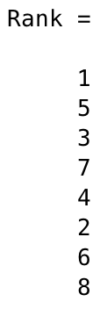
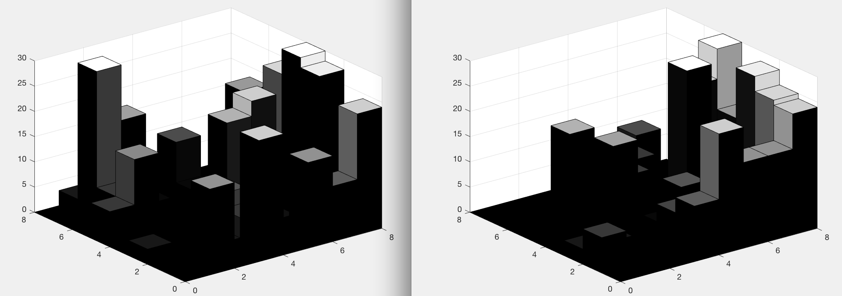
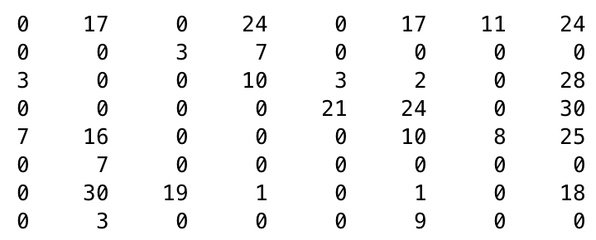
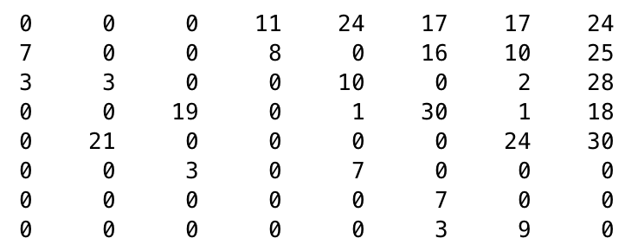
EXAMPLE: 2012 fb, point differential
n=8
k_{hillside}=82
p=1
Point Differential D
D(r,r)

Slide 35
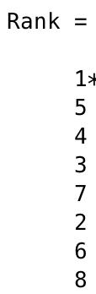
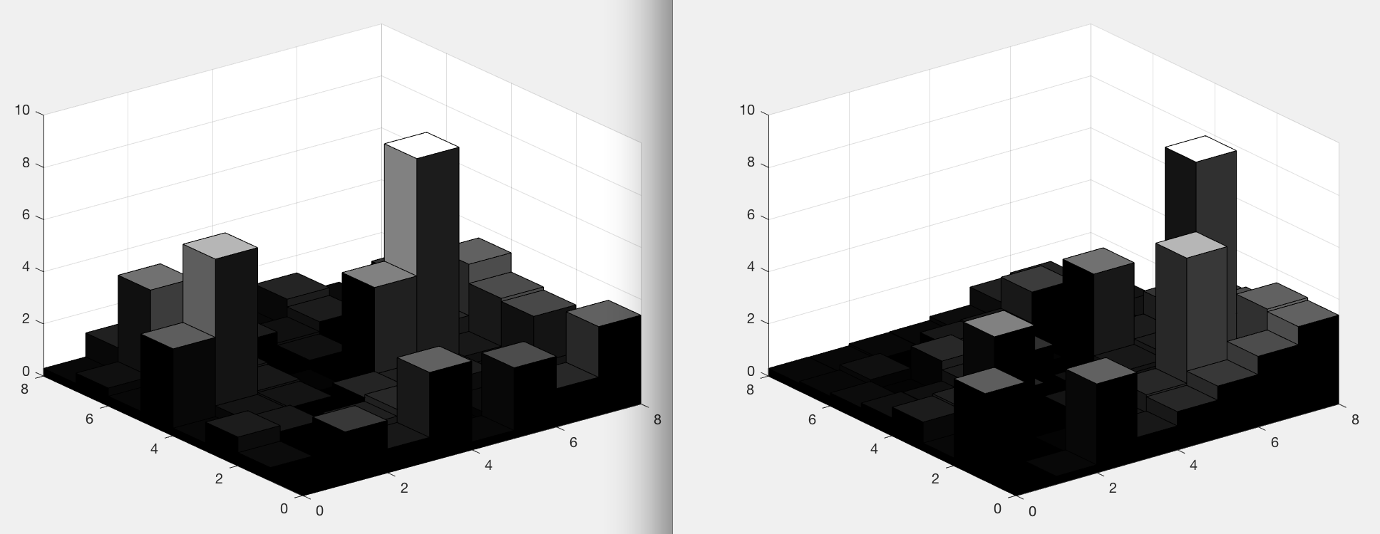
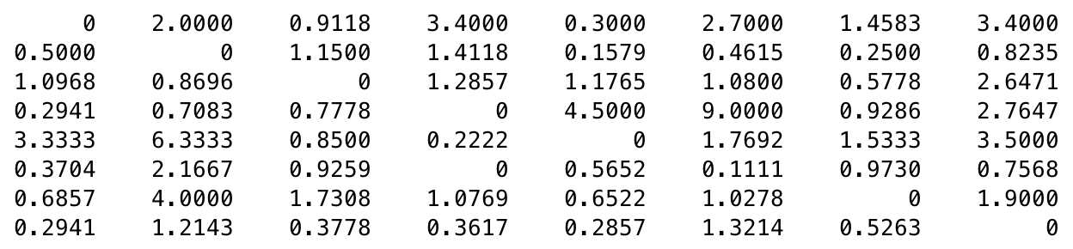
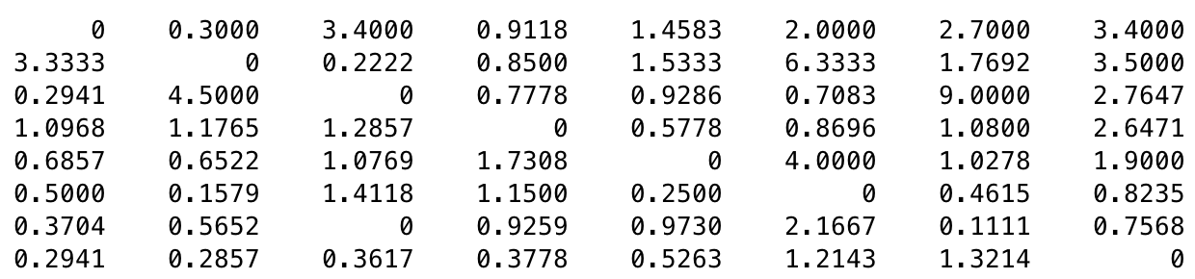
EXAMPLE: 2012 fb, point ratio
n=8
k_{hillside}=148
p=2
Point Ratio D
D(r,r)

Slide 36
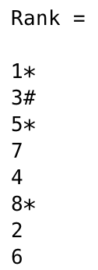
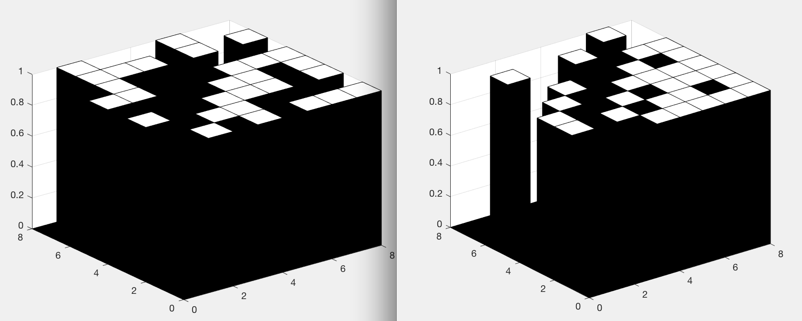
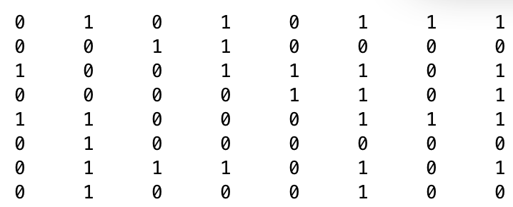
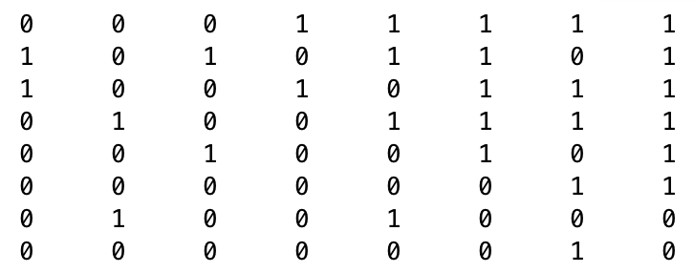
EXAMPLE: 2012 fb, unweighted D
n=8
k_{hillside}=52
p=16
Unweighted D
D(r,r)

Slide 37
Questions
Do we even need P_{hillside}? Probably k_{hillside} is enough to distinguish good and bad rankability. If we use only k_{hillside}, we can use Gurobi + constraint relaxation to solve n=O(10²-10³) problems and EO to solve even bigger problems.
Hillside IP + Constraint Relaxation: is it possible to use PoolSearch and Constraint Relaxation?
P (in particular, P>) was used to make suggestions for improving rankability for original rankability definition. If we don’t form or use P for hillside rankability, how will we make suggestions on Improving Rankability?

Slide 38
Improving Hillside Rankability w/o P
Suggest links for removal by choosing nonzero element in lower triangular of D(r,r) with largest value in the C matrix.

Slide 39
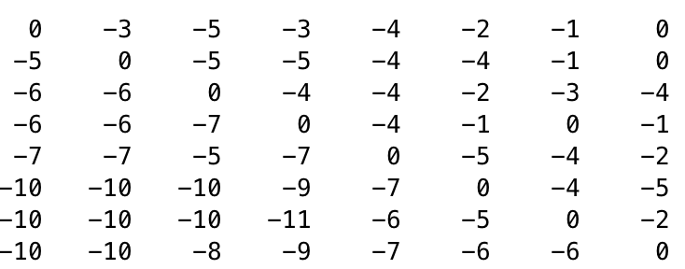
EXAMPLE: 2012 fb, point differential
n=8
k_{hillside}=82
p=1
D(r,r)
C(r,r)

Slide 40
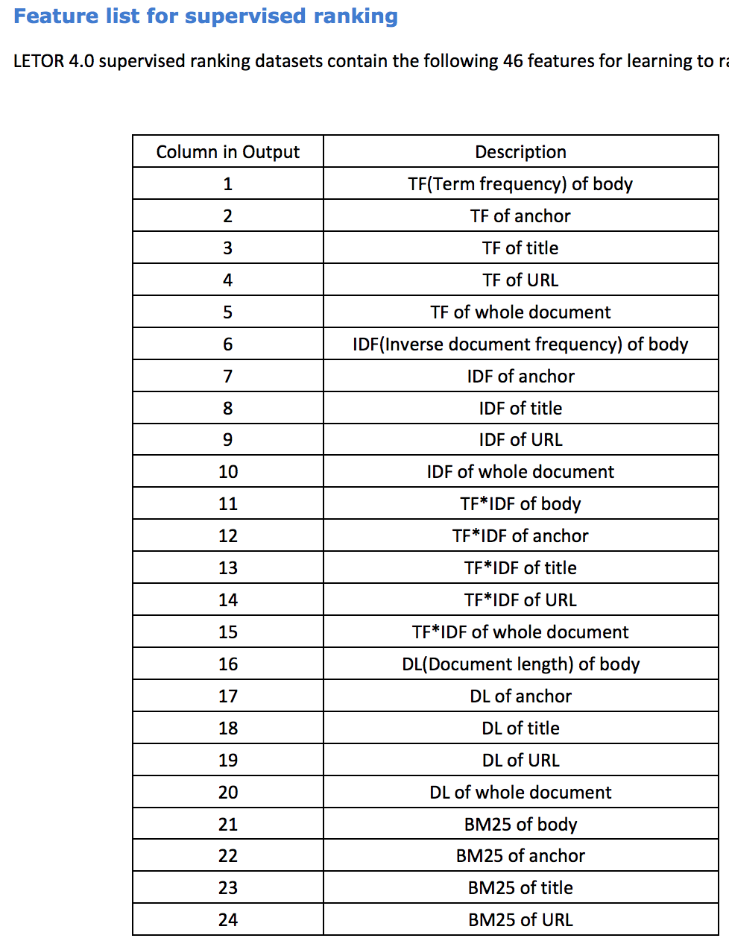
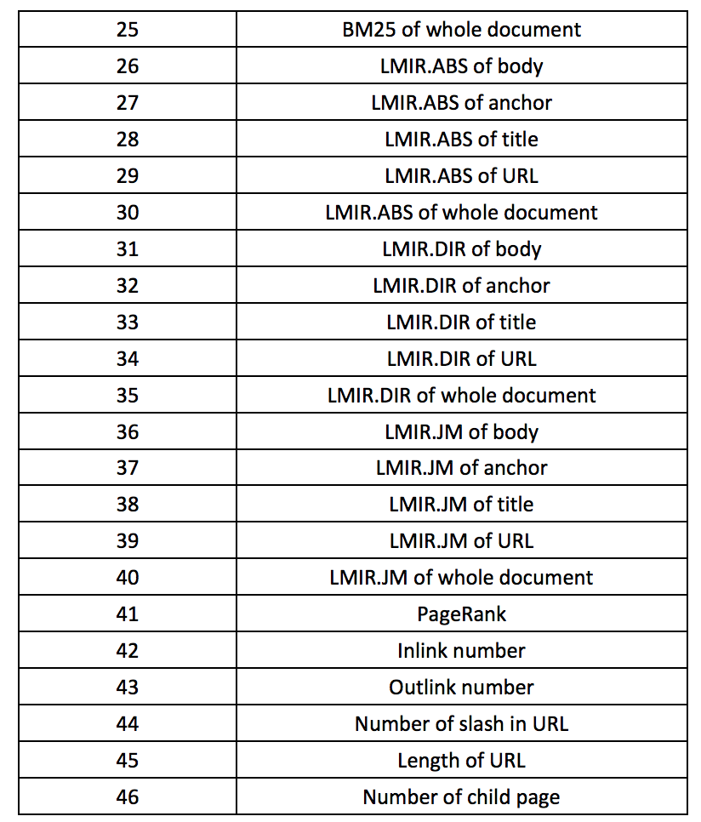
LETOR Experiment

Slide 41
LETOR Experiment Questions
Does LETOR code output feature weights it found from the training data and used to score the test data? What do the weights look like?
LETOR algorithms use X matrix of features and feature weights, so I think we should too.

Slide 42
Building D matrix for LETOR Experiment
Unweighted D: if i>j on 17 of 46 features, then d_{ij}=1 and d_{ji}=0. (Note: 17 is a parameter that can be changed.)
Unweighted D: Applying LETOR features weights as well. If i>j for cumulative weight of 3.6 and j>i for weight of 1.2, then d_{ij}=1 and d_{ji}=0.
Weighted D using only point ratios greater than 1: If i>j for 20 features and j>I for 26 features, then d_{ij}=0 and d_{ji}=26/20. And create ties with d_{ij}=1 and d_{ji}=1 if ratio is close to 1.
Weighted D using both point ratios: If i>j for 20 features and j>I for 26 features, then d_{ij}=20/26 and d_{ji}=26/20. And create ties with d_{ij}=1 and d_{ji}=1 if ratio is close to 1.
Weighted point ratios plus add LETOR feature weights: If i>j for cumulative weight of 3 and j>i for weight of 9, then d_{ij}=3/9. and d_{ji}=9/3.

