Slide 1
Improving Hillside Rankability
4/23/2019

Slide 2
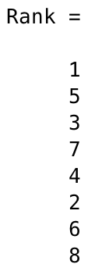
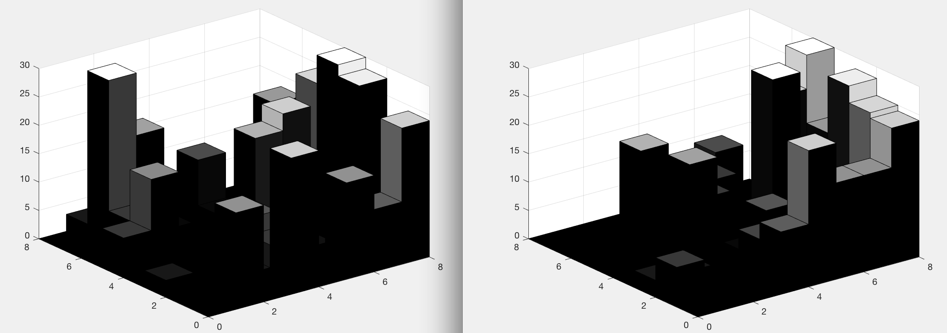
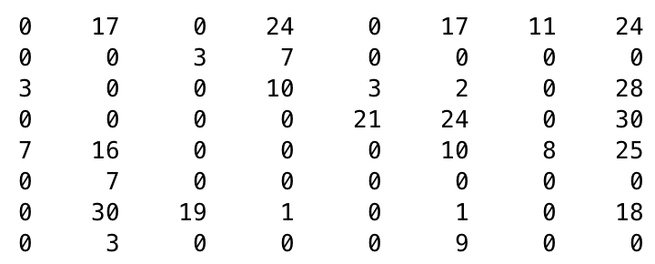
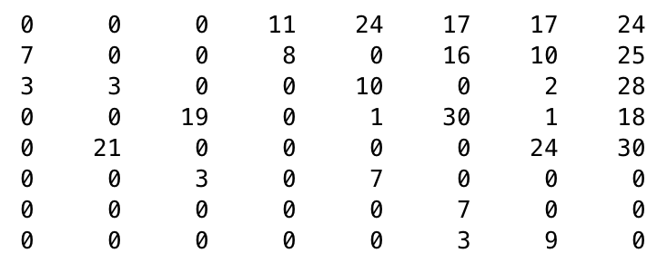
EXAMPLE: 2012 fb, point differential → weighted D
n=8
k_{hillside}=82
p=1
Point Differential D
D(r,r)

Slide 3
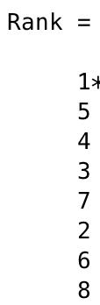
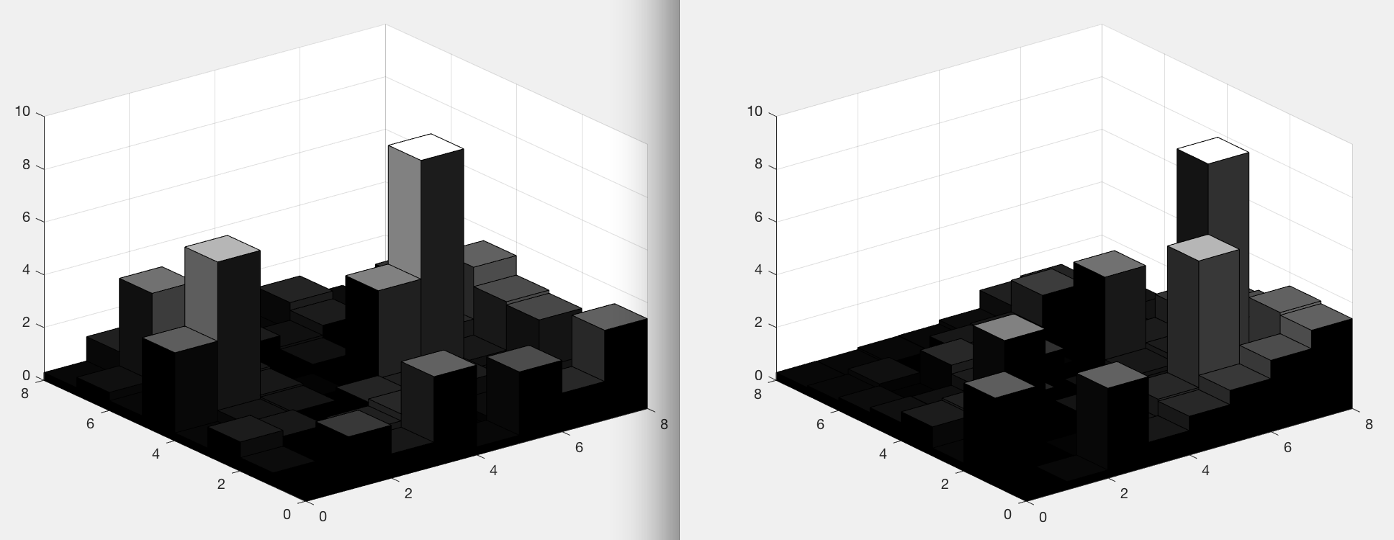
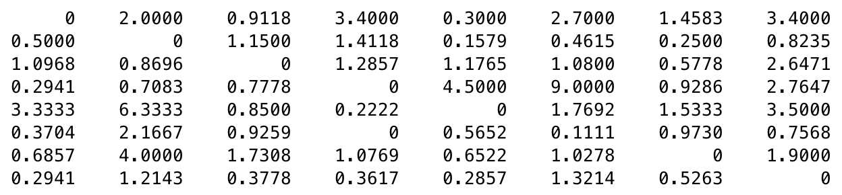
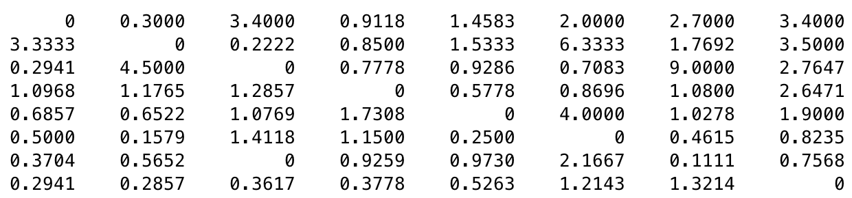
EXAMPLE: 2012 fb, point ratio, → weighted D
n=8
k_{hillside}=148
p=2
Point Ratio D
D(r,r)

Slide 4
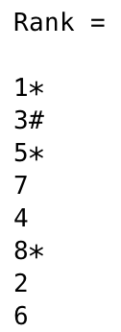
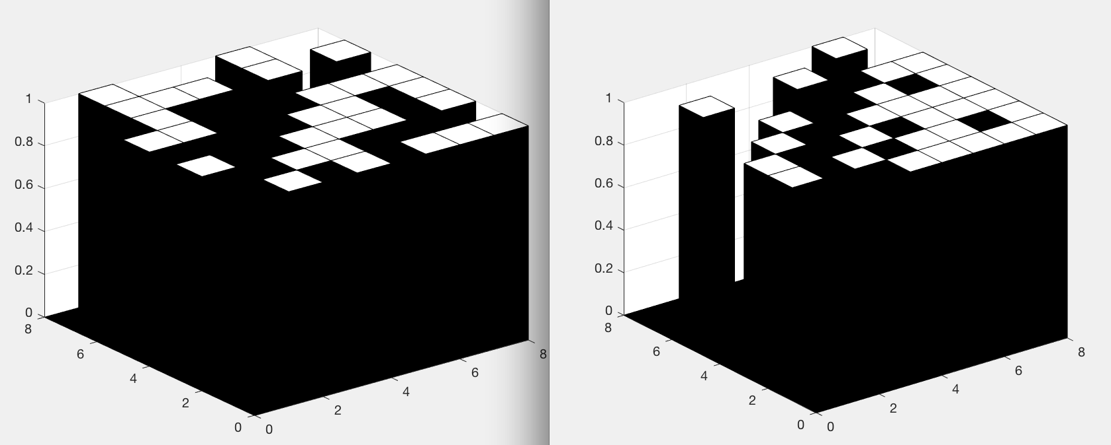
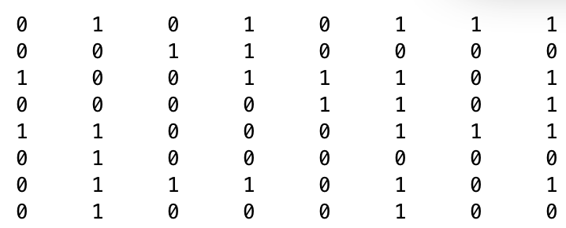
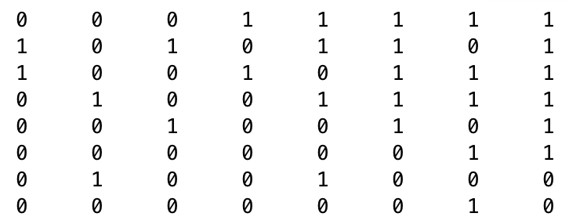
EXAMPLE: 2012 fb, unweighted D
n=8
k_{hillside}=52
p=16
Unweighted D
D(r,r)

Slide 5
Improving Rankability with P
Weighted D: has very small p, |P|=1 or just a few
Unweighted D: has small |P|
We can use Gurobi PoolSearch to expand P set to include rankings associated with optimal k and several suboptimal (next best) k values. Then we can try the previous strategies for Improving Rankability, all of which examine the P> matrix.
Strategies:
reduce indecision in P
shrink size of P set
steer toward target ranking in P
Q: Do these actually improve Hillside Rankability? It was easy to show they improve original Binary Rankability.

Slide 6
Improving Hillside Rankability w/o P
Suggest links for removal by choosing nonzero element in lower triangular of D(r,r) with largest value in the C matrix.

Slide 7
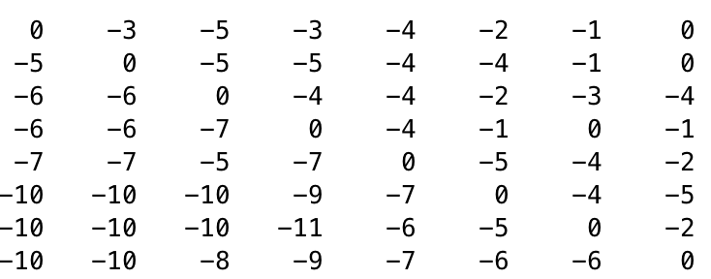
EXAMPLE: 2012 fb, point differential
n=8
k_{hillside}=82
p=1
D(r,r)
C(r,r)

Slide 8
EXAMPLE: 2012 fb, point differential
n=8
k_{hillside}=82
p=1
D(r,r)
C(r,r)
1-mod Dtilde matrices:
Set blue element from 3 to 0 in D -----> ktilde = 74
Set green element from 19 to 0 in D -----> ktilde = 76
Set yellow element from 3 to 0 in D -----> ktilde = 78
drops by 8, not c_{ij}=10. Why?
drops by 6, not c_{ij}=7. Why?
drops by 4, not c_{ij}=5. Why?

Slide 9
Counting Hillside Violations
k_{hillside}=82
f* = sum of upper triangular elements of C(r,r)
= sum of c_{ij} for upsets + sum of c_{ij} for weak wins
D(r,r)
C(r,r)

Slide 10
Counting Hillside Violations
k_{hillside}=82
f* = sum of upper triangular elements of C(r,r)
= sum of c_{ij} for upsets + sum of c_{ij} for weak wins
D(r,r)
C(r,r)

Slide 11
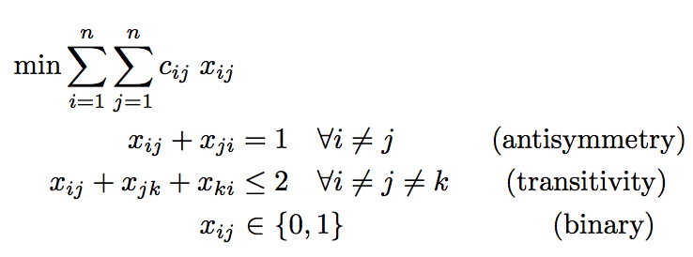
Hillside 1
Minimize the number of violations from hillside form

Slide 12
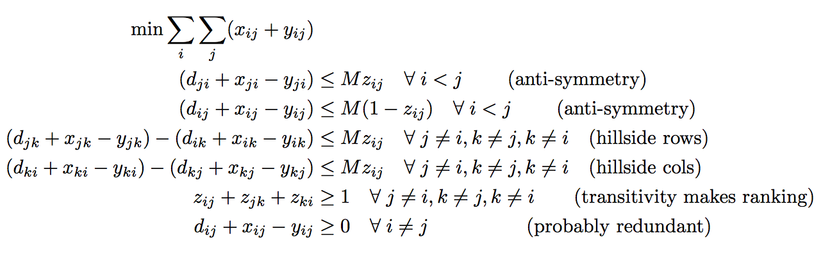
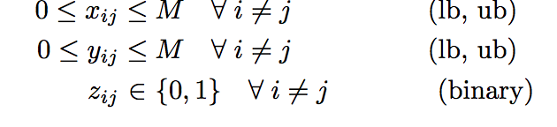
Hillside 2
Minimize the amount of violation from hillside form, i.e., the amount of modifications required to bring D to hillside form

