Slide 1
Hillside Amount Rankability
4/30/2019

Slide 2
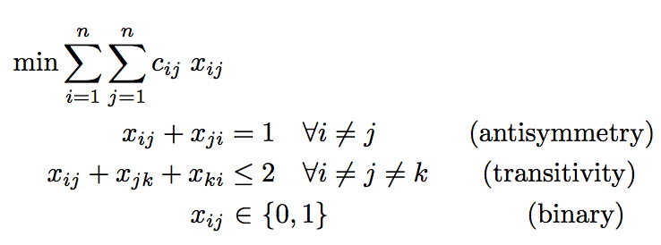
Hillside 1 = Hillside Count
Minimize the number of violations from hillside form

Slide 3
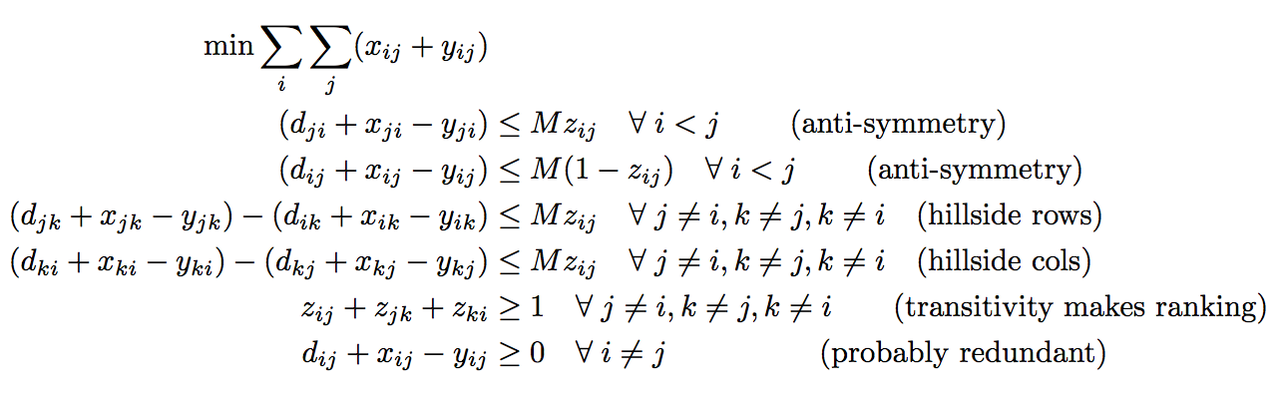
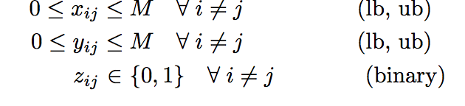
Hillside 2 = Hillside Amount
Minimize the amount of violation from hillside form, i.e., the amount of modifications required to bring D to hillside form

Slide 4
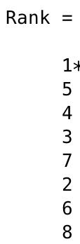
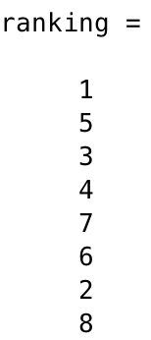
EXAMPLE: 2012 fb, point differential, → weighted D
Hillside 1
Rank
Hillside 2
Rank
k_{hillside1}=148
k_{hillside2}=189

Slide 5
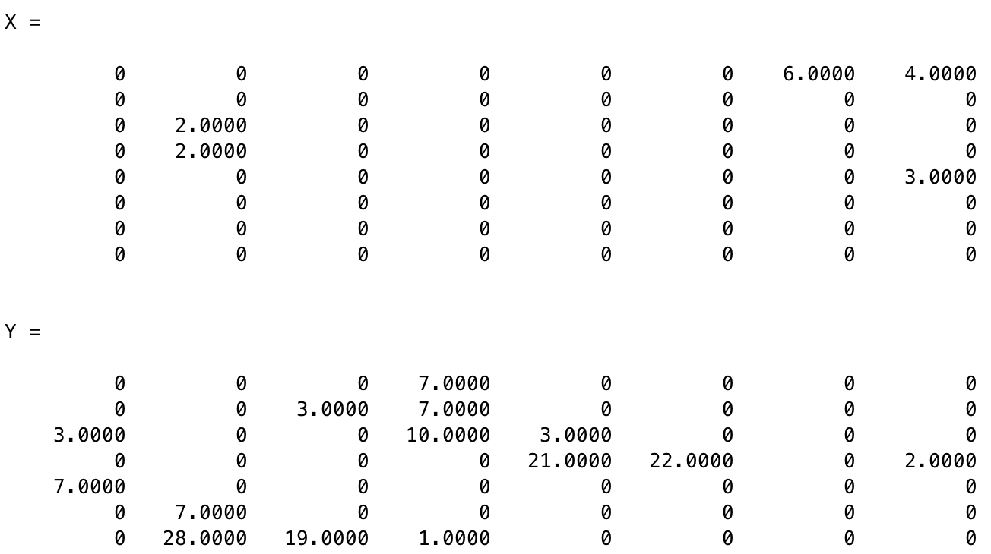
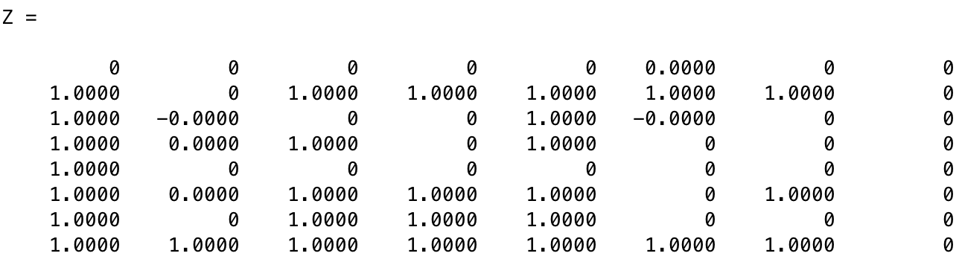
EXAMPLE: 2012 fb, point differential, → weighted D
Hillside 2
Rank
k_{hillside2}=189
D(r,r)

Slide 6
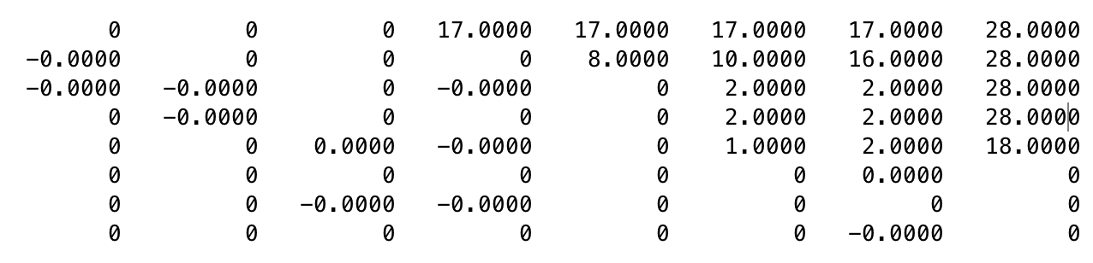
EXAMPLE: 2012 fb, point differential, → weighted D
Hillside 2
Rank
k_{hillside2}=189
Reordered D+X-Y =

Slide 7
Paper: Rankability of Weighted Data
Hillsides are better ways to handle weighted data than max D * binary perfect dom graph as proposed in SIMODS1 paper.
Hillside Amount is extension of Original Rankability to weighted graphs.
Hillside Amount works on both weighted and unweighted graphs.
Another option, Hillside Count, naturally weights the location of violations so that upsets are more violations than weak wins.
Pros and Cons of Original vs. Hillside Count vs. Hillside Amount
Dropping P from rankability definition means we can solve much larger problems, O(10²)-O(10³).

