Slide 1
Hillside Rankability
5/12/2019

Slide 2
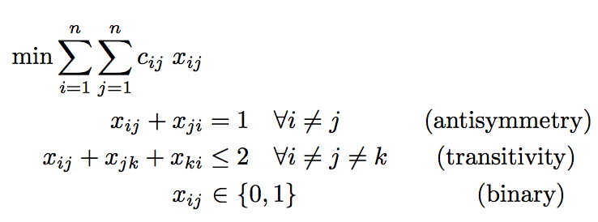
Hillside 1 (Hillside Count)
Minimize the number of violations from hillside form

Slide 3
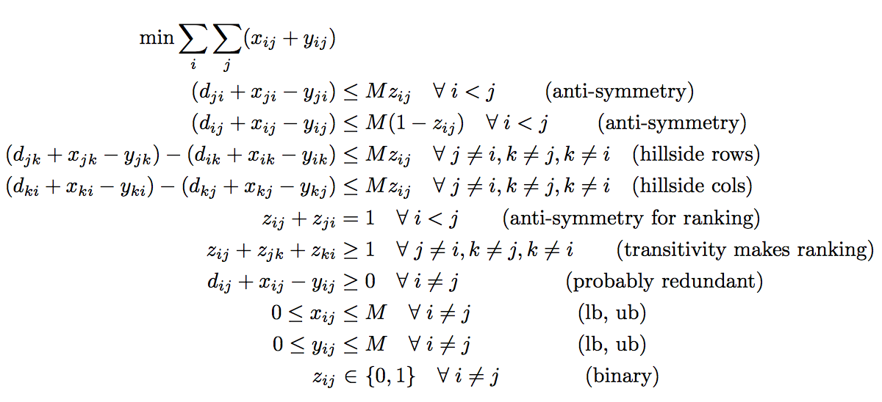
Hillside 2 (Hillside Amount)
Minimize the amount of violation from hillside form, i.e., the amount of modifications required to bring D to hillside form

Slide 4
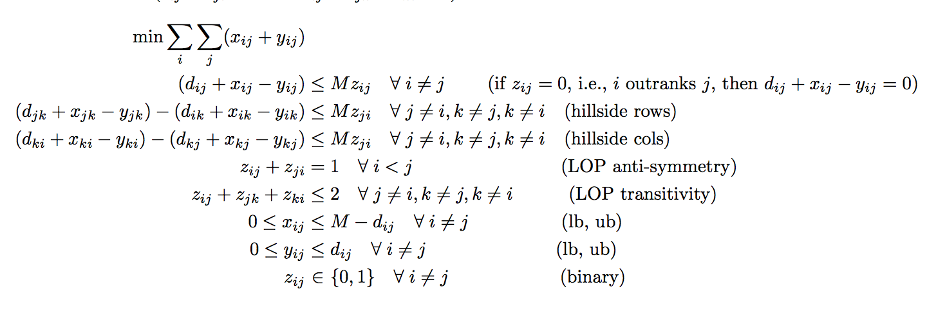
Hillside 2B (Tighter Form.)
Minimize the amount of violation from hillside form, i.e., the amount of modifications required to bring D to hillside form

Slide 5
Hillside 2 has two equivalent formulations
Hillside 2 and Hillside 2B are equivalent formulations.
They give the:
same f*, objective value,
usually the same Z matrix,
often times different X and Y matrices.
Hillside 2B takes fewer iterations due to tigher bounds.

Slide 6
2000-2012 Big East Unweighted Data

Slide 7
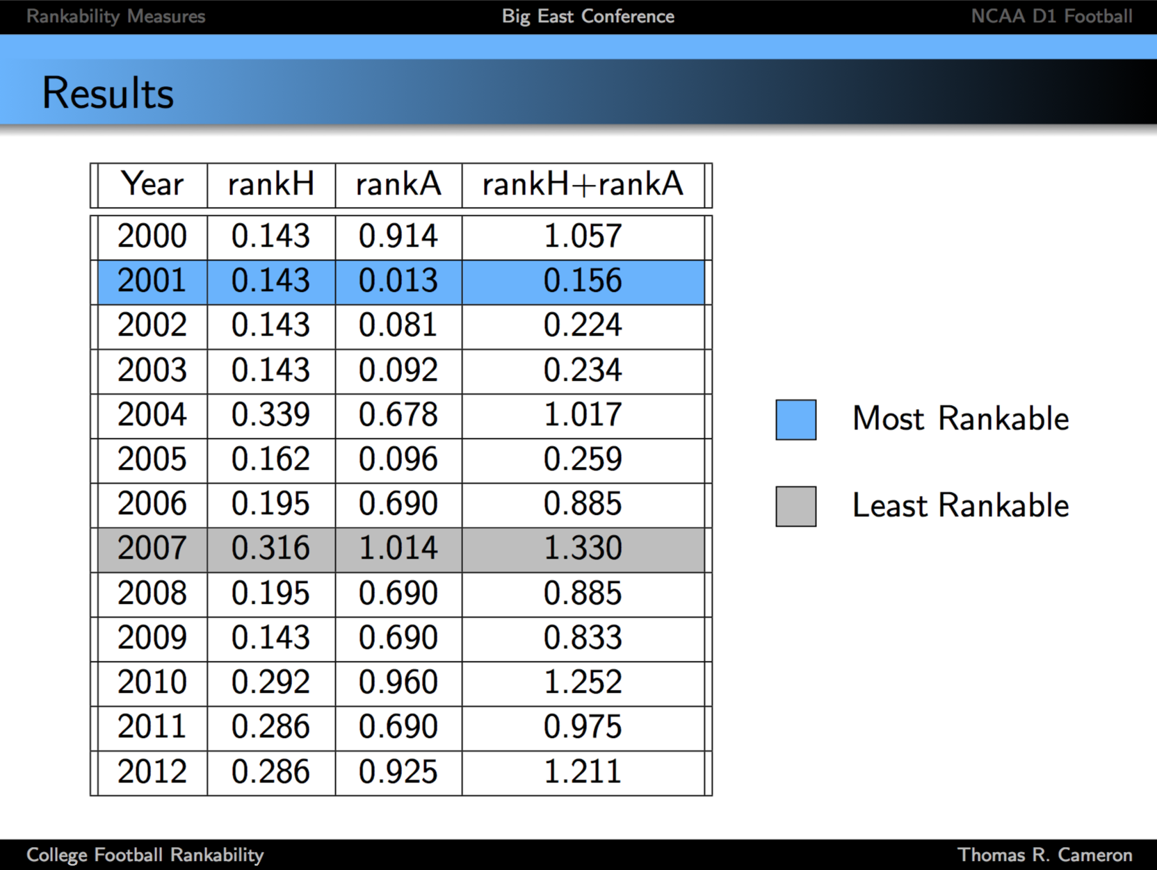
2000-2012 Big East Data

Slide 8
2000-2012 Big East Unweighted Data
Rankability
SIMODS k, p Hillside 1
2000 | 4,1 | 28
2001 | 2,1 | 10
2002 | 2,1 | 10
2003 | 4,1 | 22
2004 | 6,1 | 40
2005 | 4,1 | 25
2006 | 8,4 | 36
2007 | 12,7 | 72
2008 | 6,3 | 32
2009 | 4,1 | 28
2010 | 8,3 | 60
2011 | 8,3 | 52
2012 | 8,1 | 52

Slide 9
SIMODS Rankability and Hillside 1
are well-correlated with each other.
are well-correlated with Thomas’s rankH and rankA measures.

Slide 10
Sales Pitch: Hillside 1 >> SIMODS Rankability
no P set, so faster algorithm
no P set, so we can handle problems with bigger n
weights the location of violations
elegant model with LOP history, can leverage LOP algorithms
works on both unweighted and weighted data
can still make suggestions on improving rankability using pseudo-P and upsets with large c_{ij}

Slide 11
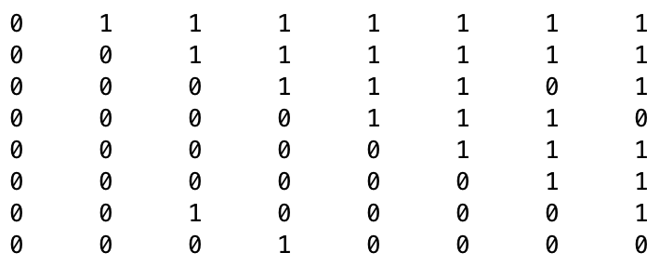
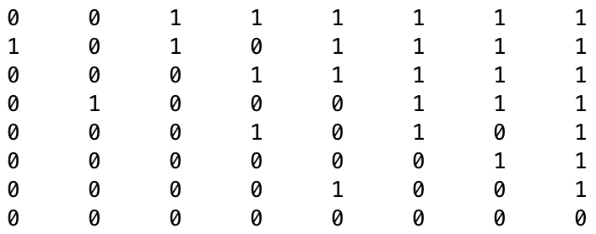
2000 vs. 2003 Big East Unweighted Data
Rankability
SIMODS k, p Hillside 1 RankH RankA
2000 D(r,r)
2000 | 4,1 | 28 | .143 | .914
2001 | 2,1 | 10
2002 | 2,1 | 10
2003 | 4,1 | 22 | .143 | .092
2004 | 6,1 | 40
2005 | 4,1 | 25
2006 | 8,4 | 36
2007 | 12,7 | 72
2008 | 6,3 | 32
2009 | 4,1 | 28
2010 | 8,3 | 60
2011 | 8,3 | 52
2012 | 8,1 | 52
2 big upsets are weighted more than . . .
2003 D(r,r)
. . . 4 mild upsets.

Slide 12
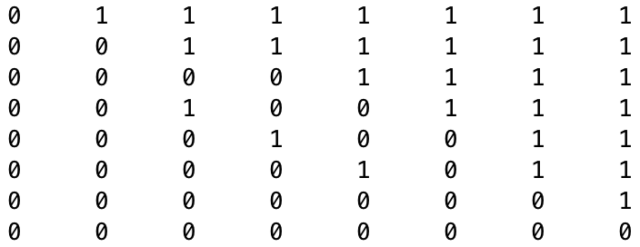
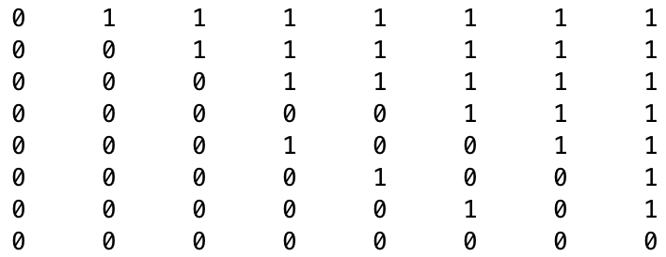
2001 vs. 2002 Big East Unweighted Data
Rankability
SIMODS k, p Hillside 1 RankH RankA
2001 D(r,r)
2000 | 4,1 | 28 | .143 | .914
2001 | 2,1 | 10 | .143 | .013
2002 | 2,1 | 10 | .143 | .081
2003 | 4,1 | 22 | .143 | .092
2004 | 6,1 | 40
2005 | 4,1 | 25
2006 | 8,4 | 36
2007 | 12,7 | 72
2008 | 6,3 | 32
2009 | 4,1 | 28
2010 | 8,3 | 60
2011 | 8,3 | 52
2012 | 8,1 | 52
3 of the mildest upsets between mid-level teams
2002 D(r,r)
3 of the mildest upsets between mid- to low-level teams

Slide 13
2001 vs. 2002 Big East Unweighted Data
Rankability
SIMODS k, p Hillside 1 RankH RankA
2001 D(r,r)
2000 | 4,1 | 28 | .143 | .914
2001 | 2,1 | 10 | .143 | .013
2002 | 2,1 | 10 | .143 | .081
2003 | 4,1 | 22 | .143 | .092
2004 | 6,1 | 40
2005 | 4,1 | 25
2006 | 8,4 | 36
2007 | 12,7 | 72
2008 | 6,3 | 32
2009 | 4,1 | 28
2010 | 8,3 | 60
2011 | 8,3 | 52
2012 | 8,1 | 52
3 of the mildest upsets between mid-level teams
So one could argue that 2002 should have slightly better rankability than 2001.
2002 D(r,r)
3 of the mildest upsets between mid- to low-level teams

Slide 14
Paper: Rankability of Weighted Data
Hillsides are better ways to handle weighted data than max D * binary perfect dom graph as proposed in SIMODS1 paper.
Hillside Amount is extension of Original Rankability to weighted graphs.
Hillside Amount works on both weighted and unweighted graphs.
Another option, Hillside Count, naturally weights the location of violations so that upsets are more violations than weak wins.
Pros and Cons of Original vs. Hillside Count vs. Hillside Amount
Dropping P from rankability definition means we can solve much larger problems, O(10²)-O(10³).

Slide 15
Paper: Rankability of Weighted Data
Hillsides are better ways to handle weighted data than max D * binary perfect dom graph as proposed in SIMODS1 paper.
Hillside Amount is extension of Original Rankability to weighted graphs.
Hillside Amount works on both weighted and unweighted graphs.
Another option, Hillside Count, naturally weights the location of violations so that upsets are more violations than weak wins.
Hillside Count works on both weighted and unweighted graphs.
Pros and Cons of Original vs. Hillside Count vs. Hillside Amount
Dropping P from rankability definition means we can solve much larger problems, O(10²)-O(10³).

Slide 16
Paper Outline
Recap SIMODS 1 paper: distance from perfection = k, uniqueness = P
Weighted D matrix and various encodings with point differentials or ratios.
Hillside as perfection for weighted graph. Define Hillside, example D.
Hillside 2 (Hillside Amount) as extension of SIMODS1, unweighted graphs, to weighted graphs.
Hillside 1 (Hillside Count) formulation and its advantages
Advice for Improving Hillside 1 Rankability: no P vs. pseudo-P
Numerical Experiments

Slide 17
Paper Numerical Experiments
Data
March Madness, years 2000-present, n=350
College Football
US News College Rankings: n=?, interesting subsets
LETOR
Points
Hillside on both unweighted and weighted data means we can solve bigger problems: tables of runtimes and biggest n we can solve in 1 hour, 5 hours, … Compare to SIMODS 1 unweighted problems.
Improving rankability improves ranking performance.

