Slide 1
Improving Rankability
Amy Langville
Mathematics Department
College of Charleston
3/11/2019

Slide 2
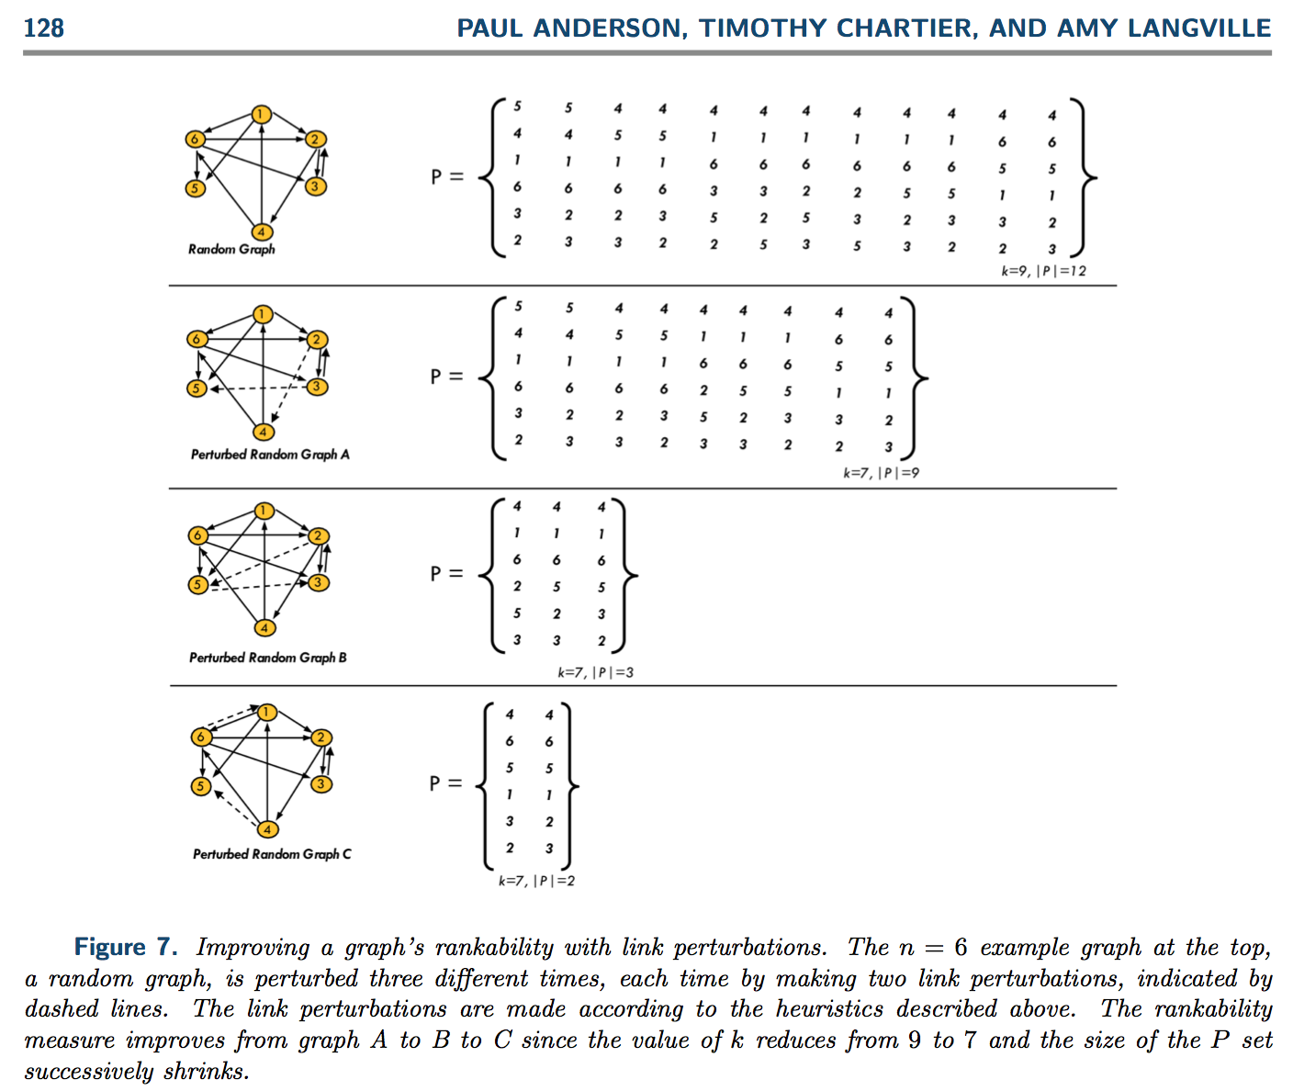
SIAM Journal on Mathematics of Data Science, 1-1 (2019), p. 121-143

Slide 3
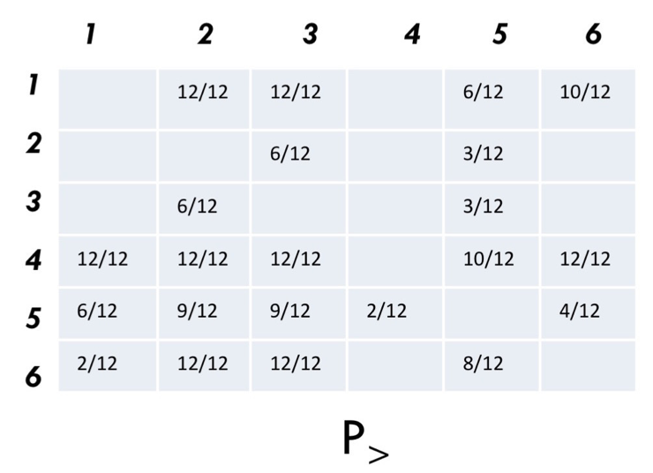
Improving Rankability, see SIMODS
STRATEGY = resolve indecision
identify “Pairs of Maximal Indecision” by choosing locations of elements in P> with values near .5

Slide 4
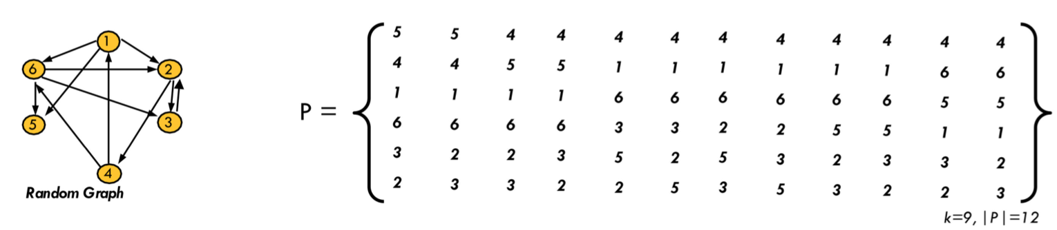
Improving Rankability, see SIMODS
STRATEGY = resolve indecision
identify “Pairs of Maximal Indecision” by choosing locations of elements in P> with values near .5
removing (2,3) or (3,2) link removes half the members of P

Slide 5
Improving Rankability, see SIMODS
STRATEGY = resolve indecision
identify “Pairs of Maximal Indecision” by choosing locations of elements in P> with values near .5
HYPOTHESIS: this halves size from P to P.
~
Q: Can we prove this?
Cut 2 → 3
~
k=8, |P|=6

Slide 6
Improving Rankability vs. Optimally Improving Rankability
Want to choose links that create the smallest |P|

Slide 7
Improving Rankability vs. Optimally Improving Rankability
Given:
k
P
l = # of link modifications
Find:
l locations (i,j) in D to flip in order to most improve rankability
from D to D
~

Slide 8
Optimally Improving Rankability
Initial Observations:
If l > k, then rankability gets worse. (trivial observation)
If l ≤ k, then rankability may improve or it may get worse. It depends on which edges are chosen.
The n²-n off-diagonal elements in D may be flipped. So there are “n²-n choose l” ways to modify D to create the new matrix D.
~

Slide 9
Exhaustive Method for Optimally Improving Rankability
~
Create one of the “n²-n choose l” new matrices D.
Find k and P for this D.
Repeat for all possible D.
Choose D with smallest |P| with k=k-l.
~
~
~
~
~
~
~
way too expensive; this is solving “n²-n choose l” rankability problems

Slide 10
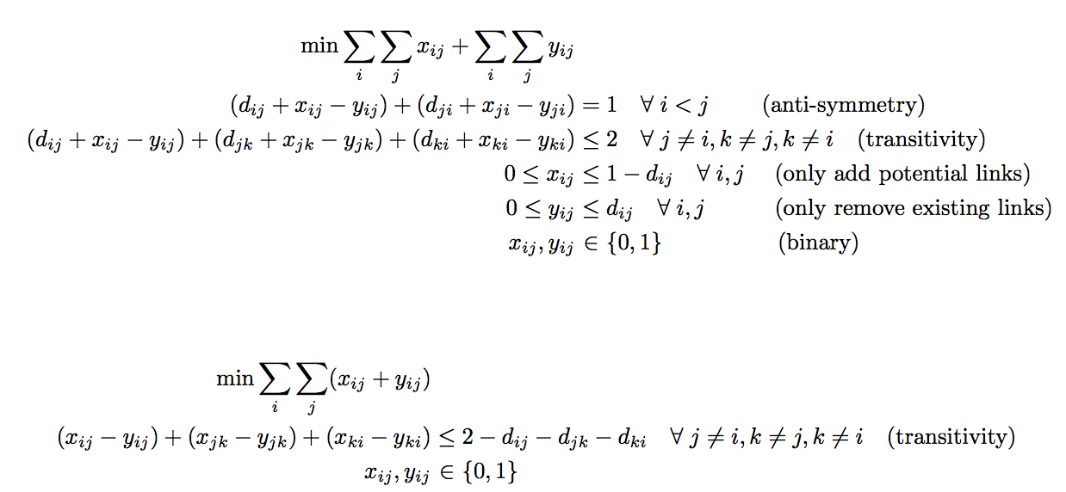
Geometry of Optimally Improving Rankability
Before Preprocessing:
After Preprocessing:
pairs of sandwiching parallel hyperplanes
So l pairs of sandwiching parallel hyperplanes are moving in and out or up and down. Walls of the polytope shift.
This is not parametric programming, which gives a range of values for the parameter for which current optimal solution remains the optimal solution. Instead we are interested in the number of extreme point optimal solutions given particular changes.

Slide 11
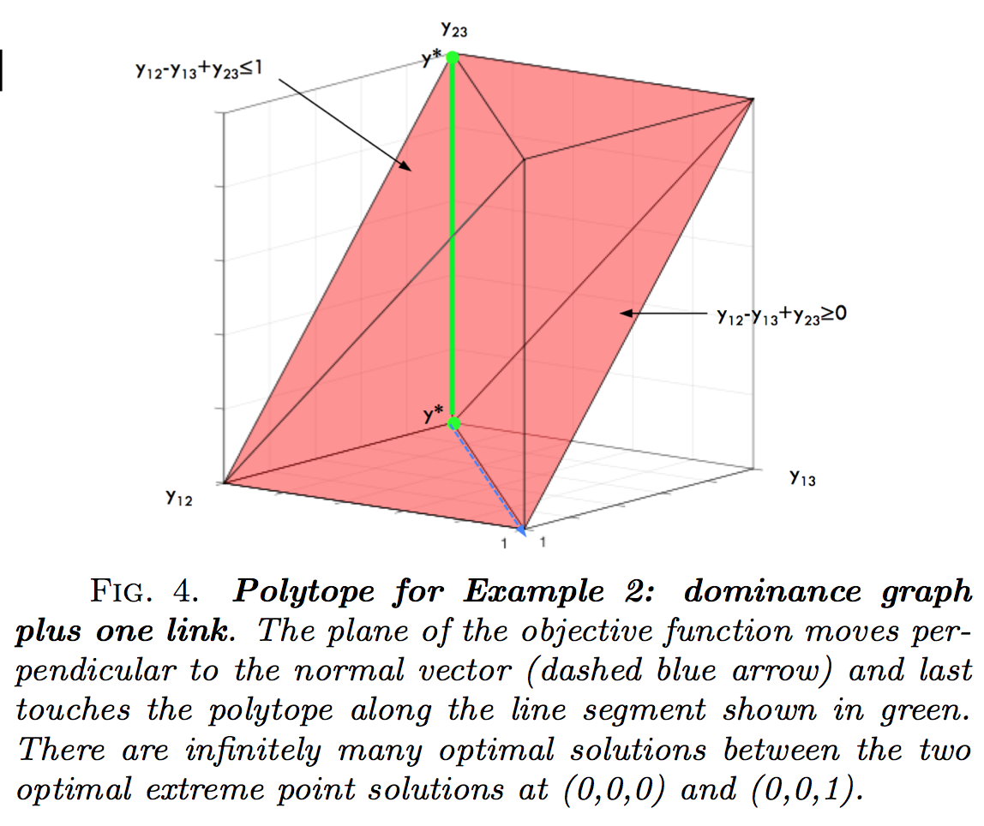
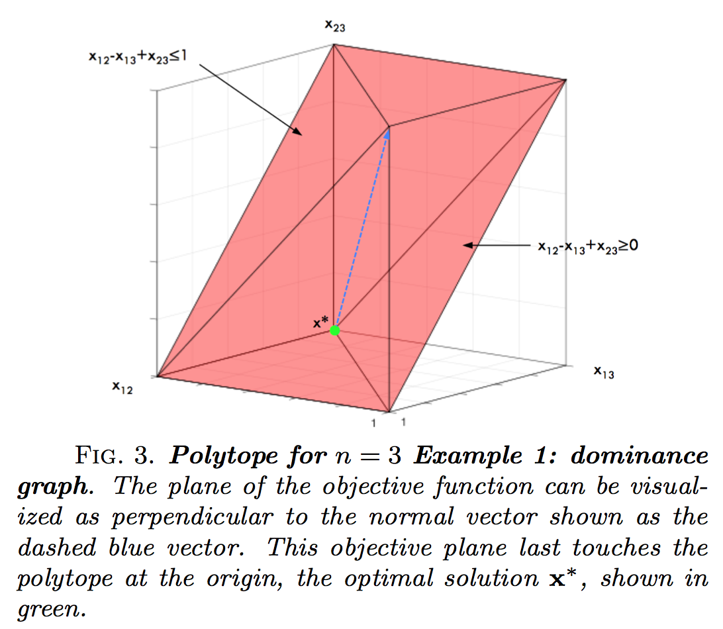
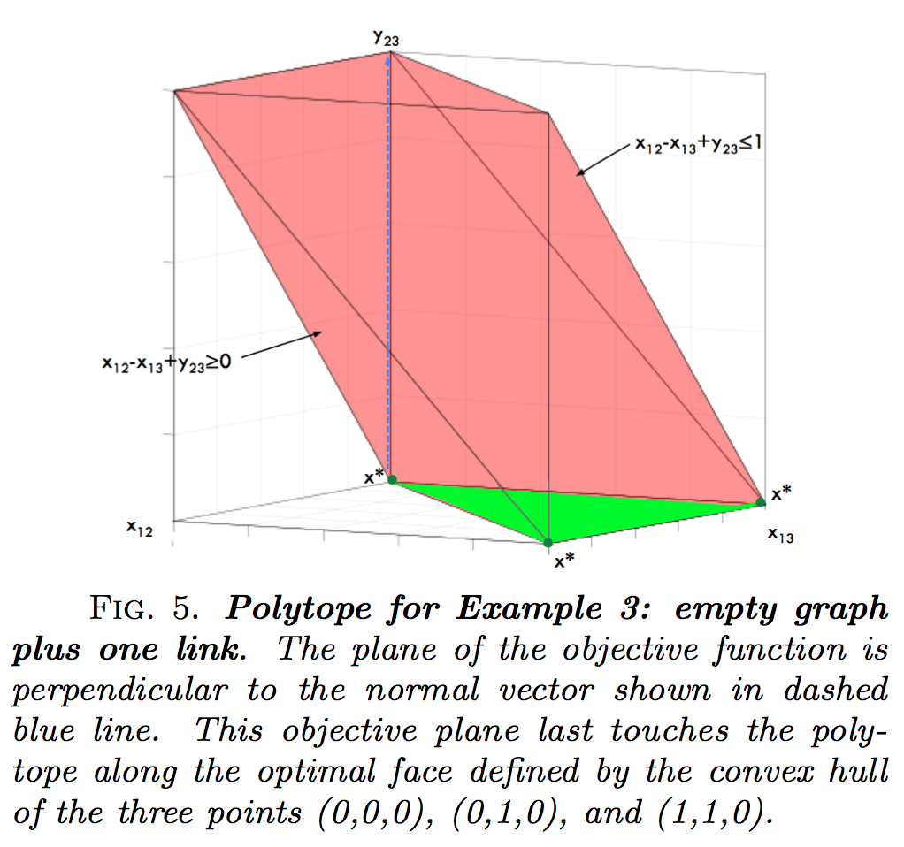
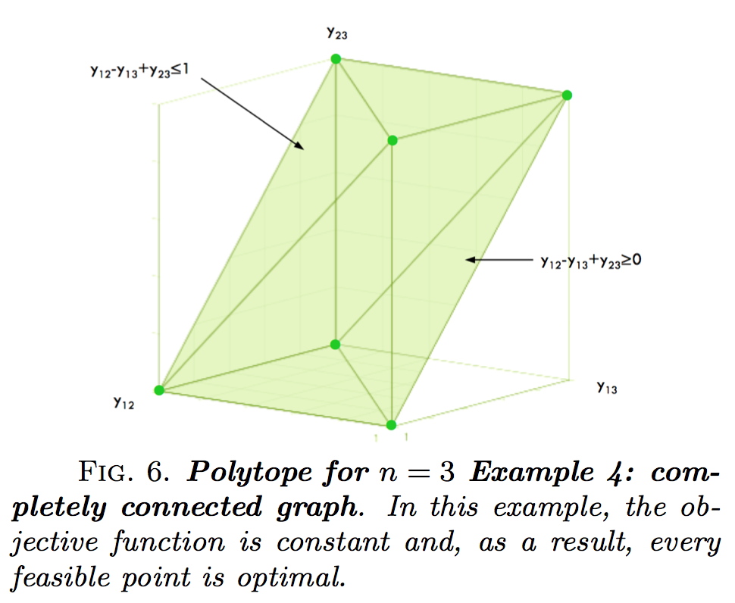
Geometry of Rankability Polytope, n=3

Slide 12
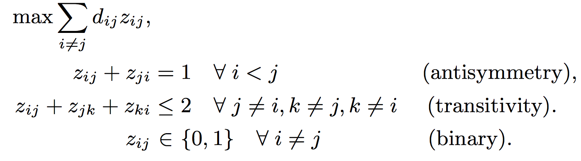
Geometry of Optimally Improving Rankability
z_{ij} = d_{ij} + x_{ij} - y_{ij}
Alternative Form. 1:
~
With this formulation, the polytope stays the same as D changes to D. Only the angle of the objective function changes.
This polytope is the LOP polytope. And there is research on which LOP constraints are facet-defining.
As D changes, the changing angle of objective function causes the optimal face to change. We want to change D so that the new optimal face has the fewest number of extreme points.
Q: Maybe each member of P can be examined to find which could be the lone e.p. on the optimal face and find which changes to D make this happen?

Slide 13

n=4 example

Slide 16
Tied and Dominated (i,j) pairs
For each (i,j) pair in D, there are 4 options:
d_{ij}=1 and d_{ji}=1
d_{ij}=0 and d_{ji}=0
d_{ij}=1 and d_{ji}=0
d_{ij}=0 and d_{ji}=1
modifying (i,j) breaks a tie in a dominance relation
modifying (i,j) makes a tie in a dominance relation

Slide 17
Exhaustive Method for Optimally Improving Rankability
~
Create one of the “t choose l” new matrices D.
Find k and P for this D.
Repeat for all possible D.
Choose D with smallest |P| with k=k-l.
~
~
~
~
~
~
~
t= # of tied dominance relations. This reduces the expense a bit because only considering tied dominance relations are considered. Of the “n²-n choose l” new modified matrices only the “t choose l” will improve rankability. The other the “n²-n - t choose l” will worsen rankability.

Slide 18
Conjecture 1
Flipping a tied dominance relation (i,j) that has a nonnegative fractional value in P> (i.e., 0<P>(i,j)<1) improves rankability by decrementing k by 1 and reducing the number of elements in the P set.
Flipping a dominated relation (i,j) decreases rankability. The value of k increases by 1 and the number of elements in the P set may remain the same or increase.

Slide 19
Conjecture 2
To make the optimal (with respect to the greatest change from p to p), l=1 one-link addition to D, identify the smallest nonzero element (i,j) in P> with a zero-tied dominance relation in D so that d_{ij}=d_{ji}=0. Then setting d_{ij}=1 creates P by removing members in P that contradict the i>j link addition, i.e.,
P = P – {members in P with i<j}.
~
~
~
~
To make the optimal (with respect to the greatest change from p to p), l=1 one-link deletion to D, identify the largest non-unit element (i,j) less than 1 in P> with a unit-tied dominance relation in D so that d_{ij}=d_{ji}=1. Then setting d_{ij}=0 creates P by removing members in P that contradict the i<j link deletion, i.e.,
P = P – {members in P with i>j}.
~
~
~
~

Slide 20
Algorithm for l=1 Optimal Link Mod to Improve Rankability
0-tied matrix
1-tied matrix
Form T₀ matrix where T₀(i,j)=1 if d_{ij}=d_{ji}=0.
Form T₁ matrix where T₁(i,j)=1 if d_{ij}=d_{ji}=1.
Form addition matrix R = T₀ .* P>
Form removal matrix A = T₁ .* P>
Identify optimal link removal location (i,j) as largest 0 < r_{ij} < 1.
Form the removal set P_{r} = P – {members in P with i<j} and p_{r} = |P_{r}|.
Form the addition set P_{a} = P – {members in P with i<j} and p_{a} = |P_{a}|.
Choose link modification (i,j) (either addition i → j or link removal i → j) by which is smaller: p_{a} or p_{r}.
Make this link modification to create D and P.
Set D=D and P=P. Form P> and go to STEP 1. Repeat l times or until p=1.
~
~
~
~
~
~
~
~
~
~
~

Slide 21
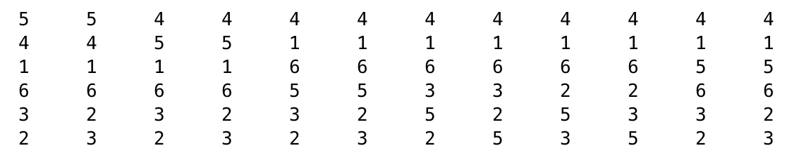
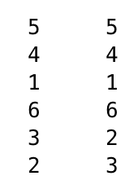


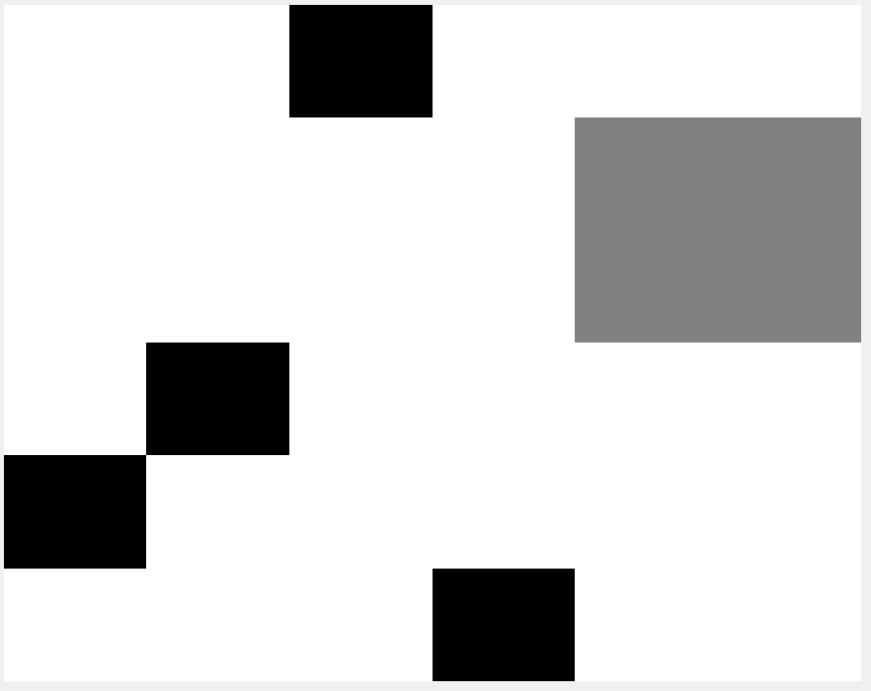




SIMODS n=6 example
L=0 L=1 L=2
added 5 → 4
deleted 3 → 2
k
p
9
12
8
2
7
1
P
R
P>

Slide 22
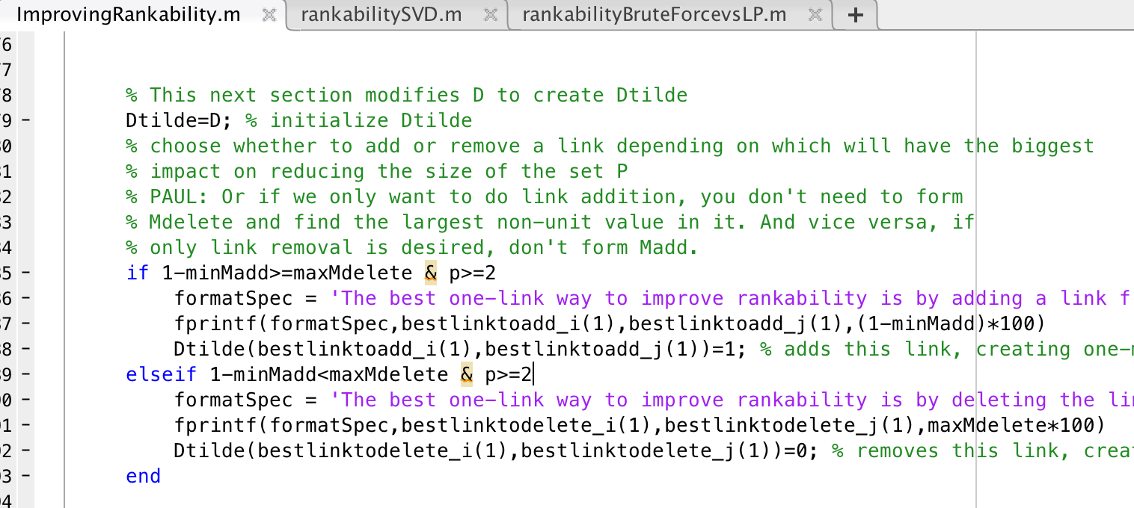
Note to Paul: small error in Matlab code

Slide 23
SIMODS n=6 example
L=0 L=1 L=2
added 5 → 4
deleted 3 → 2
k
p
9
12
8
2
7
1
P
Q: How does this Greedy Iterative Algorithm for improving rankability compare to Exhaustive Algorithm that considers all “n²-n choose 2” ways of making 2-mod changes to D?
A: For this example, the Greedy Iterative 1-mod Algorithm and Exhaustive 2-mod Algorithm give the same answer because it we know it is impossible to get p=1 in 1-mod. But there may be, and likely are, other 2-mod ways to get down to p=1 besides our two-mods of adding a link from 5 to 4 and removing the link from 3 to 2.

Slide 24
SIMODS n=6 example
L=0 L=1 L=2
added 5 → 4
deleted 3 → 2
k
p
9
12
8
2
7
1
P
R_{ij} = percentage of rankings in P that have item i in rank position j
R
Q: Is there a way to get or approximate R from P>?
P>
LP solution (X,Y) matrices can be used to approximate P> ≈ D + X – Y.

Slide 25
Can we prove things about our Greedy Iterative Algorithm for Improving Rankability?
that each 1-modification choice at each iteration is indeed 1-mod optimal?
that choosing (i,j) pair in a tied dominance relation improves 1-mod rankability?
that choosing (i,j) pair in a dominated relation keeps or decreases 1-mod rankability?
that size of P set shrinks successively with each iteration of the algorithm?

Slide 26
Redefining Rankability: adding l
Should we incorporate l into the definition of rankability?
k = distance from perfect dominance graph
p = # of rankings this distance from dom graph
l = # of modifications, distance to perfect P set (p=1)

Slide 27
Kathryn’s Idea
Use X and Y instead of P>
Not all links are equal. When considering which links to modify, create weights associated with confidence in existing links.

Slide 28
Kathryn’s Comment on encoding D
Data: 52—49 score where team i beat team j
D(i,j)=52 and D(j,i)=49
D(i,j)=3 and D(j,i)=0
D(i,j)=52/49=1.06 and D(j,i)=0

Slide 29
Binning when encoding C
Data: 52—49 score where team i beat team j
D(i,j)=52 and D(j,i)=49
D(i,j)=3 and D(j,i)=0
D(i,j)=52/49=1.06 and D(j,i)=0

