Slide 1
Improving Rankability
Amy Langville
Mathematics Department
College of Charleston
3/19/2019

Slide 2
Strategies for Improving Rankability
STRATEGY 0. Resolve indecision. (SIMODS paper)

Slide 3
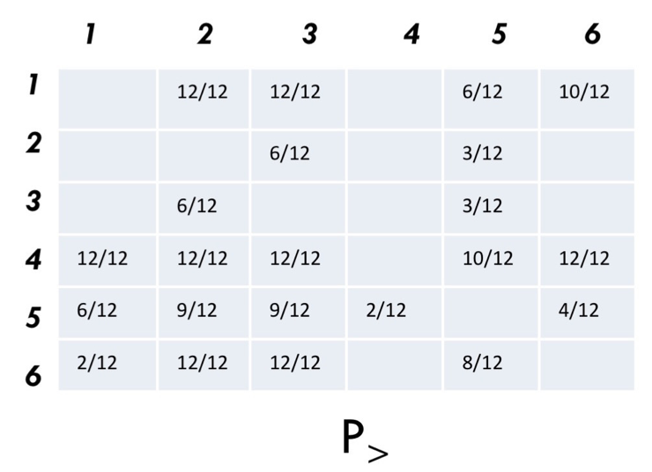
Improving Rankability, see SIMODS
STRATEGY 0 = resolve indecision in P
identify “Pairs of Maximal Indecision” by choosing pairs (i,j) and (j,i) in P> with values near .5

Slide 4
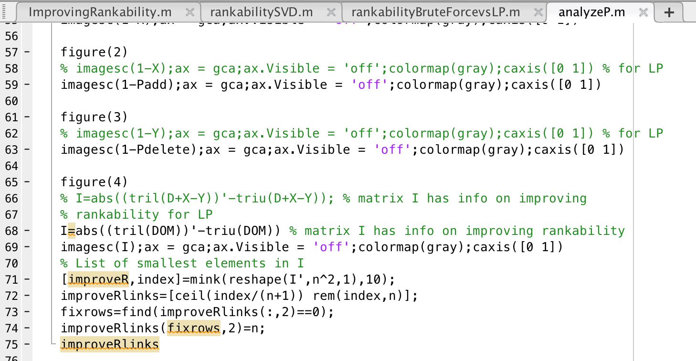
Improving Rankability, see SIMODS
STRATEGY 0 = resolve indecision in P
identify “Pairs of Maximal Indecision” by choosing pairs (i,j) and (j,i) in P> with values near .5

Slide 5
Strategies for Improving Rankability
STRATEGY 0. Resolve indecision. (SIMODS paper)
STRATEGY 1. Maximally shrink P with each link mod.

Slide 6
Kathryn’s Issue
Not all links are equal. When considering which links to modify, create weights for existing and potential links.
Unweighted
Weight by average of average rank positions of i and j in members of P
Weight by support for that link, e.g., # of reviews with i>j when considering removal of existing link from i to j or # of reviews with i<j when considering adding potential link

Slide 7
Kathryn’s Comment on encoding D
Data: 52—49 score where team i beat team j
D(i,j)=52 and D(j,i)=49
D(i,j)=3 and D(j,i)=0
D(i,j)=52/49=1.06 and D(j,i)=0

Slide 8
Binning when encoding C
For n=100 example, C contains 10,000 entries.
SVD truncated at level 2 gives 4 100-dimensional vectors u₁, u₂, v₁, v₂.
So there are 400 entries to capture trends in 10,000 entry C.
By binning C, we smooth out small variations in data.
Q: Do we bin before or after centering?

Slide 9
IP Rankability as Ranking Method on March Madness
n=68 exact P or early terminated approximate partial P
choose any member of P as ranking
choose every member of P as rankings
choose Markov’s aggregate vector t of P as ranking
n=340 approximate info for P from P>
use row sums of P> in descending order as ranking
use col sums of P> in ascending order as ranking

Slide 10
IP Rankability as Ranking Method on March Madness
n=68 exact P or early terminated approximate partial P
choose any member of P as ranking
choose every member of P as rankings
choose Markov’s aggregate vector t of P as ranking
n=340 approximate info for P from P>
use row sums of P> in descending order as ranking
use col sums of P> in ascending order as ranking

Slide 11
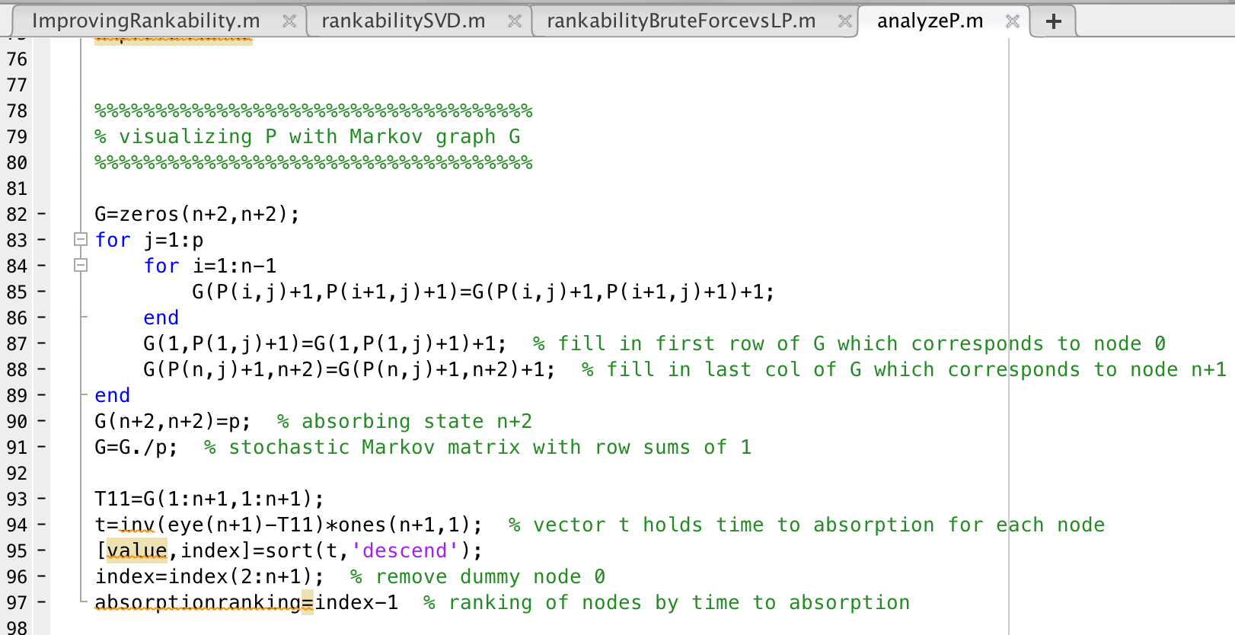
Markov Matrix G and time to absorption vector t
needs full or partial set P as input

