Slide 1
Rankability Polytopes
12/2/2019

Slide 2
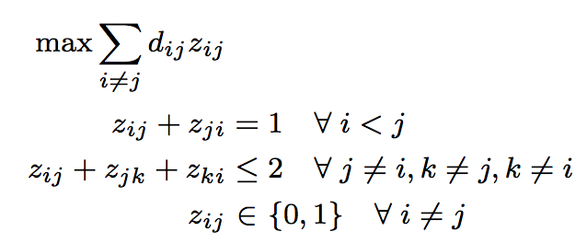
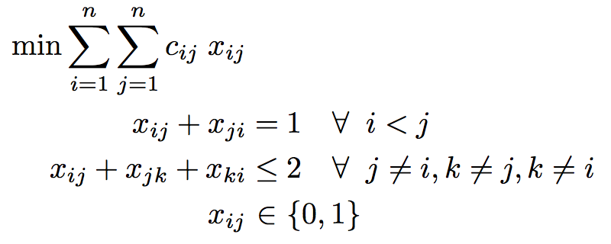
Unweighted and Weighted Problems
unweighted IP
weighted IP
same polytope, different objectives

Slide 3
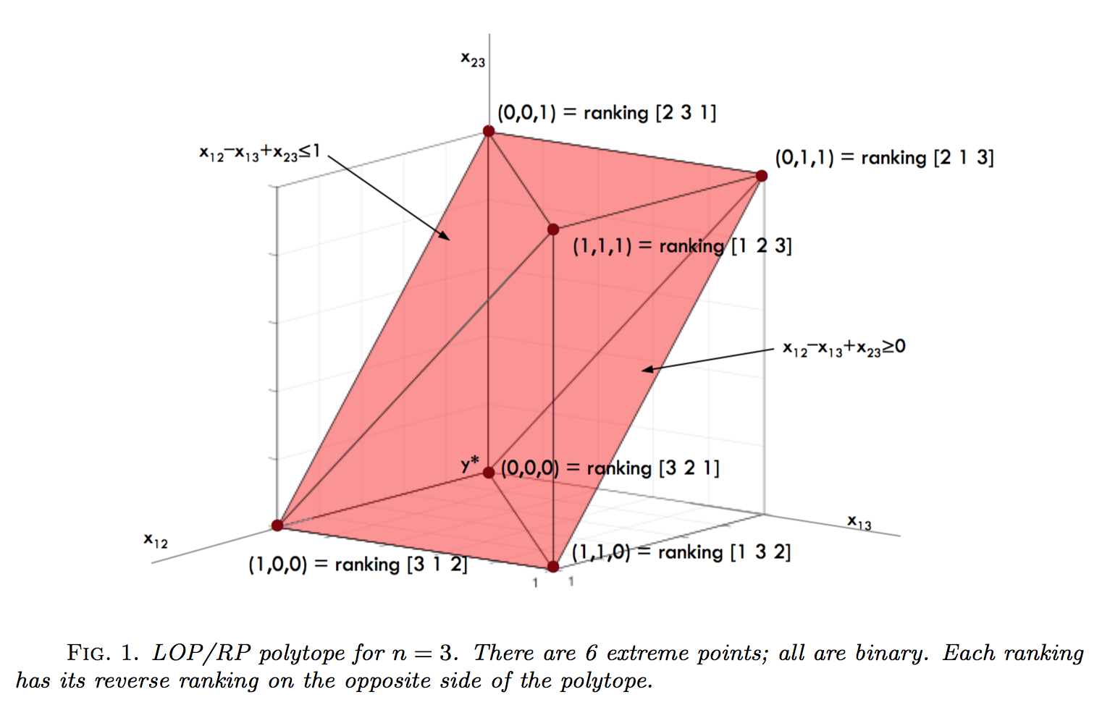
n=3 Polytope

Slide 4
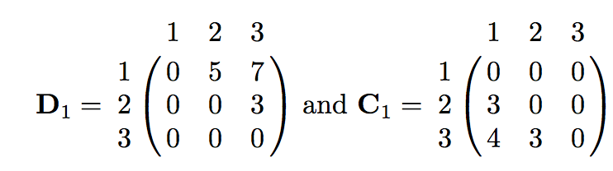

n=3 weighted example D1
•
10 contour planes (each with 1-unit increments in k) can fit between k* and k_{worst}

Slide 5
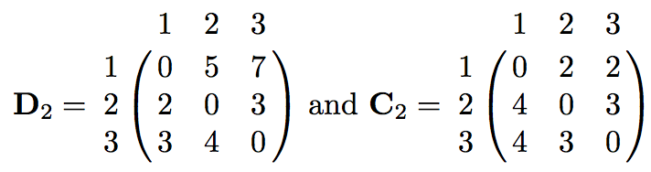


n=3 weighted example D2
•
•
4 contour planes can fit between k* and k_{worst}

Slide 6
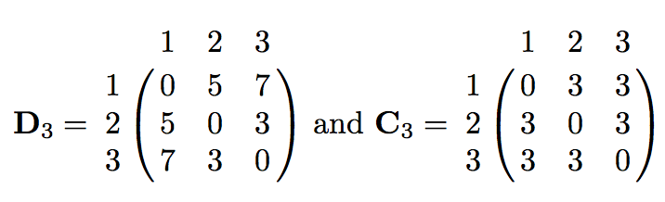


n=3 weighted example D3
•
•
D symmetric → C symmetric → c vector = 0
•
•
•
•
•
0 contour planes fit between k* and k_{worst}

Slide 7
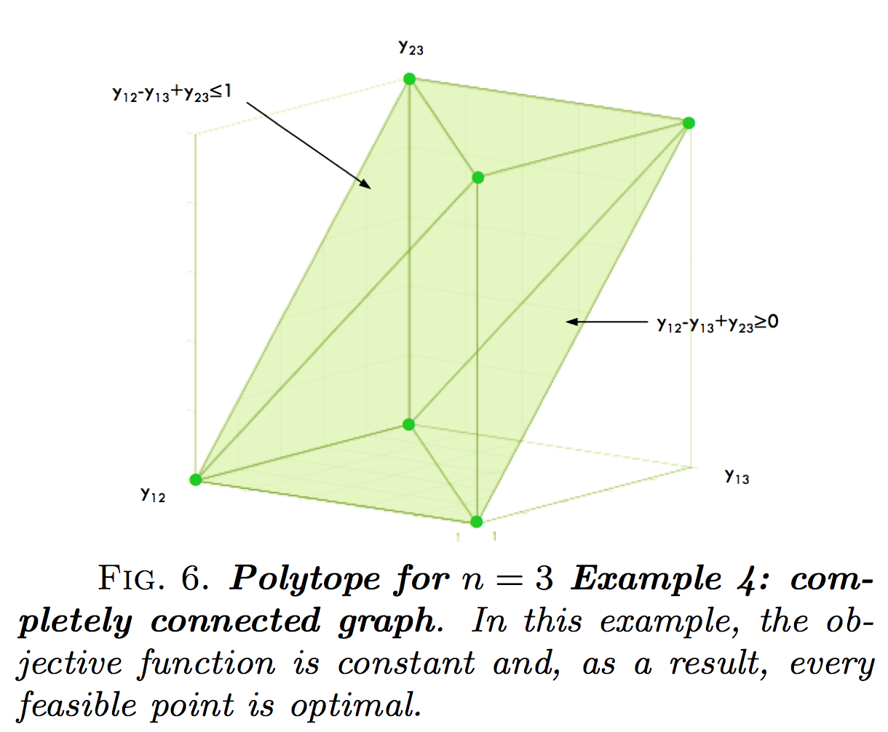
n=3 Polytope

Slide 8
Heuristic for x₀
c = c/δ; Divide c vector by largest in magnitude entry δ.
c = binaryround(c); Round entries>.5 to 1, else to 0.
Create x ranking vector that is closest to this rounded c.

Slide 9
IP Polytope vs. LP Polytope
For n ≤ 5, IP polytope = LP polytope
Stats for IP polytope (Marti & Reinelt, 2011)
n | # vertices = n! | # facets
3 | 6 | 8
4 | 24 | 20
5 | 120 | 40
6 | 720 | 910
7 | 5,040 | 87,472
8 | 40,320 | ≥ 488,602,996

Slide 10
Theorems
Every rankability problem (unweighted or weighted) is feasible.
The rankability IP polytope has n! binary e.p.s and each is a ranking.
An initial e.p. feasible solution is easy to find. Take any ranking.
An initial interior point feasible solution is easy to find. Take the centroid of the IP polytope Xbar = .5(E-I).
The LP polytope contains the IP polytope.
If the LP concludes with an integer k*, then this k* is also optimal for the IP.
The optimal face of the IP polytope has |P| binary e.p. and each is a ranking.
If the LP concludes with an integer k* and fractional X*, then this pair is also optimal for the IP.

Slide 11
More Theorems
The k-histogram of rankings for the IP polytope is symmetric about a mean.
Area under k-histogram is n!.
For a given D, the objective values of a ranking r and its reverse ranking r sum to the same constant value C_{sum} for all rankings.
A good initial feasible ranking can be constructed from the ‘colperm’ symmetric reordering method.

Slide 12
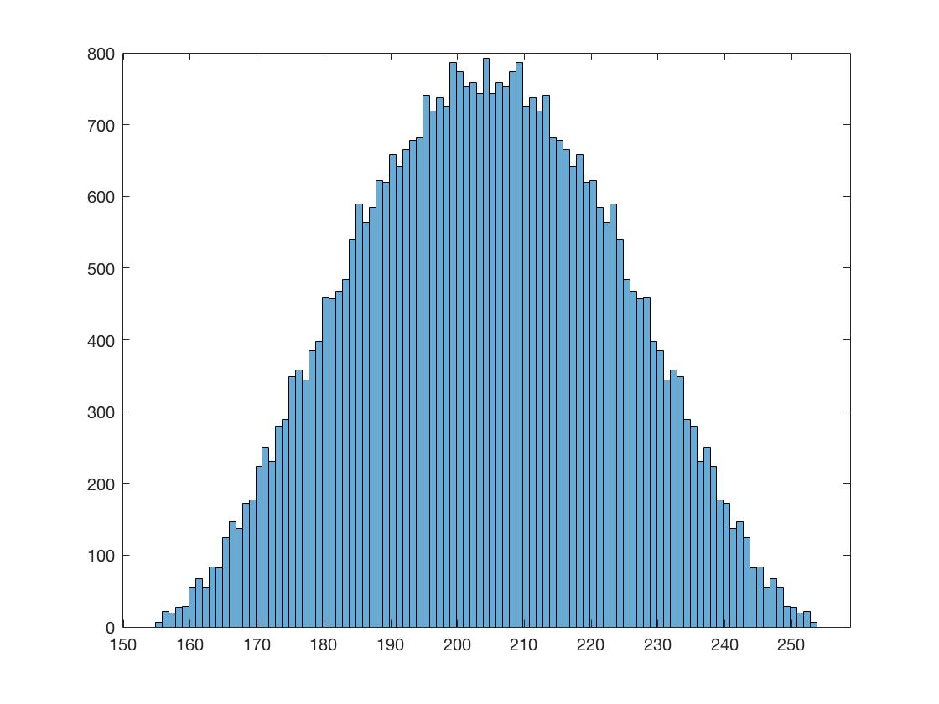
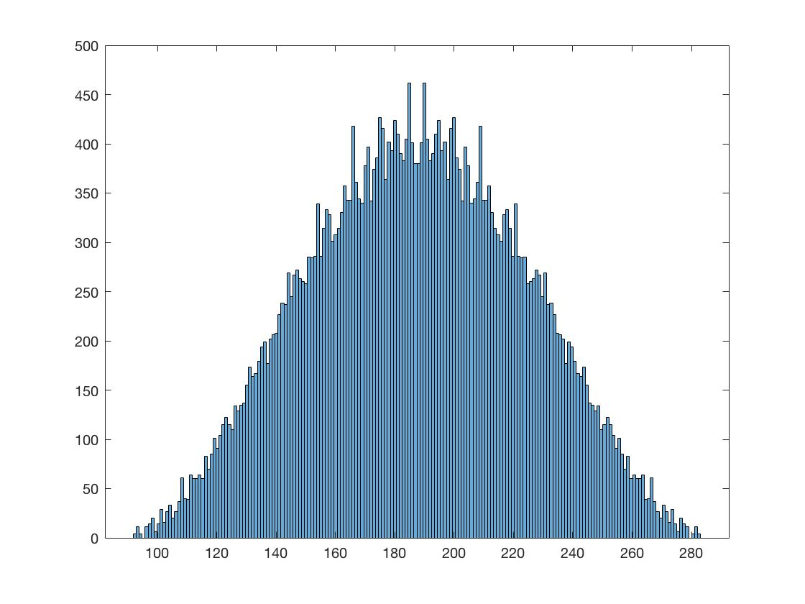
k-histograms
The k-histogram of rankings for the IP polytope is symmetric about a mean.
less rankable 2008 season, k=155, p=6
more rankable 2005 season, k=92, p=4

Slide 13
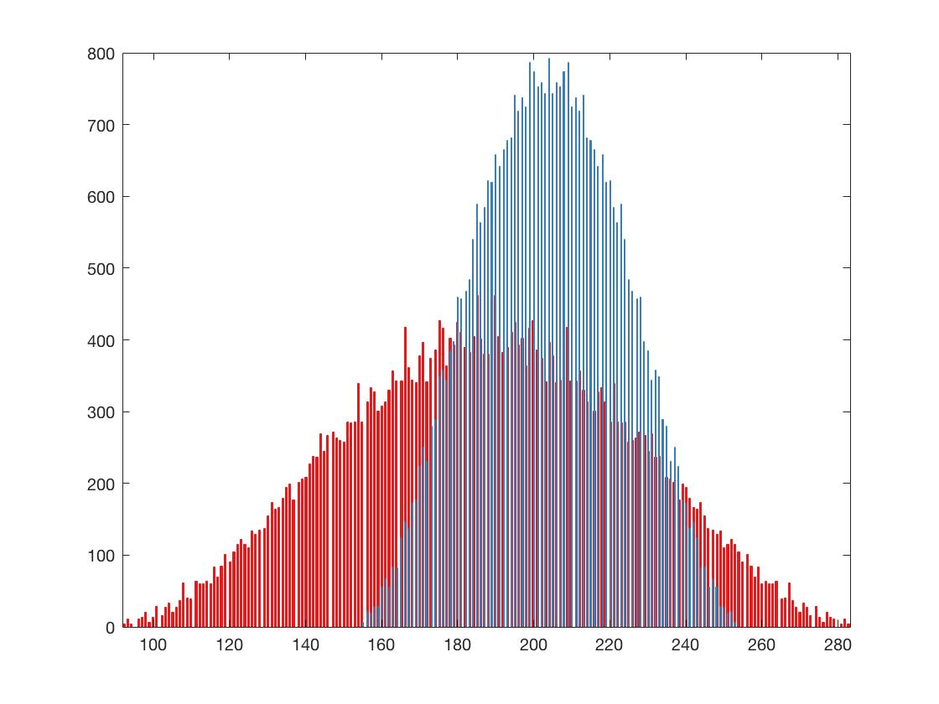
k-histograms
The k-histogram of rankings for the IP polytope is symmetric about a mean.
less rankable 2008 season, k=155, p=6
more rankable 2005 season, k=92, p=4

Slide 14
k-histograms
The k-histogram of rankings for the IP polytope is symmetric about a mean.
less rankable 2008 season, p=6, k*=155, k_{worst}=253, k_{sum}=408
more rankable 2005 season, p=4, k=92, k_{worst}=283, k_{sum}=375
p*
k*

Slide 15
k-histograms
We don’t need the whole k-histogram, just the two ends.
Get k*, r* by solving LP.
Get p* by Alg. 4.1.
Get k_{worst} by evaluating the objective function for the reverse ranking r. k_{worst} = sum of upper triangle of C(r, r).
r_{k} = (k_{worst} – k*)/((k_{worst} + k*)
p*
k*
k_{worst}

Slide 16
k-histograms
The k-histogram of rankings for the IP polytope is symmetric about a mean.
less rankable 2008 season, k=155, p=6, r_{k} = .24
more rankable 2005 season, k=92, p=4, r_{k} = .51
p*
k*

Slide 17
k-histograms
THOMAS: can you produce more figures like this for many more conferences and seasons? Or chess? Or US News colleges?
Trying to find the narrowest histogram from real data to make Tim’s point that any ranking is nearly as bad as any other ranking for that particular dataset.
less rankable 2008 season, k=155, p=6, r_{k} = .24
more rankable 2005 season, k=92, p=4, r_{k} = .51
p*
k*

Slide 18
k-histograms
We don’t need the whole k-histogram, just the two ends.
Get k*, r* by solving LP.
Get p* by Alg. 4.1.
Get k_{worst} by evaluating the objective function for the reverse ranking r. k_{worst} = sum of upper triangle of C(r, r).
r_{k} = (k_{worst} – k*)/((k_{worst} + k*)
p*
k*
k_{worst}

Slide 19
k-histograms
We don’t need the whole k-histogram, just the rough shape from the two ends and the middle.
Get k*, r* by solving LP.
Get p* by Alg. 4.1.
Get k_{worst} by evaluating the objective function for the reverse ranking r. k_{worst} = sum of upper triangle of C(r, r).
k_{med}=floor[(k*+k_{worst})/2]
Get p_{med} by solving another LP, max ½-sized polytope due to added constraint: C.*X ≤ k_{med}. Then run Alg. 4.1.
p_{med}
p*
k*
k_{med}
k_{worst}

