Slide 1
Hillside 1 Rankability: finding P
7/30/2019

Slide 2
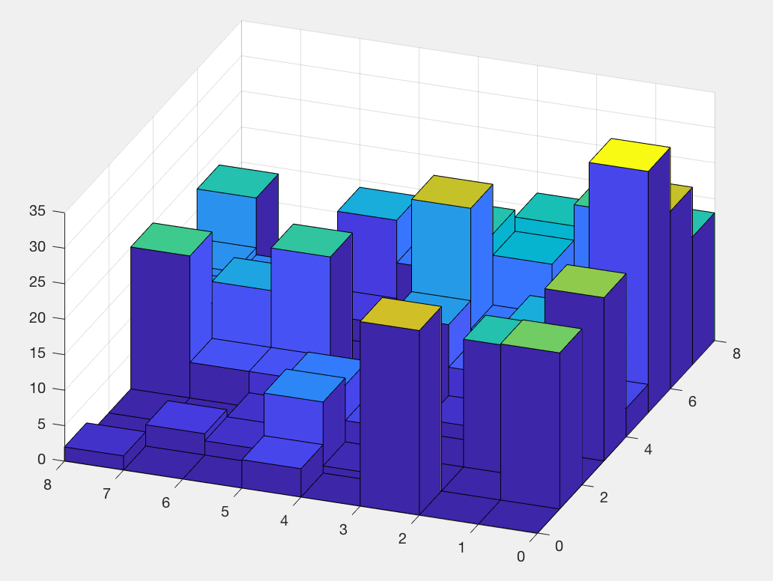
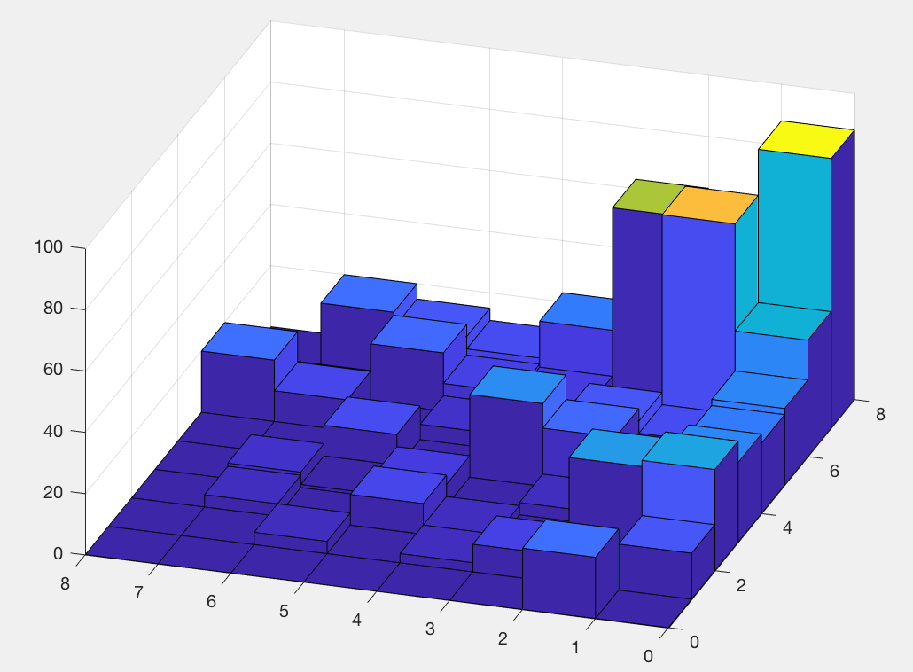
SIMODS 2 Paper Example
Patriot League Basketball D1 weighted matrices with season + tournament
unrankable 2008
k=155
p=6
rankable 2005
k=92
p=4

Slide 3
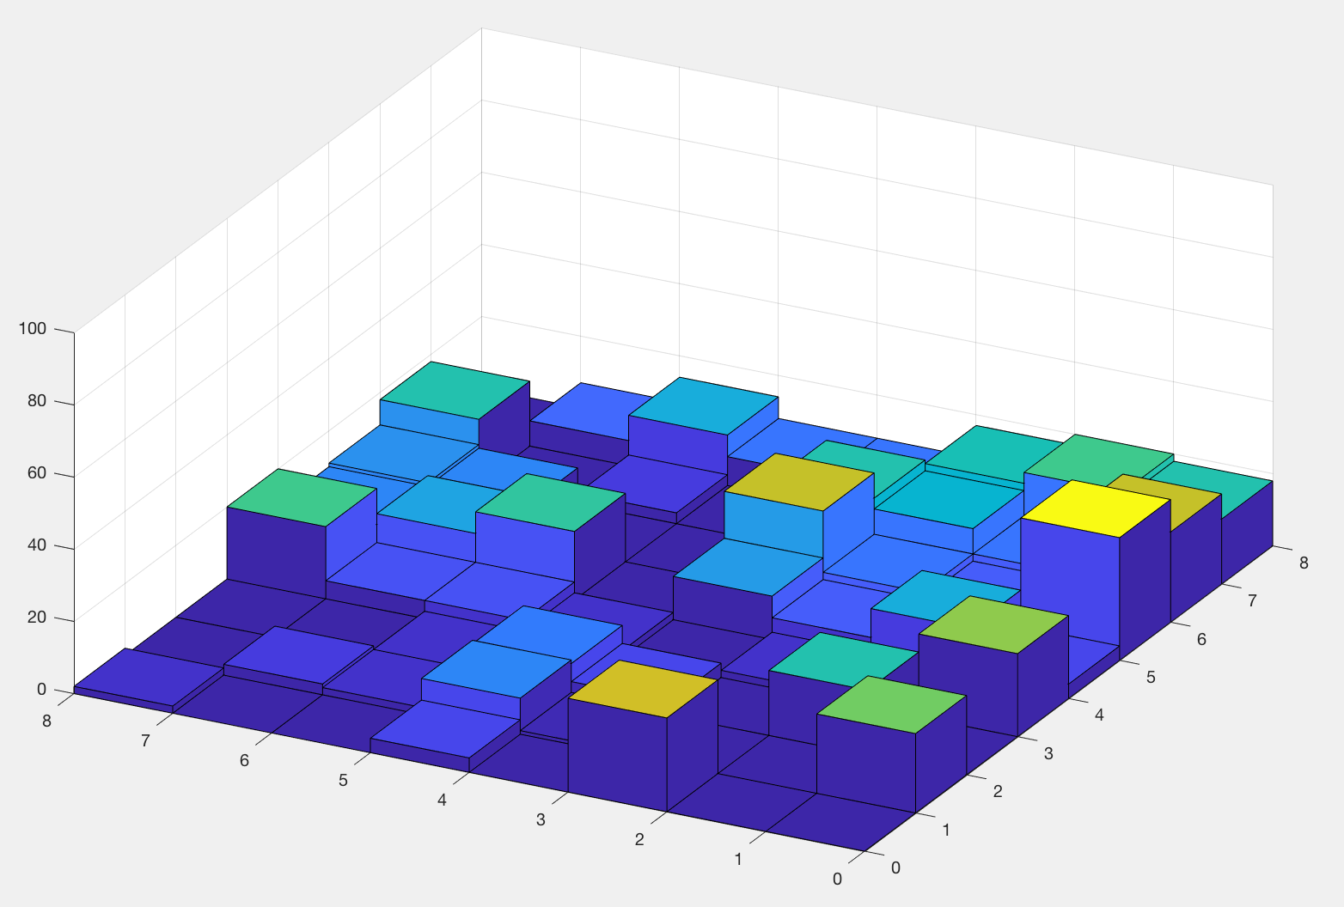
SIMODS 2 Paper Example
Patriot League Basketball D1 weighted matrices with season + tournament
unrankable 2008
k=155
p=6
rankable 2005
k=92
p=4

Slide 4
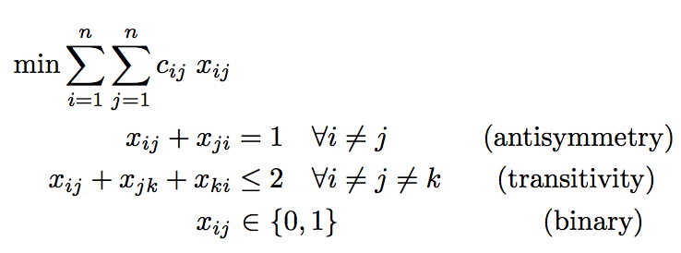
Hillside 1 (Hillside Count)
Minimize the number of violations from hillside form

Slide 5
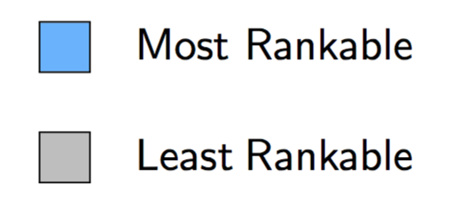
2000-2012 Big East Weighted Data
Rankability
SIMODS k, p Hillside 1
k, p
2000 | 4,1 | 36, 1
2001 | 2,1 | 47, 1
2002 | 2,1 | 36, 1
2003 | 4,1 | 66, 1
2004 | 6,1 | 61, 3
2005 | 4,1 | 60, 1
2006 | 8,4 | 59, 1
2007 | 12,7 | 92, 2
2008 | 6,3 | 67, 4
2009 | 4,1 | 55, 1
2010 | 8,3 | 92, 2
2011 | 8,3 | 91, 1
2012 | 8,1 | 82, 1
This week: added p values by new method

Slide 6
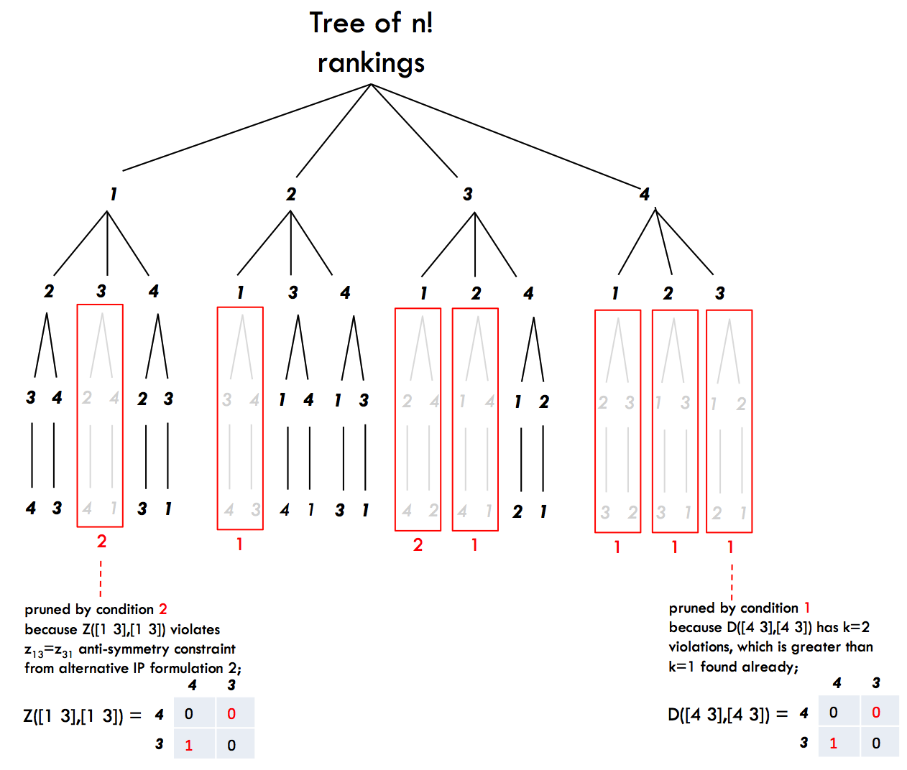
Old Method: Pruning for Hillside 1
eliminative
Prune branches whose subranking s has sub objective value (sum of upper triangular elements in C(s,s)) worse than optimal objective k.

Slide 7
New Method: LP Relaxation by Int.Pt. Method
accumulative
When the optimal face is bigger than one point, an interior point method terminates at an optimal solution near the centroid of the optimal face and thus is a convex combination of all optimal extreme points (which are rankings) on the optimal face.
The interior point method’s X matrix is a convex combination of the matrices of all optimal rankings and, thus, is a summary of all optimal rankings.
Q: Can we work backwards from this summary to build P?

Slide 8
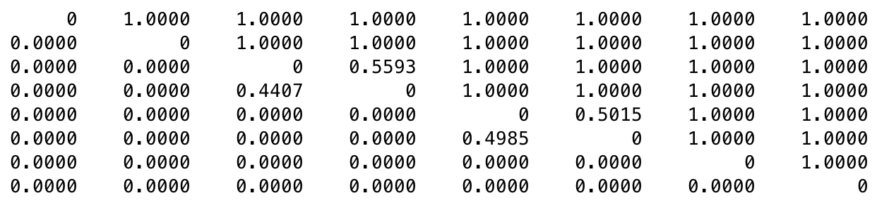
1999 Big East Weighted Data
Hillside 1 scores: k=66, p=4
X(r,r) solution matrix from LP relaxation by Interior Point Method
7 2 1 8 5 3 6 4
7
2
1
8
5
3
6
4
X(r,r) =
Fractional entries occur in two isolated sets: {1, 8} and {5, 3}.
7
2
1
8
5
3
6
4
7
2
8
1
5
3
6
4
7
2
1
8
3
5
6
4
7
2
8
1
3
5
6
4
P =
Fractional entries indicate options for alternative rankings. In this case, all (2!)(2!)=4 options are optimal.

Slide 9
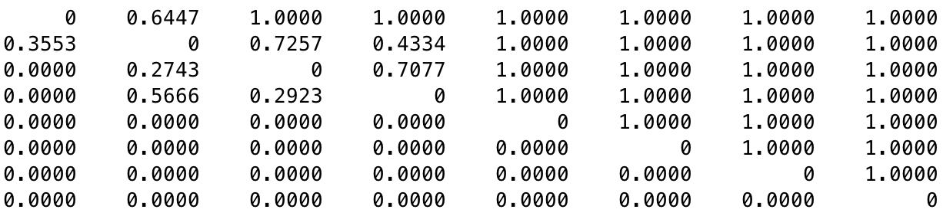
1998 Big East Weighted Data
Hillside 1 scores: k=57, p=4
5 2 8 7 1 6 4 3
5
2
8
7
1
6
4
3
X(r,r) =
Fractional entries occur in two overlapping sets: {5, 2} and {2, 8, 7}.
We create a pruning tree to determine which alternative rankings are optimal.

Slide 10
1998 Big East Weighted Data
Hillside 1 scores: k=57, p=4
5 2 8 7 1 6 4 3
5
2
8
7
1
6
4
3
X(r,r) =
Fractional entries occur in two overlapping sets: {5, 2} and {2, 8, 7}.
There are no options for these since there are no fractional entries in the last four positions. The rank positions of items 1, 6, 4, 3 are fixed in this order at the bottom of the ranking of all alternative optimal solutions.

Slide 11
1998 Big East Weighted Data
Fractional entries occur in two overlapping sets: {5, 2} and {2, 8, 7}.
1 2 3 4 5 6 7 8
5
7
7 8
2 7 8
7 8 2 8 2 7
8 7 8 2 7 2
✓
x
✓
x
x
✓
x
✓
1
6
4
3
1
6
4
3

Slide 12
1998 Big East Weighted Data
Fractional entries occur in two overlapping sets: {5, 2} and {2, 8, 7}.
1 2 3 4 5 6 7 8
5
7
7 8
2 7 8
✓
x
x
✓
✓
x
x
✓
7 8 2 8 2 7
8 7 8 2 7 2
1
6
4
3
1
6
4
3

Slide 13
1998 Big East Weighted Data
Hillside 1 scores: k=57, p=4
5 2 8 7 1 6 4 3
5
2
8
7
1
6
4
3
X(r,r) =
Fractional entries occur in two overlapping sets: {5, 2} and {8, 7, 1}.
5
2
8
7
1
6
4
3
2
5
8
7
1
6
4
3
5
7
2
8
1
6
4
3
5
8
7
2
1
6
4
3
P =

Slide 14
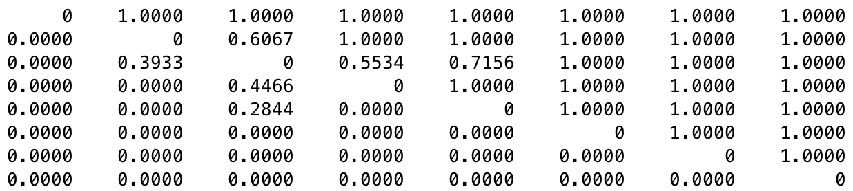
2005 Patriot bb weighted rankable
Hillside 1 scores: k=92, p=4
5 3 1 7 4 8 6 2
5
3
1
7
4
8
6
2
X(r,r) =
5
3 1
7 3
7 1 4 7
4 4 1 4
Accumulative Tree has 4 rankings and all 4 are optimal.
8
6
2

Slide 15
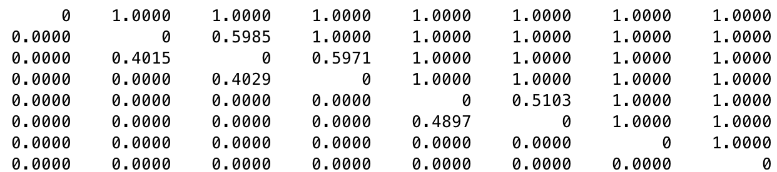
2008 Patriot bb weighted unrankable
Hillside 1 scores: k=155, p=6
1 4 8 6 3 2 7 5
1
4
8
6
3
2
7
5
X(r,r) =
1
4 8
8 6 4
8 6
Accumulative Tree has 6 rankings and all 6 are optimal.
3 2 3 2 3 2
2 3 2 3 2 3
7
5

Slide 16
Lowerbound on p
LEMMA: Let X* be the solution of an LP relaxed (unweighted or weighted) rankability problem solved by an Interior Point method. If X* is the exact centroid of all optimal rankings, then
where m is the smallest fractional element in X*.
p ≥ ceil(1/m),
Interior Point solvers terminate near (or at) the centroid on the optimal face, so this lowerbound on p is good. This bound is not tight—see, for example, example on Slide 8.

Slide 17
2005 Patriot bb weighted rankable
Hillside 1 scores: k=92, p=4
5 3 1 7 4 8 6 2
5
3
1
7
4
8
6
2
X(r,r) =
5
3 1
7 3
7 1 4 7
4 4 1 4
Accumulative Tree has 4 rankings and all 4 are optimal.
p ≥ ceil(1/m)=4
8
6
2

Slide 18
2008 Patriot bb weighted unrankable
Hillside 1 scores: k=155, p=6
1 4 8 6 3 2 7 5
1
4
8
6
3
2
7
5
X(r,r) =
1
4 8
8 6 4
8 6
Accumulative Tree has 6 rankings and all 6 are optimal.
p ≥ ceil(1/m)=3
3 2 3 2 3 2
2 3 2 3 2 3
7
5

Slide 19
Conjecture
When they exist, fractional entries in the solution matrix X must occur in diagonal blocks of X(r,r). These blocks may be overlapping.
For b nonoverlapping blocks of size n₁, n₂, …, n_{b}, there are n₁! n₂! n_{b}! alternative rankings that must be considered.
For overlapping blocks, there may be fewer rankings that must be considered in the pruning tree.

Slide 20
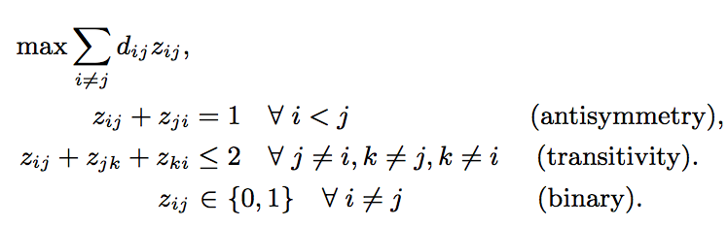
Finding ALLOPT for unweighted SIMODS1
Alternative Formulation 1 from SIMODS1 paper:
same LOP polytope as Hillside 1, just different objective function

Slide 21
Finding ALLOPT for unweighted SIMODS1
Alternative Formulation 1 from SIMODS1 paper:
e.p. of optimal face are optimal rankings. Centroid is summary of all optimal rankings. So solve LP relaxation by Interior Point method.

Slide 22
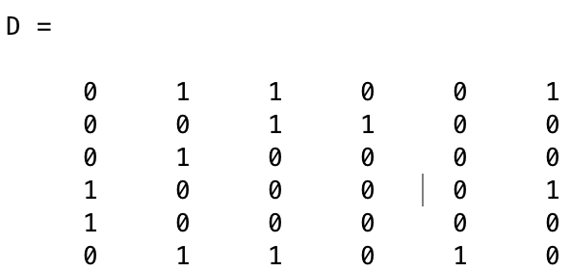
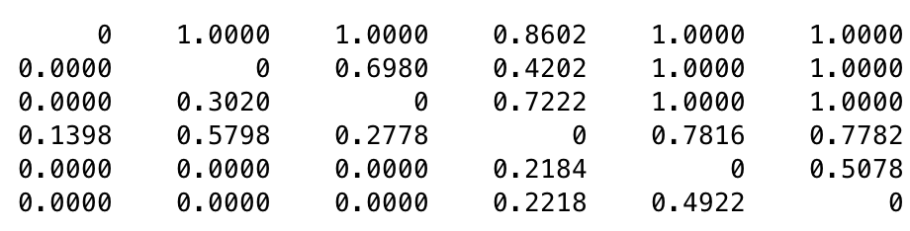
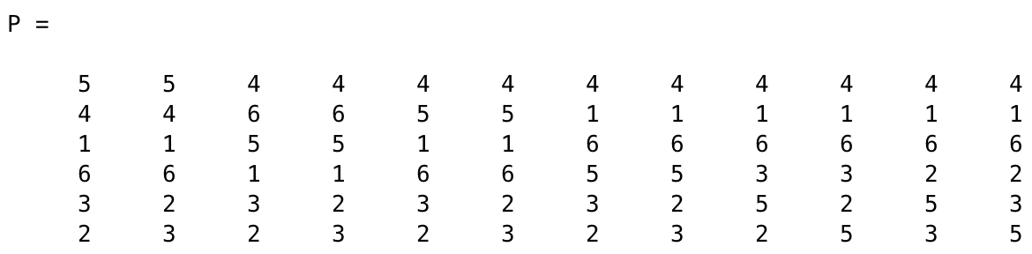
Finding ALLOPT for unweighted SIMODS1
k=9, p=12.
4 1 6 5 3 2
4
1
6
5
3
2
Z =

Slide 23
Finding ALLOPT for unweighted SIMODS1
4 1 6 5 3 2
4
1
6
5
3
2
Z =
There are 6!=720 rankings in full eliminative n! tree.
There are 2⁷=128 ways to round fractional entries to binary.
vs.
There are 20 rankings to evaluate in the accumulative tree.
And 12 of these are optimal.

Slide 24
Finding ALLOPT for unweighted SIMODS1
4 1 6 5 3 2
4
1
6
5
3
2
Z =
1 2 3 4 5 6
6
1
3 2
1/6/5
3/2
4
1/6
3/2
5/2
5/3

Slide 25

Finding ALLOPT for unweighted SIMODS1
4 1 6 5 3 2
4
1
6
5
3
2
Z =
1 2 3 4 5 6
1
6
5/3/2
5
1/6
2/3
6
1/5
2/3
4
1/6
3/2

Slide 26
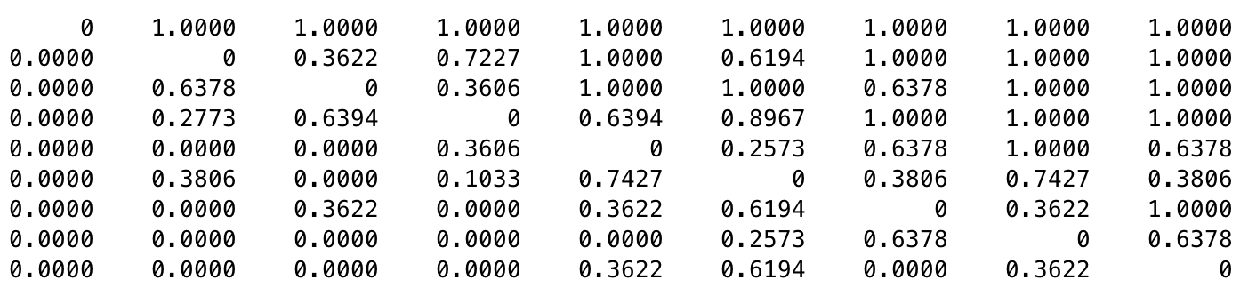
Interesting ALLOPT Example
1999 ACC football? D1 unweighted with k=12 and small p=4, yet P set is very diverse
3 1 4 8 2 6 9 5 7
3
1
4
8
2
6
9
5
7
Z =
not an optimal ranking, not in P
There are 9!=362,880 rankings in full eliminative n! tree.
There are 2¹⁵=32,768 ways to round fractional entries to binary.
vs.
There are ?? rankings to evaluate in the accumulative tree.
And 4 of these are optimal.
BUT, (Paul) how to make the accumulative tree?

Slide 27
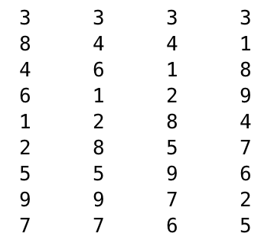
Interesting ALLOPT Example
1999 ACC football? D1 unweighted with k=12 and small p=4, yet P set is very diverse
3 1 4 8 2 6 9 5 7
3
1
4
8
2
6
9
5
7
Z =
NOTE: high # of frac entries in Z indicates low rankability (either big p and/or diverse P)
very diverse P =

Slide 28
Interesting ALLOPT Example
1999 ACC football? D1 unweighted with k=12 and small p=4, yet P set is very diverse
3 1 4 8 2 6 9 5 7
3
1
4
8
2
6
9
5
7
Z =
NOTE: This example makes the case that original SIMODS definition of rankability should include k, p, and diversity of P.
NOTE: high # of frac entries in Z indicates low rankability (either big p and/or diverse P)
very diverse P =

Slide 29
ALLOPT LOP
Does accumulative tree built from LP relaxed solution by Interior Point method find ALLOPT for any LOP?
When does it fail? What if k* is non-integer?
But Gurobi PoolSearch does a good job finding MOST and sometimes ALLOPT solutions, so why do we need the accumulative procedure?
What are n=50 LOP applications for which knowing ALLOPT is really important? Input-output tables? Job scheduling? Web search?
Can rankability be used to define the difficulty of an LOP problem instance? Reinelt book claims instance can only be difficult w.r.t. a particular algorithm.
Is ALLOPT for LOP faster than sequential Multi-objective Optimization? ALLOPT enables evaluation of secondary and tertiary goals.

