Slide 1
Hillside 1 Rankability
7/2/2019

Slide 2
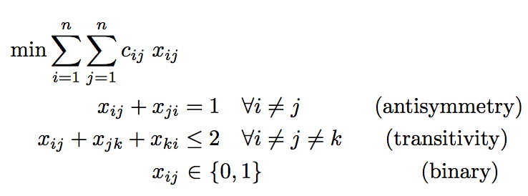
Hillside 1 (Hillside Count)
Minimize the number of violations from hillside form

Slide 3
2000-2012 Big East Unweighted Data

Slide 4
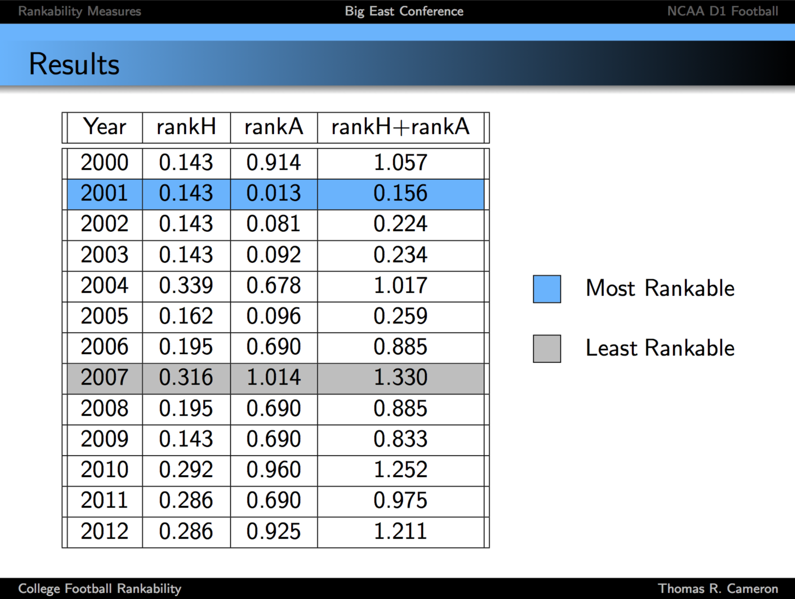
2000-2012 Big East Data

Slide 5
2000-2012 Big East Unweighted Data
Rankability
SIMODS k, p Hillside 1
2000 | 4,1 | 28
2001 | 2,1 | 10
2002 | 2,1 | 10
2003 | 4,1 | 22
2004 | 6,1 | 40
2005 | 4,1 | 25
2006 | 8,4 | 36
2007 | 12,7 | 72
2008 | 6,3 | 32
2009 | 4,1 | 28
2010 | 8,3 | 60
2011 | 8,3 | 52
2012 | 8,1 | 52

Slide 6
2000-2012 Big East Weighted Data
Rankability
SIMODS k, p Hillside 1 Hillside 1
unweighted weighted
2000 | 4,1 | 28 | 36
2001 | 2,1 | 10 | 47
2002 | 2,1 | 10 | 36
2003 | 4,1 | 22 | 66
2004 | 6,1 | 40 | 61
2005 | 4,1 | 25 | 60
2006 | 8,4 | 36 | 59
2007 | 12,7 | 72 | 92
2008 | 6,3 | 32 | 67
2009 | 4,1 | 28 | 55
2010 | 8,3 | 60 | 92
2011 | 8,3 | 52 | 91
2012 | 8,1 | 52 | 82

Slide 7

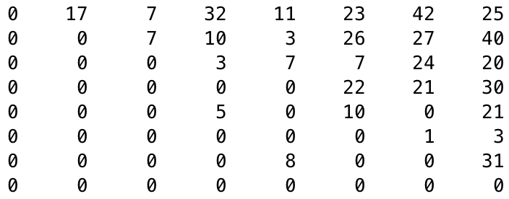
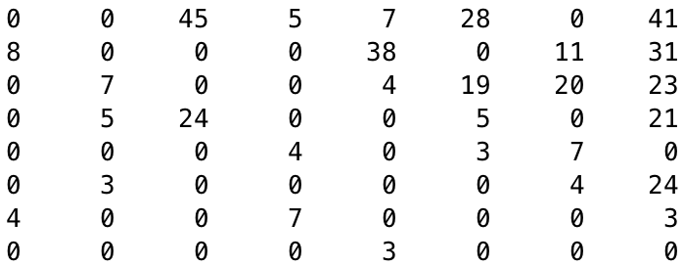
2002 vs. 2007 Big East Weighted Data
Rankability
SIMODS k, p Hillside 1 Hillside 1
unweighted weighted
rankable 2002 D(r,r)
2000 | 4,1 | 28 | 36
2001 | 2,1 | 10 | 47
2002 | 2,1 | 10 | 36
2003 | 4,1 | 22 | 66
2004 | 6,1 | 40 | 61
2005 | 4,1 | 25 | 60
2006 | 8,4 | 36 | 59
2007 | 12,7 | 72 | 92
2008 | 6,3 | 32 | 67
2009 | 4,1 | 28 | 55
2010 | 8,3 | 60 | 92
2011 | 8,3 | 52 | 91
2012 | 8,1 | 52 | 82
2 mild upsets (5th place beat 4th place, 7th place beat 5th place).
Upsets account for 11 and weak wins are 25 of 36 violations.
unrankable 2007 D(r,r)
9 upsets, some strong: 7th place beat 1st, 6th beat 2nd .
Upsets account for 63 and weak wins are 29 of 92 violations.

Slide 8
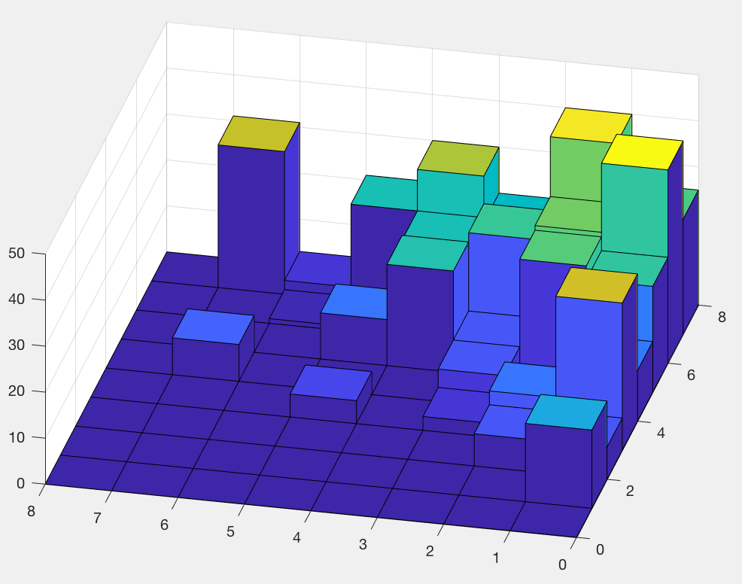
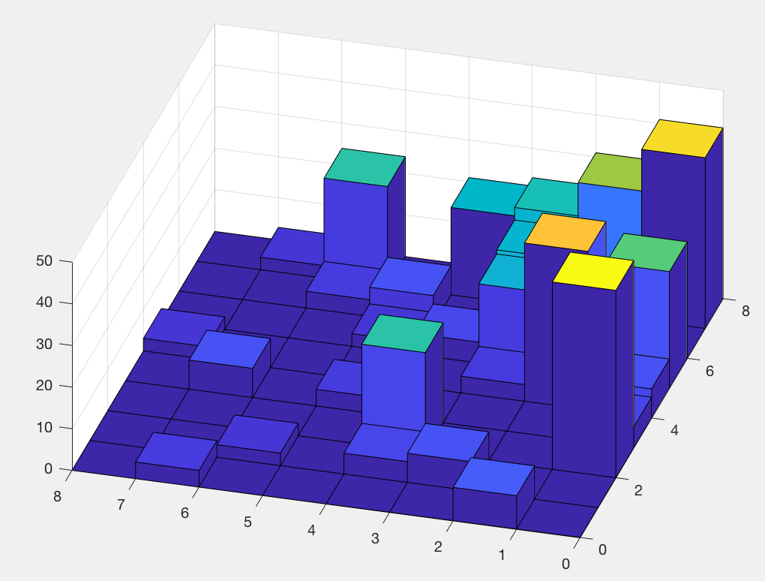
2002 vs. 2007 Big East Weighted Data
Rankability
SIMODS k, p Hillside 1 Hillside 1
unweighted weighted
rankable 2002 D(r,r)
2000 | 4,1 | 28 | 36
2001 | 2,1 | 10 | 47
2002 | 2,1 | 10 | 36
2003 | 4,1 | 22 | 66
2004 | 6,1 | 40 | 61
2005 | 4,1 | 25 | 60
2006 | 8,4 | 36 | 59
2007 | 12,7 | 72 | 92
2008 | 6,3 | 32 | 67
2009 | 4,1 | 28 | 55
2010 | 8,3 | 60 | 92
2011 | 8,3 | 52 | 91
2012 | 8,1 | 52 | 82
unrankable 2007 D(r,r)

Slide 9
Hillside on weighted vs. unweighted
rankable
2002 weighted: opt. ranking is [2 8 3 1 7 6 5 4] whereas
2002 unweighted: opt. ranking [2 8 3 1 7 5 6 4].
unrankable
2007 weighted: opt. ranking is [8 6 2 1 3 5 4 7] whereas
2007 unweighted: opt. ranking [8 2 1 6 3 4 5 7].

Slide 10
Hillside P set on weighted vs. unweighted
rankable
2002 weighted: P set is
2002 unweighted: P set is
unrankable
2007 weighted: P set is
2007 unweighted: P set is

Slide 11
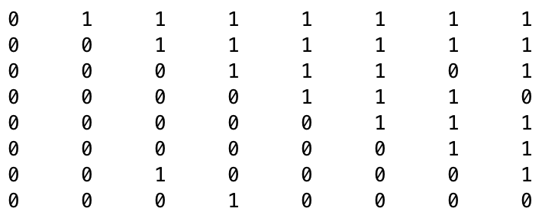
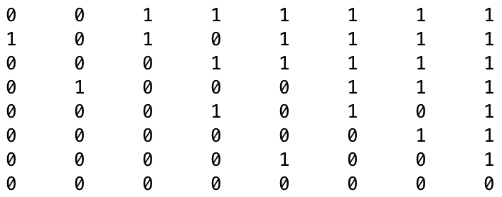
2000 vs. 2003 Big East Unweighted Data
Rankability
SIMODS k, p Hillside 1 RankH RankA
2000 D(r,r)
2000 | 4,1 | 28 | .143 | .914
2001 | 2,1 | 10
2002 | 2,1 | 10
2003 | 4,1 | 22 | .143 | .092
2004 | 6,1 | 40
2005 | 4,1 | 25
2006 | 8,4 | 36
2007 | 12,7 | 72
2008 | 6,3 | 32
2009 | 4,1 | 28
2010 | 8,3 | 60
2011 | 8,3 | 52
2012 | 8,1 | 52
2 big upsets are weighted more than . . .
2003 D(r,r)
. . . 4 mild upsets.

Slide 12
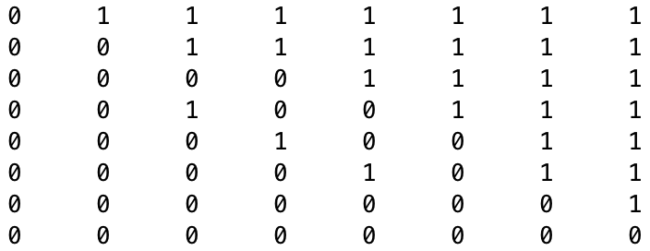
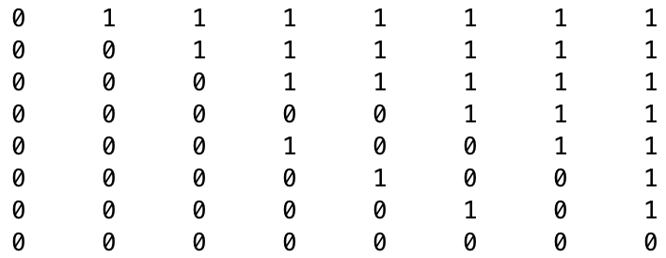
2001 vs. 2002 Big East Unweighted Data
Rankability
SIMODS k, p Hillside 1 RankH RankA
2001 D(r,r)
2000 | 4,1 | 28 | .143 | .914
2001 | 2,1 | 10 | .143 | .013
2002 | 2,1 | 10 | .143 | .081
2003 | 4,1 | 22 | .143 | .092
2004 | 6,1 | 40
2005 | 4,1 | 25
2006 | 8,4 | 36
2007 | 12,7 | 72
2008 | 6,3 | 32
2009 | 4,1 | 28
2010 | 8,3 | 60
2011 | 8,3 | 52
2012 | 8,1 | 52
3 of the mildest upsets between mid-level teams
2002 D(r,r)
3 of the mildest upsets between mid- to low-level teams

Slide 13
2001 vs. 2002 Big East Unweighted Data
Rankability
SIMODS k, p Hillside 1 RankH RankA
2001 D(r,r)
2000 | 4,1 | 28 | .143 | .914
2001 | 2,1 | 10 | .143 | .013
2002 | 2,1 | 10 | .143 | .081
2003 | 4,1 | 22 | .143 | .092
2004 | 6,1 | 40
2005 | 4,1 | 25
2006 | 8,4 | 36
2007 | 12,7 | 72
2008 | 6,3 | 32
2009 | 4,1 | 28
2010 | 8,3 | 60
2011 | 8,3 | 52
2012 | 8,1 | 52
3 of the mildest upsets between mid-level teams
So one could argue that 2002 should have slightly better rankability than 2001.
2002 D(r,r)
3 of the mildest upsets between mid- to low-level teams

Slide 14
Sales Pitch: Hillside 1 >> SIMODS Rankability
if not using P set, then faster algorithm
if not using P set, then we can handle problems with bigger n
weights the location of violations
elegant model with LOP history, can leverage LOP algorithms
works on both unweighted and weighted data
smaller P set, so reduces uncertainty in ranking
can still make suggestions on improving rankability using pseudo-P and upsets with large c_{ij}

Slide 15
Rankability Application Idea
Credit score rankings of individuals, banks, insurance companies

