Slide 1
Hillside 1 Rankability: finding P
7/16/2019

Slide 2
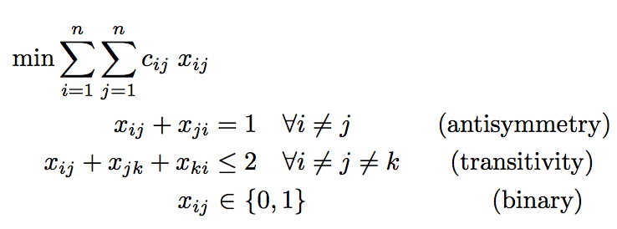
Hillside 1 (Hillside Count)
Minimize the number of violations from hillside form

Slide 3
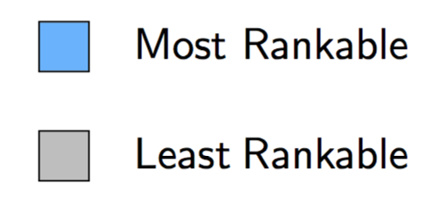
2000-2012 Big East Weighted Data
Rankability
SIMODS k, p Hillside 1
k, p
2000 | 4,1 | 36, 1
2001 | 2,1 | 47, 1
2002 | 2,1 | 36, 1
2003 | 4,1 | 66, 1
2004 | 6,1 | 61, 3
2005 | 4,1 | 60, 1
2006 | 8,4 | 59, 1
2007 | 12,7 | 92, 2
2008 | 6,3 | 67, 4
2009 | 4,1 | 55, 1
2010 | 8,3 | 92, 2
2011 | 8,3 | 91, 1
2012 | 8,1 | 82, 1
This week: added p values by new method

Slide 4
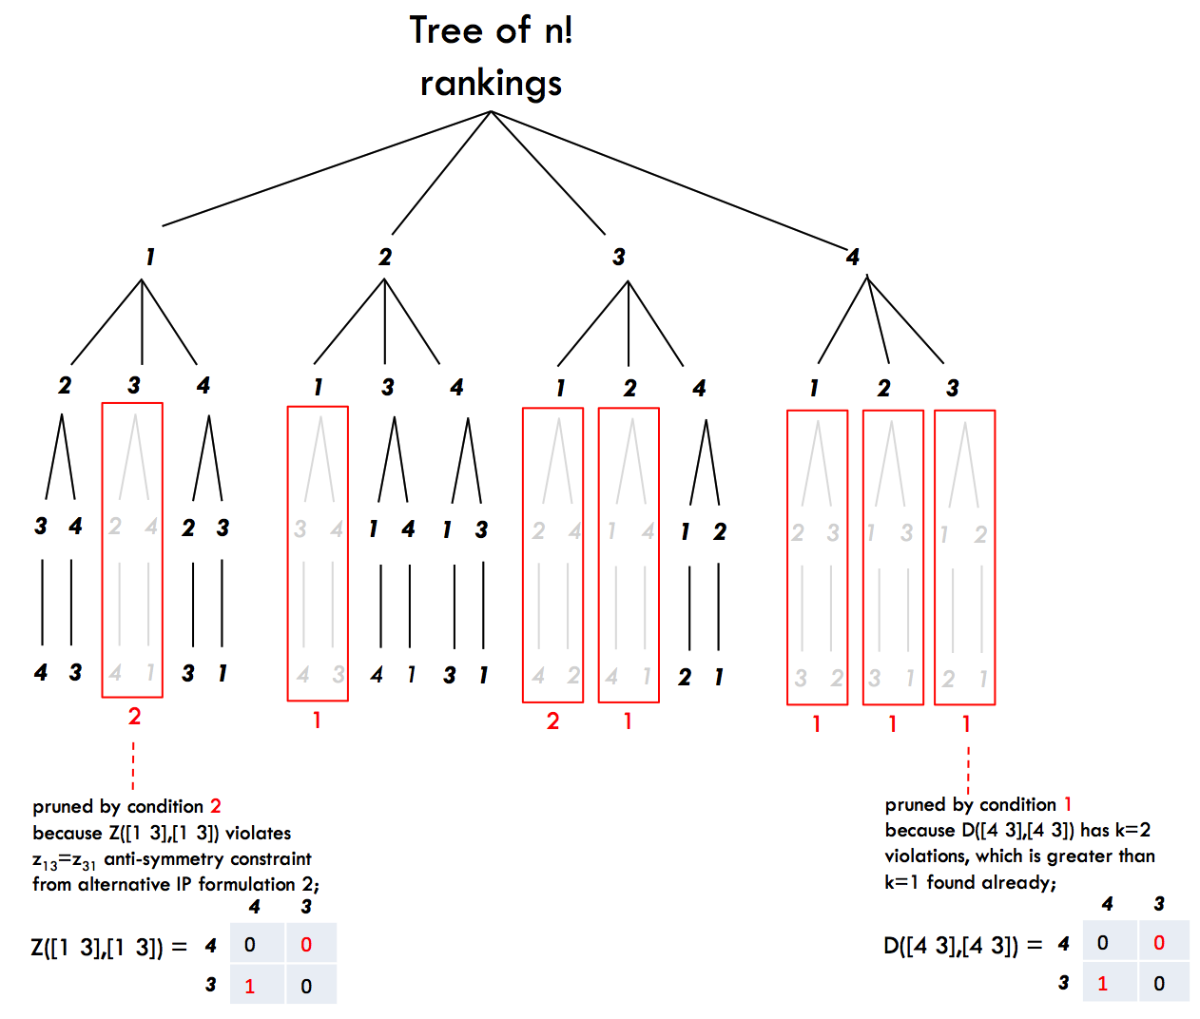
Old Method: Pruning for Hillside 1
eliminative
Prune branches whose subranking s has sub objective value (sum of upper triangular elements in C(s,s)) worse than optimal objective k.

Slide 5
New Method: LP Relaxation by Int.Pt. Method
accumulative
When the optimal face is bigger than one point, an interior point method terminates at an optimal solution near the centroid of the optimal face and thus is a convex combination of all optimal extreme points (which are rankings) on the optimal face.
The interior point method’s X matrix is a convex combination of the matrices of all optimal rankings and, thus, is a summary of all optimal rankings.
Q: Can we work backwards from this summary to build P?

Slide 6
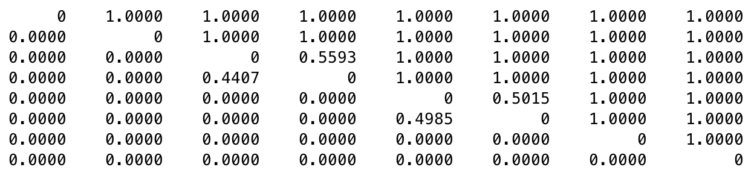
1999 Big East Weighted Data
Hillside 1 scores: k=66, p=4
X(r,r) solution matrix from LP relaxation by Interior Point Method
7 2 1 8 5 3 6 4
7
2
1
8
5
3
6
4
X(r,r) =
Fractional entries occur in two isolated sets: {1, 8} and {5, 3}.
7
2
1
8
5
3
6
4
7
2
8
1
5
3
6
4
7
2
1
8
3
5
6
4
7
2
8
1
3
5
6
4
P =
Fractional entries indicate options for alternative rankings. In this case, all (2!)(2!)=4 options are optimal.

Slide 7
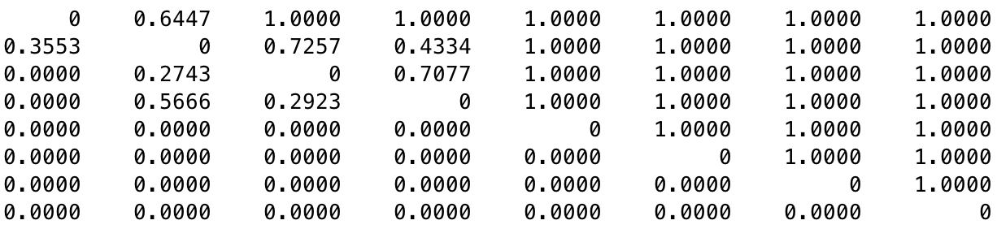
1998 Big East Weighted Data
Hillside 1 scores: k=57, p=4
5 2 8 7 1 6 4 3
5
2
8
7
1
6
4
3
X(r,r) =
Fractional entries occur in two overlapping sets: {5, 2} and {2, 8, 7}.
We create a pruning tree to determine which alternative rankings are optimal.

Slide 8
1998 Big East Weighted Data
Hillside 1 scores: k=57, p=4
5 2 8 7 1 6 4 3
5
2
8
7
1
6
4
3
X(r,r) =
Fractional entries occur in two overlapping sets: {5, 2} and {2, 8, 7}.
There are no options for these since there are no fractional entries in the last four positions. The rank positions of items 1, 6, 4, 3 are fixed in this order at the bottom of the ranking of all alternative optimal solutions.

Slide 9
1998 Big East Weighted Data
Fractional entries occur in two overlapping sets: {5, 2} and {2, 8, 7}.
1 2 3 4 5 6 7 8
5
7
7 8
2 7 8
7 8 2 8 2 7
8 7 8 2 7 2
✓
x
✓
x
x
✓
x
✓
1
6
4
3
1
6
4
3

Slide 10
1998 Big East Weighted Data
Hillside 1 scores: k=57, p=4
5 2 8 7 1 6 4 3
5
2
8
7
1
6
4
3
X(r,r) =
Fractional entries occur in two overlapping sets: {5, 2} and {8, 7, 1}.
5
2
8
7
1
6
4
3
2
5
8
7
1
6
4
3
5
7
2
8
1
6
4
3
5
8
7
2
1
6
4
3
P =

Slide 11
Conjecture
When they exist, fractional entries in the solution matrix X must occur in diagonal blocks of X(r,r). These blocks may be overlapping.
For b nonoverlapping blocks of size n₁, n₂, …, n_{b}, there are n₁! n₂! n_{b}! alternative rankings that must be considered.
For overlapping blocks, there may be fewer rankings that must be considered in the pruning tree.

Slide 12
Sales Pitch: Hillside 1 >> SIMODS Rankability
if not using P set, then faster algorithm
if not using P set, then we can handle problems with bigger n
weights the location of violations
elegant model with LOP history, can leverage LOP algorithms
works on both unweighted and weighted data
smaller P set, so reduces uncertainty in ranking
can still make suggestions on improving rankability using pseudo-P and upsets with large c_{ij}

Slide 13
Rankability Application Idea
Credit score rankings of individuals, banks, insurance companies

