Slide 1
Rankability Polytopes
9/9/2019

Slide 2
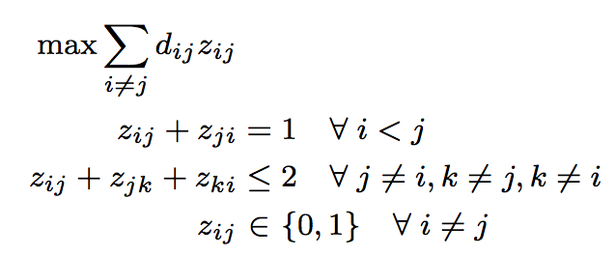
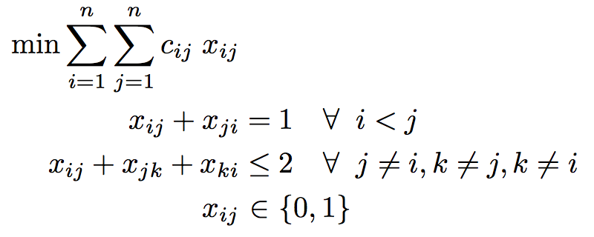
Unweighted and Weighted Problems
unweighted IP
weighted IP
same polytope, different objectives

Slide 3
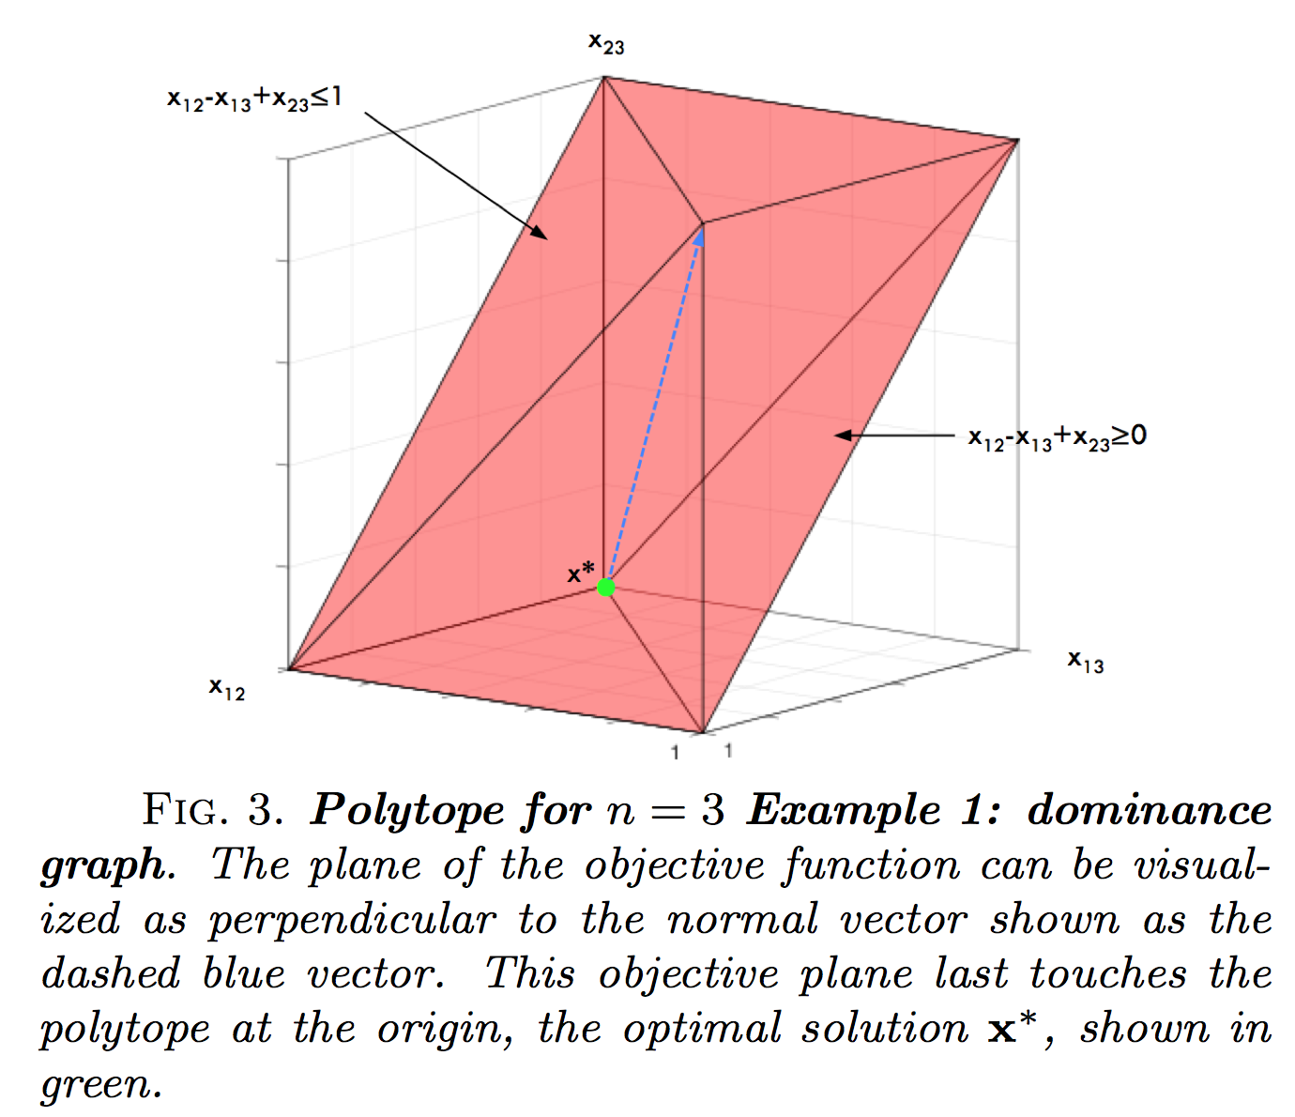
n=3 Polytope

Slide 4
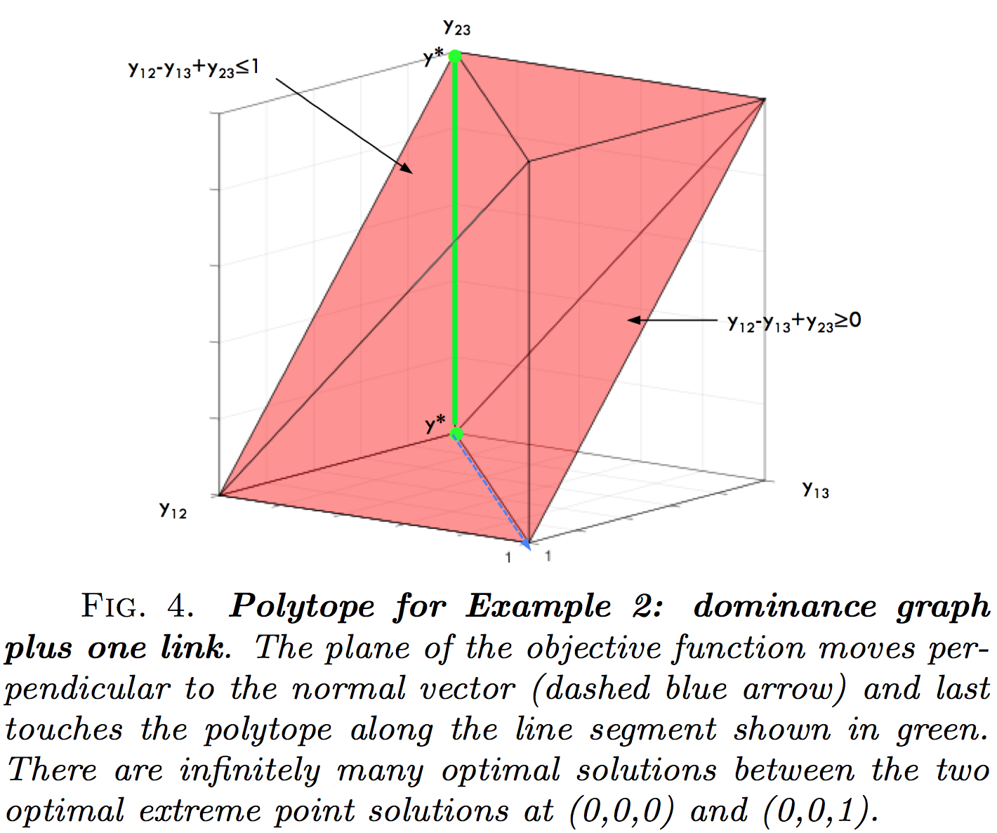
n=3 Polytope

Slide 5
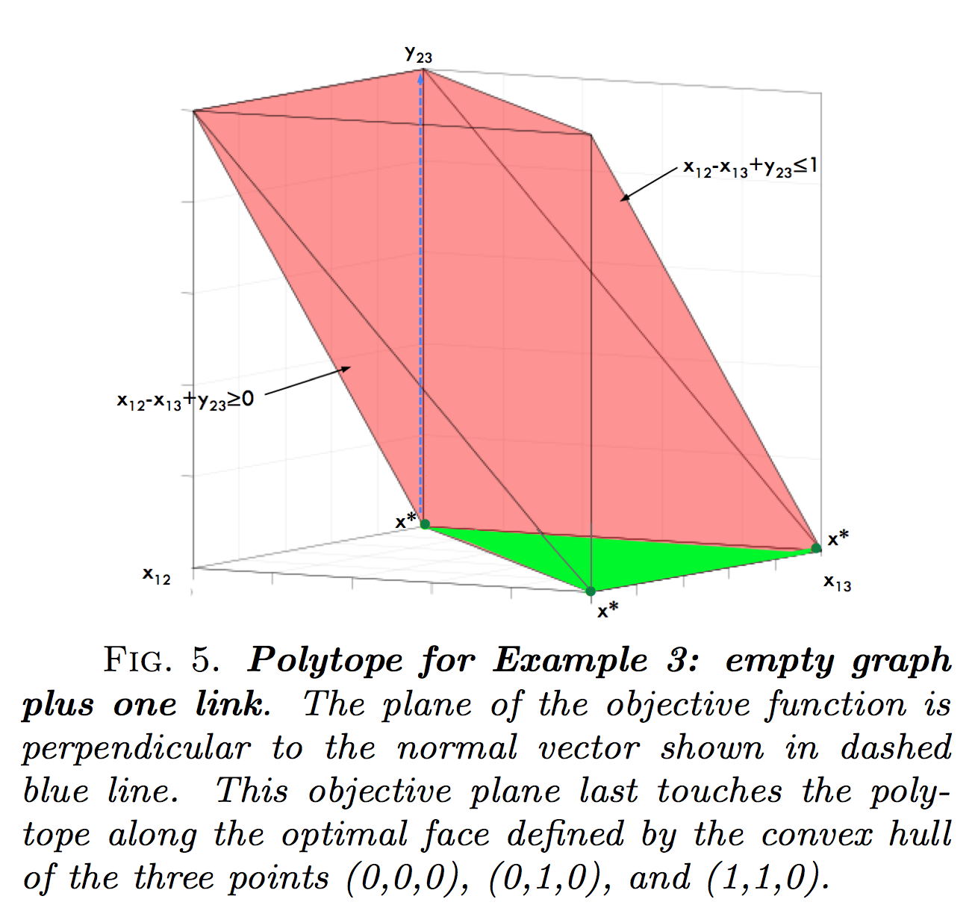
n=3 Polytope

Slide 6
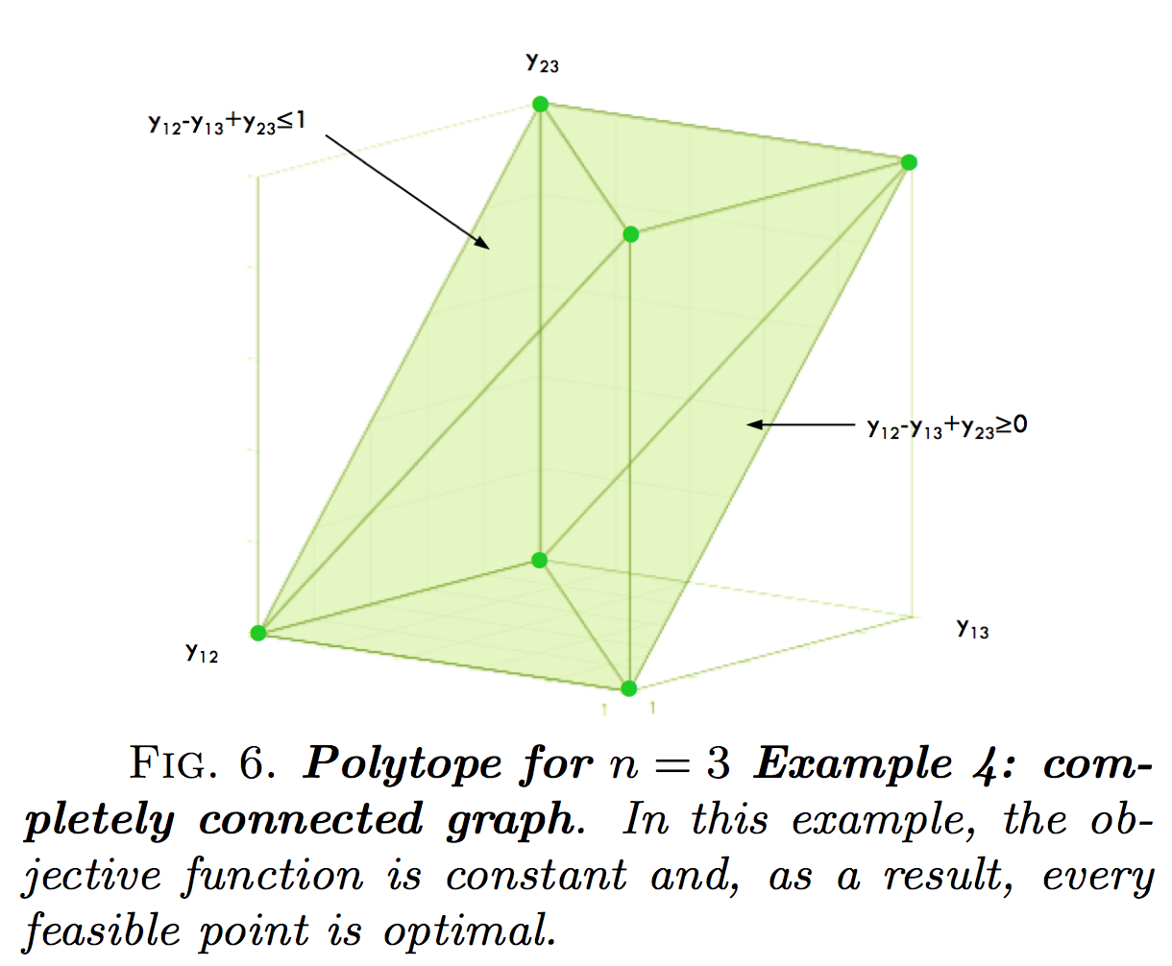
n=3 Polytope

Slide 7
IP Polytope vs. LP Polytope
Reinelt table

Slide 8
Theorems
Every rankability problem (unweighted or weighted) is feasible.
The rankability IP polytope has n! binary e.p.s and each is a ranking.
An initial e.p. feasible solution is easy to find. Take any ranking.
An initial interior point feasible solution is easy to find. Take the centroid of the IP polytope Xbar = .5(E-I).
The LP polytope contains the IP polytope.
If the LP concludes with an integer k*, then this k* is also optimal for the IP.
The optimal face of the IP polytope has |P| binary e.p. and each is a ranking.
If the LP concludes with an integer k* and fractional X*, then this pair is also optimal for the IP.

Slide 9
More Theorems
The k-histogram of rankings for the IP polytope is symmetric about a mean.
For a given D, the objective values of a ranking r and its reverse ranking r sum to the same constant value for all rankings.
A good initial feasible ranking can be constructed from the ‘colperm’ symmetric reordering method.

Slide 10
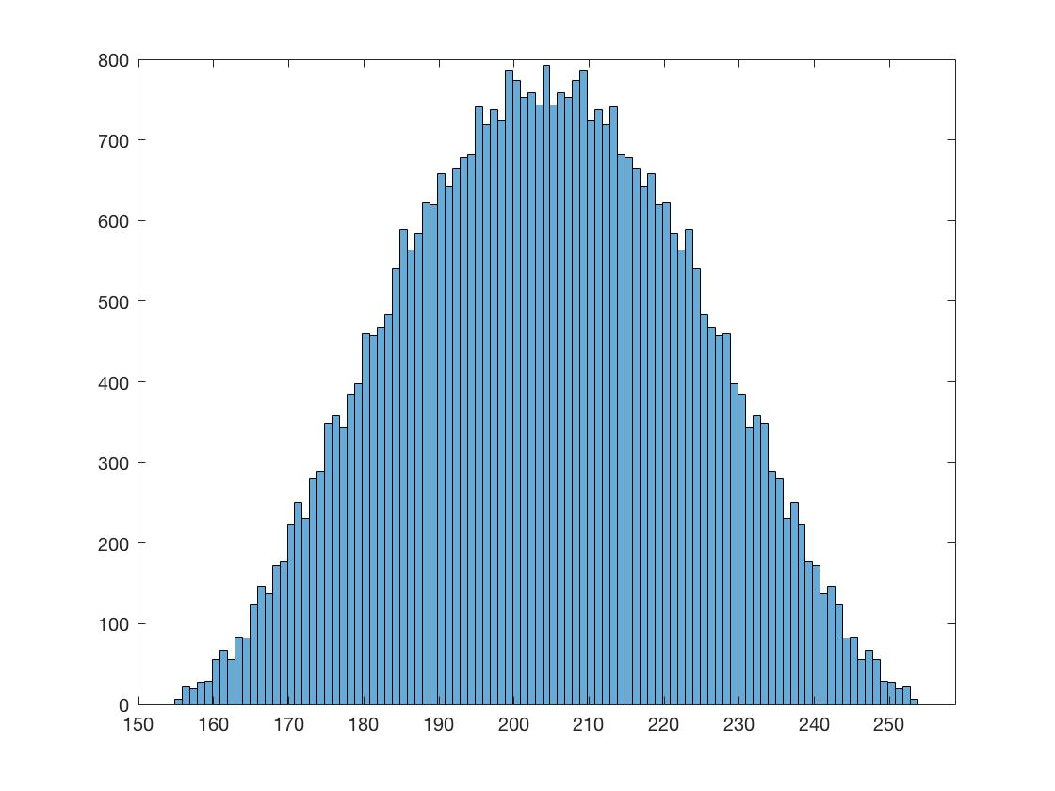
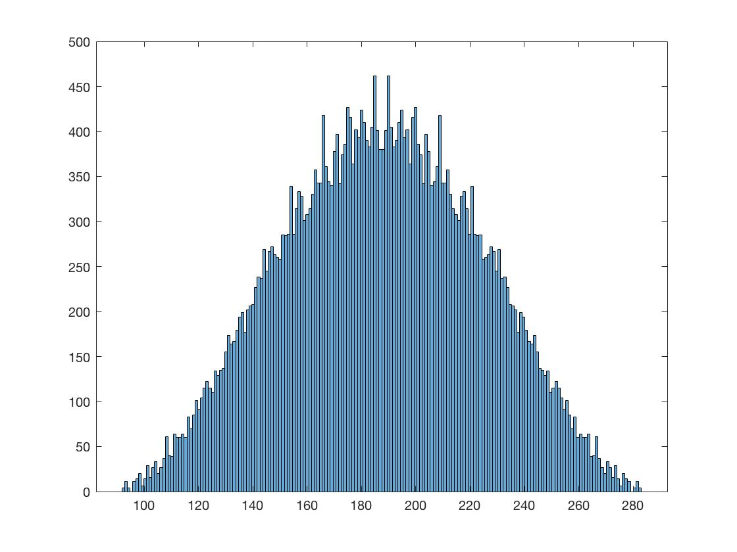
k-histograms
The k-histogram of rankings for the IP polytope is symmetric about a mean.
less rankable 2008 season, k=155, p=6
more rankable 2005 season, k=92, p=4

Slide 11
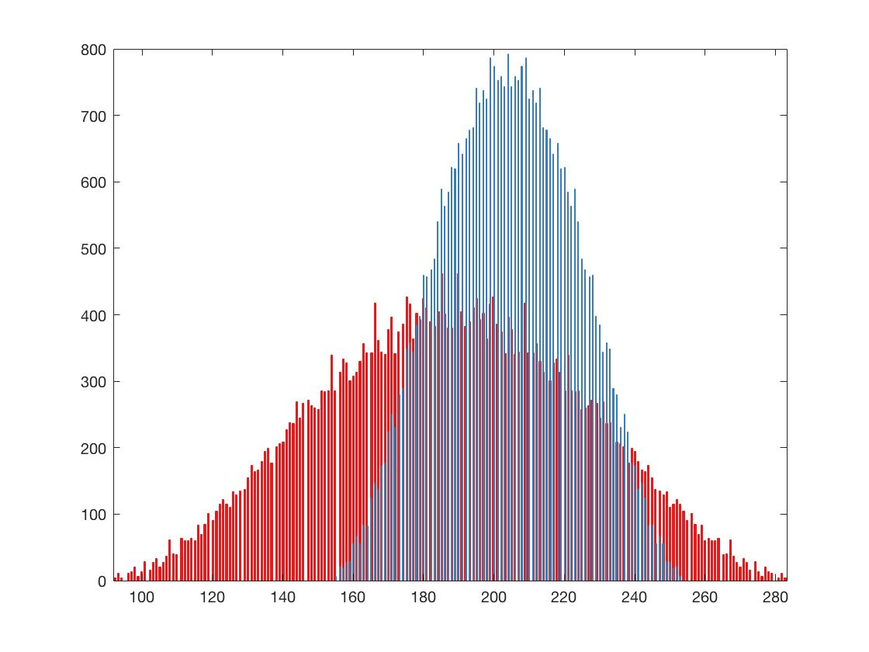
k-histograms
The k-histogram of rankings for the IP polytope is symmetric about a mean.
less rankable 2008 season, k=155, p=6
more rankable 2005 season, k=92, p=4

Slide 12
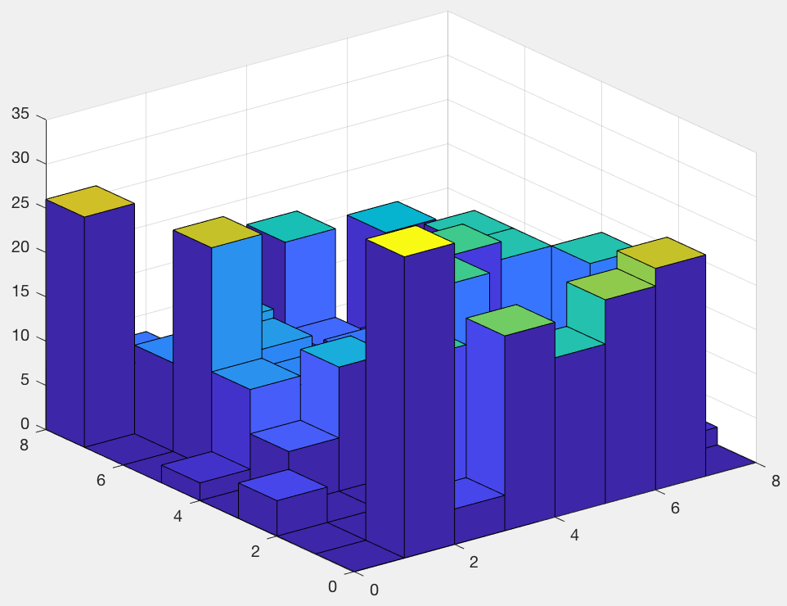
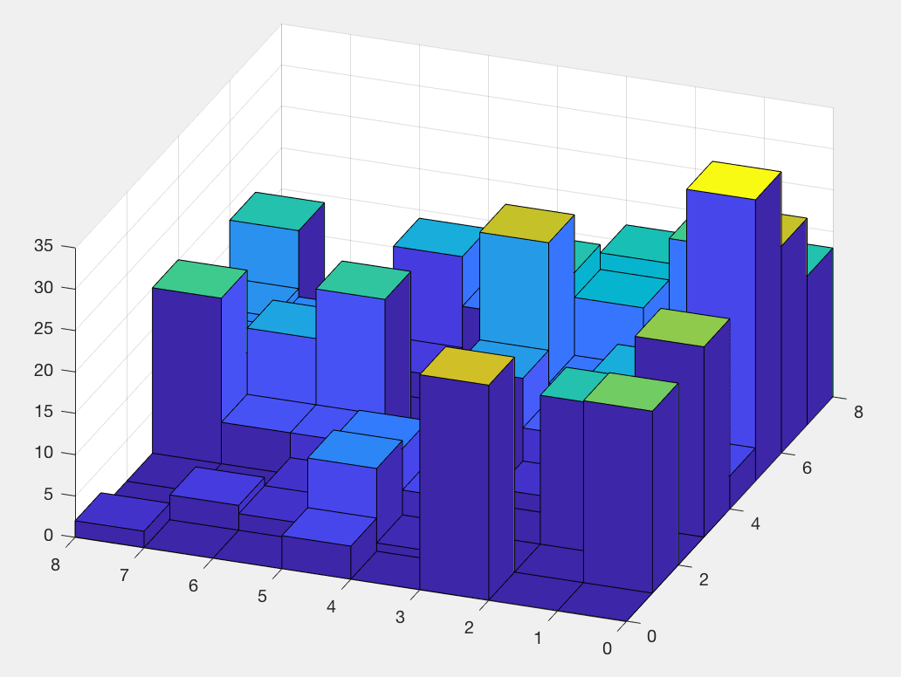
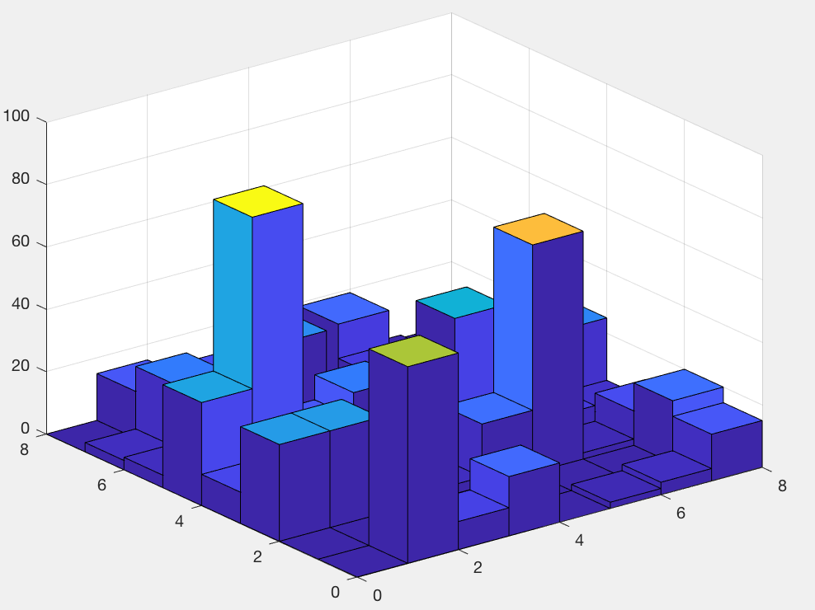
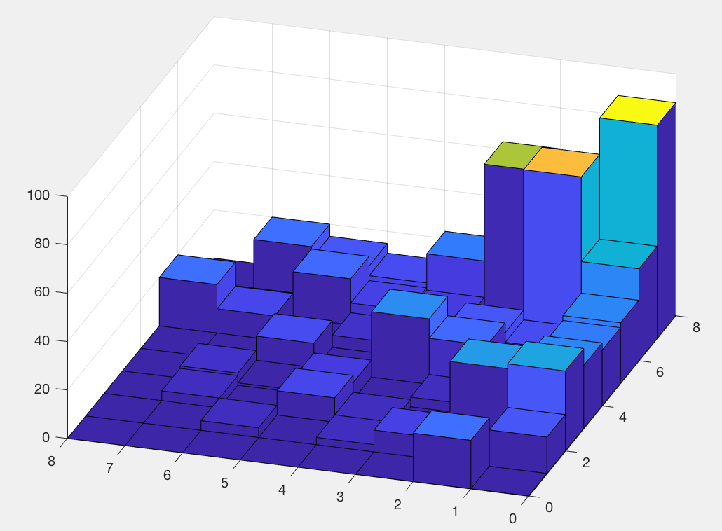
less rankable 2008 season, k=155, p=6
original ordering
optimal ordering
more rankable 2005 season, k=92, p=4
original ordering
optimal ordering

Slide 13
k-histograms
The k-histogram of rankings for the IP polytope is symmetric about a mean.
less rankable 2008 season, k=155, p=6
more rankable 2005 season, k=92, p=4
p*
k*

Slide 14
k-histograms
We don’t need the whole k-histogram, just the two ends.
Get k*, r* by solving LP.
Get p* by Alg. 4.1.
Get k_{worst} by evaluating the objective function for the reverse ranking r. Compute sum of upper triangle of C(r, r).
r_{k} = (k_{worst} – k*)/((k_{worst} + k*)
p*
k*
k_{worst}

Slide 15
k-histograms
The k-histogram of rankings for the IP polytope is symmetric about a mean.
less rankable 2008 season, k=155, p=6, r_{k} = .24
more rankable 2005 season, k=92, p=4, r_{k} = .51
p*
k*

