Slide 1
Rankability Polytopes
9/16/2019

Slide 2
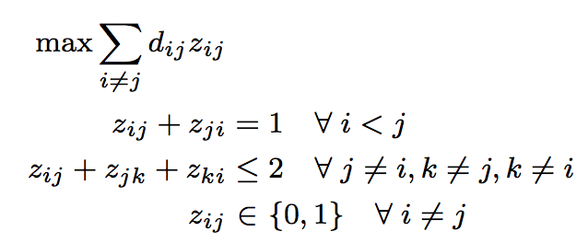
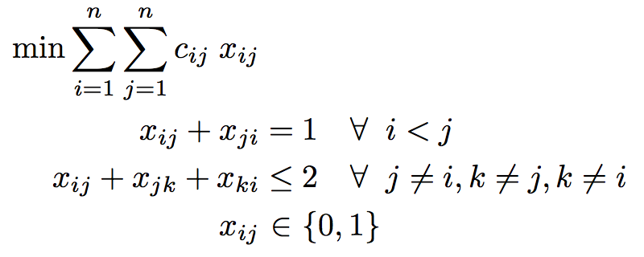
Unweighted and Weighted Problems
unweighted IP
weighted IP
same polytope, different objectives

Slide 3
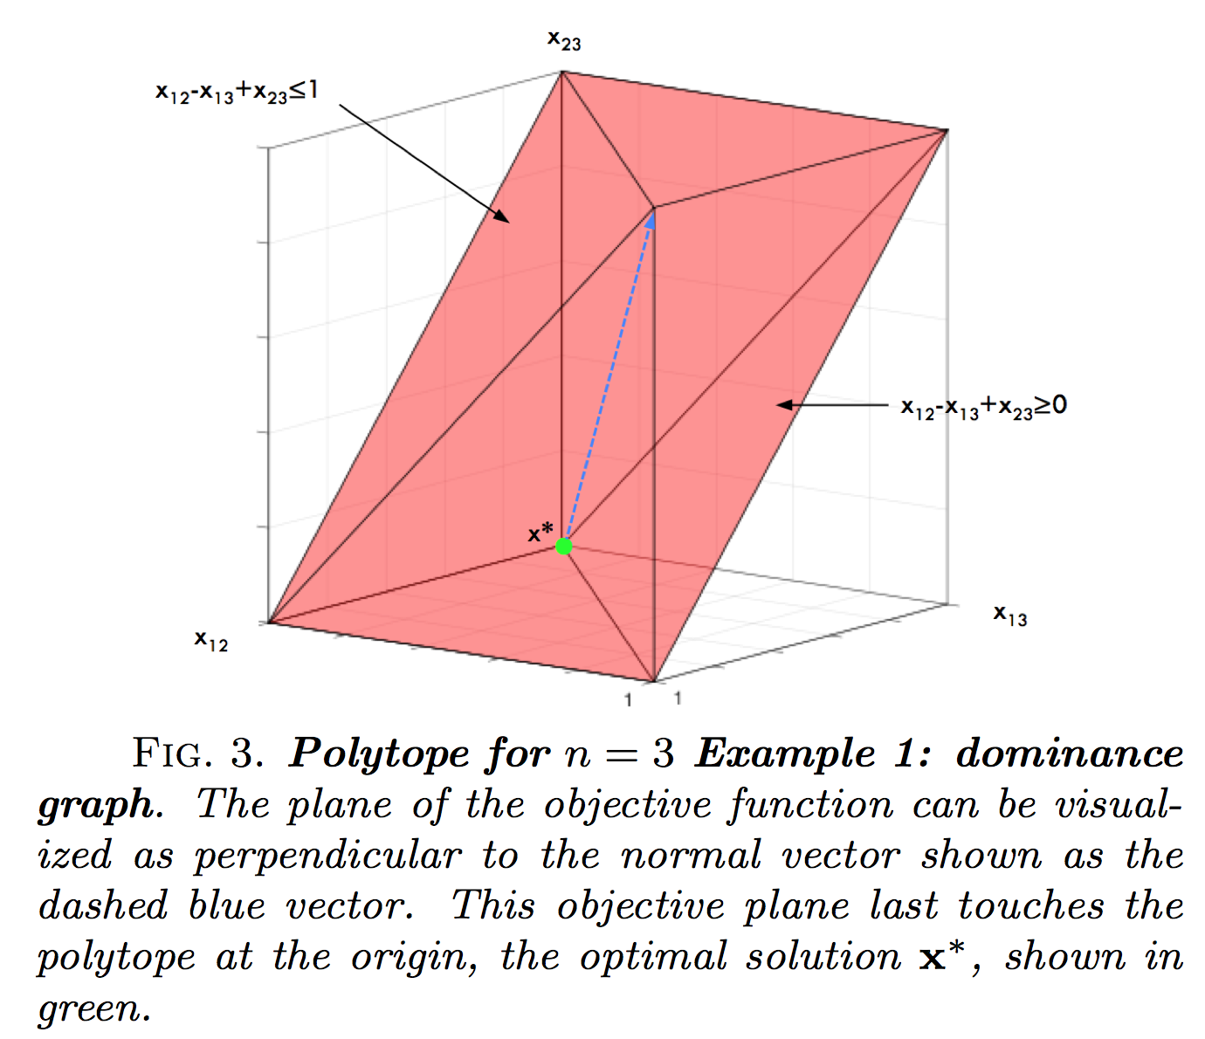
n=3 Polytope

Slide 4
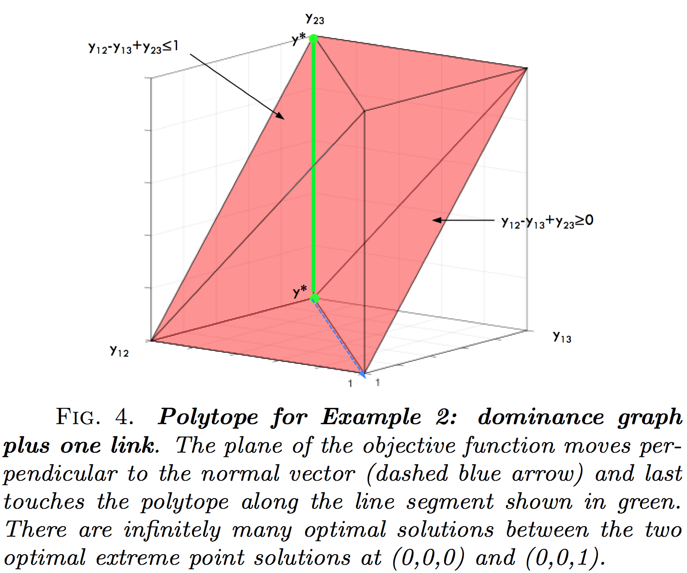
n=3 Polytope

Slide 5
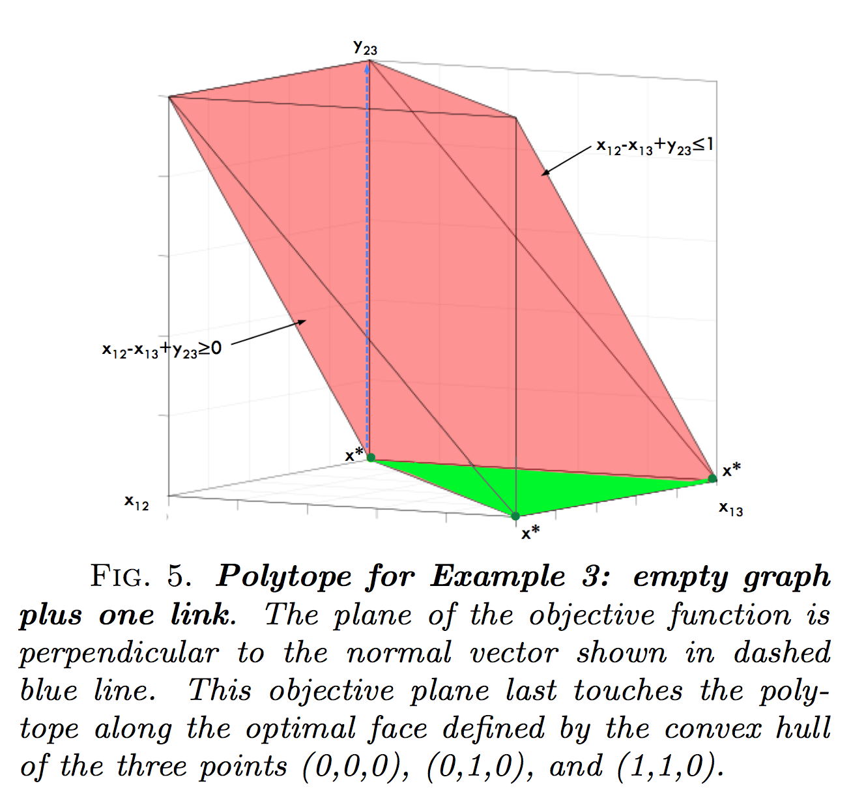
n=3 Polytope

Slide 6
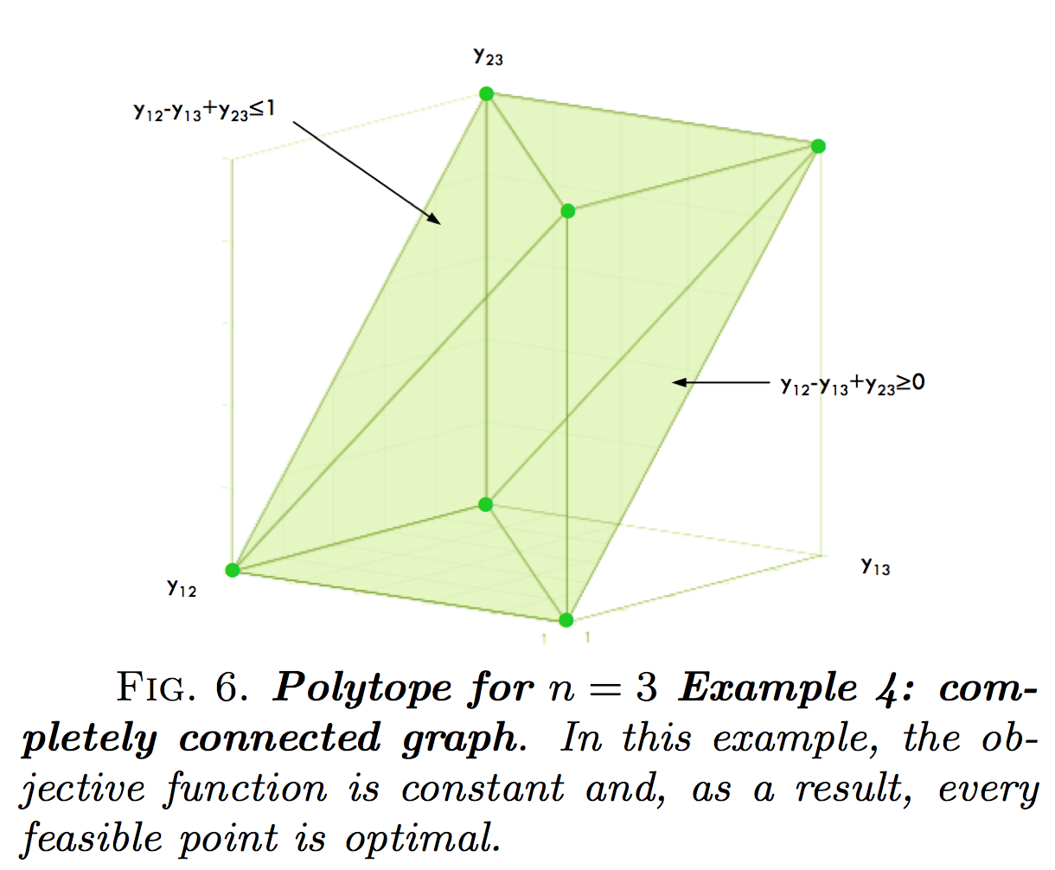
n=3 Polytope

Slide 7
IP Polytope vs. LP Polytope
For n ≤ 5, IP polytope = LP polytope
Stats for IP polytope (Marti & Reinelt, 2011)
n | # vertices = n! | # facets
3 | 6 | 8
4 | 24 | 20
5 | 120 | 40
6 | 720 | 910
7 | 5,040 | 87,472
8 | 40,320 | ≥ 488,602,996

Slide 8
Theorems
Every rankability problem (unweighted or weighted) is feasible.
The rankability IP polytope has n! binary e.p.s and each is a ranking.
An initial e.p. feasible solution is easy to find. Take any ranking.
An initial interior point feasible solution is easy to find. Take the centroid of the IP polytope Xbar = .5(E-I).
The LP polytope contains the IP polytope.
If the LP concludes with an integer k*, then this k* is also optimal for the IP.
The optimal face of the IP polytope has |P| binary e.p. and each is a ranking.
If the LP concludes with an integer k* and fractional X*, then this pair is also optimal for the IP.

Slide 9
More Theorems
The k-histogram of rankings for the IP polytope is symmetric about a mean.
For a given D, the objective values of a ranking r and its reverse ranking r sum to the same constant value for all rankings.
A good initial feasible ranking can be constructed from the ‘colperm’ symmetric reordering method.

Slide 10
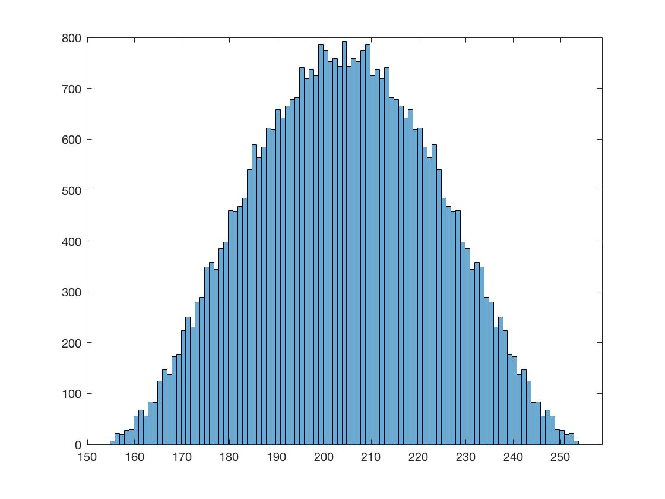
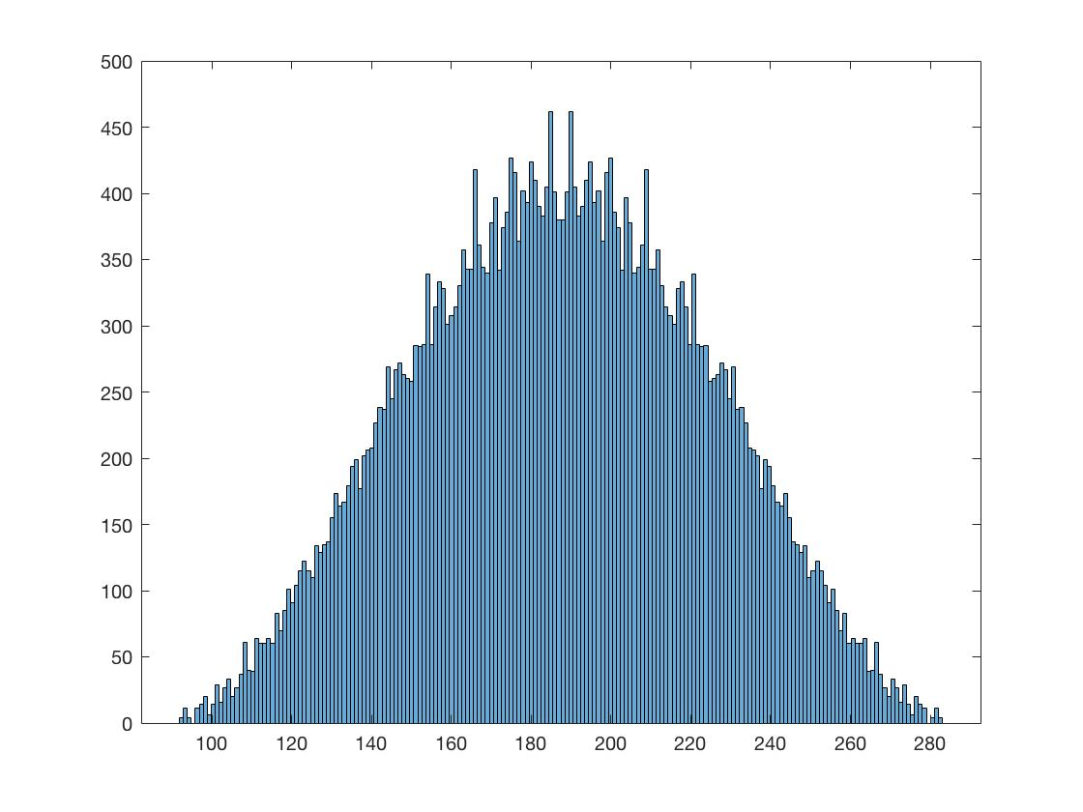
k-histograms
The k-histogram of rankings for the IP polytope is symmetric about a mean.
less rankable 2008 season, k=155, p=6
more rankable 2005 season, k=92, p=4

Slide 11
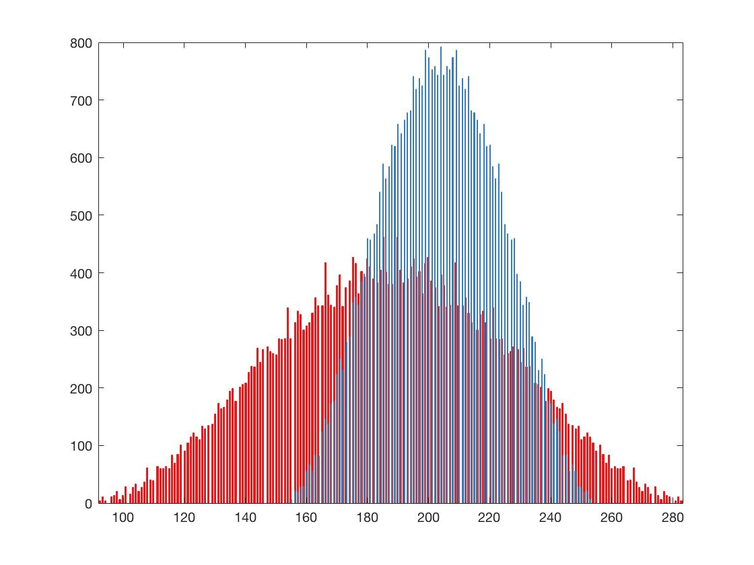
k-histograms
The k-histogram of rankings for the IP polytope is symmetric about a mean.
less rankable 2008 season, k=155, p=6
more rankable 2005 season, k=92, p=4

Slide 12
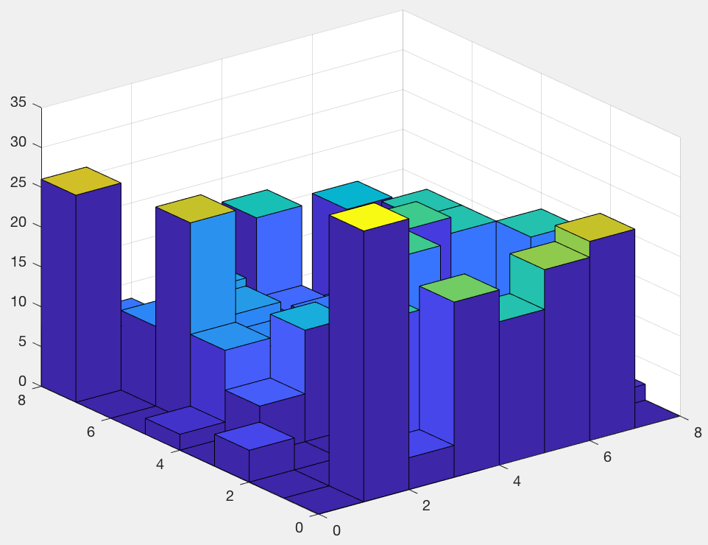
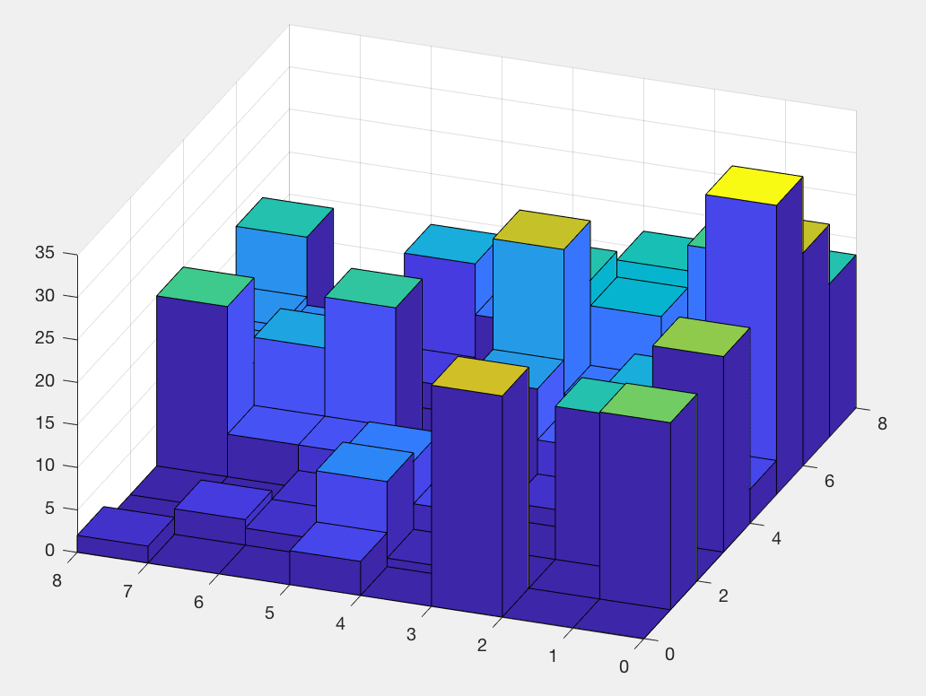
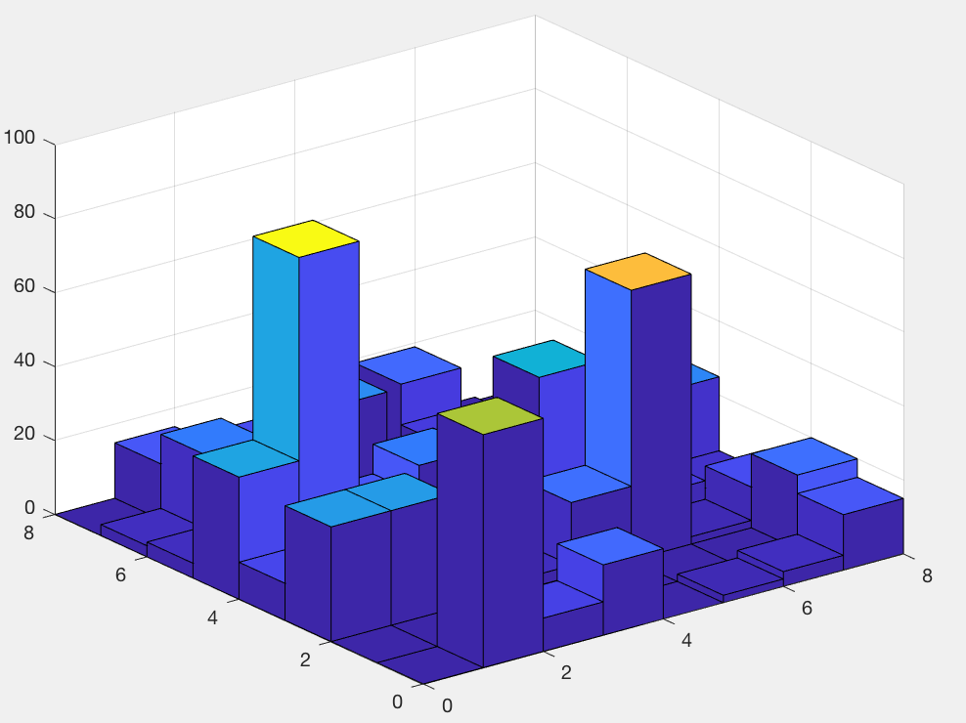
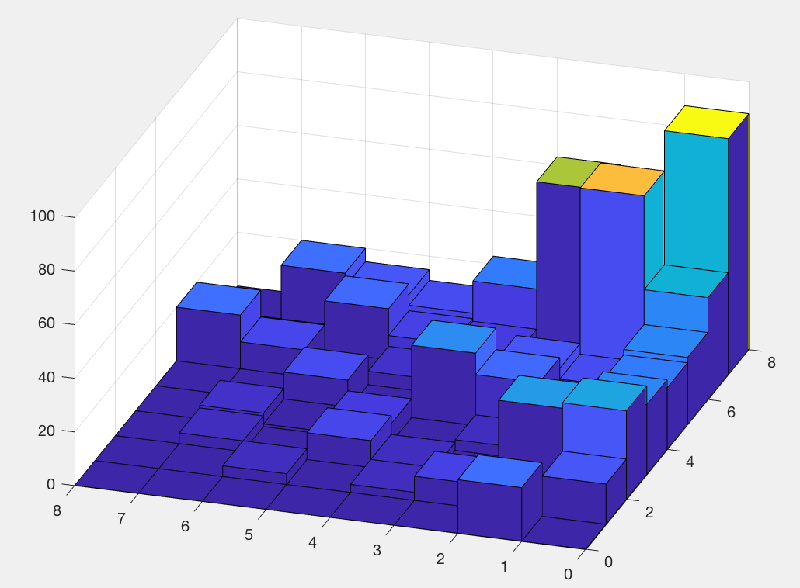
less rankable 2008 season, k=155, p=6
original ordering
optimal ordering
more rankable 2005 season, k=92, p=4
original ordering
optimal ordering

Slide 13
k-histograms
The k-histogram of rankings for the IP polytope is symmetric about a mean.
less rankable 2008 season, k=155, p=6
more rankable 2005 season, k=92, p=4
p*
k*

Slide 14
k-histograms
We don’t need the whole k-histogram, just the two ends.
Get k*, r* by solving LP.
Get p* by Alg. 4.1.
Get k_{worst} by evaluating the objective function for the reverse ranking r. k_{worst} = sum of upper triangle of C(r, r).
r_{k} = (k_{worst} – k*)/((k_{worst} + k*)
p*
k*
k_{worst}

Slide 15
k-histograms
The k-histogram of rankings for the IP polytope is symmetric about a mean.
less rankable 2008 season, k=155, p=6, r_{k} = .24
more rankable 2005 season, k=92, p=4, r_{k} = .51
p*
k*

Slide 16
k-histograms
THOMAS: can you produce more figures like this for many more conferences and seasons? Or chess? Or US News colleges?
Trying to find the narrowest histogram from real data to make Tim’s point that any ranking is nearly as bad as any other ranking for that particular dataset.
less rankable 2008 season, k=155, p=6, r_{k} = .24
more rankable 2005 season, k=92, p=4, r_{k} = .51
p*
k*

Slide 17
k-histograms
We don’t need the whole k-histogram, just the two ends.
Get k*, r* by solving LP.
Get p* by Alg. 4.1.
Get k_{worst} by evaluating the objective function for the reverse ranking r. k_{worst} = sum of upper triangle of C(r, r).
r_{k} = (k_{worst} – k*)/((k_{worst} + k*)
p*
k*
k_{worst}

Slide 18
k-histograms
We don’t need the whole k-histogram, just the rough shape from the two ends and the middle.
Get k*, r* by solving LP.
Get p* by Alg. 4.1.
Get k_{worst} by evaluating the objective function for the reverse ranking r. k_{worst} = sum of upper triangle of C(r, r).
k_{med}=floor[(k*+k_{worst})/2]
Get p_{med} by solving another LP, max ½-sized polytope due to added constraint: C.*X ≤ k_{med}. Then run Alg. 4.1.
p_{med}
p*
k*
k_{med}
k_{worst}

Slide 19
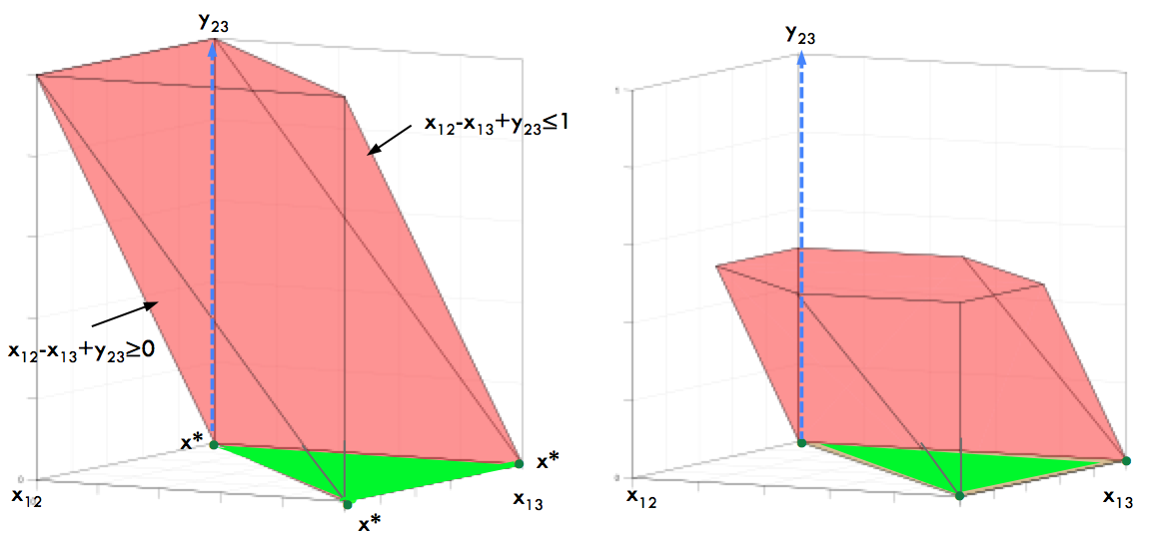
k-histograms
We don’t need the whole k-histogram, just the rough shape from the two ends and the middle.
Get k*, r* by solving LP.
Get p* by Alg. 4.1.
Get k_{worst} by evaluating the objective function for the reverse ranking r. k_{worst} = sum of upper triangle of C(r, r).
k_{med}=floor[(k*+k_{worst})/2]
Get p_{med} by solving another LP, max ½-sized polytope due to added constraint: C.*X ≤ k_{med}. Then run Alg. 4.1.
full polytope ½ polytope

Slide 20
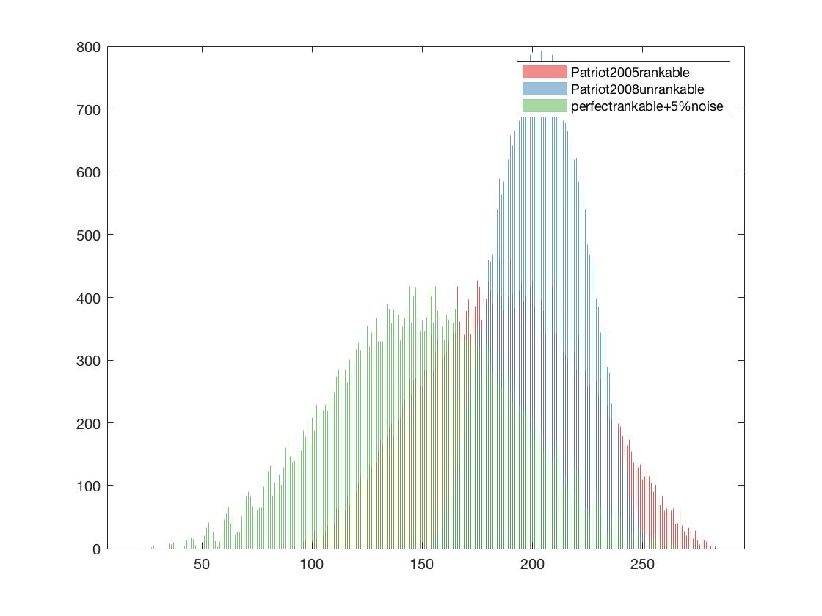
Comparing to data at the extremes
Compare given data, 2005 Patriot, to randomly generated nearly perfectly rankable data with same n
less rankable 2008 season, k=155, p=6, r_{k} = .24
perfectly rankable + 5% noise , k=20, p=1, r_{k} = .87
more rankable 2005 season, k=92, p=4, r_{k} = .51

Slide 21
Comparing to data at the extremes
ISSUES:
What is the other extreme of unrankable data for Hillside Count? Not 0 or E matrices. Maybe Random?
The nearly perfectly rankable data is shifted left relative to the Patriot data. Why? Maybe because, even though n is the same, nnz is not.
How to generate random data with given nnz?
less rankable 2008 season, k=155, p=6, r_{k} = .24
perfectly rankable + 5% noise , k=20, p=1, r_{k} = .87
more rankable 2005 season, k=92, p=4, r_{k} = .51

Slide 22
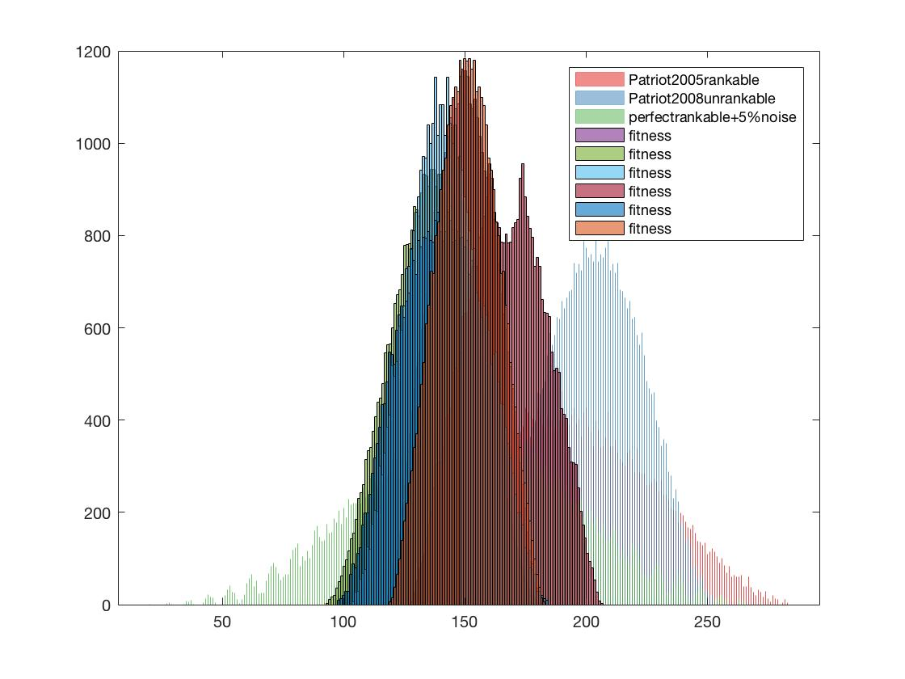
Comparing to data at the extremes
less rankable random data
less rankable 2008 season, k=155, p=6, r_{k} = .24
more rankable 2005 season, k=92, p=4, r_{k} = .51
perfectly rankable + 5% noise, k=20, p=1, r_{k} = .87

Slide 23
ISSUE: Constr. Relax. + Alg. 4.1
For problems with bigger n, we need Constraint Relaxation. Yet Algorithm 4.1 for finding p only works for the LOP LP polyope, not a constraint-relaxed version.
Can we hack ideas from Algorithm 4.1 to make it work approximately with Constraint Relaxation?

