Slide 1
WEB DEVELOPMENT & DESIGN FOUNDATIONS WITH HTML5
7TH EDITION
Chapter 1
Key Concepts

Slide 2
LEARNING OUTCOMES
In this chapter, you will learn how to
Describe the evolution of the Internet and the Web
Explain the need for web standards
Describe Universal Design
Identify benefits of accessible web design
Identify reliable resources of information on the Web
Identify ethical use of the Web
Describe the purpose of web browsers and web servers
Identify networking protocols
Define URIs and domain names
Describe HTML, XHTML, and HTML5
Describe popular trends in the use of the Web
Copyright © Terry Felke-Morris

Slide 3
REASONS FOR
INTERNET GROWTH IN THE 1990S
Removal of the ban on commercial activity
Development of the World Wide Web
by Tim Berners-Lee at CERN
Development of Mosaic,
the first graphics-based web browser at NCSA
Personal computers were increasingly available and affordable
Online service providers offered low-cost connections to the Internet
Copyright © Terry Felke-Morris

Slide 4
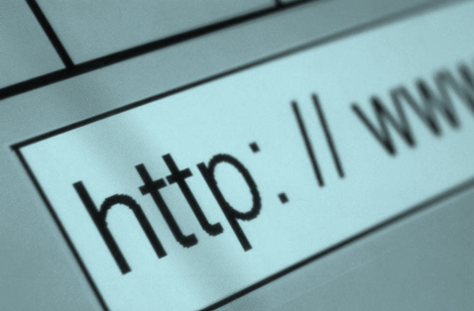
THE WORLD WIDE WEB
The graphical user interface to information stored on computers running web servers
connected to the Internet.
Copyright © Terry Felke-Morris

Slide 5
INTERNET STANDARDS & COORDINATION
The Internet Society
  A professional organization that provides leadership in addressing issues related to the future of the Internet
  IETF-- Internet Engineering Task Force
    RFC – Requests for Comments
  IAB – Internet Architecture Board
Copyright © Terry Felke-Morris

Slide 6
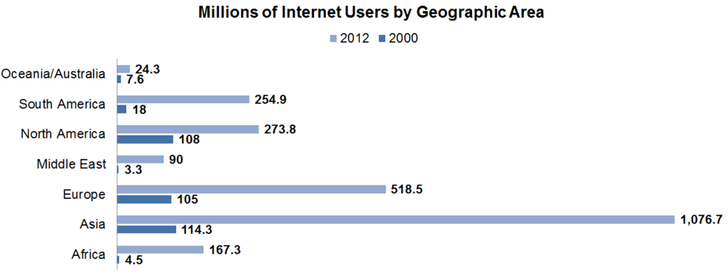
GROWTH OF THE INTERNET
http://www.internetworldstats.com/stats.htm
Copyright © Terry Felke-Morris

Slide 7

INTERNET STANDARDS & COORDINATION
ICANN - The Internet Corporation for Assigned Numbers & Names
  Non-profit organization
  Main function is to coordinate the assignment of:
    Internet domain names
    IP address numbers
    Protocol parameters
    Protocol port numbers.
Copyright © Terry Felke-Morris

Slide 8
INTRANET & EXTRANETS
Intranet
  A private network contained within an organization or business used to share information and resources among coworkers.
Extranet
  A private network that securely shares part of an organization’s information or operations with external partners
Copyright © Terry Felke-Morris

Slide 9
WEB STANDARDS
AND THE W3C CONSORTIUM
W3C – World Wide Web Consortium
  Develops recommendations and prototype technologies related to the Web
  Produces specifications, called Recommendations, in an effort to standardize web technologies
  WAI – Web Accessibility Initiative
Copyright © Terry Felke-Morris

Slide 10
WEB ACCESSIBILITY
Accessible Website
  provides accommodations for individuals with visual, auditory, physical, and neurological disabilities
WAI
  W3C’s Web Accessibility Initiative
  http://www.w3.org/WAI
WCAG
  Web Content Accessibility Guidelines
  http://www.w3.org/WAI/WCAG20/quickref/
Copyright © Terry Felke-Morris

Slide 11
WEB ACCESSIBILITY &
THE LAW
Americans with Disabilities Act (ADA)
  Prohibits discrimination against people with disabilities
Section 508 of the Rehabilitation Act
  Requires that government agencies must give individuals with disabilities access to information technology that is comparable to the access available to others
  http://www.section508.gov
Copyright © Terry Felke-Morris

Slide 12
UNIVERSAL DESIGN
FOR THE WEB
Universal Design
  the design of products and environments to be usable by all people, to the greatest extent possible, without the need for adaptation or specialized design
http://www.ncsu.edu/www/ncsu/design/sod5/cud/about_ud/about_ud.htm
Copyright © Terry Felke-Morris

Slide 13
RELIABILITY &
INFORMATION ON THE WEB
Questions to Ask:
  Is the organization credible?
  How recent is the information?
  Are there links to additional resources?
  Is it Wikipedia?
Copyright © Terry Felke-Morris

Slide 14
CHECKPOINT 1.1
Describe the difference between the Internet and the Web.
Explain three events that contributed to the commercialization and exponential growth of the Internet.
Is the concept of universal design important to web developers? Explain your answer.
Copyright © Terry Felke-Morris

Slide 15
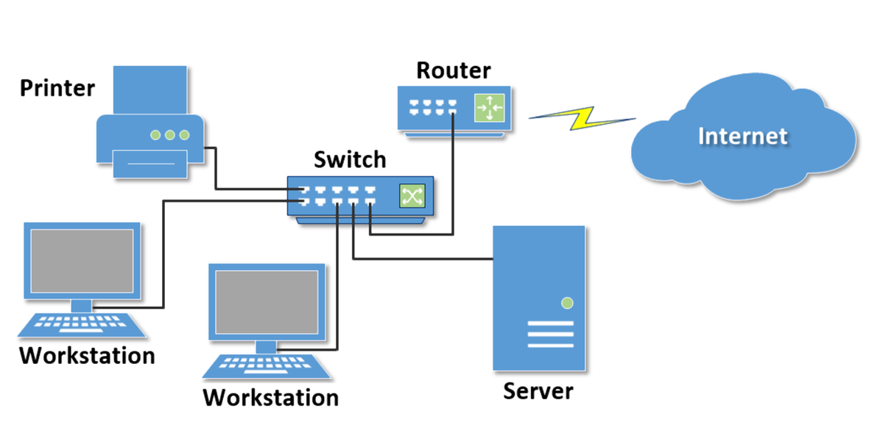
NETWORK OVERVIEW
Network
two or more computers connected together for the purpose of communicating and sharing resources
Copyright © Terry Felke-Morris

Slide 16
NETWORKS
LAN – Local Area Network
  Usually confined to a single building or group of buildings
WAN – Wide Area Network
  Usually uses some form of public or commercial communications network to connect computers is widely dispersed geographical areas.
Copyright © Terry Felke-Morris

Slide 17
INTERNET INFRASTRUCTURE
Internet Backbone
A high capacity communication link that carries data gathered from smaller links that interconnect with it.
Maps of the Internet Backbone
  http://www.google.com/search?q=global+internet+backbone+map+images
Copyright © Terry Felke-Morris

Slide 18
THE CLIENT/SERVER MODEL
Client/Server can describe a relationship between two computer programs –
the "client" and the "server".
Client
  requests some type of service (such as a file or database access) from the server.
Server
  fulfills the request and transmits the results to the client over a network
Copyright © Terry Felke-Morris

Slide 19
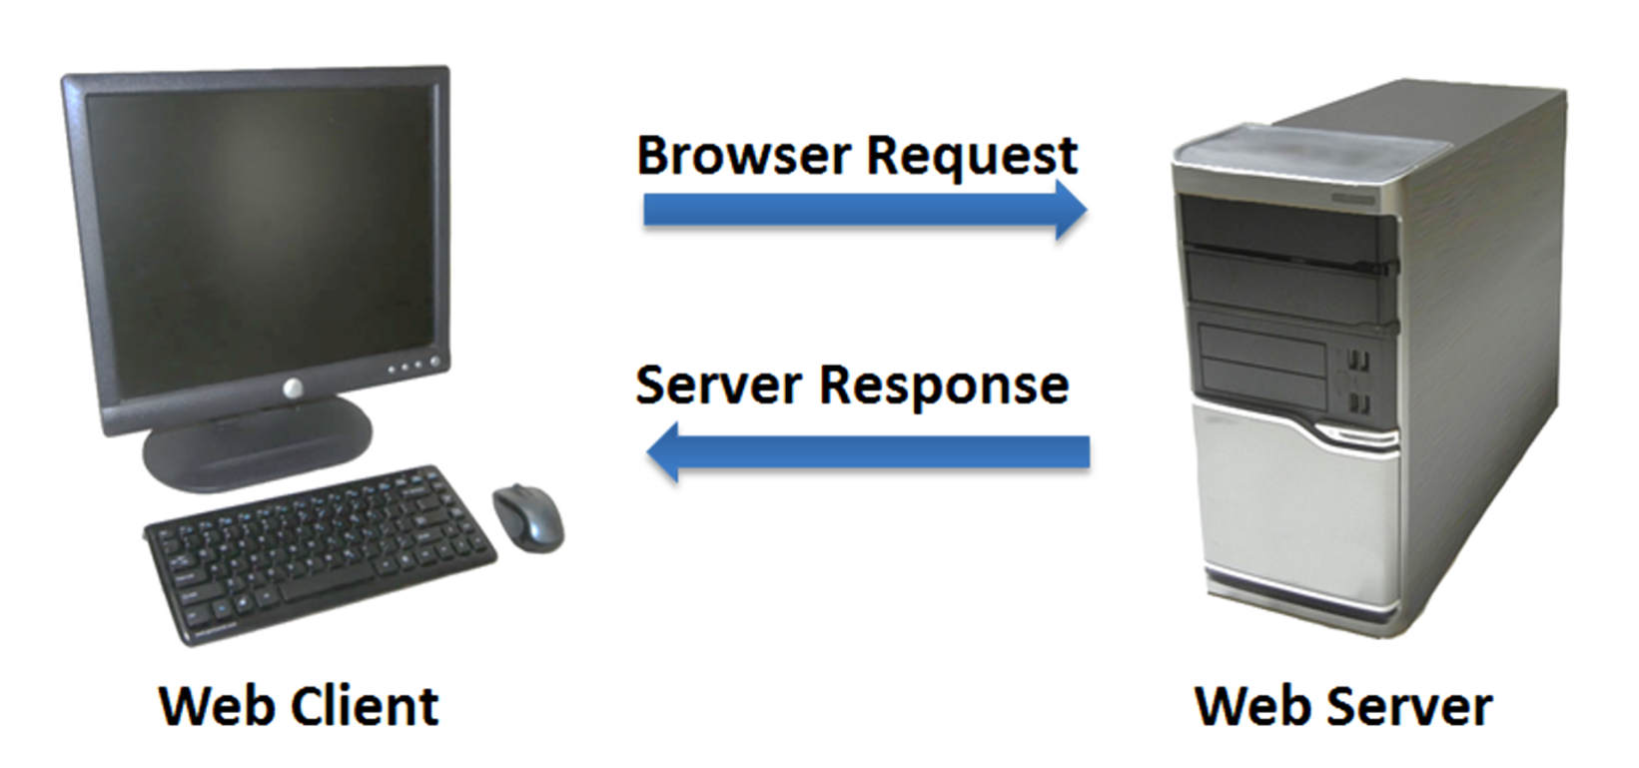
THE INTERNET CLIENT/SERVER MODEL
Client – Web Browser
Server – Web Server
Copyright © Terry Felke-Morris

Slide 20
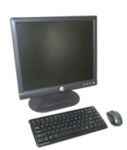
WEB CLIENT
Connected to the Internet when needed
Usually runs web browser (client) software
(such as Internet Explorer or Firefox)
Uses HTTP (Hypertext Transfer Protocol)
Requests web pages from server
Receives web pages and files from server
Copyright © Terry Felke-Morris

Slide 21
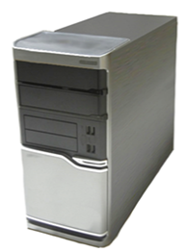
WEB SERVER
Continually connected to the Internet
Runs web server software
(such as Apache or Internet Information Server)
Uses HTTP (Hypertext Transfer Protocol)
Receives request for the web page
Responds to request and transmits status code, web page, and associated files
Copyright © Terry Felke-Morris

Slide 22
MIME TYPE
Multi-Purpose Internet Mail Extension
  a set of rules that allow multimedia documents
  to be exchanged among
  many different computer systems
Copyright © Terry Felke-Morris

Slide 23
INTERNET PROTOCOLS
Protocols
  Rules that describe the methods used for clients and servers to communicate with each other over a network.
There is no single protocol that makes the Internet and Web work.
A number of protocols with specific functions are needed.
Copyright © Terry Felke-Morris

Slide 24
FTP
FILE TRANSFER PROTOCOL
A set of rules that allow files to be exchanged between computers on the Internet.
Web developers commonly use FTP to transfer web page files from their computers to web servers.
FTP is also used to download programs and files from other servers to individual computers.
Copyright © Terry Felke-Morris

Slide 25
E-MAIL PROTOCOLS
Sending E-mail
  SMTP Simple Mail Transfer Protocol
Receiving E-mail
  POP (POP3) Post Office Protocol
  IMAP Internet Mail Access Protocol
Copyright © Terry Felke-Morris

Slide 26
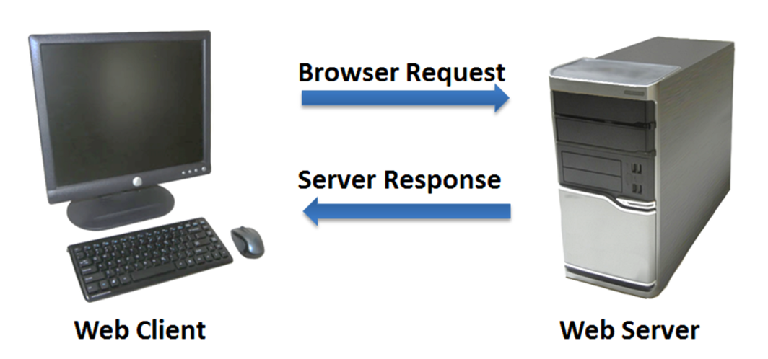
HTTP - HYPERTEXT TRANSFER PROTOCOL
A set of rules for exchanging files such as text, graphic images, sound, video, and other multimedia files on the Web.
Web browsers send HTTP requests for web pages and their associated files.
Web servers send HTTP responses back to the web browsers.
http request
http
response
Copyright © Terry Felke-Morris

Slide 27
TCP/IP
TRANSMISSION CONTROL PROTOCOL/
INTERNET PROTOCOL
TCP/IP has been adopted as the official communication protocol of the Internet.
TCP and IP have different functions that work together to ensure reliable communication over the Internet.
Copyright © Terry Felke-Morris

Slide 28
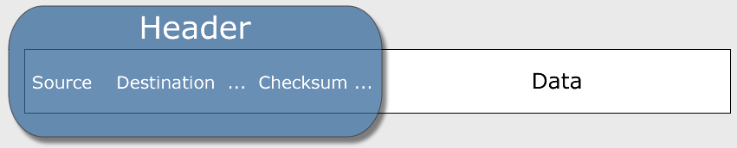
TCP
TRANSMISSION CONTROL PROTOCOL
Purpose is to ensure the integrity of communication
Breaks files and messages into individual units called packets
Copyright © Terry Felke-Morris

Slide 29
IP
INTERNET PROTOCOL
A set of rules that controls how data is sent between computers on the Internet.
IP routes a packet to the correct destination address.
The packet gets successively forwarded to the next closest router (a hardware device designed to move network traffic) until it reaches its destination.
http://visualroute.visualware.com/
http://www.tracert.com/cgi-bin/trace.pl
Copyright © Terry Felke-Morris

Slide 30
IP ADDRESS
Each device connected to the Internet has a unique numeric IP address.
These addresses consist of a set of four groups of numbers, called octets.
74.125.225.78 will get you Google!
An IP address may correspond to a domain name.
Copyright © Terry Felke-Morris

Slide 31
DOMAIN NAME
Locates an organization or other entity on the Internet
Domain Name System
  Divides the Internet into logical groups and understandable names
  Associates unique computer IP Addresses with the text-based domain names you type into a web browser
  Browser: http://google.com
  IP Address: 74.125.225.78
Copyright © Terry Felke-Morris

Slide 32
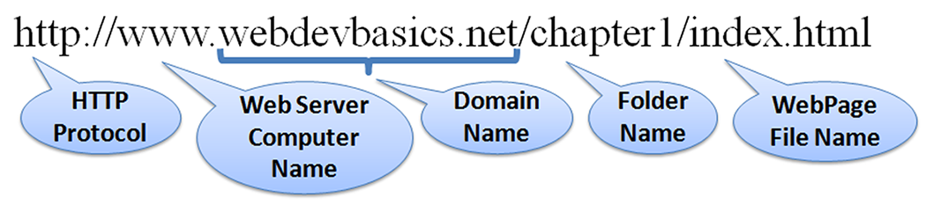
UNIFORM RESOURCE IDENTIFIER
URI – Uniform Resource Identifier
  identifies a resource on the Internet
URL – Uniform Resource Locator
  a type of URI which represents the network location of a resource such as a web page, a graphic file, or an MP3 file.
Copyright © Terry Felke-Morris

Slide 33
TLD
TOP-LEVEL DOMAIN NAME
A top-level domain (TLD) identifies the right-most part of the domain name.
Current generic TLDs:
.com, .org, .net, .mil, .gov, .edu, .int, .aero, .asia, .cat, .jobs, .name, .biz, .mobi, .museum, .info, .coop, .post, .pro, .tel, .travel, .xxx
Copyright © Terry Felke-Morris

Slide 34
COUNTY CODE TLDS
Two character codes originally intended to indicate the geographical location (country) of the web site.
In practice, it is fairly easy to obtain a domain name with a country code TLD that is not local to the registrant.
Examples:
  .tv, .ws, .au, .jp, .uk
  See http://www.iana.org/cctld/cctld-whois.htm
Copyright © Terry Felke-Morris

Slide 35
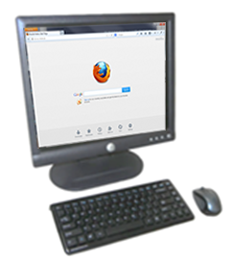
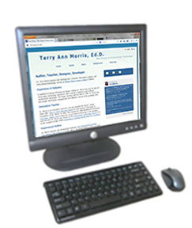
DOMAIN NAME SYSTEM
The Domain Name System (DNS) associates
Domain Names with IP addresses.
Web
Browser
Domain Name
DNS
IP Address
Web
Server
Use TPC/IP to send HTTP Request
Use TCP/IP
to send HTTP Responses
with web page files & images
Web Browser displays web page
Copyright © Terry Felke-Morris

Slide 36
MARKUP LANGUAGES
SGML – Standard Generalized Markup Language
  A standard for specifying a markup language or tag set
HTML – Hypertext Markup Language
  The set of markup symbols or codes placed in a file intended for display on a web browser.
Copyright © Terry Felke-Morris

Slide 37
MARKUP LANGUAGES (2)
XML – eXtensible Markup Language
  A text-based language designed to describe, deliver, and exchange structured information.
  It is not intended to replace HTML –
  it is intended to extend the power of HTML by separating data from presentation.
Copyright © Terry Felke-Morris

Slide 38
MARKUP LANGUAGES (3)
XHTML – eXtensible Hypertext Markup Language
  Developed by the W3C as the reformulation of HTML 4.0 as an application of XML.
  It combines the formatting strengths of HTML 4.0 and the data structure and extensibility strengths of XML.
Copyright © Terry Felke-Morris

Slide 39
MARKUP LANGUAGES (4)
HTML 5
  The next version of HTML4 and XHTML
  http://www.w3.org/html/
Copyright © Terry Felke-Morris

Slide 40
CHECKPOINT 1.2
Describe the components of the client/server model as applied to the Internet.
Identify two protocols used on the Internet to convey information that use the Internet but do not use the Web.
Explain the similarities and differences between a URL and a domain name.
Copyright © Terry Felke-Morris

Slide 41
POPULAR USES OF THE INTERNET
Continued importance of E-Commerce
Mobile Access
Blogs
Wikis
Social Networking
RSS
Podcasts
Web 2.0
Cloud Computing
Copyright © Terry Felke-Morris

Slide 42
SUMMARY
This chapter provided a brief overview of Internet, Web, and introductory networking concepts.
Copyright © Terry Felke-Morris

