Slide 1
Static Multiple-Issue example (4.10)
Lecture 39
Notes:
Last time?

Slide 2
Multiple Issue
Static multiple issue
Compiler groups instructions to be issued together
Packages them into “issue slots”
Compiler detects and avoids hazards
Dynamic multiple issue
CPU examines instruction stream and chooses instructions to issue each cycle
Compiler can help by reordering instructions
CPU resolves hazards using advanced techniques at runtime
Notes:
Sometimes the compiler can’t package them perfectly into slots b/c of dependencies…use what’s called a “nop”

Slide 3
Compiler/Hardware Speculation
Compiler can reorder instructions
e.g., move load before branch
Can include “fix-up” instructions to recover from incorrect guess
Hardware can look ahead for instructions to execute
Buffer results until it determines they are actually needed
Flush buffers on incorrect speculation

Slide 4
Static Multiple Issue
Compiler groups instructions into “issue packets”
Group of instructions that can be issued on a single cycle
Determined by pipeline resources required
Think of an issue packet as a very long instruction
Specifies multiple concurrent operations
⇒ Very Long Instruction Word (VLIW)

Slide 5
Scheduling Static Multiple Issue
Compiler must remove some/all hazards
Reorder instructions into issue packets
No dependencies within a packet
Possibly some dependencies between packets
Varies between ISAs; compiler must know!
Pad with nop if necessary
Notes:
MIPS was designed carefully, but with a different ISA we might have a different pipeline. For example, the memory access might actually come BEFORE the alu operation! Different hazards will result from that,…

Slide 6
MIPS with Static Dual Issue
Two-issue packets
One ALU/branch instruction
One load/store instruction
64-bit aligned
ALU/branch, then load/store
Pad an unused instruction with nop
Address | Instruction type | Pipeline Stages
n | ALU/branch | IF | ID | EX | MEM | WB
n + 4 | Load/store | IF | ID | EX | MEM | WB
n + 8 | ALU/branch |  | IF | ID | EX | MEM | WB
n + 12 | Load/store |  | IF | ID | EX | MEM | WB
n + 16 | ALU/branch |  |  | IF | ID | EX | MEM | WB
n + 20 | Load/store |  |  | IF | ID | EX | MEM | WB
Notes:
Notice we have to replicate the ALU, but not the memory, since an ALU/branch doesn’t access the memory

Slide 7
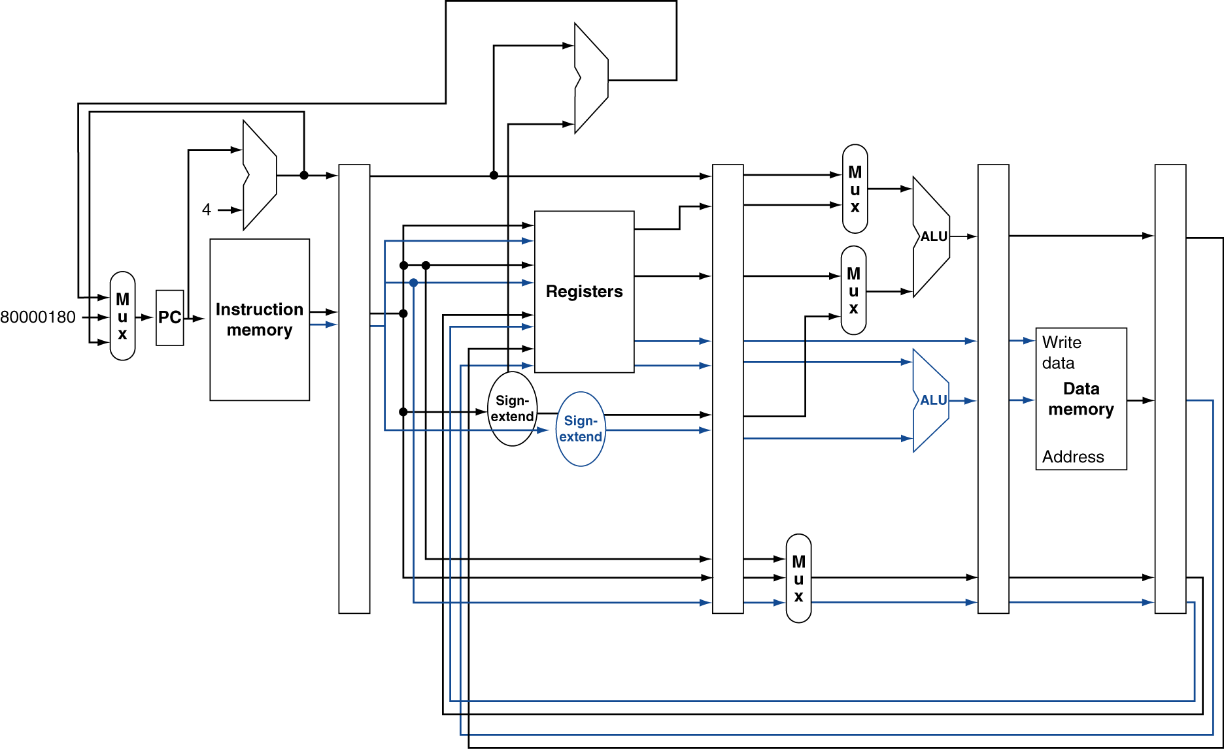
MIPS with Static Dual Issue
Notes:
There’s a bug in this figure…what is it? (Need to add 8 to PC…)
Also, notice just one ALU above registers…(first, what is this for?) why don’t new need to replicate this?
Why doesn’t the bottom ALU need muxes?

Slide 8
Hazards in the Dual-Issue MIPS
More instructions executing in parallel
EX data hazard
Forwarding avoided stalls with single-issue
Now can’t use ALU result in load/store in same packet
add $t0, $s0, $s1 lw $s2, 0($t0)
Split into two packets, effectively a stall
Load-use hazard
Still one cycle use latency, but now two instructions
More aggressive scheduling required

Slide 9
Scheduling Example
Schedule this for dual-issue MIPS
Loop: lw $t0, 0($s1) # $t0=array element addu $t0, $t0, $s2 # add scalar in $s2 sw $t0, 0($s1) # store result addi $s1, $s1,–4 # decrement pointer bne $s1, $zero, Loop # branch $s1!=0
Notes:
First, let’s think about what C code this came from… (just for practice)?
Do {
x[i] += c;
i--;
} while (x[i] != 0);
Keep in mind you can change the instructions, e.g. the offset of a lw or sw

Slide 10
Scheduling Example
Schedule this for dual-issue MIPS
Loop: lw $t0, 0($s1) # $t0=array element addu $t0, $t0, $s2 # add scalar in $s2 sw $t0, 0($s1) # store result addi $s1, $s1,–4 # decrement pointer bne $s1, $zero, Loop # branch $s1!=0
 | ALU/branch | Load/store | cycle
Loop: | nop | lw $t0, 0($s1) | 1
 | addi $s1, $s1,–4 | nop | 2
 | addu $t0, $t0, $s2 | nop | 3
 | bne $s1, $zero, Loop | sw $t0, 4($s1) | 4
What’s the IPC?
Notes:
Keep in mind you can change the instructions, e.g. the offset of a lw or sw
Simple:
Nop, lw
Addu, sw (currently can’t do this, but you could envision some kind of bypassing that would make this work…though it takes more hardware (no…))
Addi, nop (but actually, the above doesn’t work, after the load the result is not ready for the add, even if we waited to start the add!)
Bne
Any problem with:
addi $s1, $s1, -4 | lw $t0, 0($s1) // use “old” value of $s1
Addu (again, use after load problem…)
Don’t count nop as an executed instruction
Q: What’s IPC?

Slide 11
Scheduling Example
Schedule this for dual-issue MIPS
Loop: lw $t0, 0($s1) # $t0=array element addu $t0, $t0, $s2 # add scalar in $s2 sw $t0, 0($s1) # store result addi $s1, $s1,–4 # decrement pointer bne $s1, $zero, Loop # branch $s1!=0
 | ALU/branch | Load/store | cycle
Loop: | nop | lw $t0, 0($s1) | 1
 | addi $s1, $s1,–4 | nop | 2
 | addu $t0, $t0, $s2 | nop | 3
 | bne $s1, $zero, Loop | sw $t0, 4($s1) | 4
IPC = 5/4 = 1.25 (c.f. peak IPC = 2)

Slide 12
Loop Unrolling
Replicate loop body to expose more parallelism
Reduces loop-control overhead
Use different registers per replication
Called “register renaming”
Avoid loop-carried “anti-dependencies”
Store followed by a load of the same register
Aka “name dependence”
Reuse of a register name
Notes:
Go back to previous example, first unroll the code naively, then try to do dual-issue

Slide 13
Loop Unrolling Example
 | ALU/branch | Load/store | cycle
Loop: | addi $s1, $s1,–16 | lw $t0, 0($s1) | 1
 | nop | lw $t1, 12($s1) | 2
 | addu $t0, $t0, $s2 | lw $t2, 8($s1) | 3
 | addu $t1, $t1, $s2 | lw $t3, 4($s1) | 4
 | addu $t2, $t2, $s2 | sw $t0, 16($s1) | 5
 | addu $t3, $t4, $s2 | sw $t1, 12($s1) | 6
 | nop | sw $t2, 8($s1) | 7
 | bne $s1, $zero, Loop | sw $t3, 4($s1) | 8
IPC = 14/8 = 1.75
Closer to 2, but at cost of registers and code size
Notes:
What’s the IPC here?
Great, but what are the downsides?
Increased code size and more registers used…

Slide 14
Dynamic Multiple Issue
“Superscalar” processors
CPU decides whether to issue 0, 1, 2, … each cycle
Avoiding structural and data hazards
Avoids the need for compiler scheduling
Though it may still help
Code semantics ensured by the CPU

