Slide 1
SuperSCALAR (4.10)
Lecture 42
Notes:
Last time?

Slide 2
Multiple Issue
Static multiple issue
Compiler groups instructions to be issued together
Packages them into “issue slots”
Compiler detects and avoids hazards
Dynamic multiple issue
CPU examines instruction stream and chooses instructions to issue each cycle
Compiler can help by reordering instructions
CPU resolves hazards using advanced techniques at runtime
Notes:
Sometimes the compiler can’t package them perfectly into slots b/c of dependencies…use what’s called a “nop”

Slide 3
Compiler/Hardware Speculation
Compiler can reorder instructions
e.g., move load before branch
Can include “fix-up” instructions to recover from incorrect guess
Hardware can look ahead for instructions to execute
Buffer results until it determines they are actually needed
Flush buffers on incorrect speculation

Slide 4
Static Multiple Issue
Compiler groups instructions into “issue packets”
Group of instructions that can be issued on a single cycle
Determined by pipeline resources required
Think of an issue packet as a very long instruction
Specifies multiple concurrent operations
⇒ Very Long Instruction Word (VLIW)

Slide 5
Scheduling Static Multiple Issue
Compiler must remove some/all hazards
Reorder instructions into issue packets
No dependencies within a packet
Possibly some dependencies between packets
Varies between ISAs; compiler must know!
Pad with nop if necessary
Notes:
MIPS was designed carefully, but with a different ISA we might have a different pipeline. For example, the memory access might actually come BEFORE the alu operation! Different hazards will result from that,…

Slide 6
MIPS with Static Dual Issue
Two-issue packets
One ALU/branch instruction
One load/store instruction
64-bit aligned
ALU/branch, then load/store
Pad an unused instruction with nop
Address | Instruction type | Pipeline Stages
n | ALU/branch | IF | ID | EX | MEM | WB
n + 4 | Load/store | IF | ID | EX | MEM | WB
n + 8 | ALU/branch |  | IF | ID | EX | MEM | WB
n + 12 | Load/store |  | IF | ID | EX | MEM | WB
n + 16 | ALU/branch |  |  | IF | ID | EX | MEM | WB
n + 20 | Load/store |  |  | IF | ID | EX | MEM | WB
Notes:
Notice we have to replicate the ALU, but not the memory, since an ALU/branch doesn’t access the memory

Slide 7
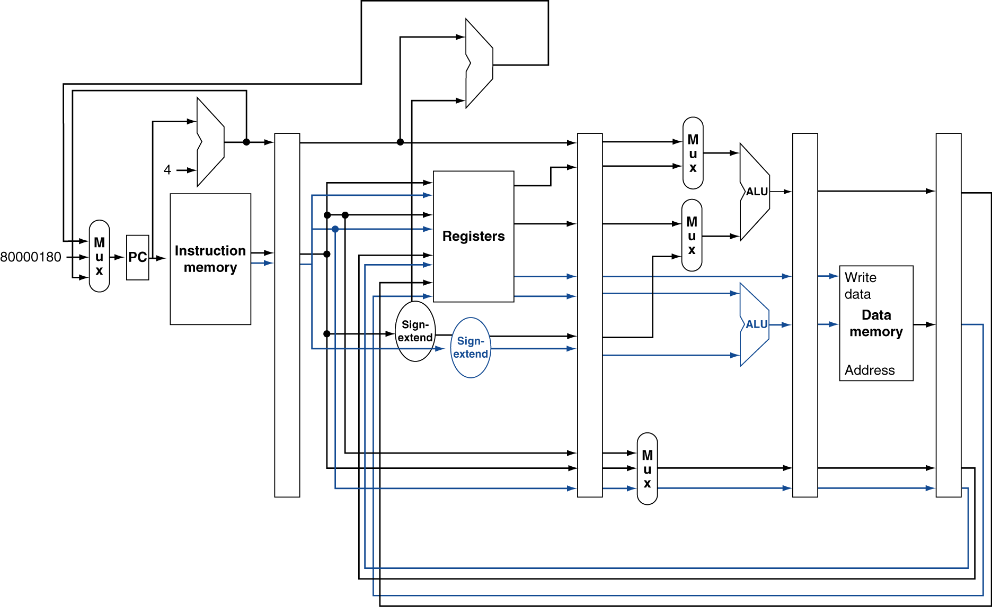
MIPS with Static Dual Issue
Notes:
There’s a bug in this figure…what is it? (Need to add 8 to PC…)
Also, notice just one ALU above registers…(first, what is this for?) why don’t new need to replicate this?
Why doesn’t the bottom ALU need muxes?

Slide 8
Hazards in the Dual-Issue MIPS
More instructions executing in parallel
EX data hazard
Forwarding avoided stalls with single-issue
Now can’t use ALU result in load/store in same packet
add $t0, $s0, $s1 lw $s2, 0($t0)
Split into two packets, effectively a stall
Load-use hazard
Still one cycle use latency, but now two instructions
More aggressive scheduling required

Slide 9
Scheduling Example
Schedule this for dual-issue MIPS
Loop: lw $t0, 0($s1) # $t0=array element addu $t0, $t0, $s2 # add scalar in $s2 sw $t0, 0($s1) # store result addi $s1, $s1,–4 # decrement pointer bne $s1, $zero, Loop # branch $s1!=0
Notes:
First, let’s think about what C code this came from… (just for practice)?
Do {
x[i] += c;
i--;
} while (x[i] != 0);
Keep in mind you can change the instructions, e.g. the offset of a lw or sw

Slide 10
Scheduling Example
Schedule this for dual-issue MIPS
Loop: lw $t0, 0($s1) # $t0=array element addu $t0, $t0, $s2 # add scalar in $s2 sw $t0, 0($s1) # store result addi $s1, $s1,–4 # decrement pointer bne $s1, $zero, Loop # branch $s1!=0
 | ALU/branch | Load/store | cycle
Loop: | nop | lw $t0, 0($s1) | 1
 | addi $s1, $s1,–4 | nop | 2
 | addu $t0, $t0, $s2 | nop | 3
 | bne $s1, $zero, Loop | sw $t0, 4($s1) | 4
What’s the IPC?
Notes:
Keep in mind you can change the instructions, e.g. the offset of a lw or sw
Simple:
Nop, lw
Addu, sw (currently can’t do this, but you could envision some kind of bypassing that would make this work…though it takes more hardware (no…))
Addi, nop (but actually, the above doesn’t work, after the load the result is not ready for the add, even if we waited to start the add!)
Bne
Any problem with:
addi $s1, $s1, -4 | lw $t0, 0($s1) // use “old” value of $s1
Addu (again, use after load problem…)
Don’t count nop as an executed instruction
Q: What’s IPC?

Slide 11
Scheduling Example
Schedule this for dual-issue MIPS
Loop: lw $t0, 0($s1) # $t0=array element addu $t0, $t0, $s2 # add scalar in $s2 sw $t0, 0($s1) # store result addi $s1, $s1,–4 # decrement pointer bne $s1, $zero, Loop # branch $s1!=0
 | ALU/branch | Load/store | cycle
Loop: | nop | lw $t0, 0($s1) | 1
 | addi $s1, $s1,–4 | nop | 2
 | addu $t0, $t0, $s2 | nop | 3
 | bne $s1, $zero, Loop | sw $t0, 4($s1) | 4
IPC = 5/4 = 1.25 (c.f. peak IPC = 2)

Slide 12
Loop Unrolling
Replicate loop body to expose more parallelism
Reduces loop-control overhead
Use different registers per replication
Called “register renaming”
Avoid loop-carried “anti-dependencies”
Store followed by a load of the same register
Aka “name dependence”
Reuse of a register name
Notes:
Go back to previous example, first unroll the code naively, then try to do dual-issue

Slide 13
Loop Unrolling Example
 | ALU/branch | Load/store | cycle
Loop: | addi $s1, $s1,–16 | lw $t0, 0($s1) | 1
 | nop | lw $t1, 12($s1) | 2
 | addu $t0, $t0, $s2 | lw $t2, 8($s1) | 3
 | addu $t1, $t1, $s2 | lw $t3, 4($s1) | 4
 | addu $t2, $t2, $s2 | sw $t0, 16($s1) | 5
 | addu $t3, $t4, $s2 | sw $t1, 12($s1) | 6
 | nop | sw $t2, 8($s1) | 7
 | bne $s1, $zero, Loop | sw $t3, 4($s1) | 8
IPC = 14/8 = 1.75
Closer to 2, but at cost of registers and code size
Notes:
What’s the IPC here?
Great, but what are the downsides?
Increased code size and more registers used…

Slide 14
Dynamic Multiple Issue
“Superscalar” processors
CPU decides whether to issue 0, 1, 2, … each cycle
Avoiding structural and data hazards
Avoids the need for compiler scheduling
Though it may still help
Code semantics ensured by the CPU

Slide 15
Dynamic Pipeline Scheduling
Allow the CPU to execute instructions out of order to avoid stalls
But commit result to registers in order
Example
lw $t0, 20($s2) addu $t1, $t0, $t2 sub $s4, $s4, $t3 slti $t5, $s4, 20
Can start sub while addu is waiting for lw
Notes:
The only “dependence” is the t0 from lw to addu…
Actually, it’s often quite helpful to go through your instructions and explicitly write down the dependences
The dependence here is W->R, which is an important one (RAW)
R->W is also an important one (WAR)
R->R we don’t care about, as long as there is no write in between.
Example: the lw actually used t0 as the base address, then we don’t care that we use it for the addu…

Slide 16
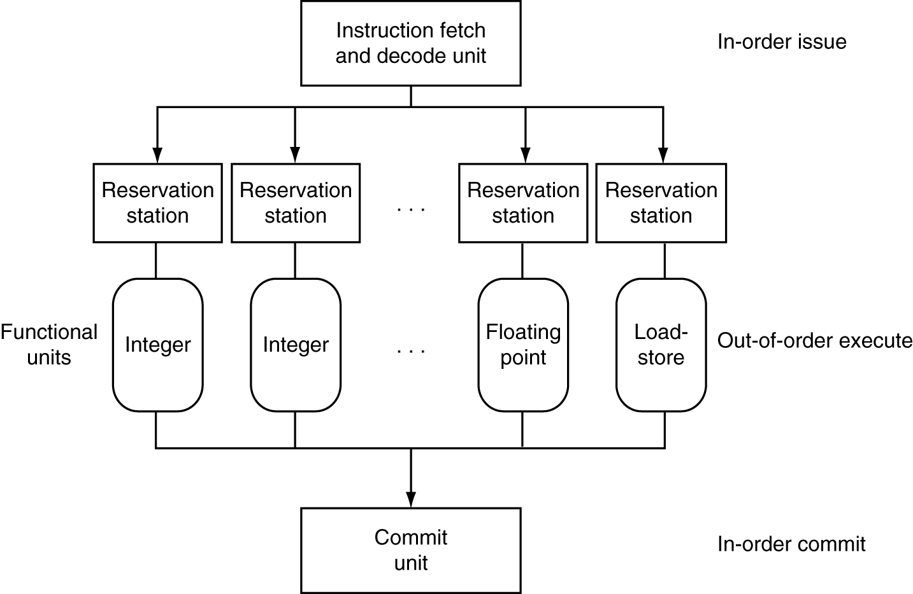
Dynamically Scheduled CPU
Preserves dependencies
Hold pending operands
Results also sent to any waiting reservation stations
Reorders buffer for register writes
Can supply operands for issued instructions
Notes:
This is a high-level overview. Lots more details. See Baer’s textbook.

Slide 17
Register Renaming
Reservation stations and reorder buffer effectively provide register renaming
On instruction issue to reservation station
If operand is available in register file or reorder buffer
Copied to reservation station
No longer required in the register; can be overwritten
If operand is not yet available
It will be provided to the reservation station by a function unit
Register update may not be required
Notes:
Maybe another instruction or set of instructions needs to use r2, but another instruction is waiting to use that value. If another instruction finishes using, say, r3 and then r3 is copied to a reservation station (and no later instruction will need it), the instruction that needs r2 can use r3 instead. What happens is the hardware keeps a “map” from logical registers to physical registers, can it can just change this map. So we can basically let any instruction use whatever register is free and all the dependencies will be handled correctly.

Slide 18
Speculation
Predict branch and continue issuing
Don’t commit until branch outcome determined
Load speculation
Avoid load delay
Predict the effective address
Predict loaded value
Load before completing outstanding stores
Bypass stored values to load unit
Don’t commit load until speculation cleared
Notes:
Loads from RAM are way, way slower than everything else. Like, 100x slower.
We’ve acted like the memory is just the RAM, but that’s not actually true. We will see in the next chapter that it’s this thing called cache.

Slide 19
Why Do Dynamic Scheduling?
Why not just let the compiler schedule code?
Can’t always schedule around branches
Branch outcome is dynamically determined
Not all stalls are predictable
e.g., cache misses
Different implementations of an ISA have different latencies and hazards
Compiler would have to know about everything!
Notes:
Scheduling around branch outcomes, obviously.
The caches, as we will see in the next chapter, let us make lw and sw much faster…except not always. Sometimes we have what’s called a “cache miss”, where we have to wait to load from slower memory. It’s really hard to predict ahead of time when this is going to happen, so static scheduling for multiple issue is not really an option.
Really hard to write a compiler that has to optimize for every possible architecture like this….

Slide 20
Does Multiple Issue Work?
The BIG Picture
Yes, but not as much as we’d like
Programs have real dependencies that limit ILP
Some dependencies are hard to eliminate
e.g., pointer aliasing
Some parallelism is hard to expose
Limited window size during instruction issue
Memory delays and limited bandwidth
Hard to keep pipelines full
Speculation can help if done well

Slide 21
Power Efficiency
Complexity of dynamic scheduling and speculations requires power
Multiple simpler cores may be better
Microprocessor | Year | Clock Rate | Pipeline Stages | Issue width | Out-of-order/ Speculation | Cores | Power
i486 | 1989 | 25MHz | 5 | 1 | No | 1 | 5W
Pentium | 1993 | 66MHz | 5 | 2 | No | 1 | 10W
Pentium Pro | 1997 | 200MHz | 10 | 3 | Yes | 1 | 29W
P4 Willamette | 2001 | 2000MHz | 22 | 3 | Yes | 1 | 75W
P4 Prescott | 2004 | 3600MHz | 31 | 3 | Yes | 1 | 103W
Core | 2006 | 2930MHz | 14 | 4 | Yes | 2 | 75W
UltraSparc III | 2003 | 1950MHz | 14 | 4 | No | 1 | 90W
UltraSparc T1 | 2005 | 1200MHz | 6 | 1 | No | 8 | 70W
Notes:
The downside is that if you want a single program to execute faster, you have to program it explicitly to use these extra cores…
… But doing so is actually really difficult. Making is easier is the focus of my research.

Slide 22
Cortex A8 and Intel i7
Processor | ARM A8 | Intel Core i7 920
Market | Personal Mobile Device | Server, cloud
Thermal design power | 2 Watts | 130 Watts
Clock rate | 1 GHz | 2.66 GHz
Cores/Chip | 1 | 4
Floating point? | No | Yes
Multiple issue? | Dynamic | Dynamic
Peak instructions/clock cycle | 2 | 4
Pipeline stages | 14 | 14
Pipeline schedule | Static in-order | Dynamic out-of-order with speculation
Branch prediction | 2-level | 2-level
1st level caches/core | 32 KiB I, 32 KiB D | 32 KiB I, 32 KiB D
2nd level caches/core | 128-1024 KiB | 256 KiB
3rd level caches (shared) | - | 2- 8 MB
§4.11 Real Stuff: The ARM Cortex-A8 and Intel Core i7 Pipelines

Slide 23
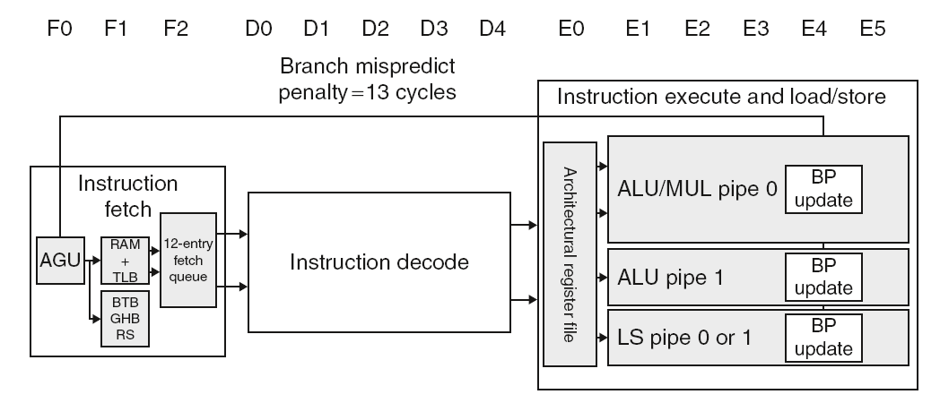
ARM Cortex-A8 Pipeline
Notes:
BP = branch predict update?

Slide 24
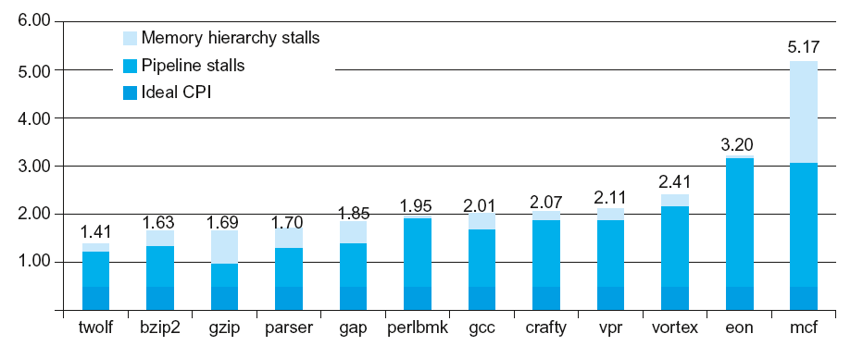
ARM Cortex-A8 Performance
Notes:
We’ll see in chapter 5 that memory is very slow…

Slide 25
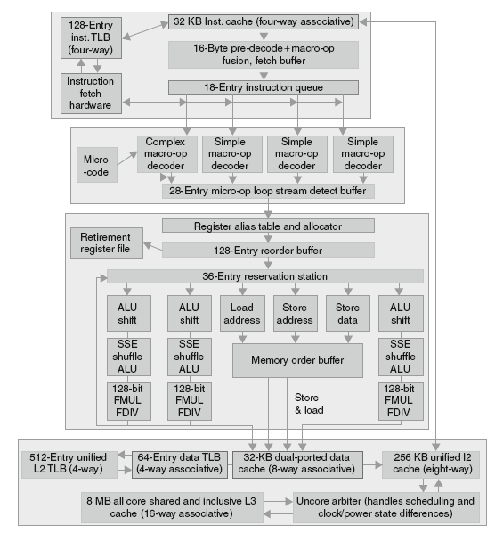
Core i7 Pipeline
Notes:
Ugh…don’t worry too much about this….
X86 makes pipelining difficult, so instead they take a micro-code approach…

Slide 26
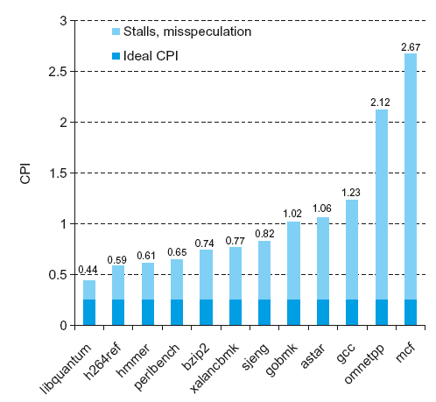
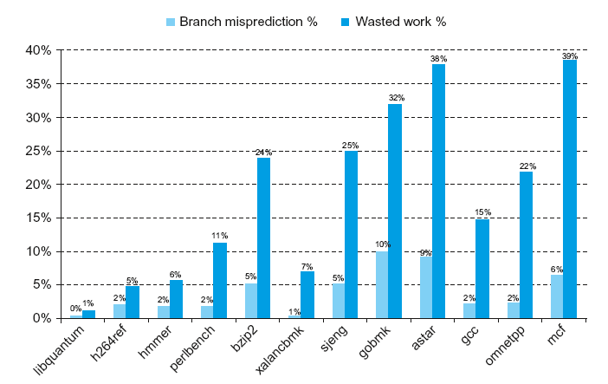
Core i7 Performance
Notes:
Little bit hard to measure what causes stalls due to speculation, OOO, etc.

Slide 27
Matrix Multiply
Unrolled C code
1 #include <x86intrin.h>
2 #define UNROLL (4)
3
4 void dgemm (int n, double* A, double* B, double* C)
5 {
6 for ( int i = 0; i < n; i+=UNROLL*4 )
7 for ( int j = 0; j < n; j++ ) {
8 __m256d c[4];
9 for ( int x = 0; x < UNROLL; x++ )
10 c[x] = _mm256_load_pd(C+i+x*4+j*n);
11
12 for( int k = 0; k < n; k++ )
13 {
14 __m256d b = _mm256_broadcast_sd(B+k+j*n);
15 for (int x = 0; x < UNROLL; x++)
16 c[x] = _mm256_add_pd(c[x],
17 _mm256_mul_pd(_mm256_load_pd(A+n*k+x*4+i), b));
18 }
19
20 for ( int x = 0; x < UNROLL; x++ )
21 _mm256_store_pd(C+i+x*4+j*n, c[x]);
22 }
23 }
§4.12 Instruction-Level Parallelism and Matrix Multiply

Slide 28
Matrix Multiply
Assembly code:
1 vmovapd (%r11),%ymm4 # Load 4 elements of C into %ymm4
2 mov %rbx,%rax # register %rax = %rbx
3 xor %ecx,%ecx # register %ecx = 0
4 vmovapd 0x20(%r11),%ymm3 # Load 4 elements of C into %ymm3
5 vmovapd 0x40(%r11),%ymm2 # Load 4 elements of C into %ymm2
6 vmovapd 0x60(%r11),%ymm1 # Load 4 elements of C into %ymm1
7 vbroadcastsd (%rcx,%r9,1),%ymm0 # Make 4 copies of B element
8 add $0x8,%rcx # register %rcx = %rcx + 8
9 vmulpd (%rax),%ymm0,%ymm5 # Parallel mul %ymm1,4 A elements
10 vaddpd %ymm5,%ymm4,%ymm4 # Parallel add %ymm5, %ymm4
11 vmulpd 0x20(%rax),%ymm0,%ymm5 # Parallel mul %ymm1,4 A elements
12 vaddpd %ymm5,%ymm3,%ymm3 # Parallel add %ymm5, %ymm3
13 vmulpd 0x40(%rax),%ymm0,%ymm5 # Parallel mul %ymm1,4 A elements
14 vmulpd 0x60(%rax),%ymm0,%ymm0 # Parallel mul %ymm1,4 A elements
15 add %r8,%rax # register %rax = %rax + %r8
16 cmp %r10,%rcx # compare %r8 to %rax
17 vaddpd %ymm5,%ymm2,%ymm2 # Parallel add %ymm5, %ymm2
18 vaddpd %ymm0,%ymm1,%ymm1 # Parallel add %ymm0, %ymm1
19 jne 68 <dgemm+0x68> # jump if not %r8 != %rax
20 add $0x1,%esi # register % esi = % esi + 1
21 vmovapd %ymm4,(%r11) # Store %ymm4 into 4 C elements
22 vmovapd %ymm3,0x20(%r11) # Store %ymm3 into 4 C elements
23 vmovapd %ymm2,0x40(%r11) # Store %ymm2 into 4 C elements
24 vmovapd %ymm1,0x60(%r11) # Store %ymm1 into 4 C elements
§4.12 Instruction-Level Parallelism and Matrix Multiply

Slide 29
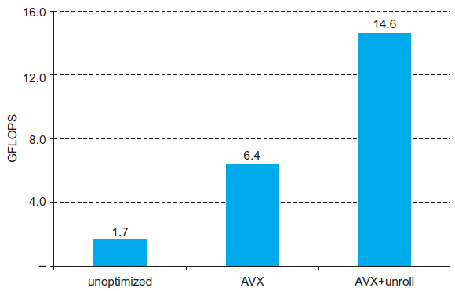
Performance Impact
Notes:
But in reality, probably don’t unroll your loop unless you’re sure it will help.
Sometimes it will help, sometimes it will actually slow your code down due to cache stuff we will talk about later.
Compilers will do this automatically if you use –funroll-loop
The right way to program for performance is
Program to correctness and *clarity*
Profile your application, noting what the slow bottlenecks are
Improve those bottlenecks by rewriting and measuring your changes

Slide 30
Fallacies
Pipelining is easy (!)
The basic idea is easy
The devil is in the details
e.g., detecting data hazards
Pipelining is independent of technology
So why haven’t we always done pipelining?
More transistors make more advanced techniques feasible
Pipeline-related ISA design needs to take account of technology trends
e.g., predicated instructions
§4.14 Fallacies and Pitfalls
Notes:
We have really just scratched the surface (given an overview) or pipelining…

Slide 31
Pitfalls
Poor ISA design can make pipelining harder
e.g., complex instruction sets (VAX, IA-32)
Significant overhead to make pipelining work
IA-32 micro-op approach
e.g., complex addressing modes
Register update side effects, memory indirection
e.g., delayed branches
Advanced pipelines have long delay slots

Slide 32
Concluding Remarks
ISA influences design of datapath and control
Datapath and control influence design of ISA
Pipelining improves instruction throughput using parallelism
More instructions completed per second
Latency for each instruction not reduced
Hazards: structural, data, control
Multiple issue and dynamic scheduling (ILP)
Dependencies limit achievable parallelism
Complexity leads to the power wall
§4.14 Concluding Remarks

