Slide 1
The Memory Hierarchy
Chapter 5
Notes:
What two types of locality do we have?

Slide 2
Principle of Locality
§5.1 Introduction
Programs access a small proportion of their address space at any time
Temporal locality
Items accessed recently are likely to be accessed again soon
e.g., instructions in a loop, induction variables
Spatial locality
Items near those accessed recently are likely to be accessed soon
E.g., sequential instruction access, array data
Notes:
And what do we call it when we have the value we want in cache? If not?

Slide 3
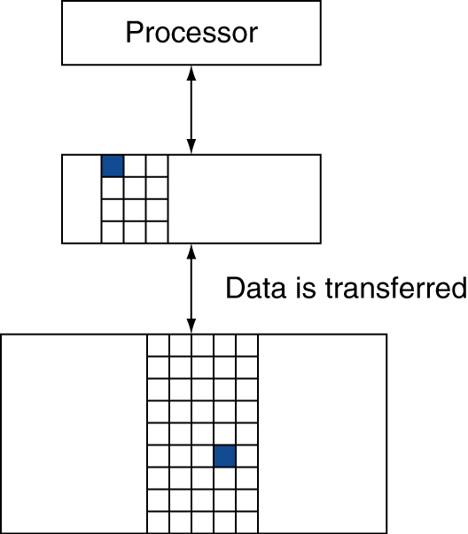
Memory Hierarchy Levels
Block (aka line): unit of copying
May be multiple words
If accessed data is present in upper level
Hit: access satisfied by upper level
Hit ratio: hits/accesses
If accessed data is absent
Miss: block copied from lower level
Time taken: miss penalty
Miss ratio: misses/accesses = 1 – hit ratio
Then accessed data supplied from upper level
Notes:
We will always be talking about inclusive memory hierarchy…

Slide 4
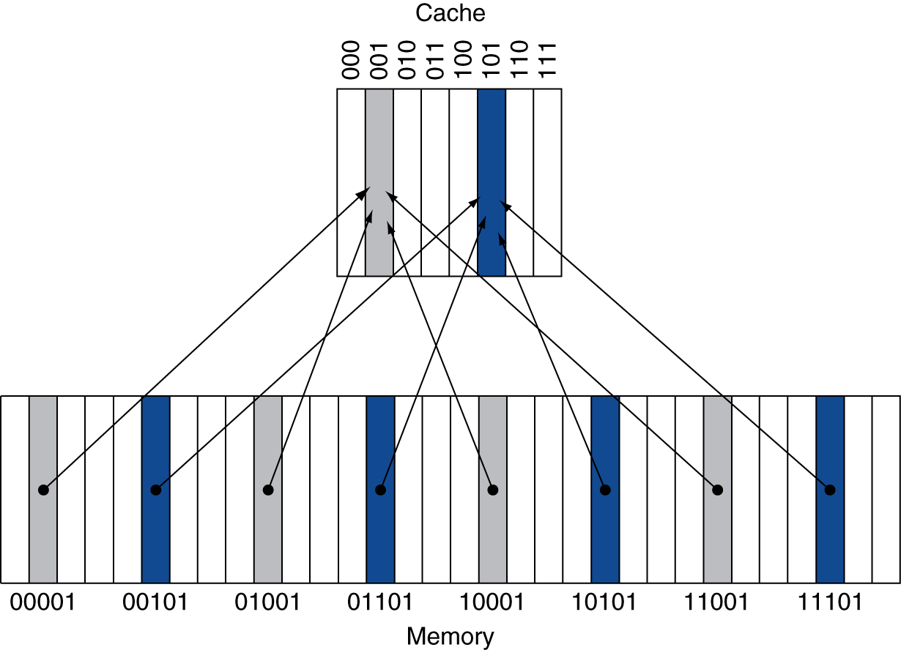
Direct Mapped Cache
Location determined by address
Direct mapped: only one choice
(Block address) modulo (#Blocks in cache)
#Blocks is a power of 2
Use low-order address bits
Notes:
BTW, what’s the problem with this approach?
We may have two slots and also use two memory locations. Theoretically they should both fit in cache, but if they both map to the same slot they don’t!

Slide 5
Cache Example
8-blocks, 1 word/block, direct mapped
Initial state
Index | V | Tag | Data
000 | N
001 | N
010 | N
011 | N
100 | N
101 | N
110 | N
111 | N
Notes:
Accesses:
22, 10 110
26, 11 010
22, 10 110
26, 11 010
16, 10 000
3, 00 011
16, 10 000
18, 10 010
16, 10 000

Slide 6
Cache Example
Word addr | Binary addr | Hit/miss | Cache block
22 | 10 110 | Miss | 110
Index | V | Tag | Data
000 | N
001 | N
010 | N
011 | N
100 | N
101 | N
110 | N
111 | N

Slide 7
Cache Example
Word addr | Binary addr | Hit/miss | Cache block
22 | 10 110 | Miss | 110
Index | V | Tag | Data
000 | N
001 | N
010 | N
011 | N
100 | N
101 | N
110 | Y | 10 | Mem[10110]
111 | N

Slide 8
Cache Example
Word addr | Binary addr | Hit/miss | Cache block
26 | 11 010 | Miss | 010
Index | V | Tag | Data
000 | N
001 | N
010 | N
011 | N
100 | N
101 | N
110 | Y | 10 | Mem[10110]
111 | N

Slide 9
Cache Example
Word addr | Binary addr | Hit/miss | Cache block
26 | 11 010 | Miss | 010
Index | V | Tag | Data
000 | N
001 | N
010 | Y | 11 | Mem[11010]
011 | N
100 | N
101 | N
110 | Y | 10 | Mem[10110]
111 | N

Slide 10
Cache Example
Word addr | Binary addr | Hit/miss | Cache block
22 | 10 110 | Hit | 110
26 | 11 010 | Hit | 010
Index | V | Tag | Data
000 | N
001 | N
010 | Y | 11 | Mem[11010]
011 | N
100 | N
101 | N
110 | Y | 10 | Mem[10110]
111 | N

Slide 11
Cache Example
Word addr | Binary addr | Hit/miss | Cache block
16 | 10 000 | Miss | 000
3 | 00 011 | Miss | 011
16 | 10 000 | Hit | 000
Index | V | Tag | Data
000 | N
001 | N
010 | Y | 11 | Mem[11010]
011 | N
100 | N
101 | N
110 | Y | 10 | Mem[10110]
111 | N

Slide 12
Cache Example
Word addr | Binary addr | Hit/miss | Cache block
16 | 10 000 | Miss | 000
3 | 00 011 | Miss | 011
16 | 10 000 | Hit | 000
Index | V | Tag | Data
000 | Y | 10 | Mem[10000]
001 | N
010 | Y | 11 | Mem[11010]
011 | Y | 00 | Mem[00011]
100 | N
101 | N
110 | Y | 10 | Mem[10110]
111 | N

Slide 13
Cache Example
Word addr | Binary addr | Hit/miss | Cache block
18 | 10 010 | Miss | 010
Index | V | Tag | Data
000 | Y | 10 | Mem[10000]
001 | N
010 | Y | 11 | Mem[11010]
011 | Y | 00 | Mem[00011]
100 | N
101 | N
110 | Y | 10 | Mem[10110]
111 | N

Slide 14
Cache Example
Word addr | Binary addr | Hit/miss | Cache block
18 | 10 010 | Miss | 010
Index | V | Tag | Data
000 | Y | 10 | Mem[10000]
001 | N
010 | Y | 10 | Mem[10010]
011 | Y | 00 | Mem[00011]
100 | N
101 | N
110 | Y | 10 | Mem[10110]
111 | N

Slide 15
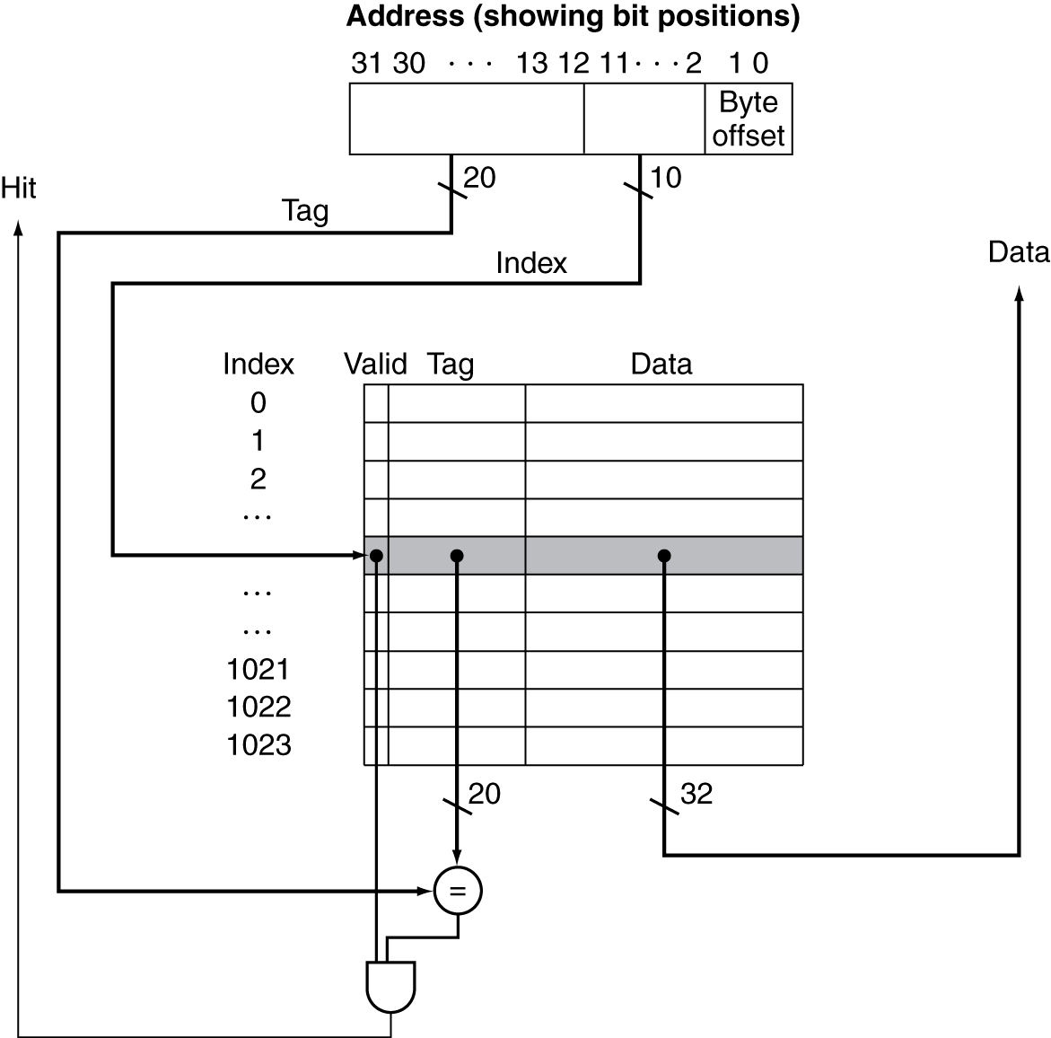
Address Subdivision

Slide 16
Example: Larger Block Size
64 blocks, 16 bytes/block
To what block number does address 1200 map?
Block address = ⎣1200/16⎦ = 75
Block number = 75 modulo 64 = 11
31
10
9
4
3
0
Tag
Index
Offset
22 bits
6 bits
4 bits
Notes:
What block address? What block number?
In general, block addr = address / num blocks
Then mod by # blocks to get block number
Question: If you increase block size, how does that affect cache miss rate? More misses or fewer misses?

Slide 17
Block Size Considerations
Larger blocks should reduce miss rate
Due to spatial locality
But in a fixed-sized cache
Larger blocks ⇒ fewer of them
More competition ⇒ increased miss rate
Larger blocks ⇒ pollution
Larger miss penalty
Can override benefit of reduced miss rate
Early restart and critical-word-first can help

Slide 18
Cache Misses
On cache hit, CPU proceeds normally
On cache miss
Stall the CPU pipeline
Fetch block from next level of hierarchy
Instruction cache miss
Restart instruction fetch
Data cache miss
Complete data access
Notes:
OOO pipelines (superscalar) can actually get around this by executing other, non-dependent instructions…

Slide 19
Write-Through
On data-write hit, could just update the block in cache
But then cache and memory would be inconsistent
Write through: also update memory
But makes writes take longer
e.g., if base CPI = 1, 10% of instructions are stores, write to memory takes 100 cycles
Effective CPI = 1 + 0.1×100 = 11
Solution: write buffer
Holds data waiting to be written to memory
CPU continues immediately
Only stalls on write if write buffer is already full

Slide 20
Write-Back
Alternative: On data-write hit, just update the block in cache
Keep track of whether each block is dirty
When a dirty block is replaced
Write it back to memory
Can use a write buffer to allow replacing block to be read first

Slide 21
Write Allocation
What should happen on a write miss?
Alternatives for write-through
Allocate on miss: fetch the block
Write around: don’t fetch the block
Since programs often write a whole block before reading it (e.g., initialization)
For write-back
Usually fetch the block

