Slide 1
Building a simple ALU (B.4)
Instructor: Robert Utterback
Lecture 7

Slide 2
Binary Representation of Integers
Unsigned Integers
0 and positive integers only
Signed Integers
0, negative, and positive integers
Three ways
Sign-Magnitude
1’s Complement
2’s Complement
Notes:
We talked before about representing positive integers…we call those “unsigned.”
But obviously sometimes we want to talk about negative numbers. There are a few different ways to represent negative numbers.
Some of this is foreshadowing chapter 2, but it will help to understand how the Adder works.

Slide 3
2’s Complement
2’s Complement
Positive number represented in the same way as sign-magnitude and 1’s complement
Negative number obtained by taking 1’s complement of positive number and adding 1
6712₁₀ = 00000000 00000000 00011010 00111000₂
1’s comp: -6712₁₀ = 11111111 11111111 11100101 11000111₂
2’s comp: -6712₁₀ = 11111111 11111111 11100101 11001000₂
One version of 0
Convenient in arithmetic
Notes:
Exercise: How to write -42?

Slide 4
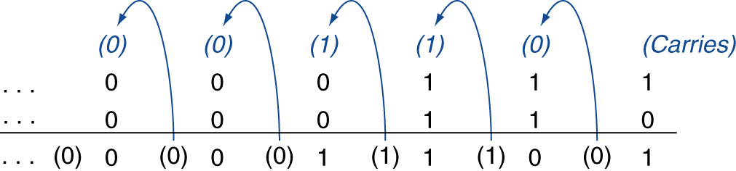
Integer Addition
Example: 7 + 6
00000000 00000000 00000000 00000111
+ 00000000 00000000 00000000 00000110
00000000 00000000 00000000 00001101
§3.2 Addition and Subtraction
Notes:
Write out -57 and 86, and add them using this procedure. What is the answer as a list of bits, and as a decimal number?

Slide 5
Integer Subtraction
Subtraction is actually an addition
Example: 7 – 6 = 7 + (-6)
2’s complement
00000000 00000000 00000000 00000111
+ 11111111 11111111 11111111 11111010
00000000 00000000 00000000 00000001
Notes:
Rather than implementing both add and subtract, we can save some transistors and just implement add.
This also exhibits how we don't need to treat negative numbers any differently when using 2's complement!

Slide 6
Overflow
Overflow if result out of range
Adding +value and –value operands, no overflow
Adding two +value operands
Overflow if result sign is -
Adding two –value operands
Overflow if result sign is +
Notes:
With an 8-bit word, let’s try to add 125 and 4.

Slide 7
Arithmetic Logic Unit
Arithmetic Logic Unit (ALU)
Heart of a CPU
Operations
Arithmetic operations
Addition
Subtraction
Logical operations
NOT
AND
OR

Slide 8
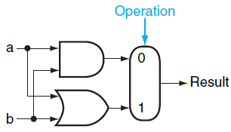
1-bit Logical Unit for AND and OR
1-bit logical unit for AND and OR
Notes:
You can generalize this to the basic idea behind an ALU: it’s a big multiplexor. ALL the operations actually get computed, but the CPU instruction tells the ALU which result we actually want.

Slide 9
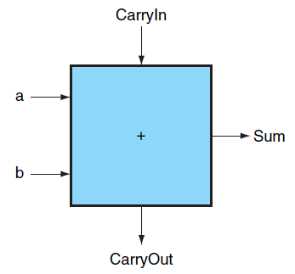
1-bit adder
Notes:
The sum is just if exactly 1 or all 3 inputs are 1.

Slide 10
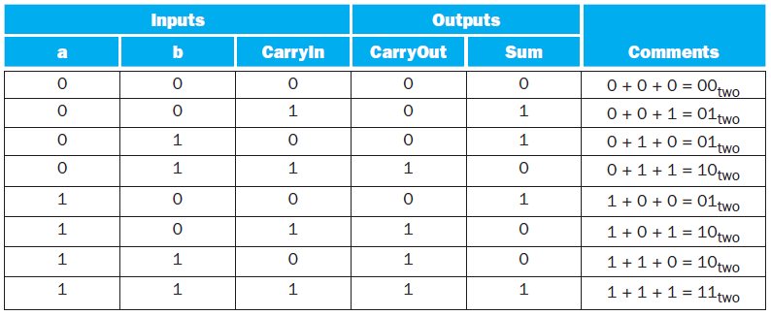
1-bit adder truth table

Slide 11
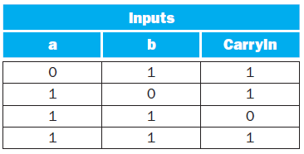
Simplifying 1-bit adder
If a and b and CarryIn are true, then the three other terms are true as well
can be simplified as
Values when CarryOut is true
Notes:
Draw a set of gates for this. Hint: It’s three and gates and 1 or gate.

Slide 12
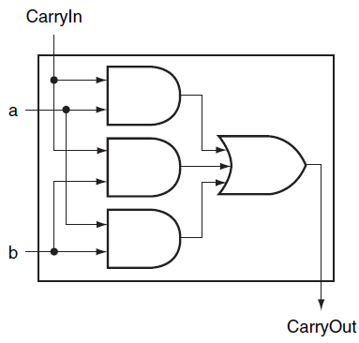
Logic of CarryOut Bit

Slide 13
Logic of Sum Bit
Notes:
Exactly 1 bit is set or all three are set. Draw a PLA for this, together with the CarryOut bit.

Slide 14
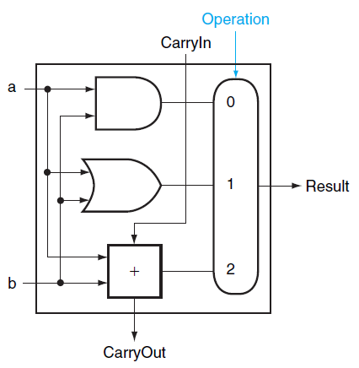
Overall 1-bit ALU

Slide 15
Extending to 32 Bits

Slide 16
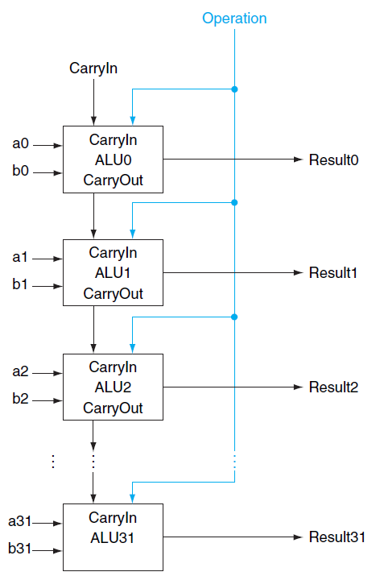
32-bit ALU
Notes:
To operate on two WORDS, which are a set of bits, we again use an array of logic blocks, in this case 32 1-bit ALUs. Notice how we have to connect the carryout of one to the carryin of the next.
This WORKS, although it is actually really slow…we have to wait for 32 1-bit additions…we will see later how to improve this.
This is called a "ripple" adder, since the carry bit ripples through.

